Slide 1
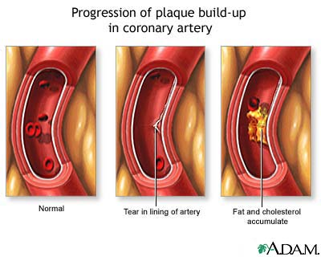
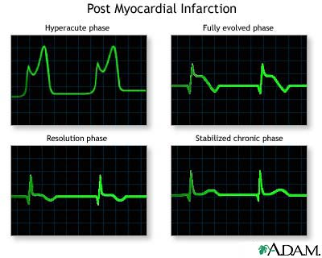
Antianginal Drugs
Lecture Outcomes:-
Define angina pectoris and know the causes
Identify the factors that control coronary blood flow
Know the types of angina
Be aware of the drug therapy of angina pectoris

Slide 2
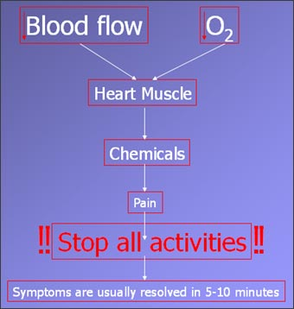
Angina pectoris
Angina pectoris ”strangle breast” or Chest pain.
Can occur during exercise or stress →↑O₂ demand→ ischemia → release of pain mediators such as K⁺, PGs, Kinins, nucleotides

Slide 3
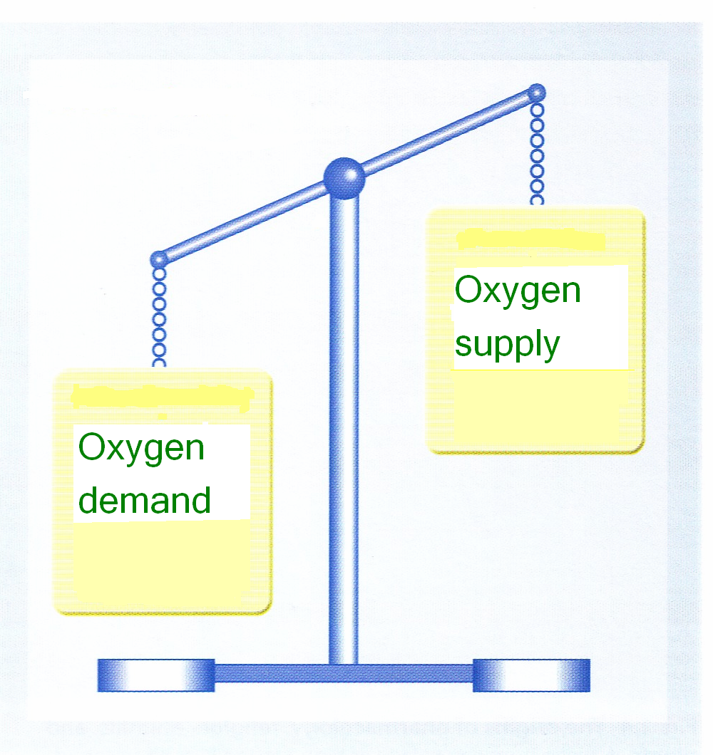
Basic mechanism is an imbalance between O₂ demand & O₂ supply to myocardium.

Slide 4
FACTOR DETERMINING O2 DEMAND (O₂ consumption)
factors
Myocardial work
Some substances e.g. fatty acids
Heart rate
contractility
Wall thickness
Ventricular volume
(pressure)
We can treat angina by decreasing these factors

Slide 5
Causes of Angina
Coronary arteriosclerosis (e.g. Atherosclerosis)
Transient platelet aggregation & coronary thrombosis.
Coronary artery spasm.

Slide 6

Coronary Blood Flow
Coronary flow is controlled mainly by :-
1-Transmural pressure during systole (stress of wall of myocardium).remember: there’s negligible O2 perfusion during systole.
Diastolic coronary perfusion pressure =
Diastolic aortic pressure - Diastolic ventricular pressure.
Which means, during distole:pressure on aorta – pressure on ventricles .
Coronary arteries arise from the aorta so if aortic pressure coronary blood flow
Coronary artery pass through ventricular wall so if ventricular pressure there will be resistance by the coronary arteries coronary perfusion

Slide 7
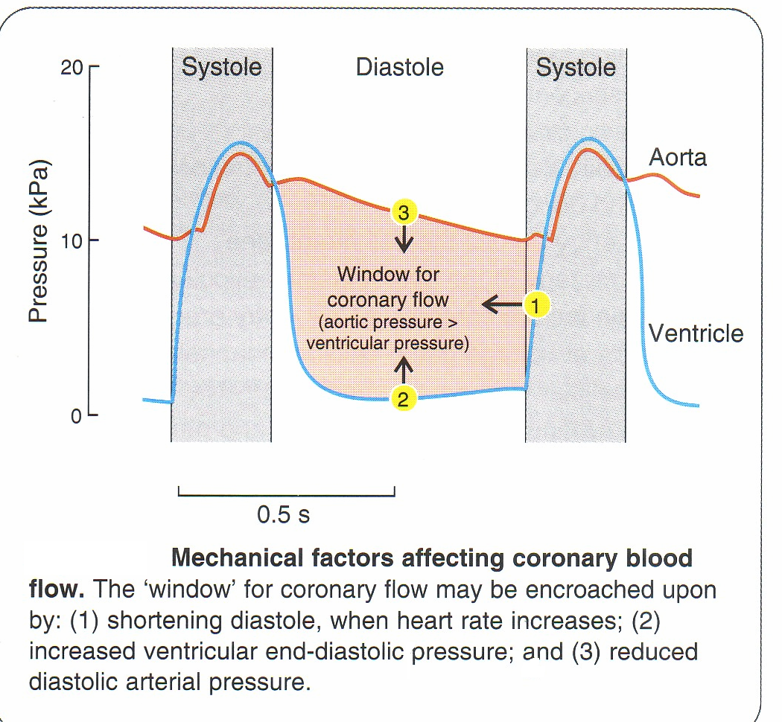
Coronary Blood Flow
Coronary blood flow directly related to aortic diastolic pressure and duration of diastole
2- Coronary flow is inversely related to coronary vessel resistance
Coronary blood flow occurs only in diastole
↑ heart rate → ↓duration of diastole → ↓coronary flow
3- vasodilator metabolites from the heart affect coronary flow e.g. adenosine, K⁺

Slide 8
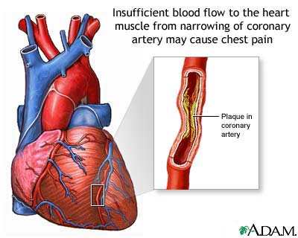
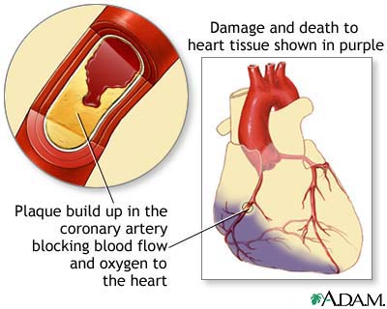
Coronary ischemia is usually the result of atherosclerosis, and it is responsible for anginal pain.
Sudden ischemia is usually caused by thrombosis and may result in myocardial infarction.

Slide 9
pathogenesis
Myocardial ischemia
DNA fragmentation → apoptosis
↓ATP in heart → ↓ activity of ion pump → ↑intracellular Ca⁺⁺
Cell death
↑intracellular Ca⁺⁺ → arrhythmia → ↑heart work → myocardial ischemia (vicious cycle)
Also, myocardial ischemia → pain → ↑sympathetic activity → tachycardia→ ischemia

Slide 10
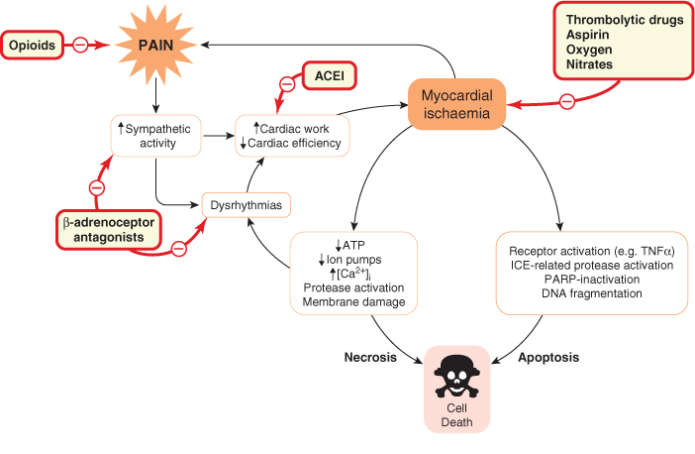
Same as the previous slide but with drugs
used to treat severe pain only
e.g. MI, ischemia
Decrease remodeling and afterload
Note the cell death occurs by 2 mechanism apoptosis and necrosis

Slide 11
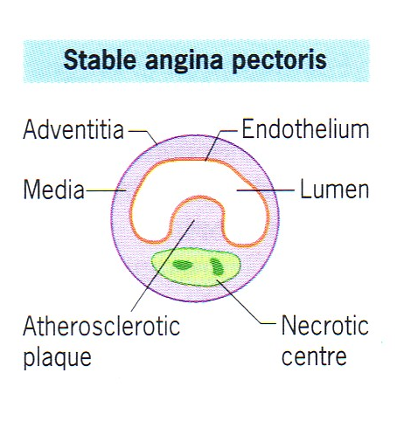
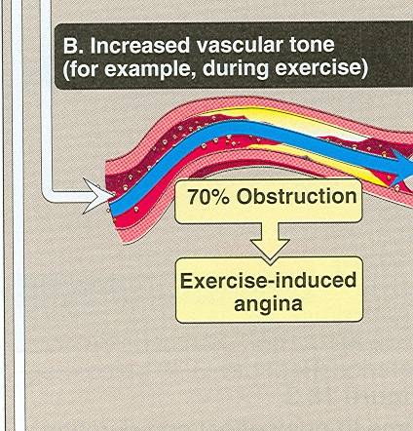
Types of Angina
1-Chronic stable angina (fixed coronary stenosis) occurring reliably after certain levels of exertion (angina of effort) (classical angina)
Silent angina is
a type of classical angina but with out pain.
Partial obstruction of the artery

Slide 12
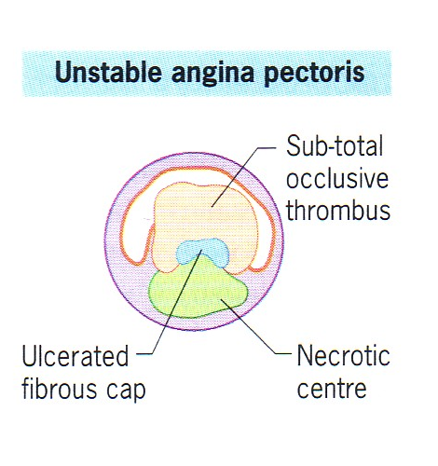
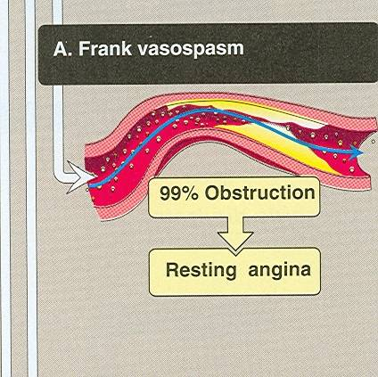
2-Unstable angina: an acute coronary syndrome (acute changes happen to the plaque) occurs at rest or with physical activity. Can lead to myocardial infarction.

Slide 13
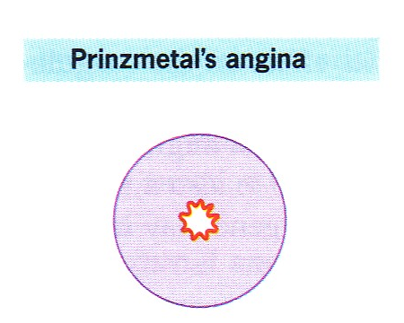
3-Variant angina or Prinzmetal occurs at rest & is caused by coronary vasospasm (vasospastic angina).

Slide 14
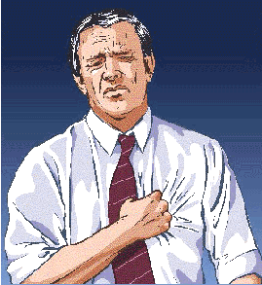
Drug Thrapy for Angina
Organic nitrates
β-adrenoceptor blockers
Calcium channel blockers
Potassium channel openers
Partial fatty acid oxidation (pFOX) inhibitors
Aspirin

Slide 15
Classification of nitrates
Organic
Nitrates
Short acting
-Nitroglycerine (solid)
Liquid))-Amylnitrite
Long acting
-Isosorbide dinitrate
-Penterythritol
-Tetranitrate

Slide 16
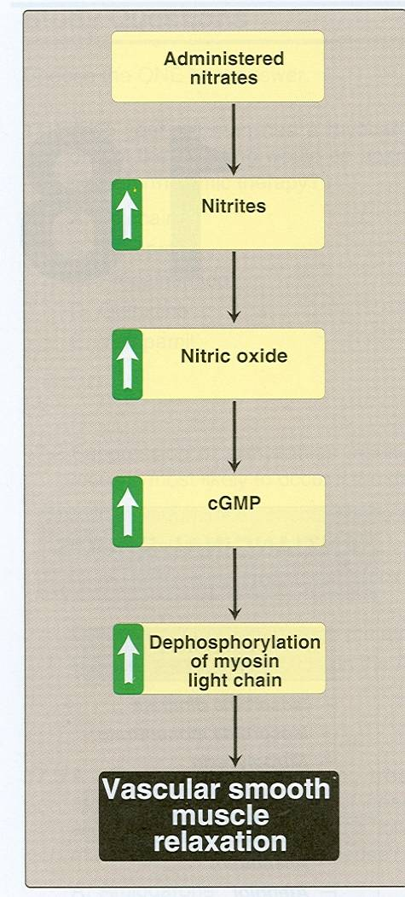
Organic Nitrates
Mechanism
of action:-
Act by relaxing smooth muscles.

Slide 17
Molecular action of nitrates
In normal state (vasoconstriction)
phosphorylate
Myosin
Myosin _{(phosphorylated}
Myosin kinase
With actin
contraction
With the use of nitrates
Activate guanlyl cyclase
GTP → cGMP
nitrates
NO
relaxation
dephosphorylate
Myosin

Slide 18
حط صورة 12-2

Slide 19
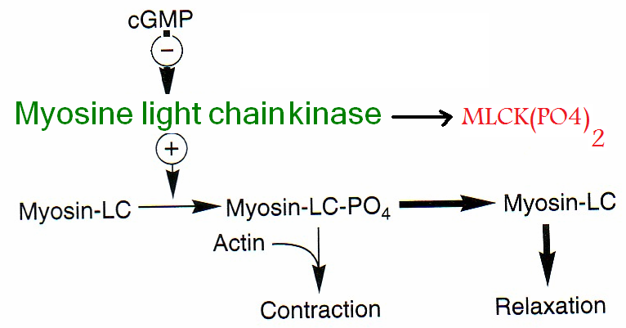

Slide 20
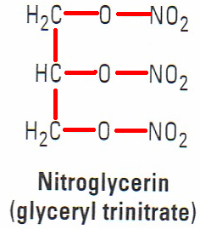
Pharmacodynamic
Ethacrynic acid inihibits glutathione
Glutathione needs a thiol group (SH) provided by cysteine
Denitrated by glutathione S-transferase
nirtroglycerin
Free nitrites
NO
↓CO + ↓arteriolar blood pressure
↓O₂ demand
↓oxygen demand + ↑blood flow
↑O₂ supply
nitrates
Dilate veins*
↓preload
nitrates (at high dose)
arteriolar dilation
↓blood pressure
↓work
↓cardiac output (CO)
↓coronary resistance
↑blood flow
-* Veins are more sensitive than artery to NO. It is believed that veins are more capable of releasing NO in higher amount than arteries.
- Arteries at higher doses show vasodilation.

Slide 21
???

Slide 22
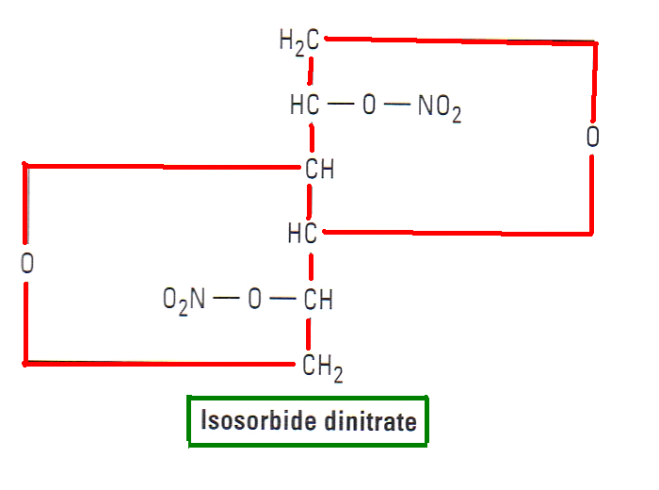
2-In variant angina organic nitrates relax the smooth muscle so they relieve coronary artery spam.
3-In unstable angina nitrate is useful because: - ↓vascular tone
- ↓O2 demand
- ↓platelets aggregation
4*-Organic nitrates in ischemic patient divert blood from normal areas of the heart to ischemic areas (see next 3 slides)

Slide 23
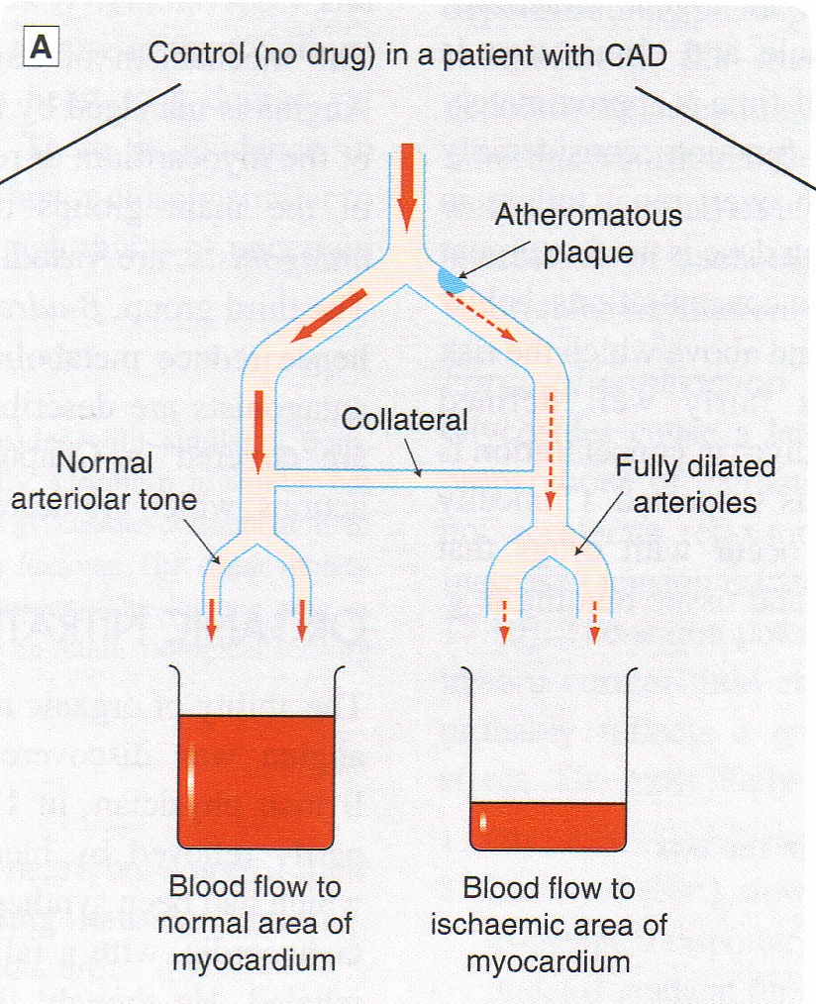
Collateral is constricted no blood flow
Ischemia results in an increase in vasodilating metabolites → arteriolar dilation

Slide 24
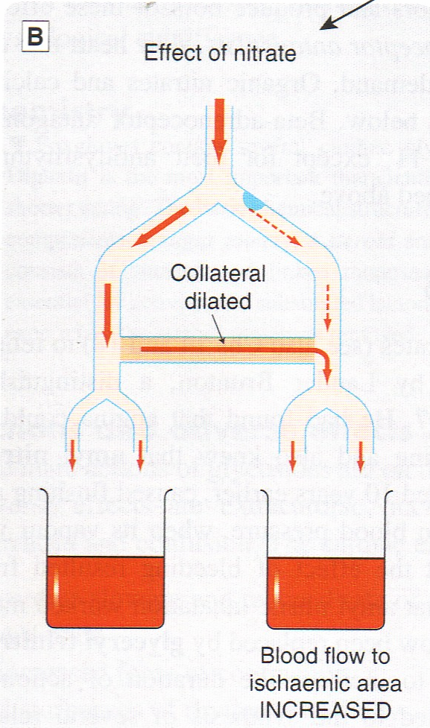
Nitrates increase blood flow from normal area to ischemic area by dialate collateral arteries.

Slide 25
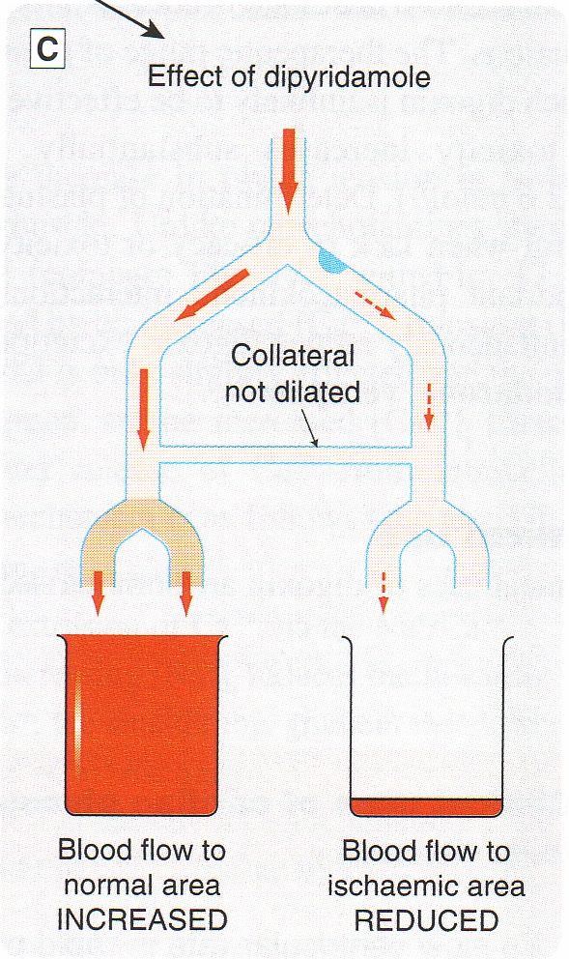
and hydralazine
This drug ↑ blood flow to non-ischemic heart tissue
Blood flow is further decreased
it dilates arteriole but not collateral and that will increase blood flow to normal area
This phenomenon is called “coronary steal”

Slide 26
Other Pharmacodynamic Effects
Relaxation of the smooth muscles of the bronchi, gastrointestinal tract , biliary system, and Genitourinary tract
These actions rarely have any clinical value
Decrease in platelet aggregation
Nitric Oxide is thought for having a slight –ve ionotropic effect

Slide 27
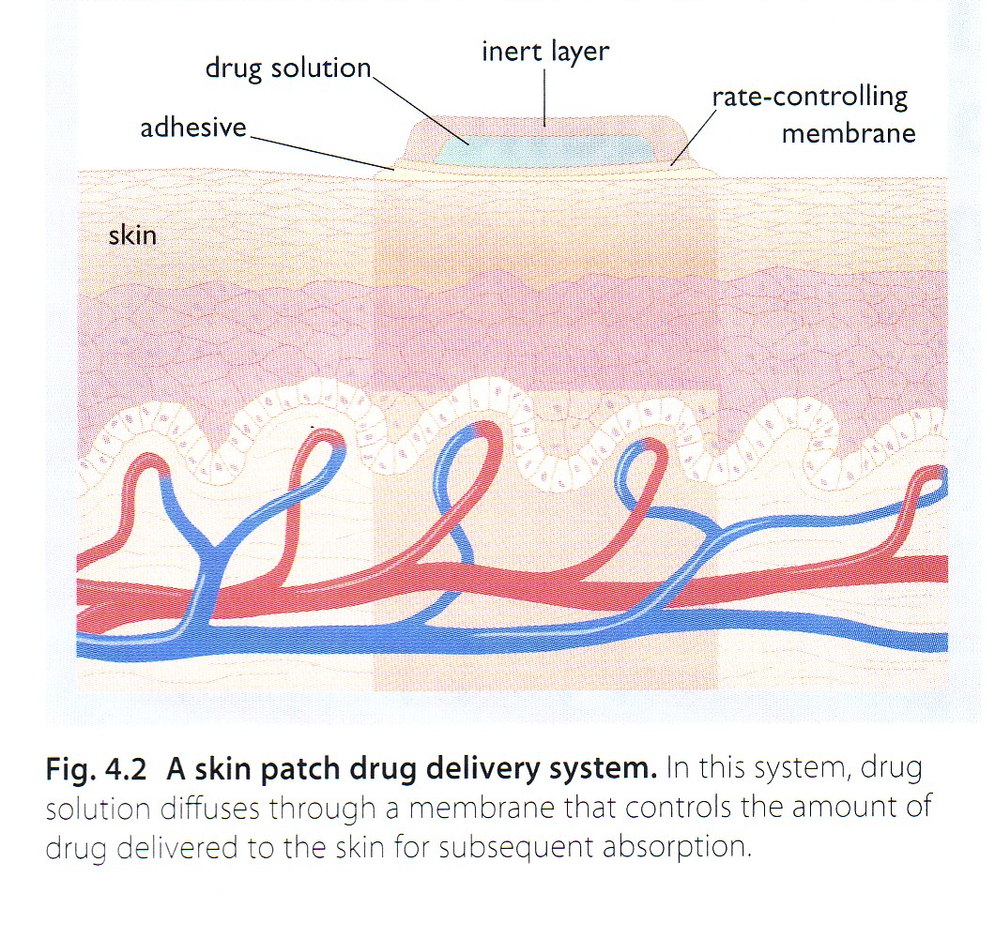
Administration:-
Glyceryl trinitrate , formulated as:-
1-sublingual tablets
2-preparation for transdermal absorption.
2-3% concentration in lanolin (wax) for prophylaxis , 4-8h, occluded into dressing on the chest well absorbed through the skin, more sustained effect
We don’t put the transdermal patch on the arm or thigh because with movement → absorption this may lead to toxic effects.
We put it on chest or abdomen

Slide 28
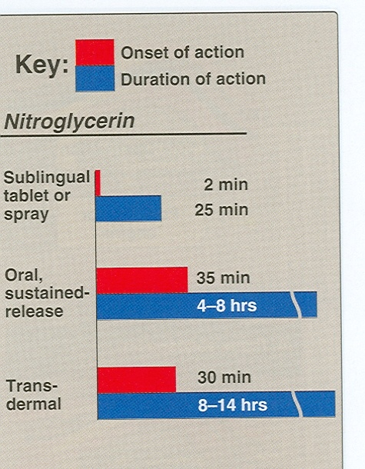
4-Oral sustained- release preparations
5-Buccal sustained- release (chewable)
6-IV preparations (in emergency)
Sublingual tablets have a short onset of action. Because of that, it is used in emergencies of acute anginal attacks.
The sublingual tablets of nitroglycerin may lose potency when stored as a result of volatilization and adsorption to plastic surfaces.Thus, it stored in glass.
In oral administration, nitroglycerin is metabolized by the liver by the removal of the nitrate group.
Parent molecule inactivation of the drug → slight dilation.
So it has low bioavailability < 10-20%
Nitrate reductase

Slide 29
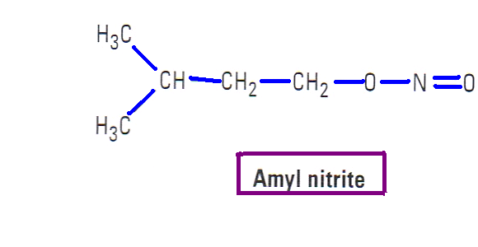
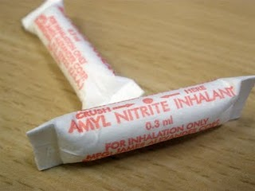
Amyl nitrite ( not nitrate) is available in fragile glass ampoules packaged in a protective cloth covering.
The ampoule is crushed and the drug is inhaled through the cloth covering
It is not used anymore due to its unpleasant odor and short duration of action. Now, it is only used as a sex enhancer.

Slide 30
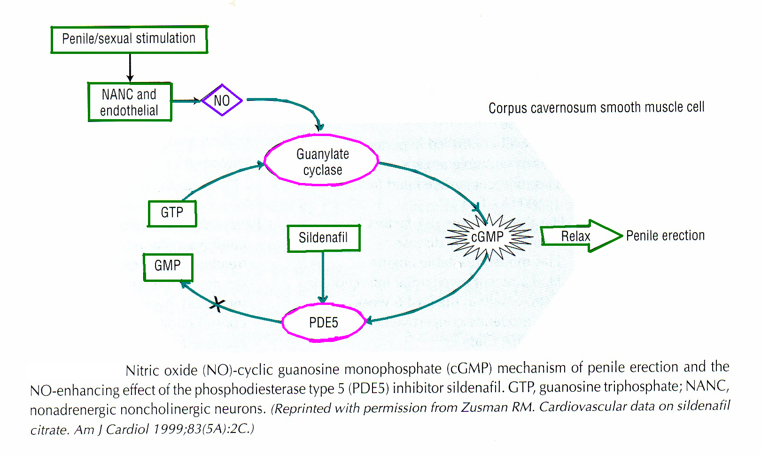
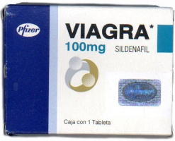
activated by NO
Causes dephosphorylation of myosin light chain

Slide 31
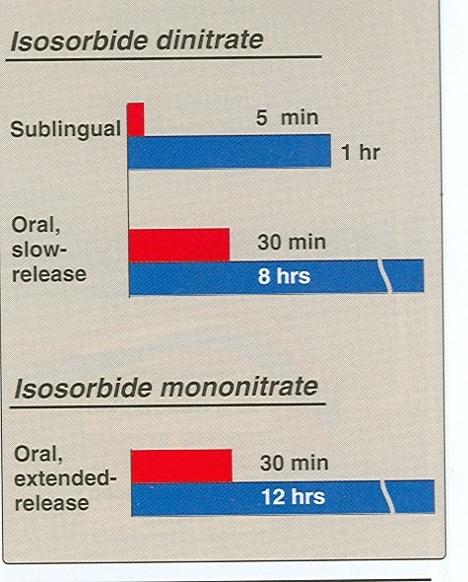
Long acting organic nitrates is isosorbide dinitrate .
Isosorbide dinitrate → isosorbide mononitrate (in liver) which is biologically active with a t_{1/2} of 4 hrs.
Isosorbide mononitrate is available for clinical use and has 100% bioavailability.
Isosorbide dinitrate is administered orally for prophylaxis, chewed for a more rapid effect.
They have slow onset of action (that is the reason why they are used as prophylaxis).

Slide 32
Adverse effects
Flushing & headache.
Orthostatic(postural) hypotension (because of the venodilation)
Tachycardia (as a reflex)
Formation of methemoglobin. (see next slide)
Carcinogenesis (nitrosamine is formed by combination of nitrates and amino acids and it is potent carcinogenic)(only in experimental animal)

Slide 33
methemoglobinemia
Hemoglobin
Fe++
Methemoglobin
Fe+++
nitrates
This is the normal form hemoglobin which contains ferrous Fe⁺⁺
methemoglobin which contains ferric Fe⁺⁺⁺
We can use this toxic effect to treat cyanide poisoning
In CN⁻ poisoning
Cellular respiration ceases
Death
CN binds to the cytochrome iron
With use of nitrates
Methemoglobin has high affinity for CN
CN binds to methemoglobin and detach cytochrome
Regenerated cytochrome
Normal cellular respiration

Slide 34
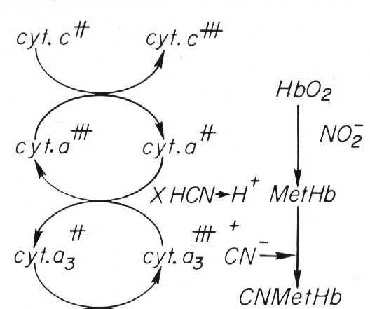
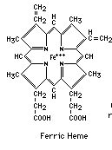
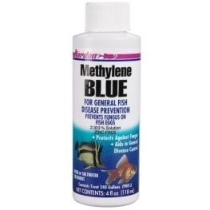
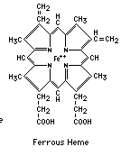
Normal hemoglobin
nitrates
For excretion of cyanomethomoglobin we give sodium thiosulfate (Na₂S₂O₃ )
It will convert cyanmethomoglobin to thiocynate and methemoglobin .
Thiocyanate less toxic than cyanide and excreted by kidney.
If there’s excessive methemoglobinemia we give methylene blue (IV)

Slide 35
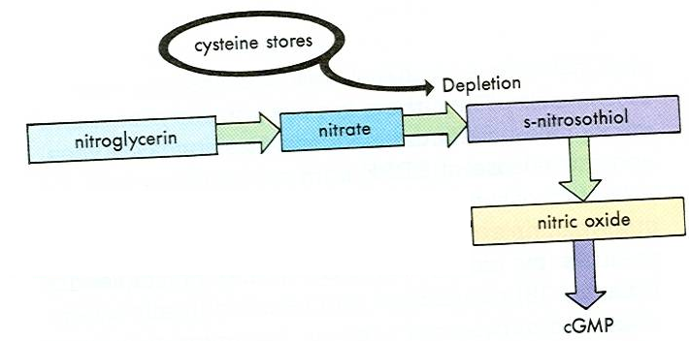
Tolerance
Occurs in
Long acting formulations(oral transdermal)
Continues intravenous infusion
causes
Diminished NO release
Compensation by sympathetic system and salt water retention
↓SH

Slide 36
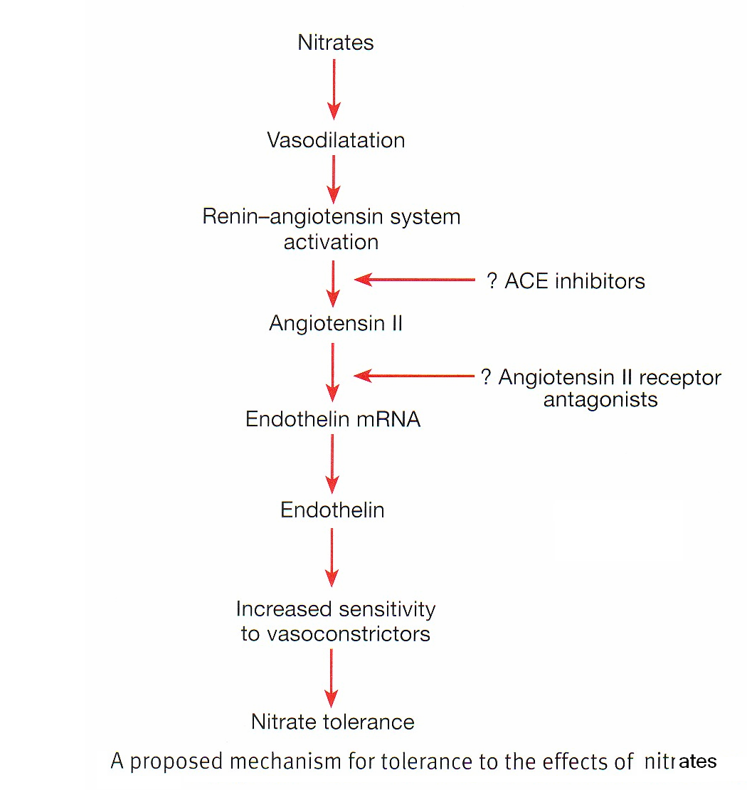

Slide 37
Contraindications
Known sensitivity to organic nitrates.
Glaucoma (not contraindicated nowadays)
In ↑intracranial pressure → pressure exerted on blood vessels of the brain so when we use nitrates → vasodilation → ↑pressure
Uncorrected hypovolemia because in hypovolemia → hypotension (shock) → vasoconstriction(to increase blood pressure) and nitrates causes vasodilation so we don’t use them
Concomitant administration of phosphodiesterase inhibitors (viagra) for the treatment of erectile dysfunction.(see slide #30)

Slide 38
Beneficial & Deleterious Effects
Cont’d…
Notes:
المفروض الجدول دا نخليه في البداية ولا ايش رايك انا خالد من قروب B احس الجدول مكانه هنا افضل
Muhammad thinks that it is better if we were to put it in the very beginning, Just like in Katzung!!!

Slide 40
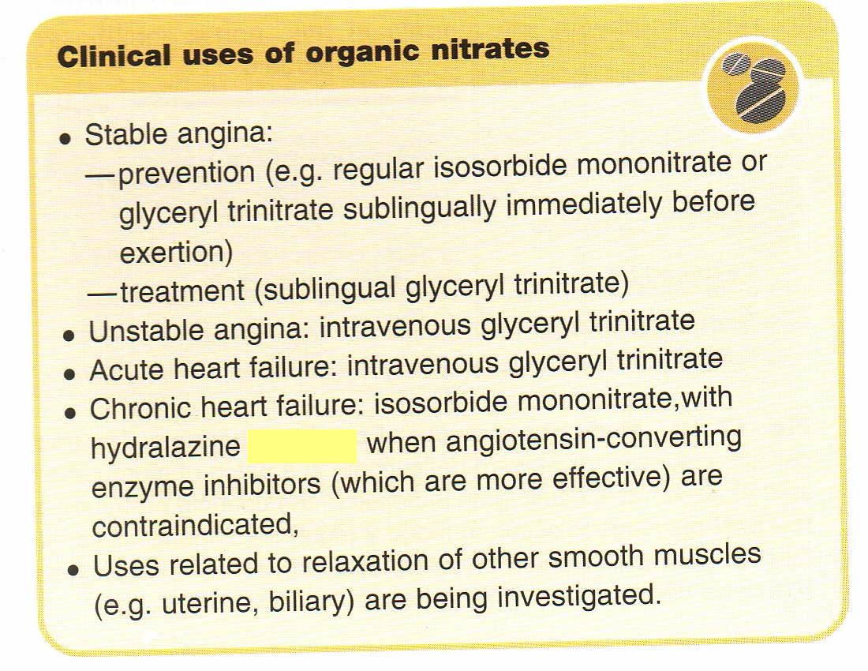
Notes:
exert yourself (MAKE AN EFFORT)

Slide 41
Beta -adrenoceptor Blockers
Antagonizes the effect of norepinepherine from sympathetic nerve ending &epinephrine from adrenal medulla .
↓ HR,BP,&CO. which in turn ↓ O2 demand at rest & during exercise.
Lower HR → ↑diastolic perfusion time → ↑ coronary perfusion

Slide 42
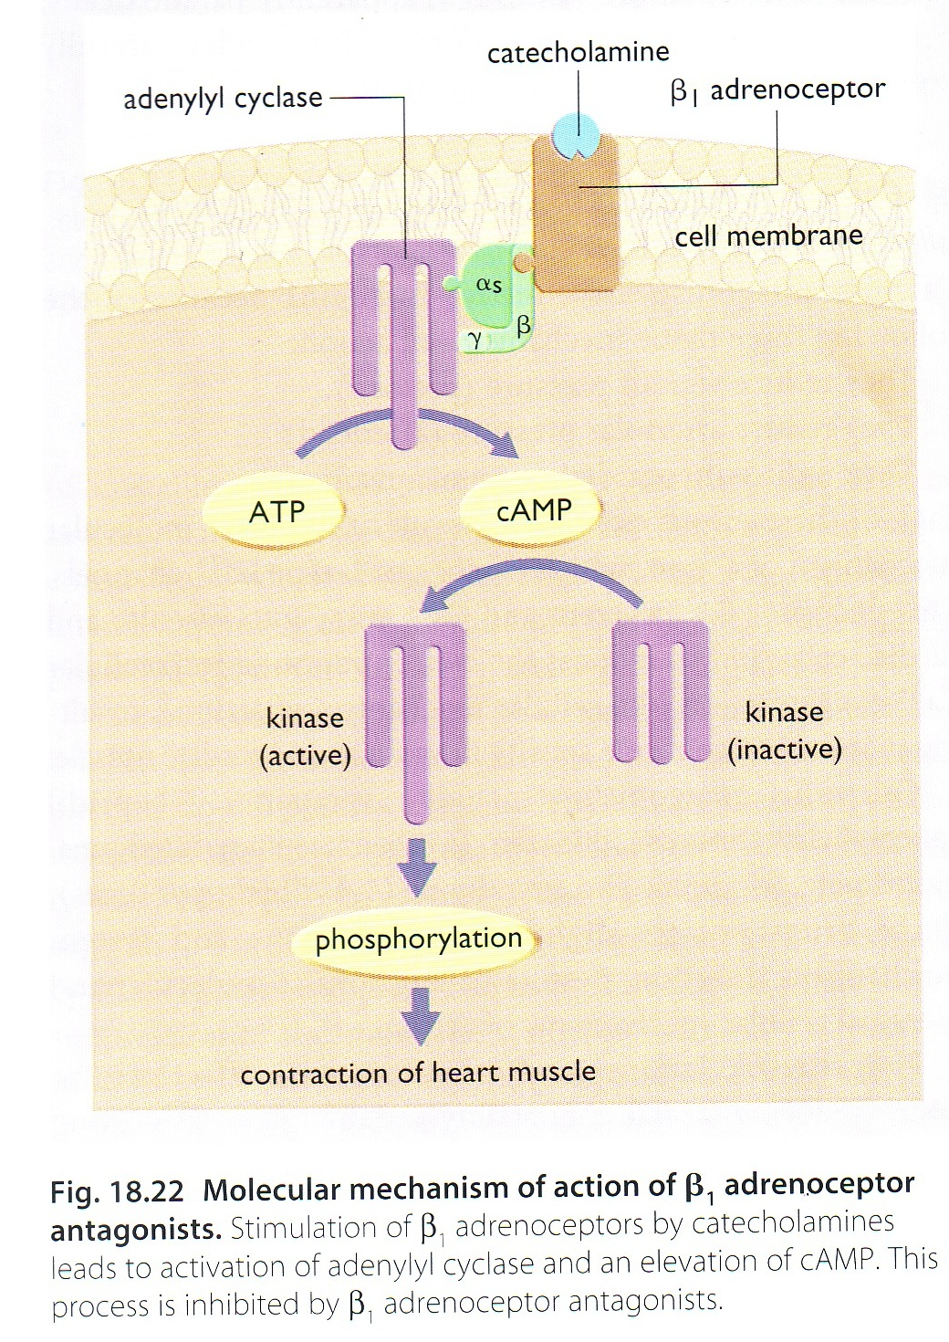
Normal action of β receptor
Receptor is inhibited by β blocker

Slide 43
β-blockers have Antihypertensive effect.
Contraindicated in variant angina, may allow unopposed α-adrenergic coronary vasoconstriction to occur
β- blockers should not be rapidly withdrawn from patient to avoid rebound angina or hypertension

Slide 44
Clinical uses of β blockers
They are effective in the prophylactic treatment of classic & unstable angina
They are effective in the treatment of silent or ambulatory angina (no pain)
Decrease mortality of patients with recent myocardial infarction

