Slide 1
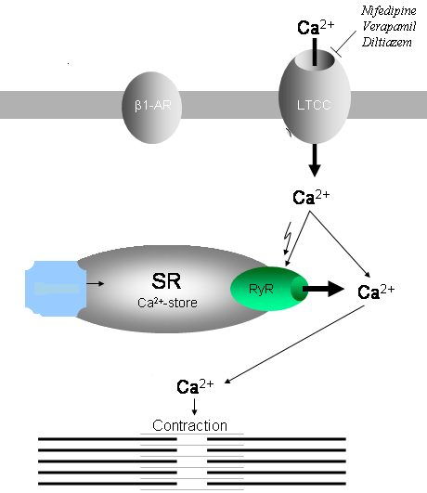
Calcium channel blockers
(Calcium antagonists)
They bind to the channel from the inner side of the membrane.
They bind to channels in depolarized membranes.
Binding → ↓ frequency of opening of the channels (block)

Slide 2
This results in the marked ↓ in Ca⁺⁺ current → ↓ force of contraction → ↓ O2 demand
Also it cause ↓ in the peripheral vascular resistance → ↓ after load
Also ↓ spasm in coronary arteries → ↑ perfusion to the myocardium.

Slide 3
Types of Calcium Channels
Distribution | Type
Smooth muscle, Cardiac muscle, neurons | L
Heart, neurons* | T
Neurons* | N
Cerebellar Purkinje neurons* | P

Slide 4
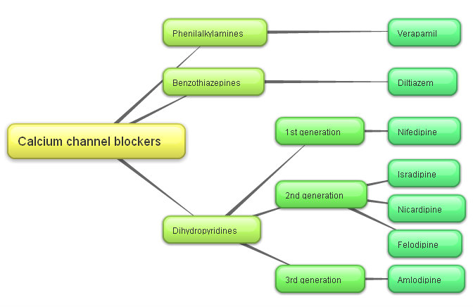

Slide 5
The selectivity varies between drugs:
Verapamil → heart
Nifedipine →smooth muscle
Diltaizem → intermediate
In angina, calcium channel blockers reduce cardiac work and oxygen consumption.
To prevent angina use dihydropyridine or diltaizem

Slide 6

Pharmacokinetics

Slide 7
Adverse effects
Serious cardiac depression e.g. : cardiac arrest, bradycardia, atrioventricular block, and heart failure
Immediate-acting nifedipine → vasodilation → tachycardia (reflex) → ↑O₂ demand → myocardial infarction if the patient is hypertensive (so we use sustained release of the drug to avoid this effect)
Patients receiving β-adrenoceptor-blocking drugs are more sensitive to the cardiodepressant effects of calcium channel blockers (because both drugs lead to cardiac depression)
Flushing, dizziness, nausea, constipation (they relax SM in GIT), and peripheral edema

Slide 8

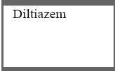
Adverse effect

Slide 9
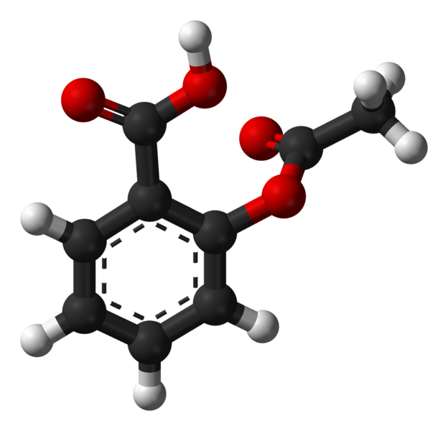
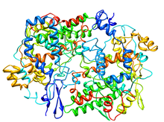
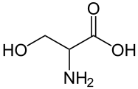
Aspirin
Aspirin reduces the chance of coronary thrombosis.
Mechanism of action
Aspirin acetylates this amino group → inhibition of the enzyme
Terminal group of the enzyme is serine
serine
COX enzyme
Inhibition of the enzyme → no thromboxane → ↓thrombosis
Used for stable & unstable angina.

Slide 10
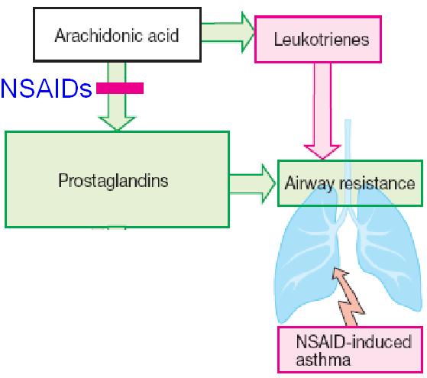
ADVERSE EFFECTS
GIT bleeding.
Gastric ulceration
Reduced renal function
Occasional bronchospasm with high doses Aspirin inhibits COX enzyme but not lypoxegenase so arachidonic acid is converted to leukotrienes → bronchoconstriction (see the figure)
Also aspirin used as analgesic and antiplatelet .
aspirin

Slide 11
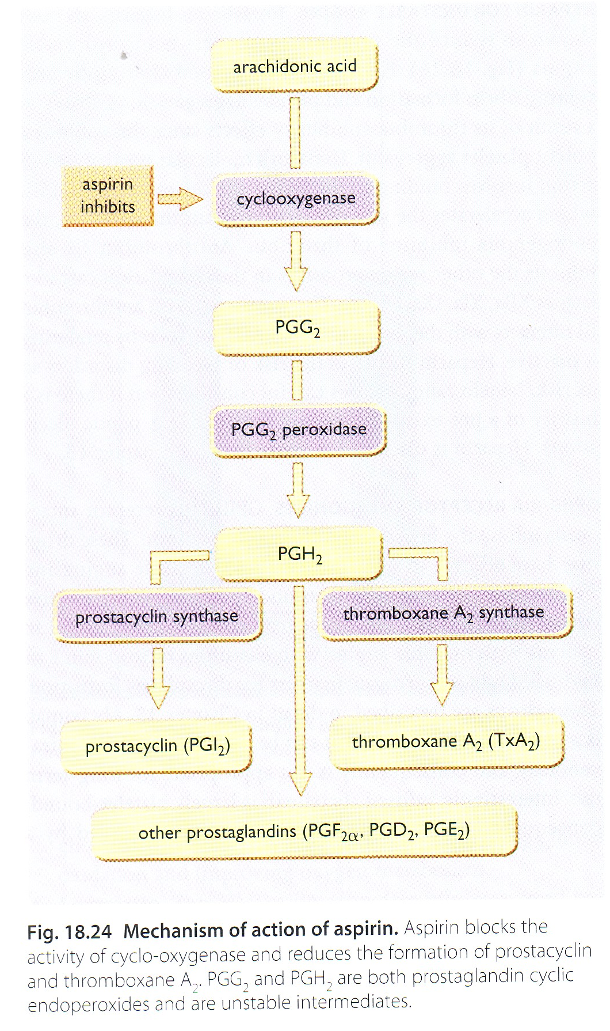

Slide 12
Potassium channel openers
(Nicorandil )
Relaxes vascular smooth muscles especially veins by:-
1-Activation of potassium channels → stabilize membrane potential near resting potential (-50 mV) . Also, when K⁺ channels open → ↓ Ca⁺⁺ influx → relaxation
2-Nitric oxide release
Used as prophylactic therapy (in chronic stable angina)
May cause : flushing, palpitation, weakness, headache, mouth and peri-anal ulcers , nausea and vomiting

Slide 13
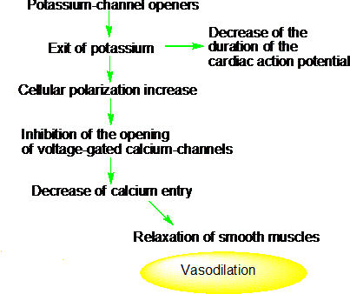

Slide 14
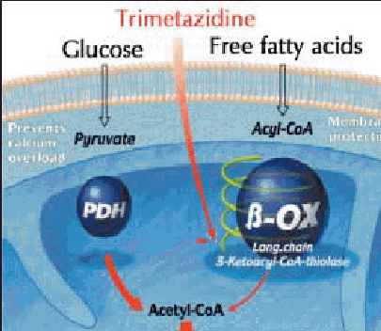
Fatty acid oxidation inhibitors
Oxidation of fatty acids requires more oxygen than the oxidation of carbohydrates.
Oxidation of fatty acid occurs in ischemic myocardium
Partial fatty acid oxidation inhibitors (pFOX inhibitors) shift myocardial metabolism toward greater use of glucose reducing the oxygen demand without altering the hemodynamic system.
e.g. trimetazidine & ranolazine.
Ranolazine blocks Na⁺ current → ↓ Ca⁺⁺ entry

Slide 15
Drug treatment of angina
Treatment
Acute attack
Short acting nitrates or nitrites
prophylaxis
Long acting nitrates
Calcium channel blocker
β blocker
K⁺ opener

Slide 16
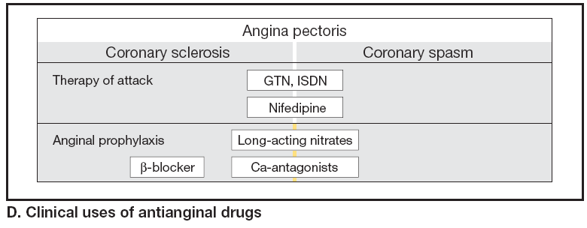
GTN: glycryl nitrate ISDN: isosorbide dinitrate
N.B. β blocker are contraindicated in variant angina

Slide 17
Combination therapy only if patient didn't respond to monotherapy
Nitrates and β-adrenoceptors blockers.(because nitrates → tachycardia (reflex) and β blockers ↓ heart rate)
Calcium channel blockers and nitrates. (because nitrate → ↑ contraction (reflex) which CCB can deal with it)
Calcium channel blockers, β-adrenoceptor blockers, nitrates (in refractory cases only) (patient does not respond to occasional combination therapy)

Slide 18
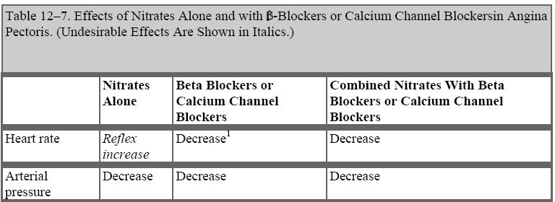

Slide 19
Unstable Angina & Acute coronary syndrome
(treatment)
Anticoagulant (Heparin) & Antiplatelet (Aspirin).
Nitroglycerin & β –blockers should be added
Calcium channel blockers should be added in refractory cases

Slide 20
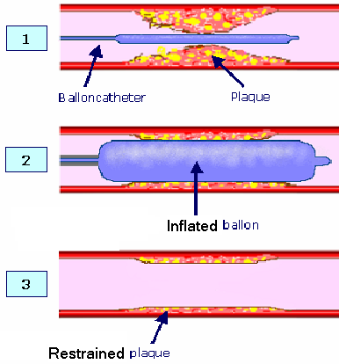
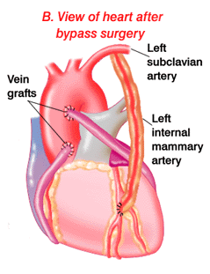

Surgical treatment
Balloon catheter
Coronary bypass surgery

