Slide 1
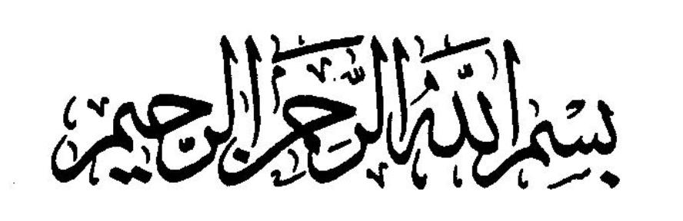

Slide 2
Cortical Motor Areas and
Descending motor tracts
(Pyramidal & Extrapyramidal System)

Slide 3
Motor
The word motor means movement.

Slide 4
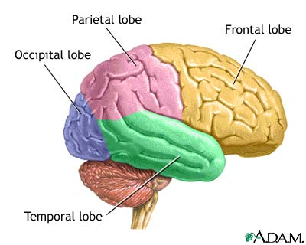

Slide 5
Motor system includes
Motor cortex
Tracts
eg. Corticospinal (skillful Voluntary movement)
Corticobulbar and Bulbospinal (Extrapyramidal)
Basal Ganglia (regulator)
Cerebellum (regulator)

Slide 6
Types of motor activities
Voluntary movements.
Involuntary (Reflex) movements
Subdivision: Rhythmic movements like swallowing, chewing and walking (mainly involuntary) but these are subject to voluntary adjustment & control.
The motor system learns by doing and the performance improves by repetition

Slide 7
CONTROL OF VOLUNTARY MOVEMENTS
PLAN
EXECUTE
BASAL GANGLIA
IDEA
CORTICAL ASSOCIATION AREA
PREMOTOR AND MOTOR CORTEX
MOVEMENT
LATERAL CEREBELLUM
INTERMEDIATE CEREBELLUM

Slide 8
Components of motor neurons
Upper motor neuron (corticospinal & corticobulbar).
Starts from motor cortex and ends in
Cranial nerve nucleus (corticobulbar).
Anterior horn of spinal cord in opposite side(corticospinal tracts).
Lower Motor Neuron
Starts from anterior horn of spinal cord and ends in appropriate muscle of the same side.
eg. All peripheral motor nerves.

Slide 9
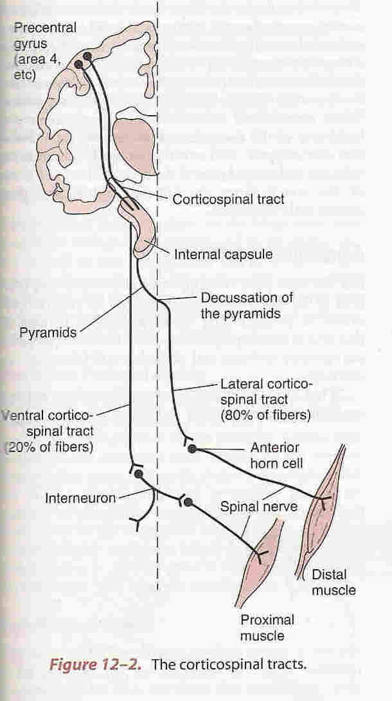

Slide 10
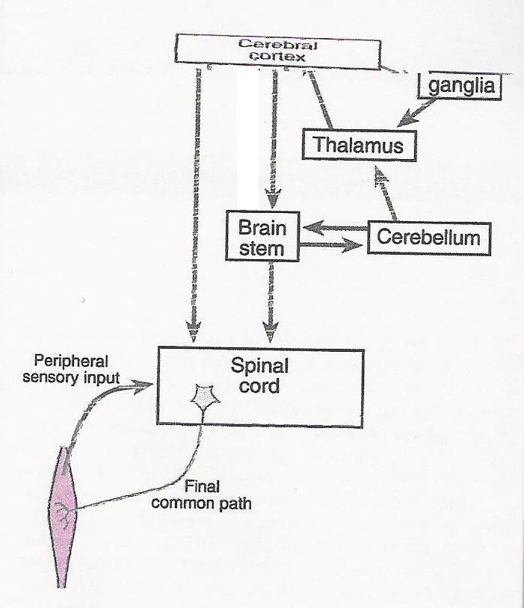
Overview of Motor System
Corticospinal tracts
Corticobulbar tracts
Bulbospinal tracts

Slide 11
Levels of motor control
Cerebral cortex
Brain stem and cranial motor nuclei
Spinal cord .

Slide 12
Cortical Motor Areas
Includes
Primary Motor Cortex (M-I)
Supplementary Motor Area (M-II)
Premotor Cortex (M-III)
  And Broca’s area & frontal eye field area

Slide 13
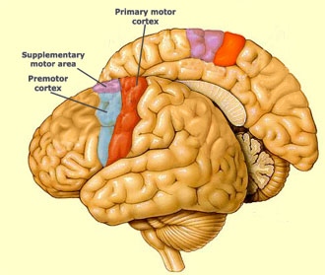

Slide 14
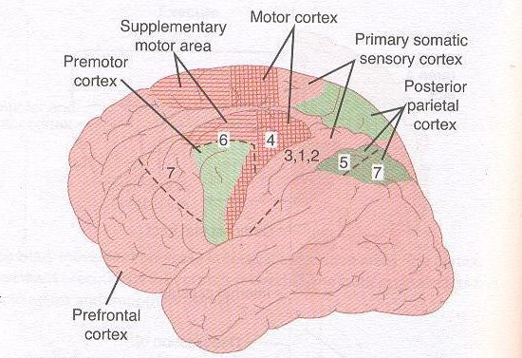

Slide 15
Motor cortex
Primary motor cortex ( M1 ; Brodmann area 4)
Premotor area (PMA) and Supplementary motor area (SMA) (Brodmann area 6)
Note: All the three projects directly to the spinal cord via corticospinal tract.
Premotor and supplementary motor cortex also project to primary motor cortex and is involved in coordinating & planning complex sequences of movement (motor learning).

Slide 16
Primary Motor Cortex (M-I)
Location :-
Immediately anterior to the central sulcus and extends to the medial surface of hemisphere also known as Broadmann’s area 4 is a motor homunculus.
Description: Body is represented as up side down and stretched on the medial surface where pelvic and leg muscles are represented.
Hand and mouth has a greater area of representation and is large because of frequent use (skill).

Slide 17
- It controls the musculature of the opposite side of the body.
Face area is bilaterally represented.
Functions:- Exerts a continual tonic stimulatory effect on motor neuron &
is used in execution of skilled movements also determines the direction, force and velocity of movements.
Lesions:-
Pure M-I lesions are rare. May have contra lateral weakness in distal muscle (fingers).
Ability to control fine movements is gone.
Ablation of M-I alone cause hypotonia not Spasticity.

Slide 18
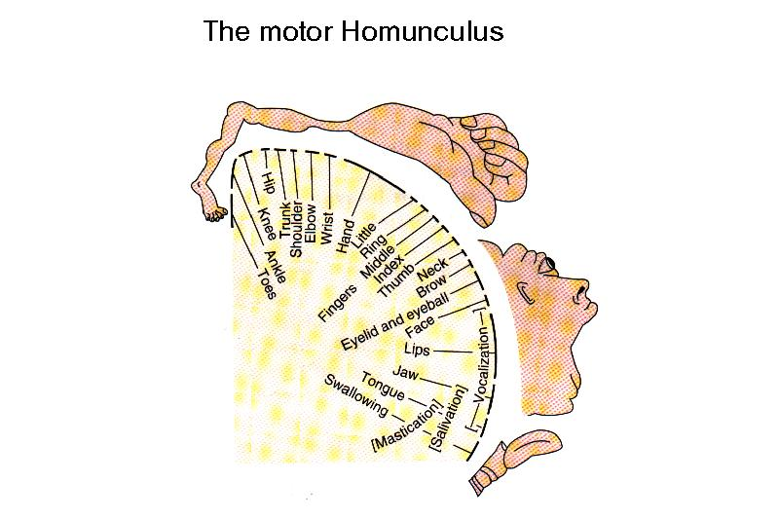

Slide 19
Supplementary Motor Area (M-II)
Location:
Found on both in lateral and medial aspect of the frontal lobe. It extends from cingulate sulcus on the medial side to reach premotor cortex on the lateral surface of the brain.
Function:
It works together with premotor cortex.
Involved in organizing or planning and prgramming motor sequences, while M1 executes movements.
Lesions: do not cause paralysis but
produces awkwardness in performing complex activity and difficulty with bimanual coordinated activity.

Slide 20
It functions in mental rehearsal of movements before performing a complex motor functions.
With premotor cortex it translates the desire to perform a motor task into a series of motor command that will do the task.

Slide 21
Premotor Cortex
(Premotor area ,M-III)
Location:
Broadmann’s area 6. It lies immediately anterior to primary motor cortex. It is more extensive than primary motor cortex (about 6 times), receives input from sensory regions of parietal cortex & projects to M1, spinal cord and brain stem reticular formation

Slide 22
Functions:
It works with the help of basal ganglia, thalamus, primary motor cortex, posterior parietal cortex.
It plays role in setting posture at the start of a planned movement so that the individual is prepared to move.
It is involved in control of proximal limb muscles thereby orienting the body for movement

Slide 23
Lesion:
It results in re-emergence of suckling and grasp reflex in adults.
It’s lesion do not cause paralysis but only slowing of the complex limb movement.
Lesion may result in loss of short-term or working memory.
When damaged with supplementary cortex it may result in APRAXIA .

Slide 24
Posterior parietal cortex
This area provides fibers for cortico spinal and cortico bulbar tracts
The somatic sensory area and the related parts of the posterior parietal cortex also project to the premotor area
Function :To execute learned sequence of movement
Lesion: inability to execute learned sequence of movement like eating food with knife and fork.

Slide 25
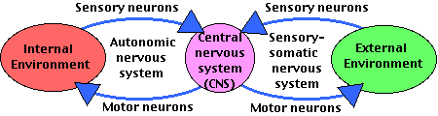
Motor – Sensory Integration

Slide 27
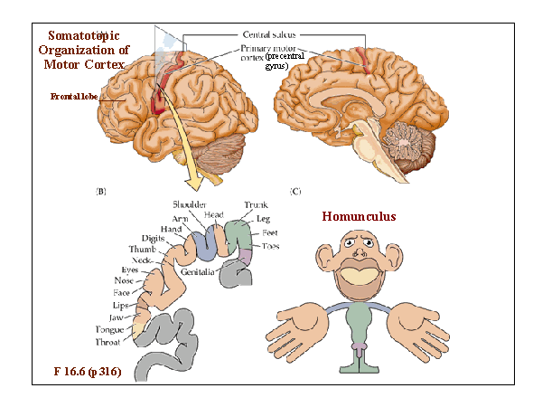

Slide 28
  CORTICOSPINAL TRACT
(PYRAMIDAL TRACT)

Slide 29
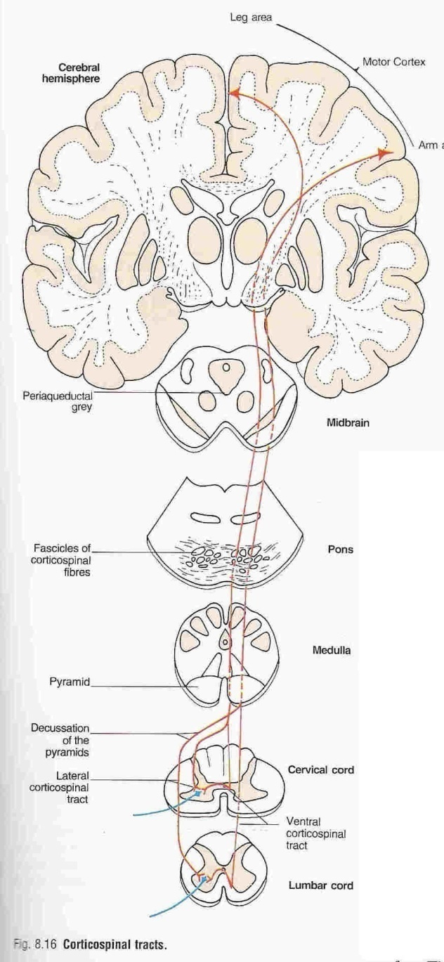
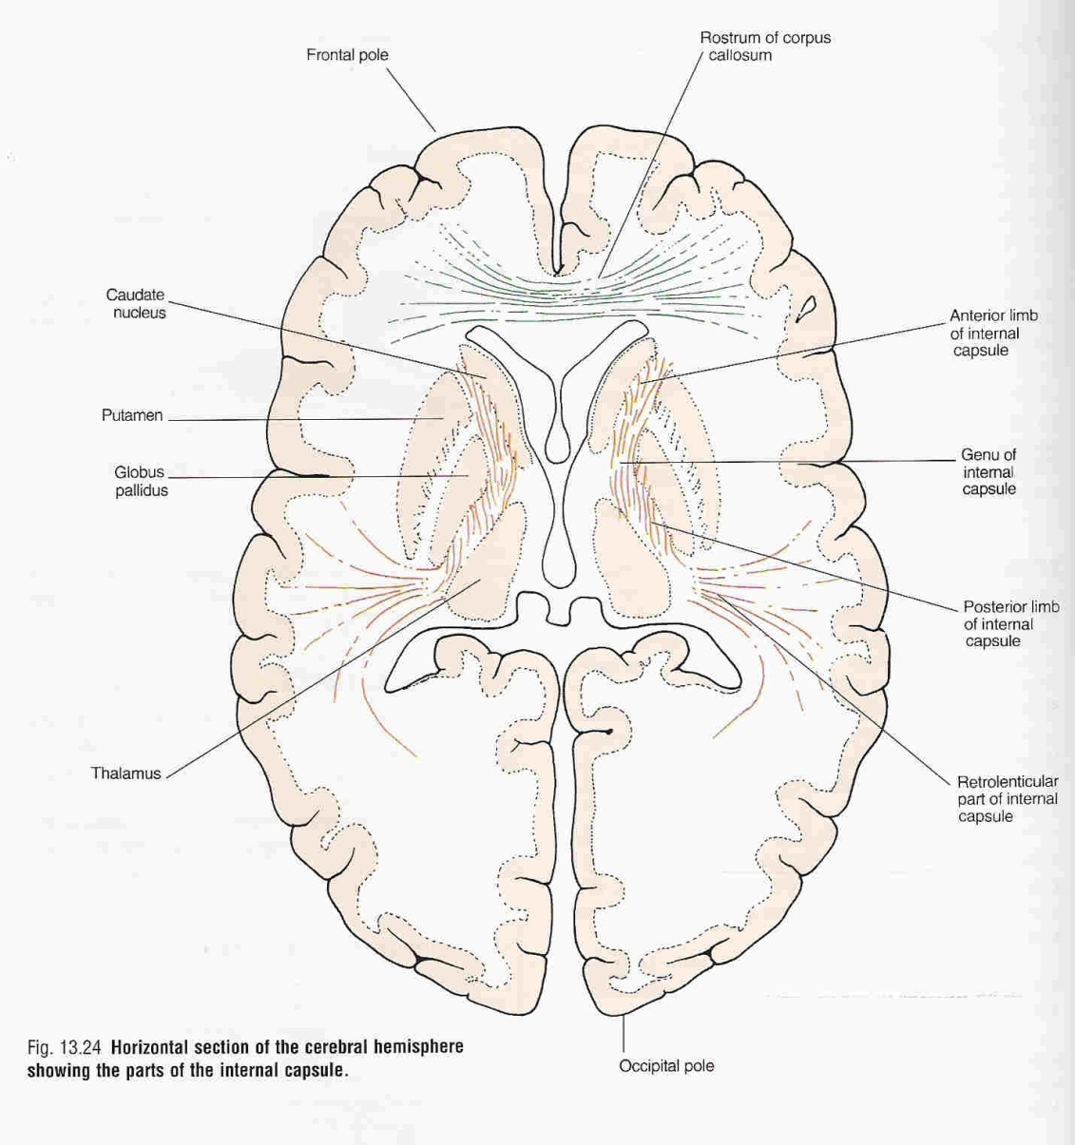
CORTICOSPINAL (PYRAMIDAL ) TRACT

Slide 30
Origin of corticospinal /corticobulbar tracts
The neurons of these tracts are Pyramidal shaped
Primary motor cortex (M1;Broadmann area 4) | 31%
Premotor cortex and supplementary motor cortex (Broadmann area 6) | 29%
Parietal lobe (Broadmann areas 5 and 7) and primary somatosensory area (Broadmann areas 3,1,2) in the post central gyrus | 40%

Slide 31
Corticospinal Tract (CST)
Origin – Sensory cortex, primary Motor Cortex, premotor & supplementary cortex
(40%) (31%) (29%)
Internal Capsule
Cerebral Peduncle (midbarain)
Pons
Medullary Pyramid
Pyramidal Decussation
(80%) of the fibres cross( lateral CST) & (20%) do not cross (Ventral CST)
Ant. Horn of spinal cord through a interconnection
α motor neuron of opposite side

Slide 32
FUNCTIONS
( The axial muscles are concerned with postural adjustments & gross movements and distal limb muscles mediate fine & skilled movements).
Lateral corticopinal tract controls primarily distal muscle which are finely controlling the skilled movements of thumb & fingers on the opposite side.
eg. Painting writing, picking up of a small object etc.
also, facilitatory to muscle tone & deep reflexes.

Slide 33
Effect of lesion:
loss of distal motor function in opposite side.
Pure corticospinal tract lesion cause hypotonia instead of spasticity
The reason is that pure pyramidal tract lesion is very very rare, and spasticity is due to loss of inhibitory control of extrapyramidal tracts.

Slide 34
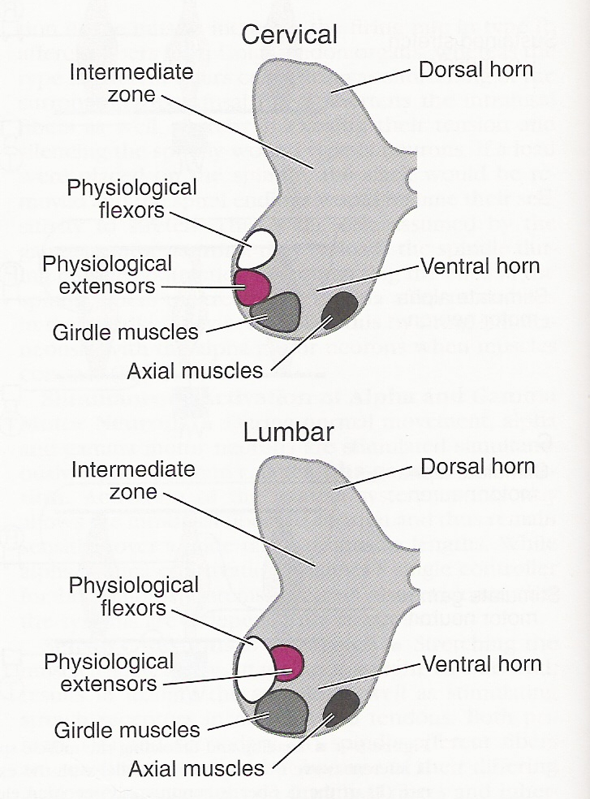

Slide 35
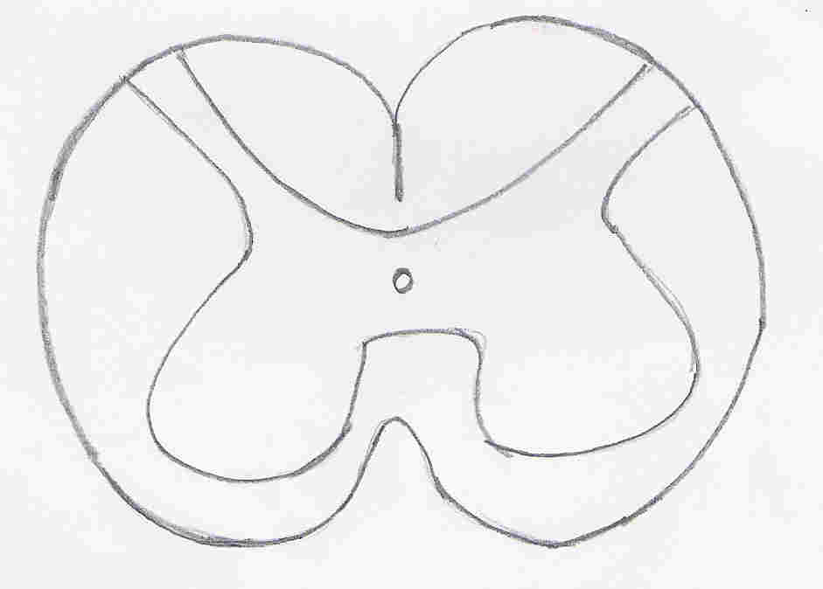
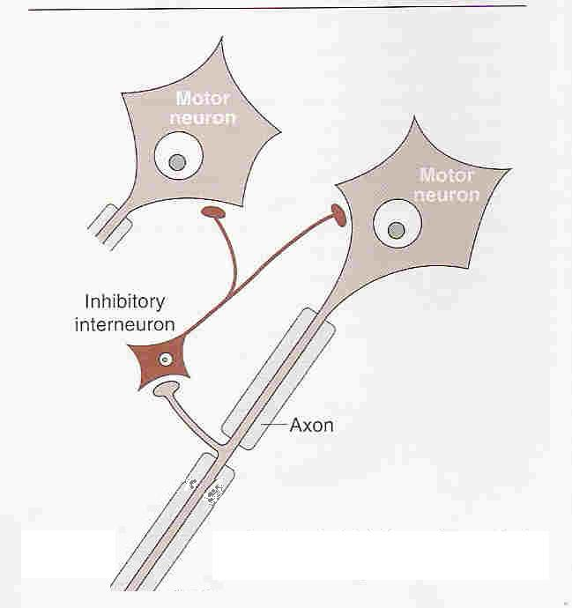
B
A
Alpha Motor Neuron (A & B)

Slide 36
EXTRAPYRAMIDAL TRACTS

Slide 37
Definition:
Tracts other than corticospinal tract are known as Extrapyramidal tract.
The word extrapyramidal is slowly being replaced by Corticonuclear & corticobulbar tracts.

Slide 38
Functions:
Control of axial & proximal muscles, adjustment of
postural background for skilled movements
Coordination and planning of movement and
control of gross movements in group of muscles
(associated movements) eg. Swinging of arms
while walking.

Slide 39
COMPONENTS OF EXTRA PYRAMIDAL SYSTEM
1.Cortical (premotor area)
2. Basal Ganglia
3. Brain Stem giving rise to following bulbospinal tracts.
Lateral brain stem pathway:
Rubrospinal tract.
Medialbrain stem pathways:
Vestibulospinal Tract.
Reticulospinal Tract
Tectospinal Tract.
( Olivospinal Tract).

Slide 40
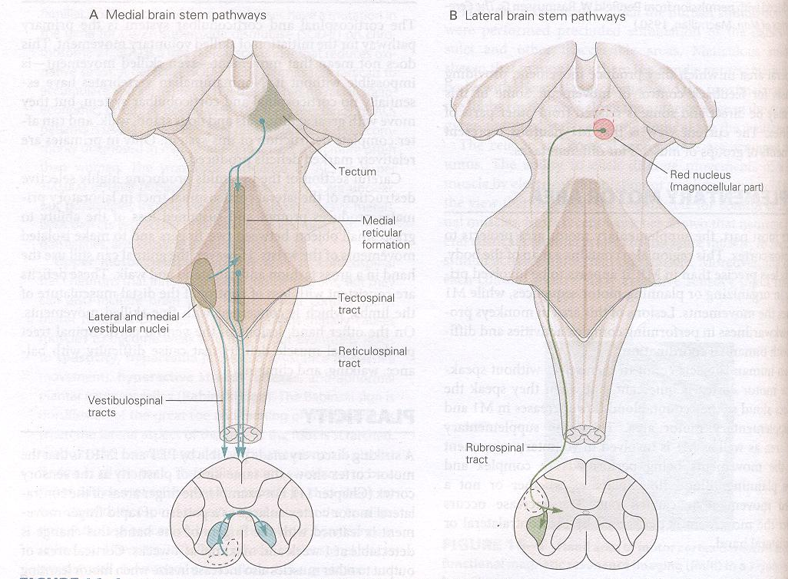

Slide 41
Overview of Motor System
Corticospinal tracts
Corticobulbar tracts
Bulbospinal tracts

Slide 42
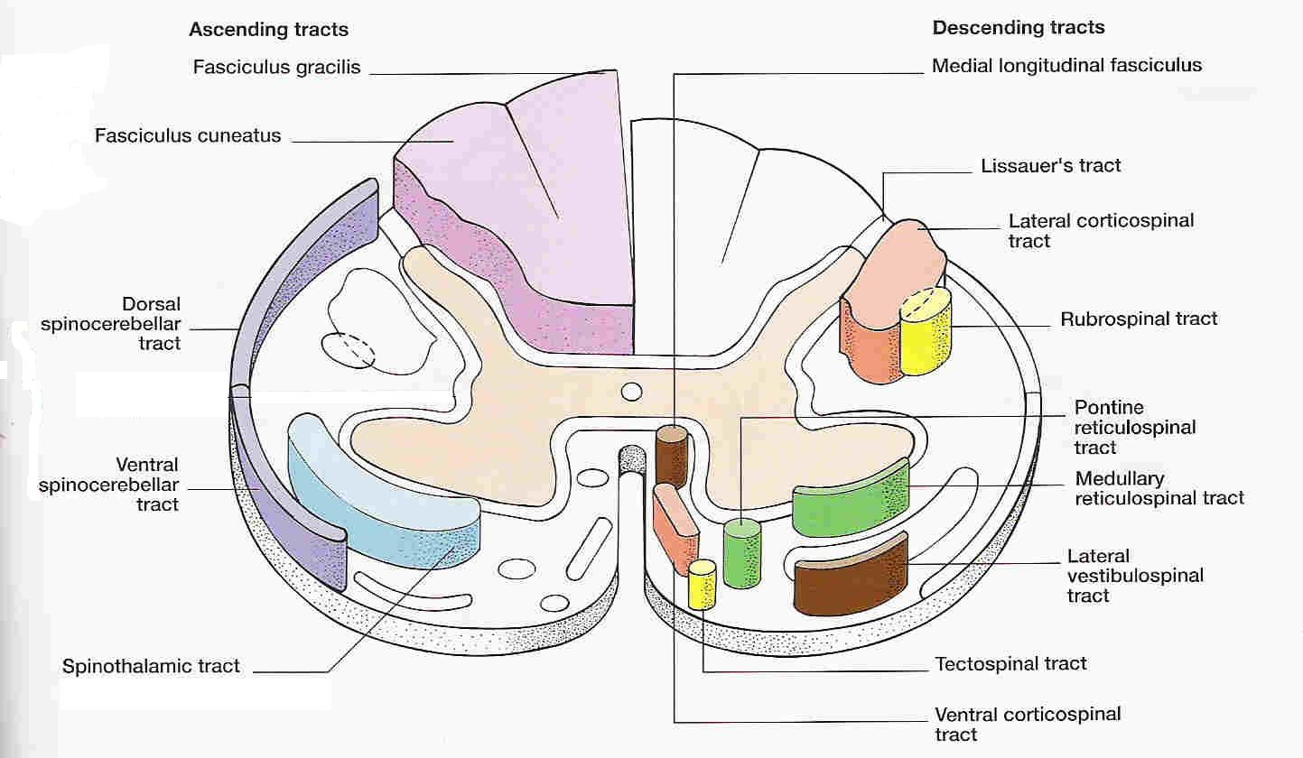

Slide 43
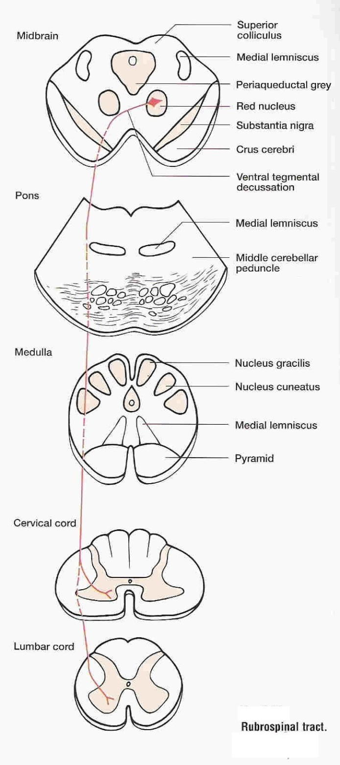
RUBROSPINAL TRACT
Red Nucleus in Midbrain
Cross to opposite side
Pass down through Pons & Medulla
Occupies the lat. White column of spinal cord
Ends in ant. Horn of spinal cord
Functions: Red nucleus integrates with cerebral cortex & helps in cerebellar processing. Its motor function is similar to corticospinal tract eg. Distal
Limb muscle control. Excitatory to flexor & inhibitory to extensor motor neurons.

Slide 44
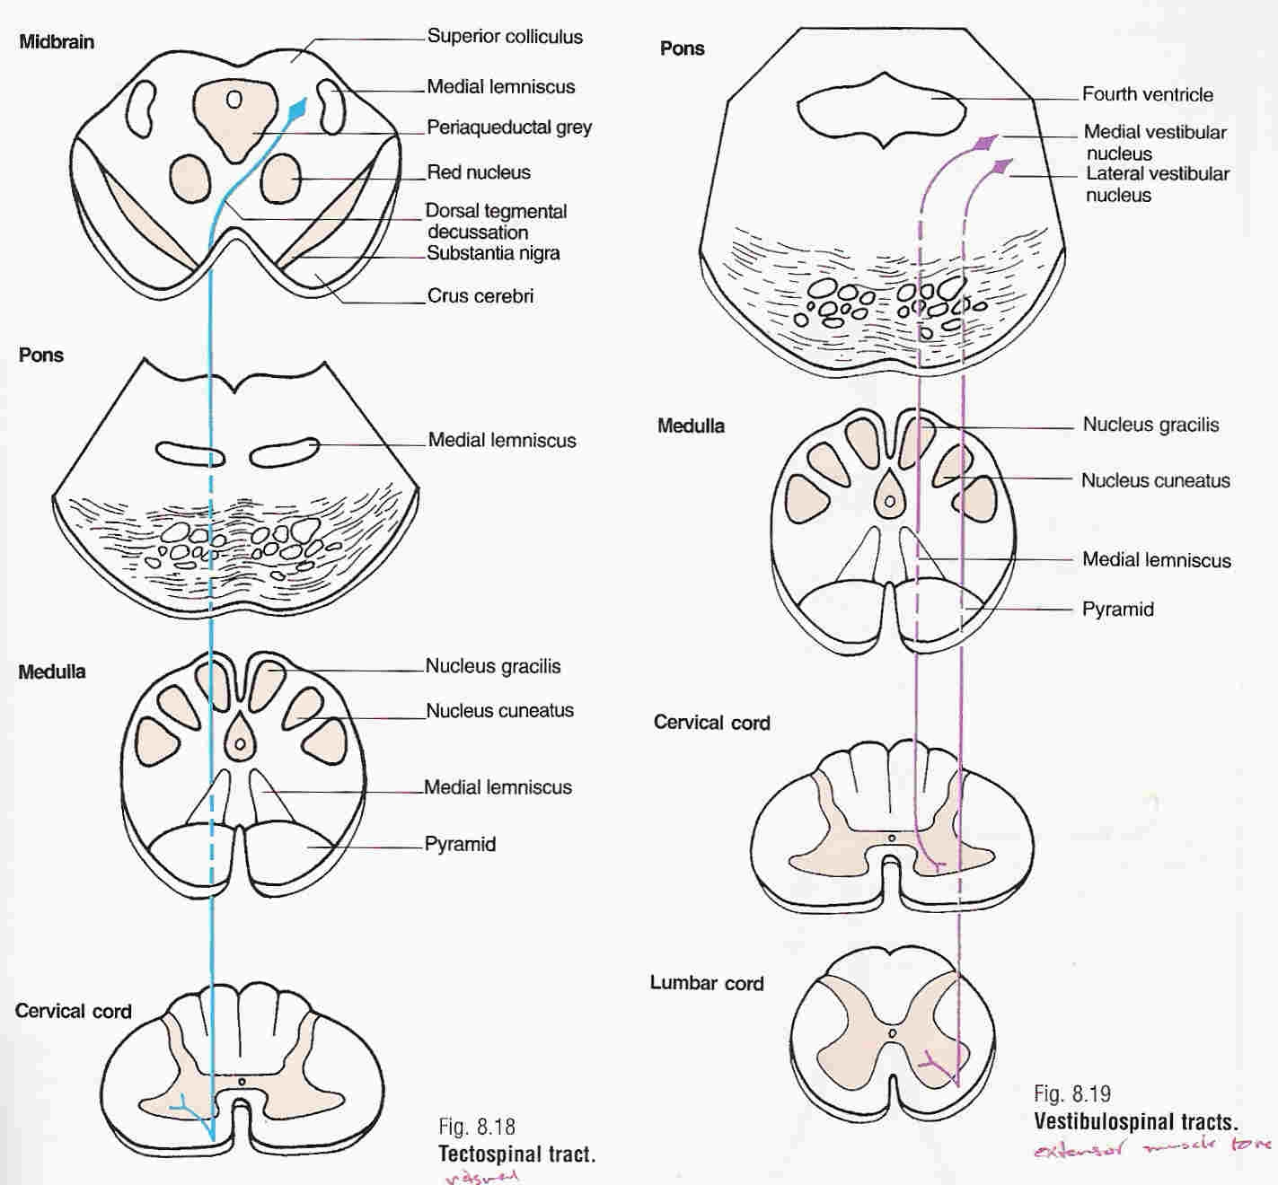
VESTIBULOSPINAL TRACTS
Vestibular. nuclei (medial and lateral)
Spinal motor neurons
Innervating neck, axial & postural muscles
Function :The medial tract projects bilaterally to cervical neurons that control neck musculature
The lateral tract projects ipsilaterally to neurons at all spinal level that activates antigravity muscles (eg proximal limb extensors) to control posture and balance

Slide 45
TECTOSPINAL TRACT
Superior collicili in midbrain
Dorsal tegmental decussation
Cervical spinal motor neuron of anterior horn
Function: controls head and eye movement and allows turning of the head in response to visual or Auditory stimuli.

Slide 46
Reticulospinal Tract
The reticular formation makes up a central core through much of the brainstem. It contains many different nuclear groups.
Pontine and medullary nuclei projects to the anterior horn of the spinal cord at all spinal levels.
Functions: maintainence of posture and is also responsible modulating the muscle tone via input to gamma motor neurons.
Pontine reticulospinal neurons are primarily excitatory while medullary reticulospinal neurons are primarily inhibitory to gamma motor neurons.

Slide 47
Olivospinal Tract
It arises in the cells of inferior olive of the medulla and is found only in the cervical region of the spinal cord.
Function is unknown

Slide 48
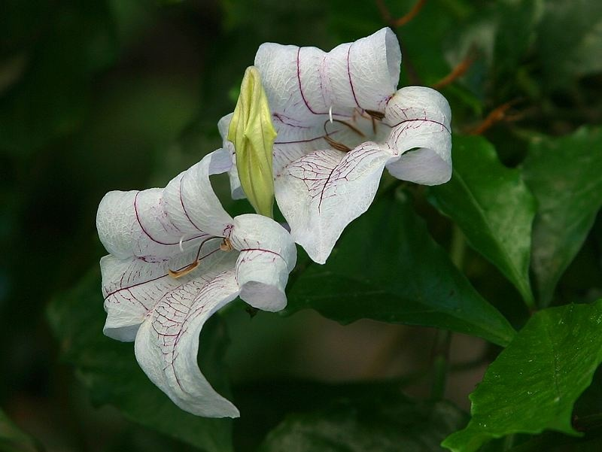
Thanks
and
good luck

