Slide 1
* NERVE SUPPLY OF FACE: 5TH & 7TH CRANIAL NERVES
Dr. Ahmed Fathalla Ibrahim
Associate Professor of Anatomy
College of Medicine
King Saud University
E-mail: ahmedfathala@hotmail.com
Dr. Sanaa Al-Sahaarawy
Associate Professor of Anatomy

Slide 2
OBJECTIVES
At the end of the lecture, students should:
List the nuclei related to trigeminal and facial nerves in the brain stem.
Describe the type and site of each nucleus.
Describe the site of emergence and course of trigeminal and facial nerves.
Describe the sensory distribution of trigeminal nerve in the face.
Describe the motor distribution of facial nerve in the face.
Describe the main motor & sensory effects in case of lesion of trigeminal and facial nerves.

Slide 3
اولا : TRIGEMINAL NERVE ( 5th )
Type: Mixed.
Fibers:
General somatic afferent دائما تعني الاحساس العام: carrying general sensations from face.
Special visceral efferent: هذه الفايبرز تطلق على
branchial archاي فايبرز تغذي العضلات الناشئه من
وهذا الارش هو عباره عن تراكيب جنينيه تتطور لتعطي عضلات الوجه والرقبه – اضافه غير مطلوبه
supplying muscles originating from 1st branchial arch.
تذكر
Spicial somatic afferent
Mean the vision and hearing sences only
Which are the 2nd and 8th nerve

Slide 4
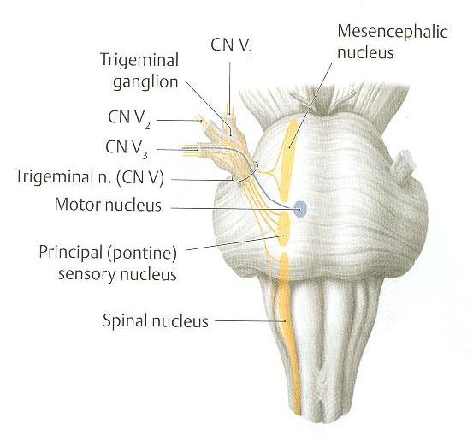
TRIGEMINAL NERVE NUCLEI
Sensation
Ganglion
تفصل لاحقا
لاحظ ان الموتور اكثر
Medialy
حسب القاعدة التي سبق شرحها في الدروس الاولى
امتداد لـ
Substintia gletnosia

Slide 5
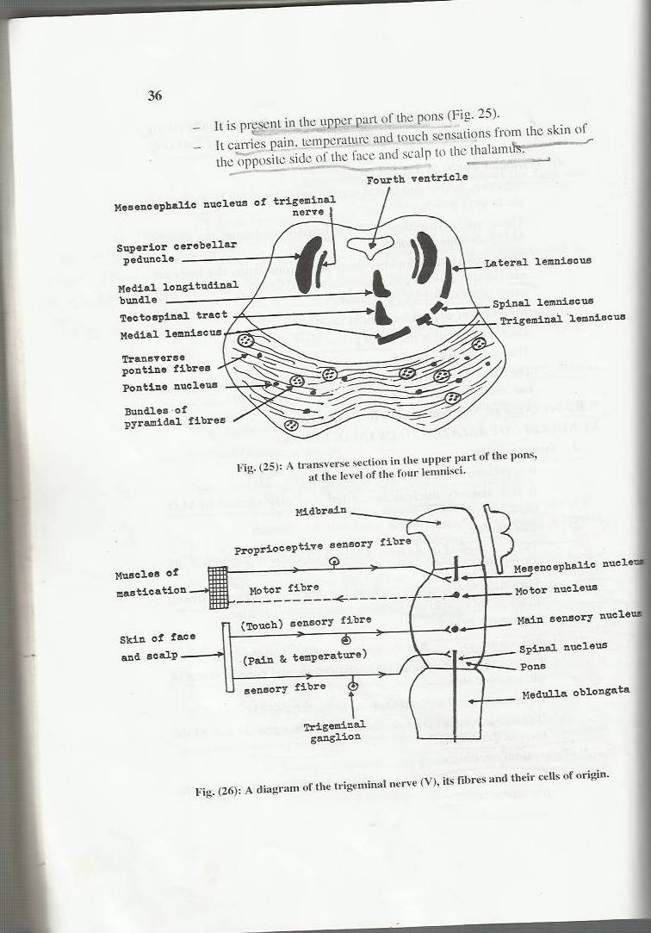
TRIGEMINAL NERVE NUCLEI

Slide 6
TRIGEMINAL NERVE NUCLEI
General somatic afferent:
Mesencephalic (pons & midbrain): receives proprioceptive fibers from face.
Principal (main) sensory (pons): receives touch fibers from face.
Spinal (pons, medulla & upper 2-3 cervical segments of spinal cord): receives pain & temperature sensations from face.
Special visceral efferent:
Motor nucleus (pons): supplies:
Muscles of mastication (temporalis, masseter, medial & lateral pterygoid).
Anterior فقط belly of digastric لان الانتيريور والبوستيريور ينشئان من ارتش مختلفه & mylohyoid muscles.
Tensor tympani & tensor palati.

Slide 7
TRIGEMINAL GANGLION
Site: Occupies a depression in the middle cranial fossa.
Importance: Contains cell bodies:
Whose dendrites carry general sensations from face.
Whose axons form the sensory root of trigeminal nerve.
تعتبر
Sensation ganglion
مهمه

Slide 8
TRIGEMINAL NERVE
Emerge from middle of ventral surface of pons.
Divides into 3 divisions (dendrites of trigeminal ganglion):
Ophthalmic.( sensory )
Maxillary.( sensory )
Mandibular. ( the only mixed division )
Axons of cells of motor nucleus join mandibular division. ( the only mixed division ) مهمه جدا جدا

Slide 9
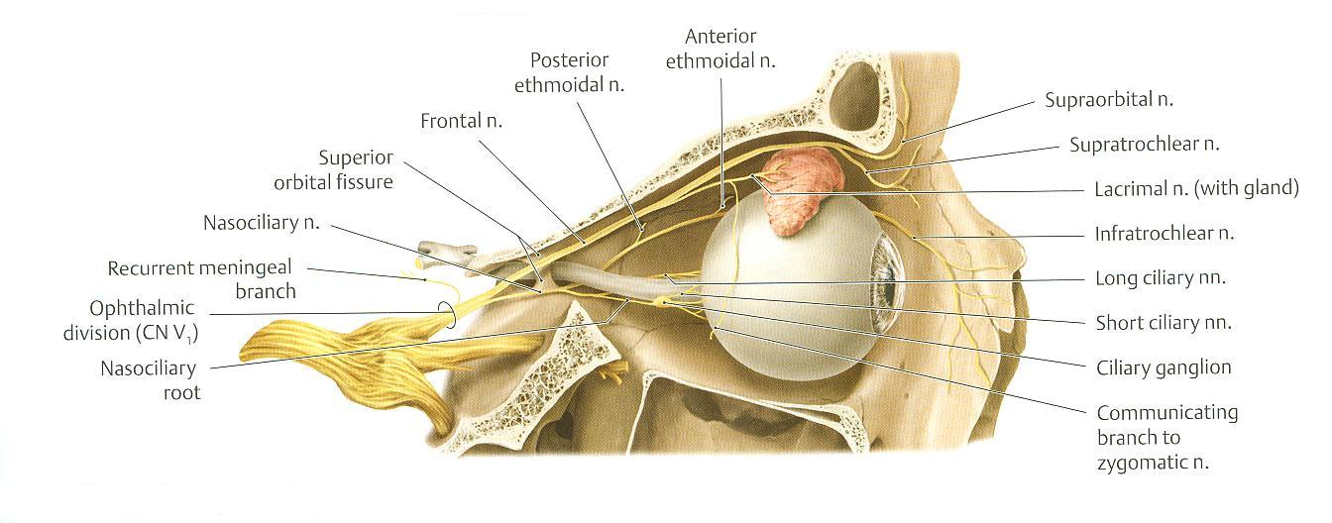
OPHTHALMIC (PURE SENSORY)
Divides into: frontal, lacrimal & nasociliary branches passing through superior orbital fissure to orbit.
Frontal: supplies skin of face & scalp.
Lacrimal: supplies skin of face & lacrimal gland.
Nasociliary: supplies skin of face, nasal cavity & eyeball.

Slide 10
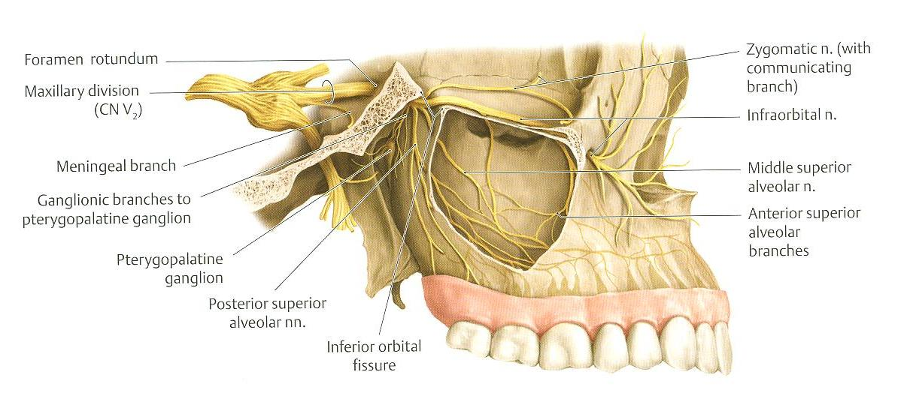
MAXILLARY (PURE SENSORY)
Supplies:
Upper teeth, upper gums & maxillary air sinus: (posterior, middle & anterior superior alveolar nerves).
Face: (zygomaticofacial & infraorbital nerves).

Slide 11
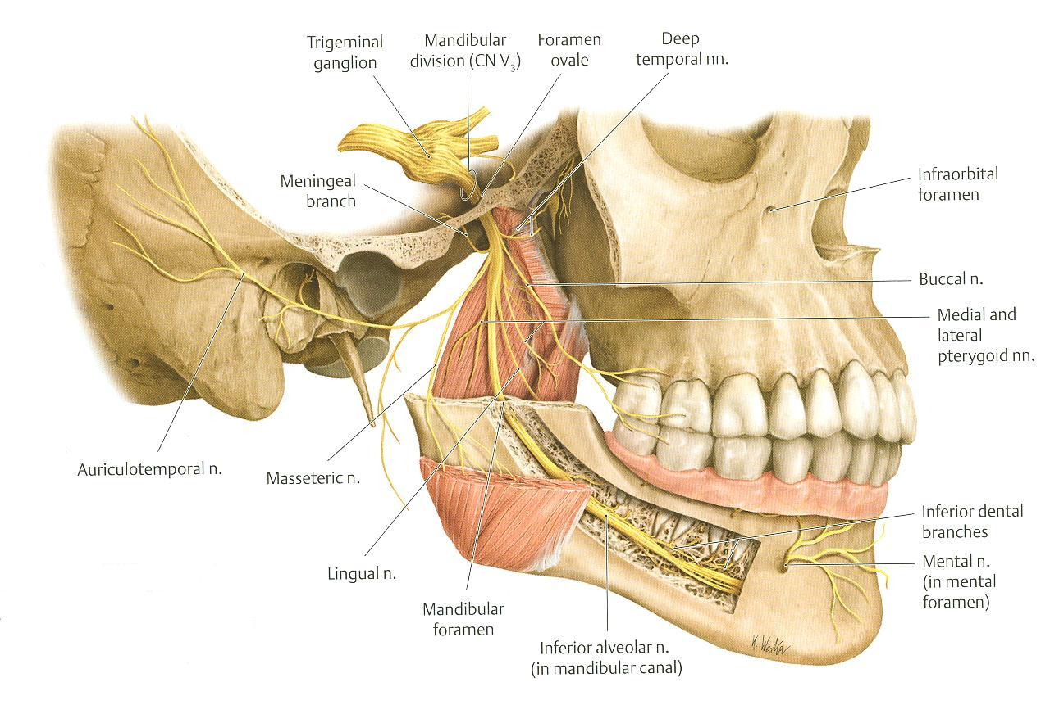
MANDIBULAR (MIXED)
SENSORY BRANCHES:
Lingual: General sensations of anterior 2/3 of tongue.
Inferior alveolar: Lower teeth, lower gums & face.
Buccal: Face.
Auriculotemporal: auricle, temple, parotid gland & TMJ.
MOTOR BRANCHES: to muscles of mastication, anterior belly of digastric, mylohyoid, tensor tympani & tensor palati.

Slide 12
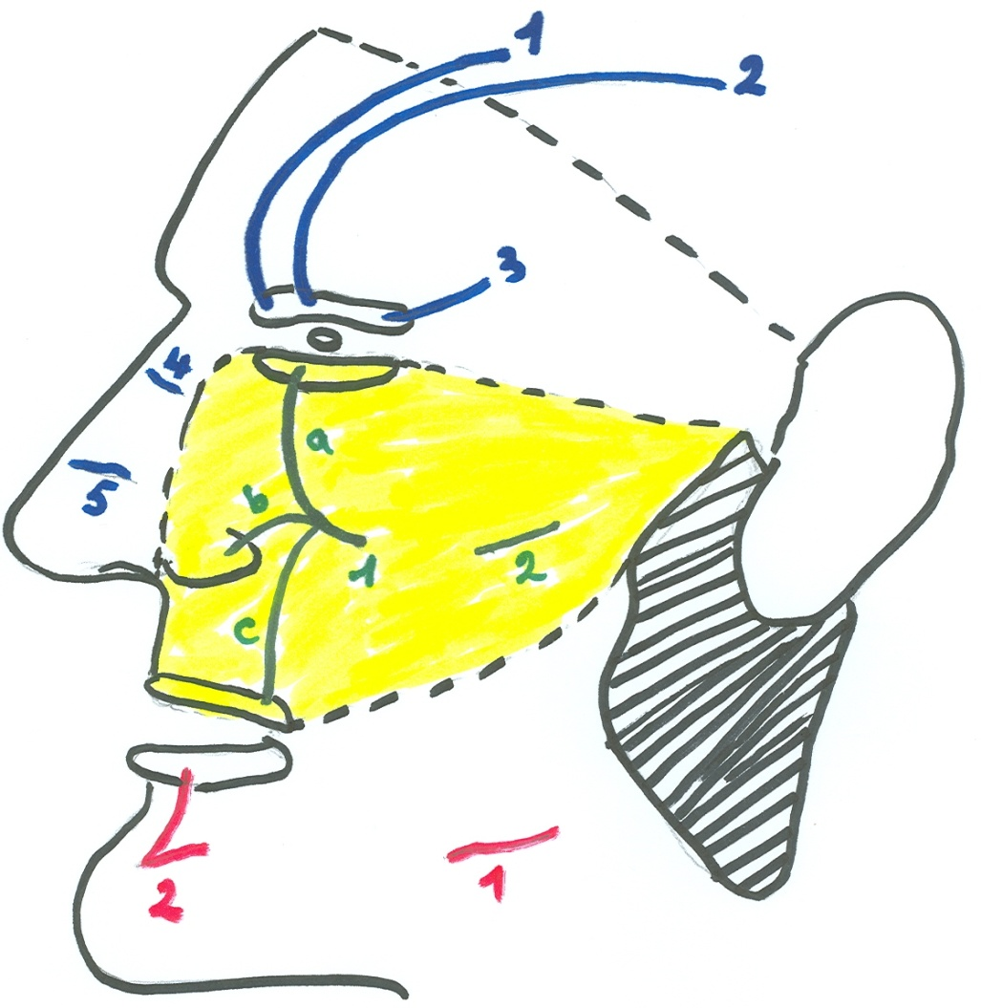
SENSORY SUPPLY OF FACE
OPHTHALMIC:
Supratrochlear of frontal: forehead + medial part of upper eyelid.
Supraorbital of frontal: forehead + medial part of upper eyelid.
Palpebral branch of lacrimal: lateral part of upper eyelid.
Infratrochlear of nasociliary: upper part of nose.
External nasal of nasociliary: lower part of nose.
Great auricular nerve
(C2,3)

Slide 13

SENSORY SUPPLY OF FACE
MAXILLARY:
Infraorbital: divides into: a) palpebral for lower eyelid. b) nasal for ala of nose. c) labial for upper lip.
Zygomaticofacial: upper part of cheek.
Great auricular nerve
(C2,3)

Slide 14

SENSORY SUPPLY OF FACE
MANDIBULAR:
Buccal: lower part of cheek.
Mental of inferior alveolar: lower lip & chin.
Q :
But T or F :
The whole face receive its sensory supply from the trigeminal N
الجواب
F , because small portion is supplied by facial N
Great auricular nerve
(C2,3)

Slide 15
TRIGEMINAL NEURALGIA
Inflammatory condition affecting one or more of the three divisions of trigeminal nerve.
This condition is characterized by recurring of episodes of intense stabbing وخز pain, radiating from angle of jaw along a branch of trigeminal nerve.
Usually involves maxillary & mandibular nerves, sparing the ophthalmic division.

Slide 16
ثانيا : FACIAL NERVE ( 7th )
Type: Mixed.
Fibers:
Special visceral afferent: اذا شفت هذا النوع من الفايبر فاعرف انها تنقل اما حاسة الشم او التذوق في هذا الدرس تحمل التذوق carrying taste sensation from anterior 2/3 of tongue.
Special visceral efferent: supplying muscles originating from 2nd branchial arch.
General visceral efferent: دائما تعني parasympathetic secretory fibers to submandibular, sublingual, lacrimal, nasal & palatine glands.
التي تتغذى بالعصب رقم 9 تغذي كل الغدد بالوجه باستثناء
Parotied

Slide 17
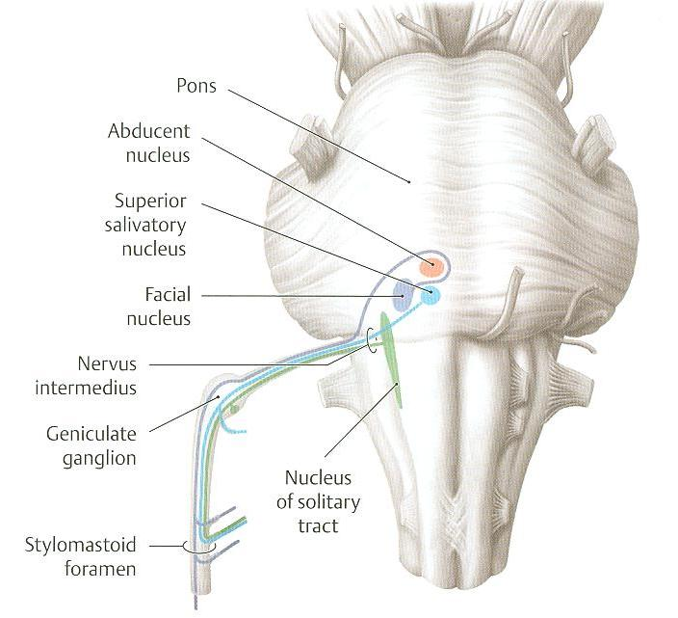
FACIAL NERVE NUCLEI

Slide 18
FACIAL NERVE NUCLEI
Special visceral afferent: upper part of solitary nucleus (nucleus solitarius): receives taste sensation from anterior 2/3 of tongue.
Special visceral efferent: motor nucleus of facial nerve: supplies: muscles of facial expression, posterior مهمه belly of digastric, stylohyoid, stapedius, occipital belly of occipitofrontalis.
General visceral efferent: superior salivatory nucleus: sends preganglionic parasympathetic secretory fibers to submandibular, sublingual, lacrimal, nasal & palatine glands.

Slide 19
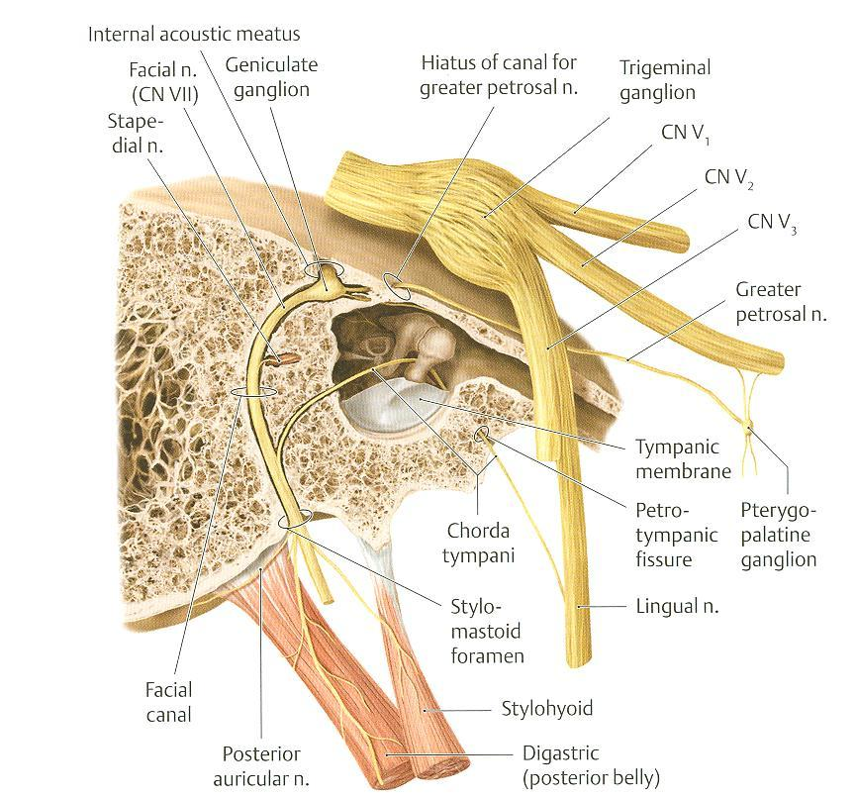
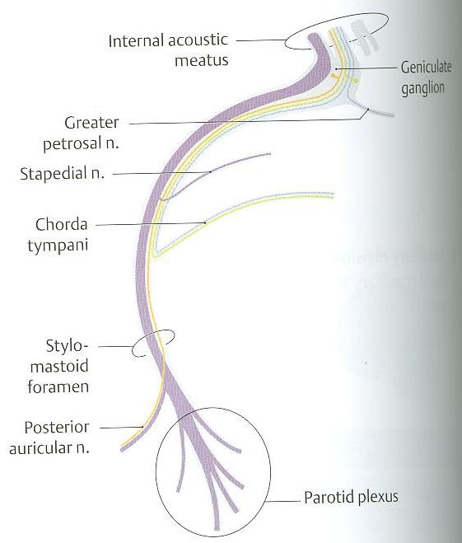
COURSE OF FACIAL NERVE
1
F
A
C
I
A
L
CANAL
2
3
To posterior belly of
digastric & stylohyoid
Q :
What are the facial divisions inside the facial canal :
الجواب الارقام 1 و 2 و 3 الاحمر
مهمه جدا جدا
(To muscles of
facial expression)

Slide 20
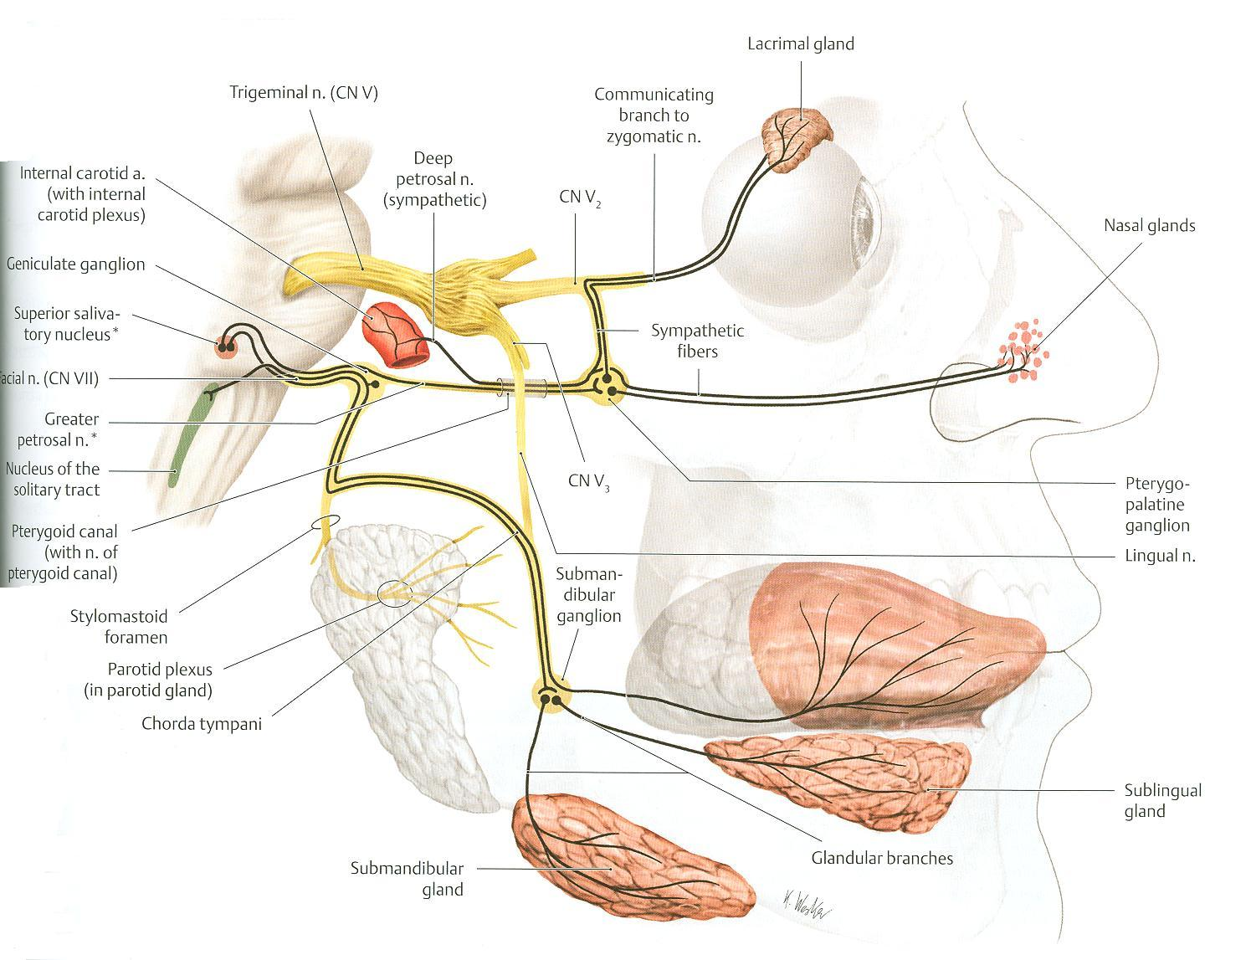
FACIAL NERVE:
COURSE & DISTRIBUTION
Taste

Slide 21
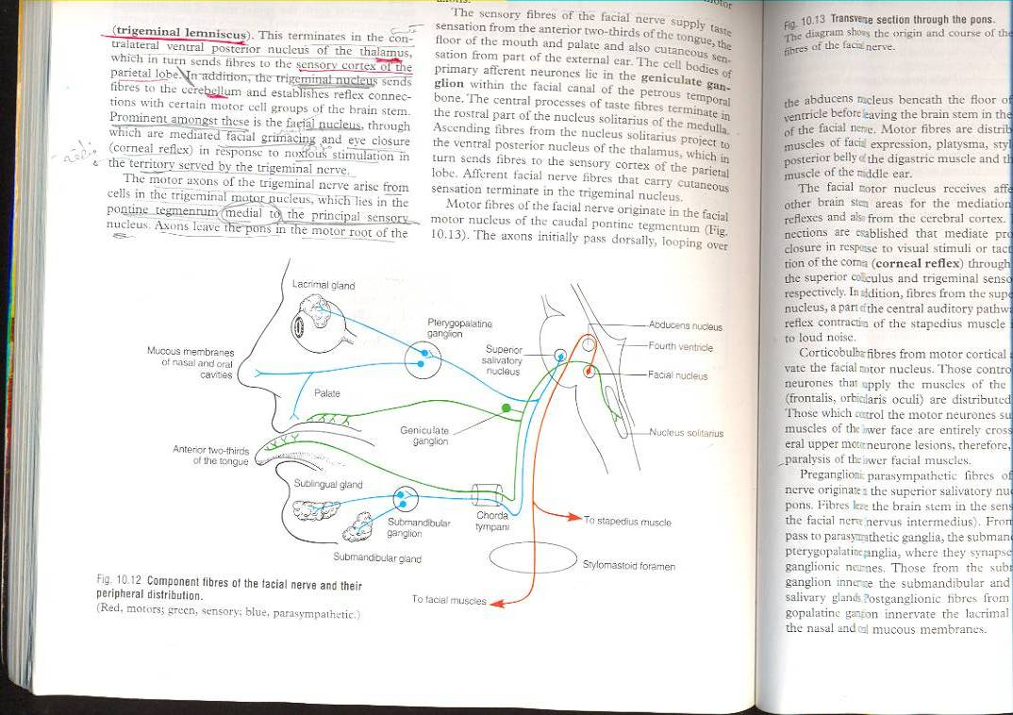
FACIAL NERVE:
COURSE & DISTRIBUTION

Slide 22
COURSE OF FACIAL NERVE
Emerges from cerebellopontine angle as 2 roots:
Medial motor root: contains motor fibers.
Lateral root (nervus intermedius): contains taste & parasympathetic fibers.
Passes through internal auditory meatus to inner ear where it runs in facial canal.
Passes through stylomastoid foramen & enters the parotid gland where it ends.

Slide 23
BRANCHES OF FACIAL NERVE
In facial canal:
Greater petrosal nerve: carries preganglionic parasympathetic fibers to lacrimal, nasal & palatine glands.
Chorda tympani: carries: a) preganglionic parasympathetic fibers to submandibular & sublingual glands. b) taste fibers from anterior 2/3 of tongue.
Nerve to stapedius.
N.B.: Geniculate ganglion: contains cell bodies of neurones carrying taste sensations from anterior 2/3 of tongue. مهمه

Slide 24
BRANCHES OF FACIAL NERVE
Just after emergence from stylomastoid foramen:
Posterior auricular: to occipitofrontalis.
Muscular branches to posterior belly of digastric & stylohyoid.
Inside parotid gland: gives 5 terminal motor branches: temporal, zygomatic, buccal, mandibular & cervical.

Slide 25
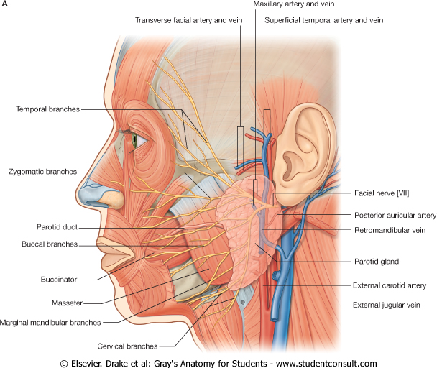
MOTOR SUPPLY OF FACE

Slide 26
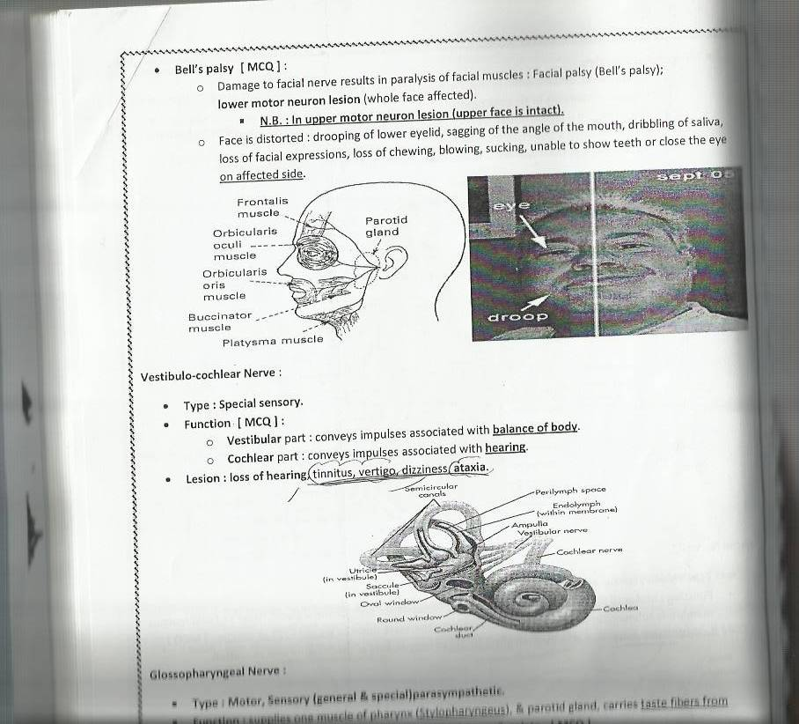
BELL’S (FACIAL) PALSY
Lesion of facial nerve (below sytlomastoid foramen) results in paralysis of muscles of facial expression.
It is of the lower motor neuron lesion type (whole face, at same side of lesion, is affected).
Distortion of face : sagging of angle of mouth, dribbling of saliva, loss of facial expressions, loss of chewing, blowing, sucking, unable to show teeth or close eye.

Slide 27
SUMMARY
Both trigeminal & facial nerves are mixed.
Nuclei of trigeminal nerve are found in midbrain, pons & medulla. They are of the general somatic afferent & special visceral efferent types.
The trigeminal nerve emerges from the pons and divides into: ophthalmic, maxillary & mandibular divisions that give sensory supply to face (with an exception of a small area over ramus of mandible).

Slide 28
SUMMARY
All motor fibers are included in the mandibular division & supply muscles of mastication.
Nuclei of facial nerve are found in pons. They are of the special visceral afferent & efferent types, as well as general visceral efferent type.
The facial nerve emerges from the cerebellopontine angle, gives motor fibers to muscles of facial expression, secretory fibers to submandibular, sublingual, lacrimal, nasal & palatine glands & receives taste fibers from anterior 2/3 of tongue.

Slide 29
QUESTION 1
The facial nerve contains
Taste fibers from posterior 1/3 of tongue.
Fibers carrying general sensation from face.
Motor fibers to buccinator.
Motor fibers to levator palpebrae superioris.

Slide 30
QUESTION 2
Lesion of mandibular nerve may result in:
Loss of sensation of skin over the nose.
Loss of lacrimation.
Loss of sensory supply of upper teeth.
Loss of general sensations of anterior 2/3 of tongue.

Slide 31
THANK YOU

