Slide 1
Central nervous system block Neuropathology practical
First Practical (21-9-11)

Slide 2
Brief review of Normal anatomy and histology

Slide 3
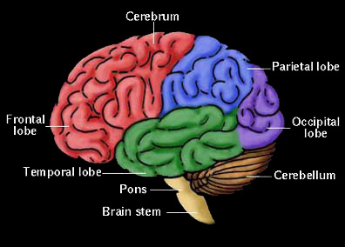
Cerebrum, Cerebellum and Brain Stem
C71.0
C71.3
C71.1
C71.4
C71.6
C71.2
C71.7

Slide 4
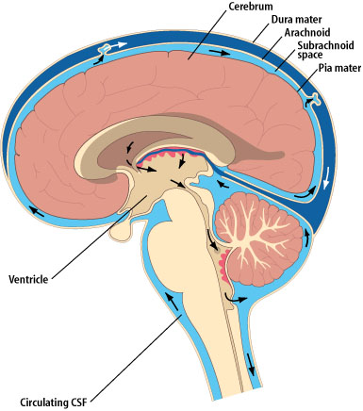
Meninges

Slide 5
CNS Cells
Two cell types
  Neuron
    Conducts nerve impulses
    Cannot be replaced if destroyed
  Neuroglial cells
    Support, nourish, and protect the neurons
    Include astrocytes, oligodendrocytes, ependymal cells and microglia
Notes:
The organs of the CNS contain two types of cells. The neurons are cells that conduct nerve impulses. Mitosis or cell division cannot take place in neurons so neurons cannot be replaced if they are destroyed.
The neuroglia or glia is the supporting structure of nervous tissue. The neuroglial cells support, nourish, and protect the neurons. Mitosis does take place in neuroglia. The types of neuroglial cells include astrocytes, oligodendrocytes, and microcytes. A large percentage of brain tumors originate in neuroglial cells.

Slide 6
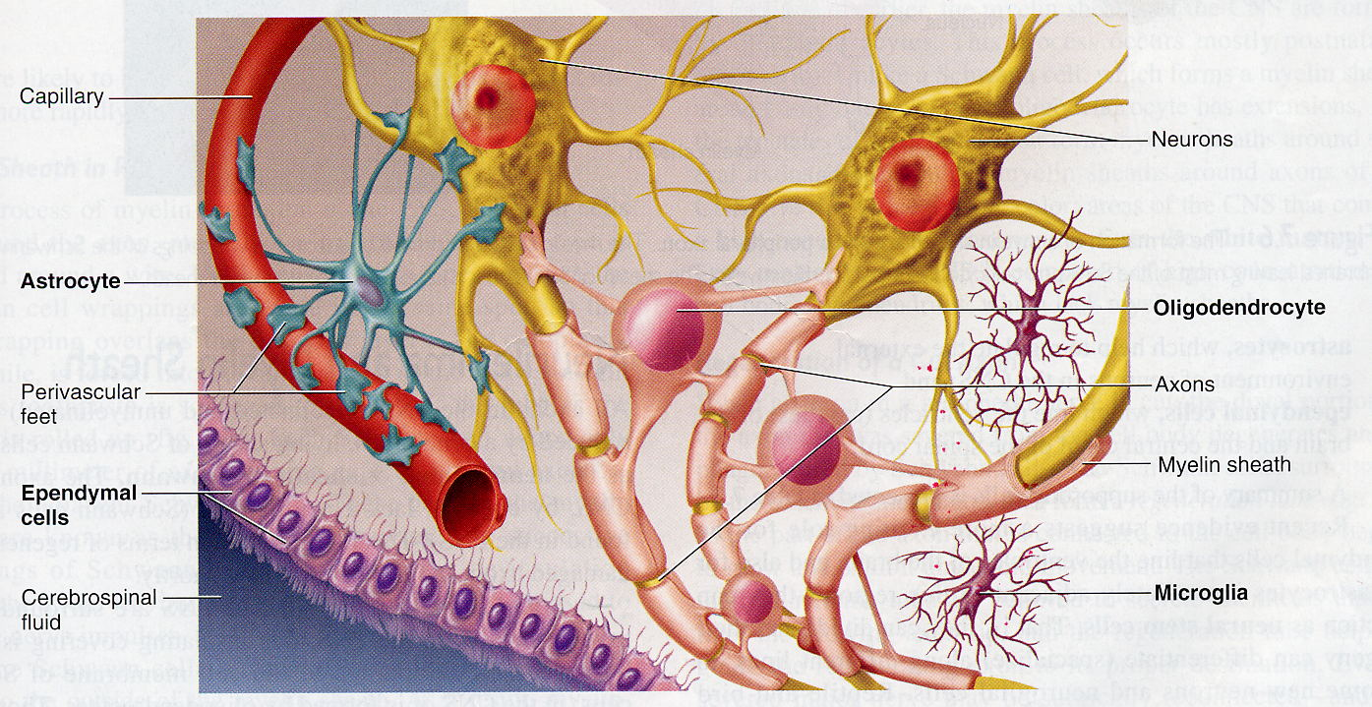

Slide 7
Gross and microscopic findings of selected CNS diseases

Slide 8
Case No. 1

Slide 9
43 years old female complained of headache and two attacks of seizures in the past 4 months . Brain MRI revealed a 3 cm. extra-axial mass in the parietal region. It was dural based with mild edema in surrounding brain tissue. What is your provisional diagnosis?

Slide 10
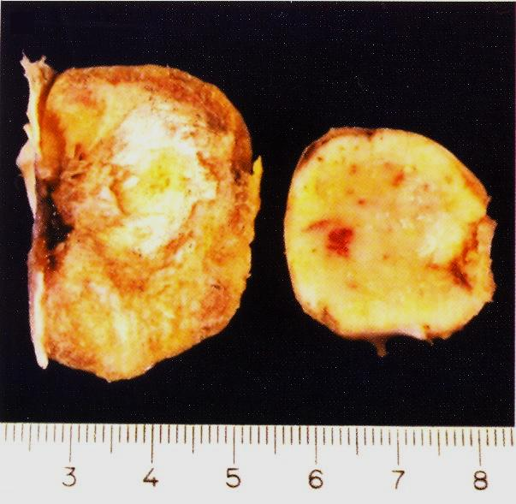

Slide 11
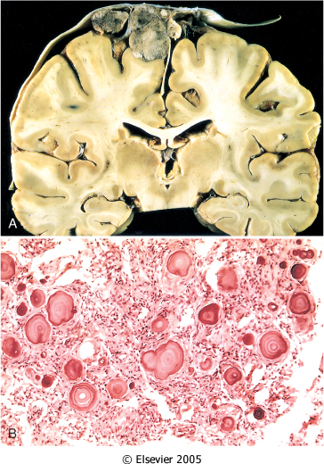
A, parasagittal multilobular meningioma attached to the dura with compression of underlying brain.
B, Meningioma with a whorled pattern of cell growth and psammoma bodies.

Slide 12
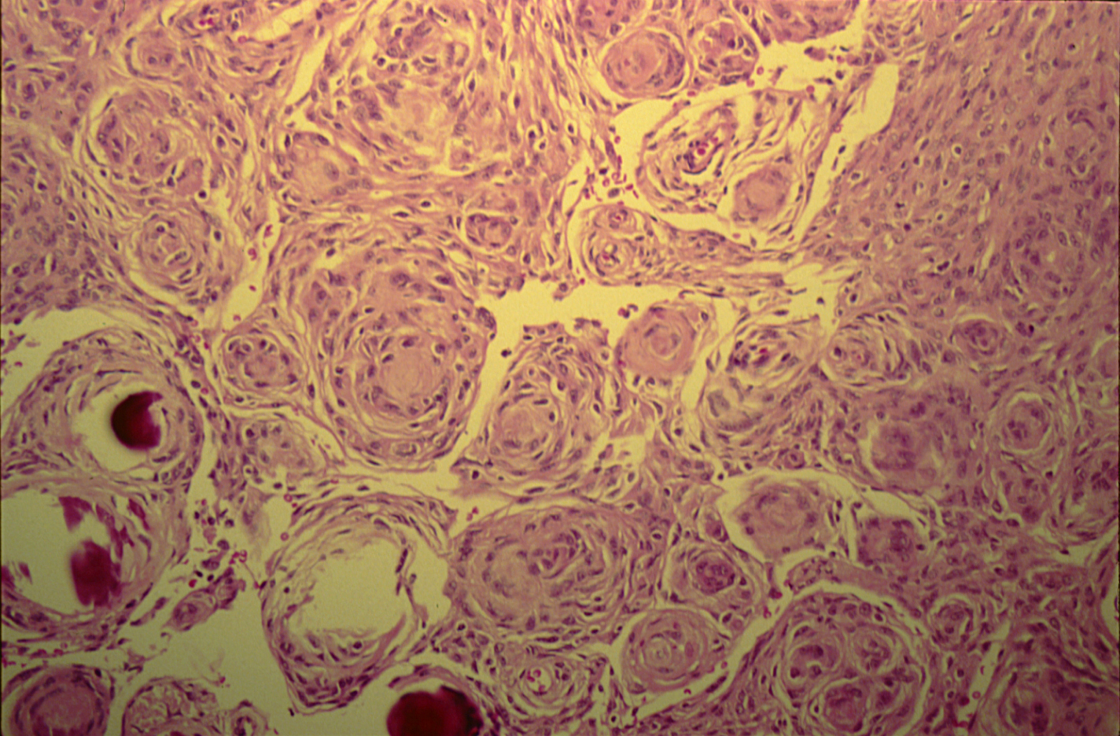
MENINGIOMA(DURA-BRAIN)

Slide 13
Meningioma:
Section of tumour shows:
Whorls of fibrocellular tissue.
Cells are oval, spindle shape or elongated and lack mitosis.
Psammoma bodies (spherical calcified particles) are also seen within the tumour.

Slide 14
Meningioma

Slide 15
Case No. 2

Slide 16
55 years old man complained for the last 2 months of headache. Brain MRI reveals a 3 cm. frontal intra-parenchymal space occupying lesion with rim enhancement on contrast studies. What is your provisional diagnosis ?

Slide 17
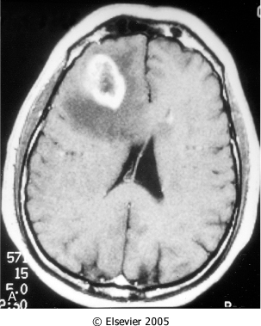
Computed tomographic (CT) scan of a large tumor in the cerebral hemisphere showing signal enhancement with contrast material and pronounced peritumoral edema.

Slide 18
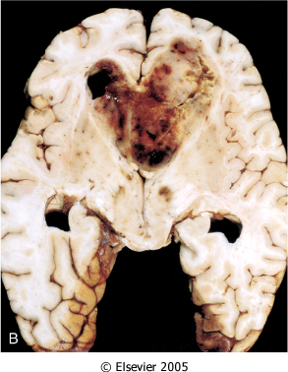
Glioblastoma multiforme appearing as a necrotic, hemorrhagic, infiltrating mass.

Slide 19
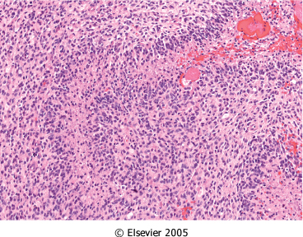
Glioblastoma. Foci of necrosis with pseudopalisading of malignant nuclei.

Slide 20
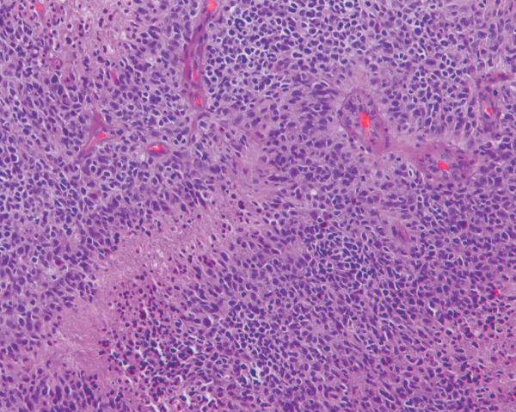
Glioblastoma. Foci of necrosis with pseudopalisading of malignant nuclei and endothelial cell proliferation

Slide 21
Glioblastoma
    The highest grade glial tumor.
    It has a histologic appearance similar to anaplastic astrocytoma with the additional features of necrosis and vascular or endothelial cell proliferation and pseudo-palisading nuclei.

Slide 22
Glioblastoma

Slide 23
Case No. 3

Slide 24
27 years old woman presents with a sudden onset of right sided blindness and weakness in her left leg. There is no history of trauma. However, she experienced a similar episode 8 months ago and was diagnosed as aseptic meningitis.

Slide 25
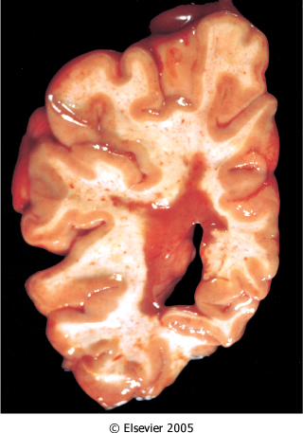
What is your provisional diagnosis?
Multiple sclerosis. Section of fresh brain showing brown plaque around occipital horn of the lateral ventricle.

Slide 26
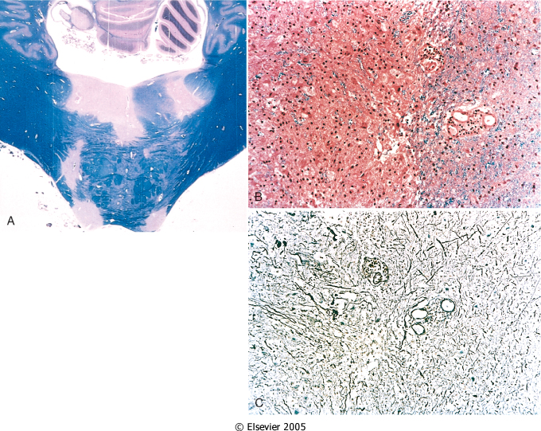
Multiple sclerosis. A, Unstained regions of demyelination (MS plaques) around the fourth ventricle (Luxol fast blue PAS stain for myelin).
B, Myelin-stained section shows the sharp edge of a demyelinated plaque and perivascular lymphocytic cuffs.
C, The same lesion stained for axons shows relative preservation.

Slide 27
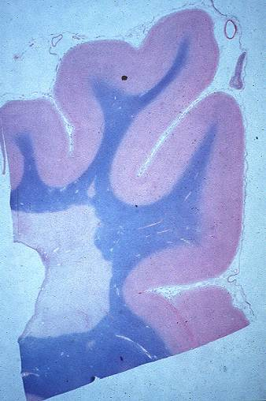
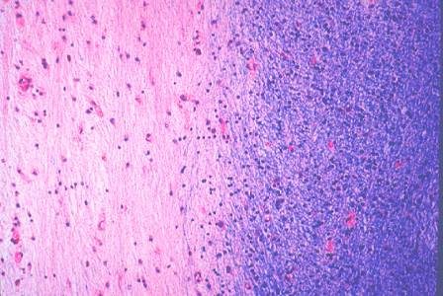
MULTIPLE SCLEROSIS PLAQUE sharp circumscription

Slide 28
Multiple sclerosis

Slide 29
MULTIPLE SCLEROSIS
Multiple sclerosis is the most common disease of CNS myelin; prevalence of 1:1000.
  Central nervous system myelin is selectively destroyed (axons are relatively preserved)
  Onset is frequently in 30 and 40 year old age groups.
  The disease is typically progressive with relapsing and remitting accumulations of focal neurologic deficits.
  The etiology is thought to be autoimmune in nature

Slide 30

Symptoms of MS
Fatigue
Depression
Memory change
Pain
Spasticity
Vertigo
Tremor
Double Vision/Vision Loss
Weakness
Dizziness/Unsteadiness
Numbness/Tingling
Ataxia
Euphoria
Speech disturbance
Bladder/Bowel/Sexual dysfunction

Slide 31
Case No.4

Slide 32
39 years old man complains that he had noticed a progressive hearing loss over a
2 years period. Except for occasional headache, he has no other complaints . Evaluation discloses severe sensori-neural hearing loss of the left side. MRI shows 1.5 cm. mass at the left cerebellopontine angle . What is your provisional diagnosis ?

Slide 33
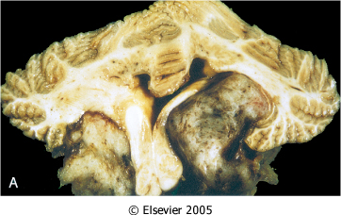
Schwannoma. A, Bilateral eighth nerve schwannomas.
What syndrome is suggested by such finding?

Slide 34
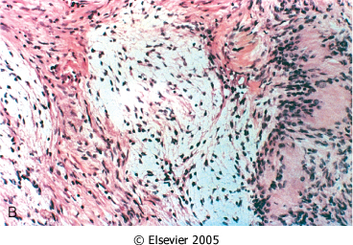
Schwannoma. B, Tumor showing cellular areas (Antoni A), including Verocay bodies (far right), as well as looser, myxoid regions(Antoni B pattern)

Slide 35
Schwannoma
  These benign tumors also known as a neurilemmoma; neoplasm composed of a proliferation of Swann cell and are associated with neurofibromatosis type 2.
  Pathogenesis is unknowm
  Within the cranial vault, the most common location is in the cerebello-pontine angle, where they are attached to the vestibular branch of the eighth nerve.
  Patients often present with tinnitus and hearing loss

Slide 36

Microscopic
Biphasic Antoni A and B areas
Antoni A pattern
Collagenous background
Compact elongated spindle cells in bundles
Verocay bundles: pallasading arrangement of peripheral aligned nuclei surround central eosinophiolic cell processes
Antoni B areas: looser, myxoid regions

Slide 37
Schwannoma

