Slide 1
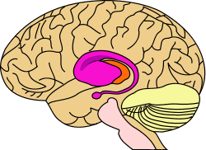
BASAL GANGLIA

Slide 2
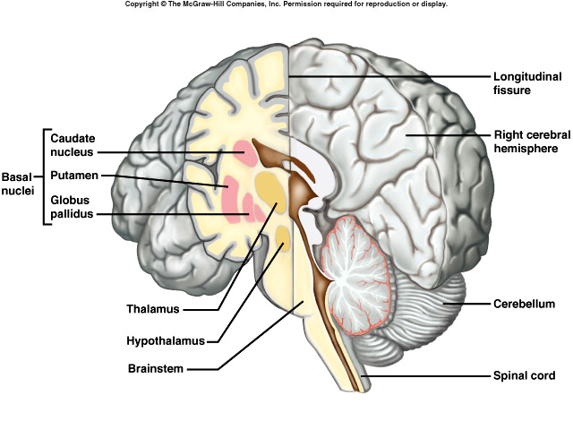
Basal Ganglia
Refer to a group of nuclei, located deep within cerebral hemispheres.
Are part of extrapyramidal motor system, principally involved in the control of posture and movements (primarily by inhibiting motor functions)

Slide 3
Basal Ganglia: Components
The basal ganglia include:
Caudate nucleus
Putamen
Globus pallidus
The Amygdala, located within the temporal lobe has a similar embryologic origin but functionally is part of the limbic system.
Substantia nigra & Subthalamic nuclei are functionally part of basal ganglia.

Slide 4
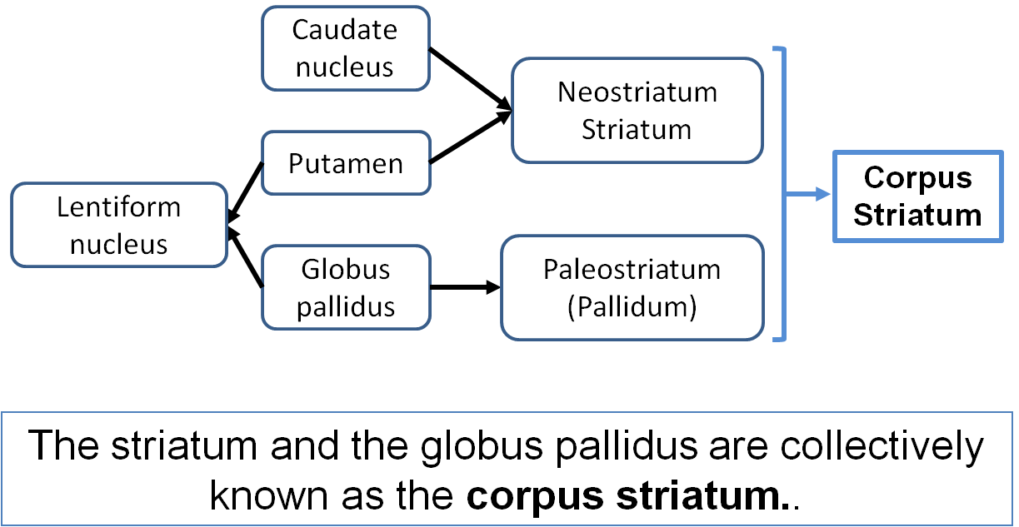
Basal Ganglia: Organization
Functionally the putamen is more closely allied to caudate nucleus and together constitute the neostriatum or simply striatum.
The globus pallidus is the oldest part of corpus striatum and is called paleostriatum or simply pallidum.
Anatomically the putamen and globus pallidus are together called the lentiform nucleus.
The striatum and the pallidum are collectively known as the corpus striatum.

Slide 5
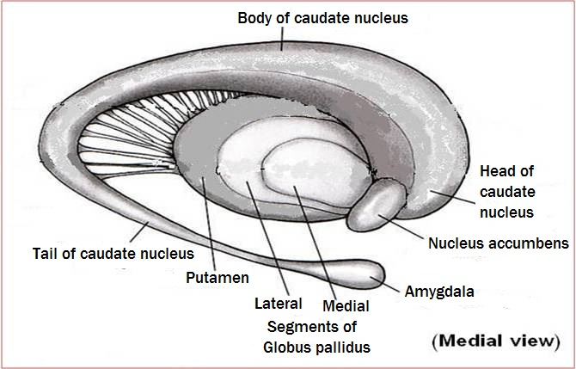
Corpus Striatum
Lies lateral to thalamus.
It is divided by internal capsule into caudate nucleus and lentiform nucleus.
Bands of grey matter pass from lentiform nucleus across the internal capsule to the caudate nucleus, giving the striated appearance hence, the name corpus striatum.
The most ventral part of the corpus striatum is called the nucleus accumbens, which has connections with the limbic system.

Slide 6
Caudate Nucleus
Large C-shaped or comma-shaped grey mass
It has a Head, a Body and a Tail.
Head : ( Anterior) Large, & rounded
Forms the lateral wall of the anterior horn of lateral ventricle.
Completely separated from the putamen by the internal capsule except rostrally where it is continuous with the putamen through and beneath the anterior limb of internal capsule.

Slide 7
Caudate Nucleus cont’d
Body: Long & narrow continuous with head
lies in the floor of body of lateral ventricle.
Tail : Long, narrow & tapering,
descends posteriorly into the temporal lobe
lies in the roof of inferior horn of lateral ventricle.

Slide 8
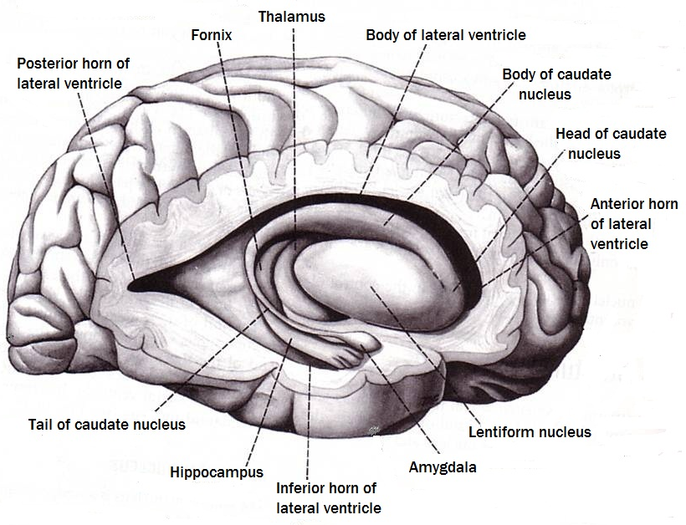
Relations of Caudate Nucleus to lateral ventricle

Slide 9
Lentiform Nucleus
A three sided, wedge-shaped mass of grey matter, with a convex outer surface and an apex which lies against the genu of the internal capsule
Divided into a:
Larger darker lateral portion called Putamen &
Smaller, lighter medial portion called Globus pallidus
External capsule

Slide 10
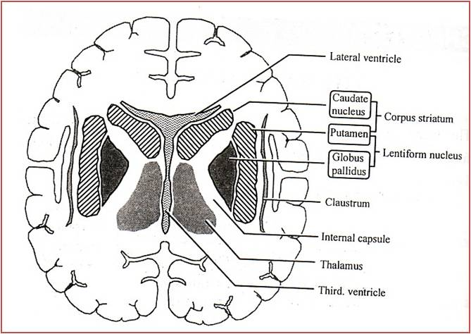
Putamen
Lies lateral to the internal capsule and globus pallidus
Separated from globus pallidus by a thin sheath of nerve fibers, the lateral medullary lamina
The white matter lateral to putamen is divided, by a sheath of grey matter, the claustrum, into two parts:
The part between the putamen and claustrum forms the external capsule*
between the claustrum and the cortex of insula (deep within the lateral fissure) forms the extreme capsule*.
*
*

Slide 11
Globus Pallidus
Lies medial to putamen, separated from it by lateral medullary lamina
Consists of two divisions, the lateral & the medial segments, separated by a thin sheath of nerve fibers, the medial medullary lamina.
The medial segment is similar, in terms of cytology and connections with the pars reticulata of substantia nigra

Slide 12
Connections of the Striatum
Striatum is the input portion of corpus striatum
Afferent Fibers
Corticostriatal
Thalamostriatal
Nigrostriatal
Brainstem striatal
1
2
I
Efferent Fibers
Striatopallidal
Striatonigral
4
II
3

Slide 13
Connections of the Globus Pallidus
Together with the pars reticulata of substatia nigra, the medial segment is regarded as output part of the basal ganglia.
Afferent Connections:
Striatopallidal fibers
Subthalamopallidal fibers: Originate from subthalamic nucleus of the diencephalon. Pass laterally through the internal capsule as subthalamic fasciculus and terminate in both segments of globus pallidus (more in the medial segment).
1
2
subthalamic fasciculus

Slide 14
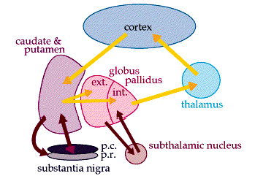
Connections of the Globus Pallidus cont’d
Efferent connections:
The two segments have different projections
The lateral segment principally projects to subthalamic nucleus via the subthalamic fascicle.
The medial segment together with the pars reticulata of substatia nigra projects:
primarily to the thalamus (pallidothalamic fibers)
to the pedunculo-pontine nucleus of the brain stem tegmentum (pallidotegmental fibers)
1
2
Midbrain
subthalamic fasciculus

Slide 15
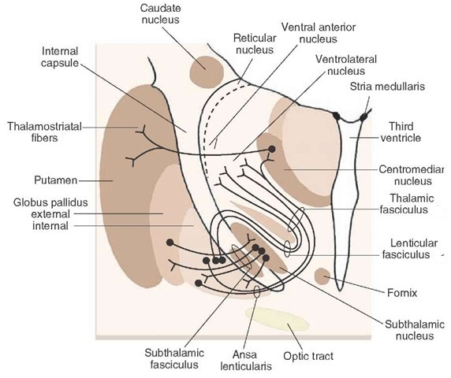
Pallidothalamic fibers: take two routes:
Pass around the anterior margin of the internal capsule as the ansa lenticularis
Pass through the internal capsule as the lenticular fasciculus.
Both set of fibers continue to course medially and then loop dorsally and laterally as thalamic fasciculus to enter the thalamus (VA, VL and centromedian nuclei).

Slide 16
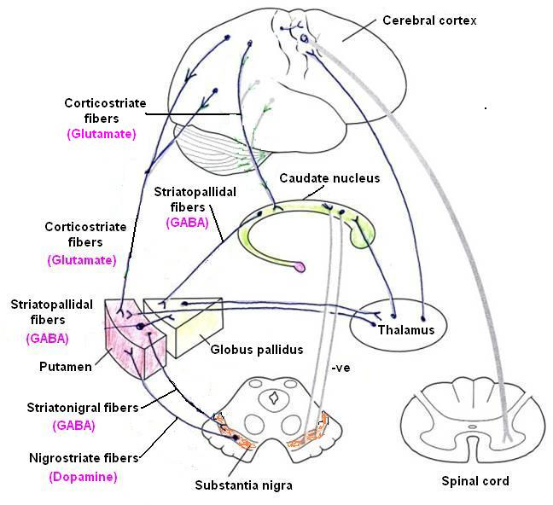
All of this circuitry is on the same side of the brain—uncrossed.
Thus, the basal ganglia affect function mediated by the ipsilateral motor cortex.
Since motor cortex controls the movements of the contralateral body, the basal ganglia affects movements of the contralateral side of the body.

Slide 17
Basal Ganglia Function - Dysfunction
Function
The corpus striatum assists in regulation of voluntary movement and learning of motor skills.
Their function is to facilitate behavior and movement that are required and appropriate, and inhibit unwanted or inappropriate movement.
Its dysfunction Does NOT cause paralysis, sensory loss or ataxia, but leads to:
Abnormal motor control: emergence of abnormal, involuntary movements (dyskinesias) e.g. tremors, chorea, athetosis, myoclonus, tic or dystonia..
Alteration in muscle tone (hypertonia /hypotonia).

Slide 18
Thank You

