Slide 1
* BRAIN STEM
EXTERNAL FEATURES
Prof. Ahmed Fathalla Ibrahim
Professor of Anatomy
College of Medicine
King Saud University
E-mail: ahmedfathala@hotmail.com

Slide 2
OBJECTIVES
At the end of the lecture, students should:
List the components of brain stem.
Describe the site of brain stem.
Describe the relations between components of brain stem & their relations to cerebellum.
Describe the external features of both ventral & dorsal surfaces of brain stem.
List cranial nerves emerging from brain stem.
Describe the site of emergence of each cranial nerve.

Slide 3
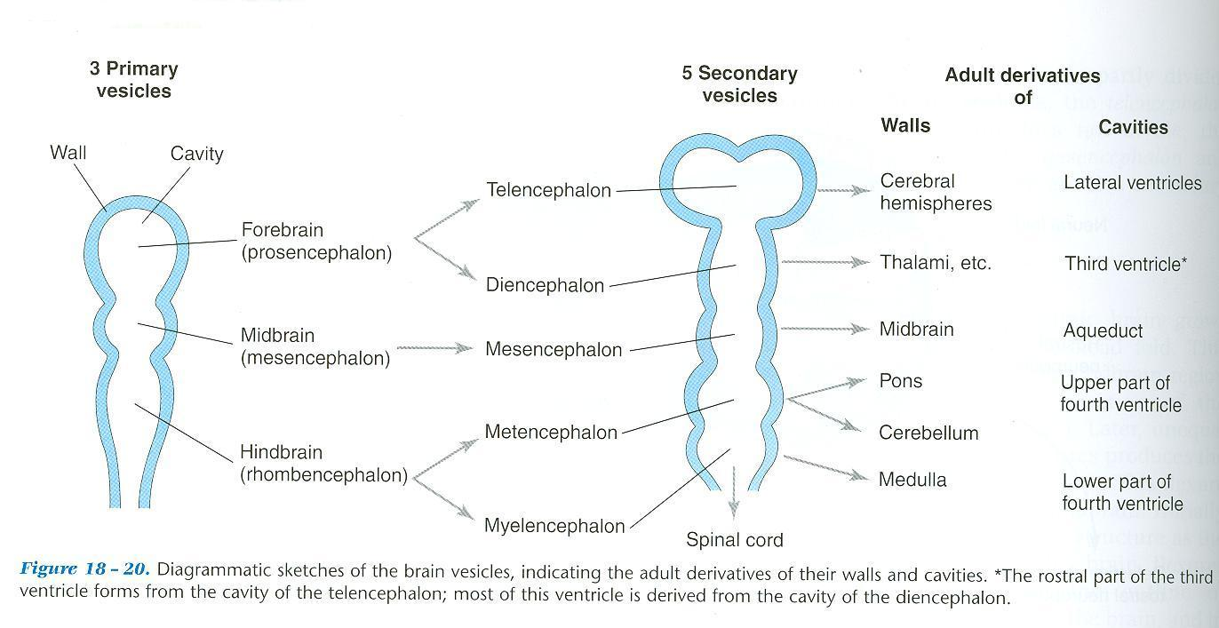
DEVELOPMENT OF BRAIN

Slide 4
DEVELOPMENT OF BRAIN
The brain develops from the cranial part of neural tube.
The cranial part divides into 3 parts:
*FOREBRAIN: subdivides into:
1-Two cerebral hemispheres (cavities: 2 lateral ventricles).
2-Diencephalon (cavity: 3rd ventricle) :
thalamus, hypothalamus, epithalamus & subthalamus
*MIDBRAIN (cavity: cerebral aqueduct).
*HINDBRAIN (cavity: 4th ventricle): subdivides into
1-Pons.
2-Cerebellum.
3- Medulla oblongata.

Slide 5
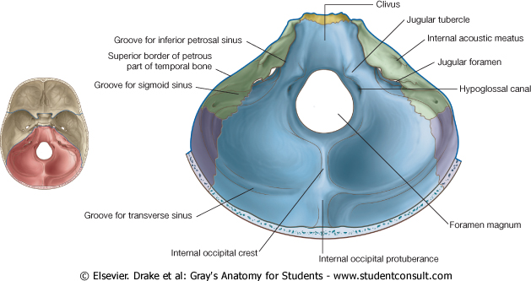
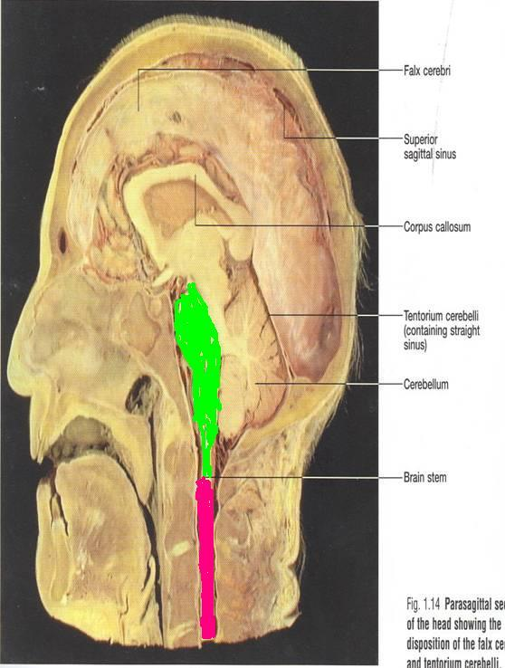
BRAIN STEM
SITE:
It lies on the basilar part of occipital bone (clivus).
PARTS: From above downwards:
Mid brain, pons & medulla oblongata
CONNECTIONS WITH CEREBELLUM:
Each part of brain stem is connected to cerebellum by cerebellar peduncles (superior, middle & inferior).

Slide 6
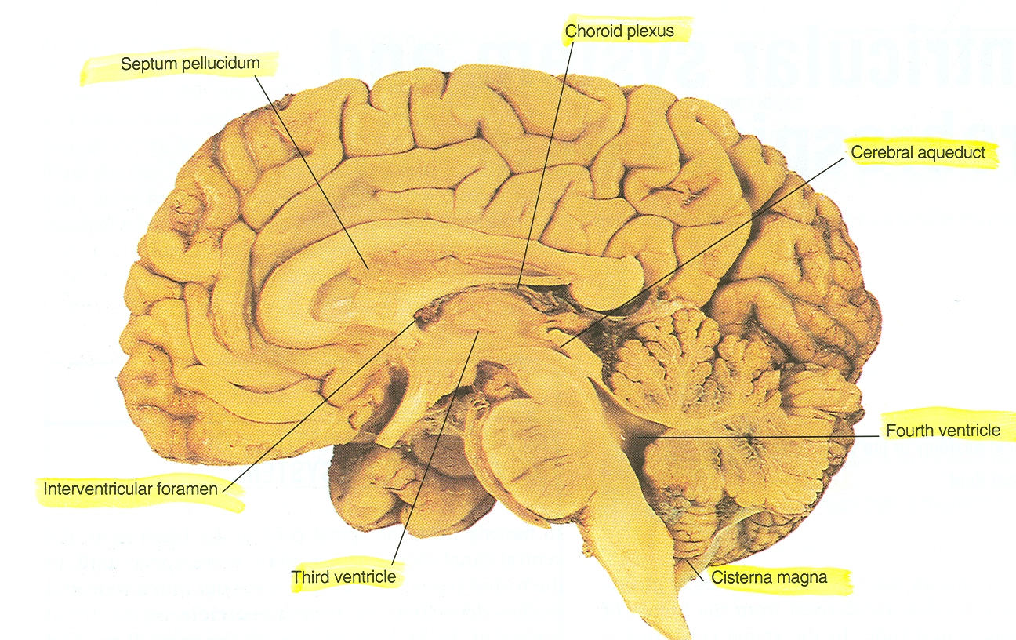
SAGITTAL SECTION OF BRAIN
Thalamus
Cerebellum
Superior
cerebellar
peduncle
Mid brain
Pons
Medulla

Slide 7
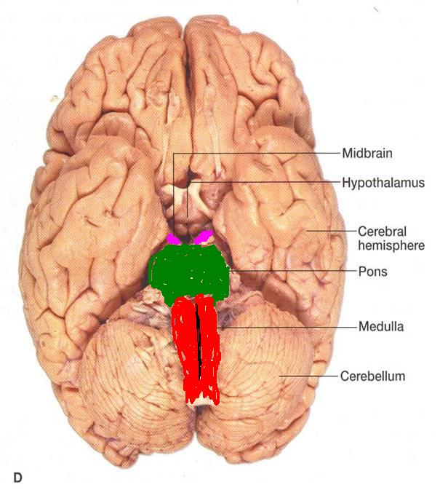
IMPORTANCE OF BRAIN STEM
Pathway of tracts between cerebral cortex & spinal cord.
Site of origin of nuclei of cranial nerves (from 3rd to 12th).
Site of emergence of cranial nerves (from 3rd to 12th).
Contains groups of nuclei & related fibers known as reticular formation responsible for: control of level of consciousness, perception of pain, regulation of cardiovascular & respiratory systems.

Slide 8
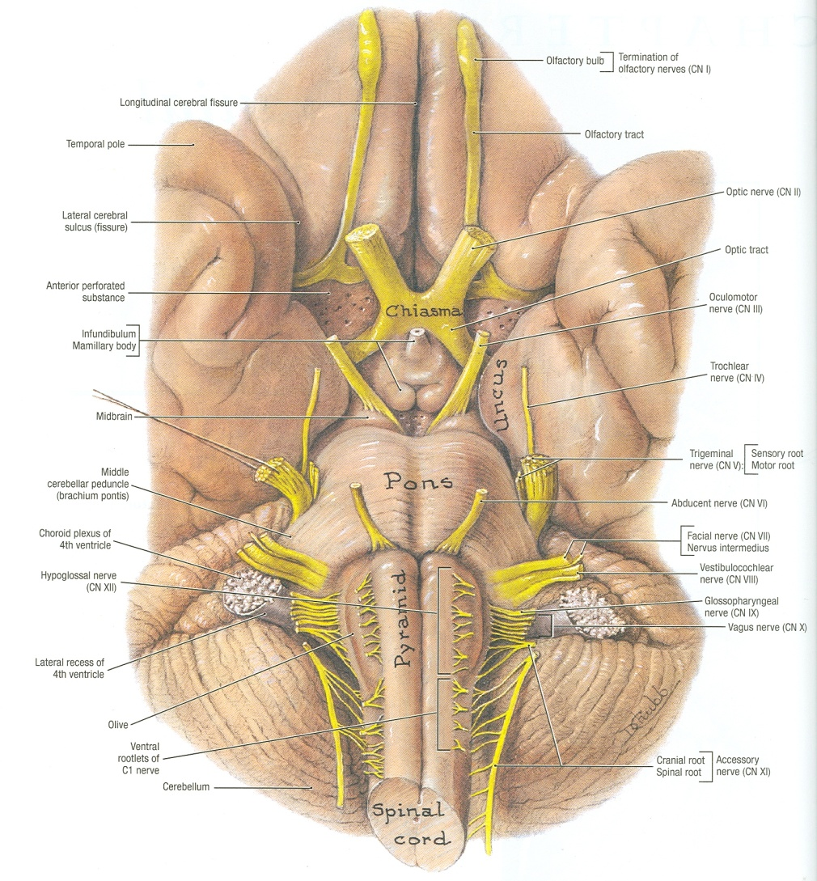
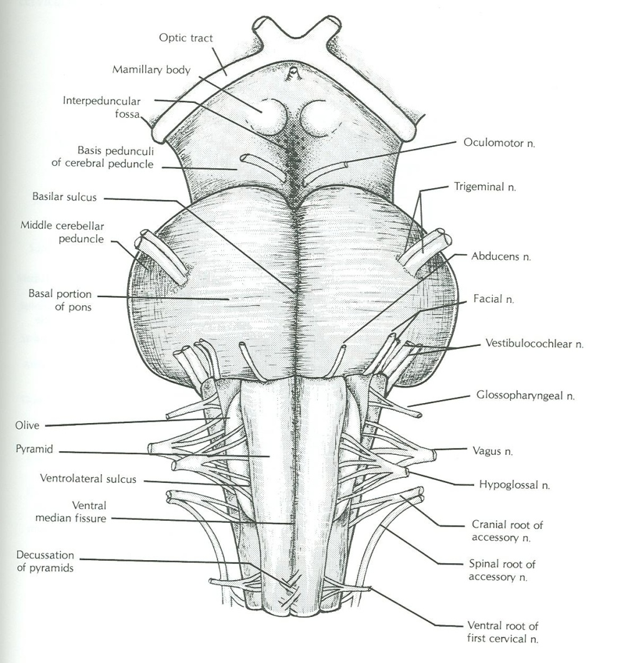
BRAIN STEM – VENTRAL SURFACE

Slide 9
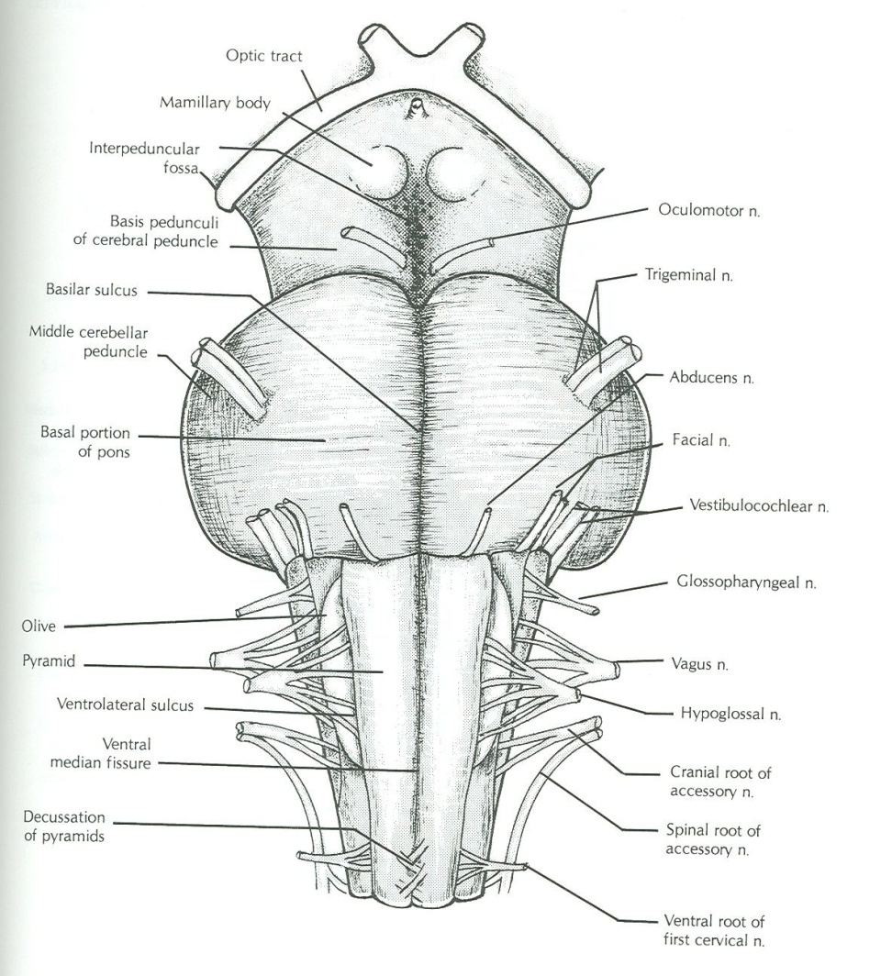
MEDULLA – VENTRAL SURFACE
Ventral median fissure:
It divides the medulla into 2 halves
Its lower part is masked by decussation of most of pyramidal (corticospinal) fibers (75%-90%).
Pyramid:
It lies on either side of ventral median fissure
It is an elevation produced by corticospinal tract.

Slide 10
MEDULLA – VENTRAL SURFACE
Olive:
It lies lateral to the pyramid.
It is an elevation produced by inferior olivary nucleus (important in control of movement).
Nerves emerging from Medulla (4 nerves):
Hypoglossal (12th): between pyramid & olive
Glossopharyngeal (9th), vagus (10th) & cranial part of accessory (11th): dorsolateral to olive (from above downwards)

Slide 11
PONS – VENTRAL SURFACE
Basilar sulcus:
It divides the pons into 2 halves.
It is occupied by basilar artery.
Transverse pontine (pontocerebellar) fibers:
It originate from pontine nuclei.
It cross midline & pass through contralateral middle cerebellar peduncle to enter the opposite cerebellar hemisphere.

Slide 12
PONS – VENTRAL SURFACE
Nerves emerging from Pons (4 nerves):
Trigeminal (5th): from the middle of ventrolateral aspect of pons, as 2 roots: a small medial motor root & a large lateral sensory root.
Abducent (6th): at junction between pons & pyramid.
Facial (7th) & vestibulocochlear (8th): at cerebellopontine angle (junction between medulla, pons & cerebellum). Both nerves emerge as 2 roots: from medial to lateral: motor root of 7th , sensory root of 7th , vestibular part of 8th & cochlear part of 8th

Slide 13
MID BRAIN – VENTRAL SURFACE
It is formed of a large column of descending fibers (crus cerebri or basis pedunculi), on either side.
The 2 crura cerebri are separated by a depression (interpeduncular fossa).
Nerve emerging from Midbrain (one):
Occulomotor (3rd): from medial aspect of crus cerebri.

Slide 14
SAGITTAL SECTION OF BRAIN

Slide 15
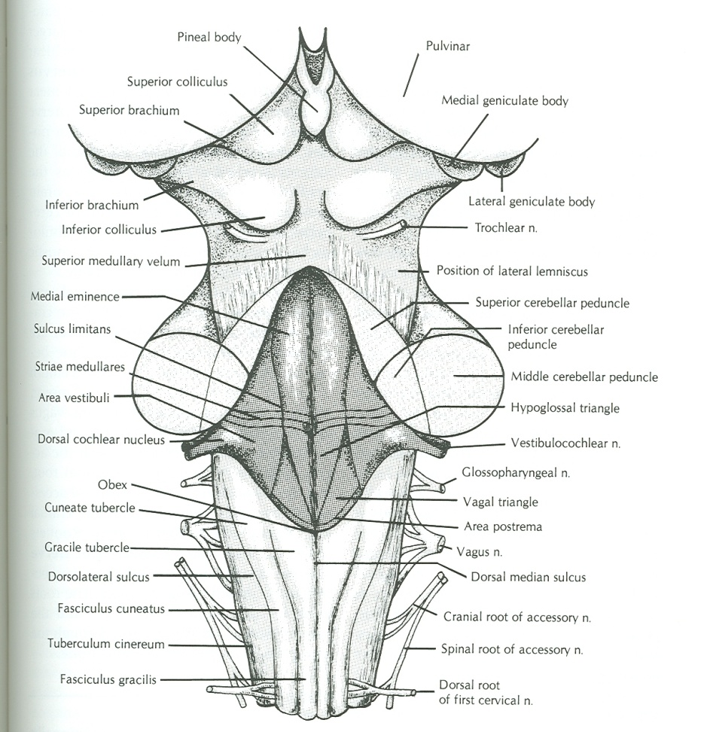
CLOSED MEDULLA
Cavity: central canal.
Composed of:
Dorsal median sulcus: divdes the closed medulla into 2 halves.
Fasciculus gracilis: on either side of dorsal median sulcus.
Gracile tubercle: an elevation produced at the upper part of fasciculus gracilis, marks the site of gracile nucleus.
Fasciculus cuneatus: on either side of fasciculus gracilis.
Cuneate tubercle: an elevation produced at the upper part of fasciculus cuneatus, marks the site of cuneate nucleus.

Slide 16
OPEN MEDULLA
Cavity: 4th ventricle
On either side, an inverted V-shaped sulcus divides the area into 3 parts (from medial to lateral):
Hypoglossal triangle: overlies hypoglossal nucleus.
Vagal triangle: overlies dorsal vagal nucleus.
Vestibular area: overlies vestibular nuclei.

Slide 17
PONS – DORSAL SURFACE
Separated from the medulla by an imaginary line passing between the caudal margins of middle cerebellar peduncle.
On either side, a sulcus divides the area into 2 parts (from medial to lateral):
Medial eminence: overlies abducent nucleus.
Vestibular area: overlies vestibular nuclei.

Slide 18
MID BRAIN – DORSAL SURFACE
Marked by 4 elevations:
Two superior colliculi: concerned with visual reflexes.
Two inferior colliculi: forms part of auditory pathway.
Nerve emerging from Midbrain (one):
Trochlear (4th): just caudal to inferior colliculus (The only cranial nerve emerging from dorsal surface of brain stem).

Slide 19
SUMMARY
The brain stem is composed (from above downwards) of: midbrain, pons & medulla oblongata which are continuous with each other, with diencephalon above & with spinal cord below.
The brain stem is connected with cerebellum through cerebellar peduncles.
The brain stem is the site of cranial nuclei, the pathway of important ascending & descending tracts & the site of emergence of cranial nerves (from 3rd to 12th).
Cranial nerves (with the exception of 4th) emerge from ventral surface of brain stem.

Slide 20
QUESTION 1
The cranial nerve that emerges from dorsal surface of midbrain is:
Occulomotor (3rd).
Trochlear (4th).
Abducent (6th).
Facial (7th).

Slide 21
QUESTION 2
Regarding the medulla oblongata:
The pyramid is lateral to olive.
The hypoglossal nerve is the most lateral nerve emerging from it.
The cuneate tubercle is lateral to gracile tubercle.
The cerebellum is connected to it by middle cerebellar peduncle.

Slide 22
THANK YOU

