Slide 1
Cranial Nerves XI-X (Glossopharyngeal & Vagus Nerves)
By
Dr. Jamela Elmedany
Dr. Essam Eldin Salama

Slide 2
Objectives
By the end of the lecture, the student will be able to:
Define the deep origin of both Glossopharyngeal and Vagus Nerves.
Locate the exit of each nerve from the brain stem.
Describe the course and distribution of each nerve .
List the branches of both nerves.

Slide 3
GLOSSOPHARYNGEAL NERVE
It is principally a sensory nerve with preganglionic parasympathetic and few motor fibers.
It has no real nucleus to itself. Instead it shares nuclei with VII and X.
The sensory information goes to the solitary nucleus.
The motor fibers; innervations of the stylopharyngeus muscle, comes from the nucleus ambiguus.
The parasympathetic fibers innervate the salivary glands, comes from the inferior salivatory nucleus

Slide 4
Glossopharyngeal nerve (Ⅸ)
Components of fibers
SVE fibers: originate from nucleus ambiguus, and supply stylopharygeus
GVE fibers: arise from inferior salivatory nucleus, relay in otic ganglion, the postganglionic fibers supply parotid gland.
SVA fibers: arise from the cells of inferior ganglion, their central processes terminate in nucleus of solitary tract, the peripheral processes supply the taste buds on posterior third of tongue.
GVA fibers: visceral sensation from mucosa of posterior third of tongue, pharynx, auditory tube and tympanic cavity, carotid sinus and glomus, end in nucleus of solitary tract.

Slide 5
Otic G

Slide 6
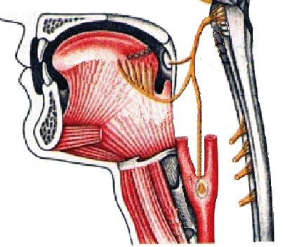
GLOSSOPHARYNGEAL NERVE
It arises from the ventral aspect of the medulla by a linear series of small rootlets, in groove between olive and inferior cerebellar peduncle.
It leaves the cranial cavity by passing through the jugular foramen in company with the Vagus , Acessory nerves and the Internal jugular vein.

Slide 7
COURSE
It Passes forwards between Internal jugular vein and External carotid artery.
Lies Deep to Styloid process.
Passes between external and internal carotid arteries at the posterior border of Stylopharyngeus then lateral to it.
It Reaches the pharynx by passing between middle and inferior constrictor, deep to Hyoglossus, where it breaks into terminal branches.

Slide 8
GANGLIA
It has two ganglia:
Superior ganglion: Small, with no branches.
Inferior ganglion:
Large and carries general sensations from pharynx, soft palate and fauces.

Slide 9
Communications
The Inferior ganglion with the Superior Cervical sympathetic ganglion.
The Superior ganglion with the Auricular Branch of Vagus.
The Trunk with the Facial nerve at the stylomastoid foramen

Slide 10
Branches.
Tympanic: relays in the otic ganglion and gives secretomotor to the parotid gland
Nerve to Stylopharyngeus muscle.
Pharyngeal: to the mucosa of pharynx .
Tonsillar.
Lingual : carries sensory branches, general and special ( taste) from the posterior third of the tongue.
Sensory branches from the carotid sinus and body (pressoreceptors and chemoreceptors).

Slide 11
Summary
It is principally a sensory nerve with preganglionic parasympathetic and few motor fibers.
It is attached to the brain stem by a linear series of small rootlets lateral to olive in rostral medulla.
Its afferent fibers conveys:
General sensation from: Pharynx, Post. 1/3 of the tongue, Eustachian tube, and middle ear.
Taste sensation of pharynx and 1/3 of the tongue
Chemoreseptors in carotid body and baroreseptors in carotid sinus.
Motor to stylopharyngeus
Preganglionic parasympathetic synapses in otic ganglion.

Slide 12
VAGUS NERVE (Ⅹ)
Deep nucleoli ;
Nucleus ambiguus;
Dorsal nucleus
Nucleus solitarius
Spinal tract of trigeminal

Slide 13
Vagus nerve (Ⅹ)
components of fibers
GVE fibers: originate from dorsal nucleus of vagus nerve, synapse in parasympathetic ganglion, short postganglionic fibers innervate cardiac muscles, smooth muscles and glands of viscera.
SVE fibers: originate from nucleus ambiguus, to muscles of pharynx and larynx.
GVA fibers: carry impulse from viscera in neck, thoracic and abdominal cavity to nucleus of solitary tract.
GSA fiber: sensation from auricle, external acoustic meatus and cerebral dura mater, spinal tract of trigeminal.

Slide 14
Vagus nerve (Ⅹ) deep nuclei

Slide 15
VAGUS NERVE
Its rootlets exit from medulla between olive and inferior cerebellar peduncle.
Leaves the skull through jugular foramen.
It occupies the posterior aspect of the carotid sheath between the internal jugular vein laterally and the internal and common carotid arteries medially.
It has two ganglia:
Superior ganglion in the jugular foramen
Inferior ganglion, just below the jugular foramen

Slide 16
Course
It lies on the prevertebral muscles and fascia.
Enters thorax through its inlet:
Right Vagus descends in front of the subclavian artery.
The Left Vagus descends between the left common carotid and subclavian arteries.
Passes through the Superior Mediastinum.

Slide 17
Communications
Superior ganglion with:
Inferior ganglion of glossopharyngeal nerve,
Superior cervical sympathetic ganglion&
Facial nerve.
Inferior ganglion with:
Cranial part of accessory nerve,
Hypoglossal nerve,
Superior cervical sympathetic ganglion.
1st cervical nerve.

Slide 18
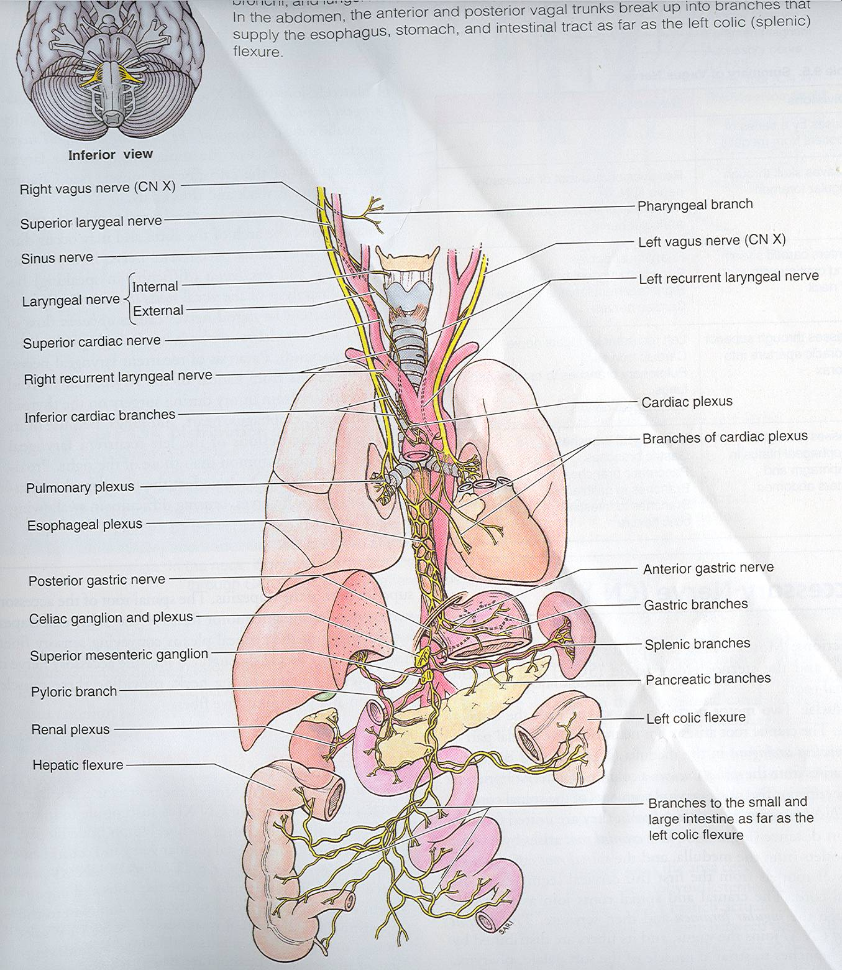
Branches
Meningeal : to the dura
Auricular nerve: to the external acoustic meatus and tympanic membrane.
Pharyngeal :to muscles and mucous membrane of the pharynx.
To carotid body
Superior Laryngeal: It divides into:
(1) Internal Laryngeal :
Supplies; the mucous membrane of the larynx as far as the vocal folds.
(2) External Laryngeal :
supplies the cricothyroid muscle.
Recurrent Laryngea : supplies all the muscles of the larynx (except cricothyroid).
The mucous membrane below the vocal folds.
The mucous membrane of the upper part of trachea.
Cardiac.

Slide 19
Summary
It is a mixed nerve.
It contains afferent, motor , and parasympatheyic fibers.
The afferent fibers convey information from:
esophagus, tympanic membrane , external auditory meatus and part of chonca of the middle ear. Ending in trigeminal sensory nucleus .
Chemoreseptors in aortic bodies and baroreseptors in aortic arch.
Receptors from thoracic abdominal and viscera, end in nucleus solitarius.
The motor fibers arise from ( nucleus ambiguus of medulla to innervate muscles of soft palate, pharynx, larynx, and upper part of esophagus.
The parasympathetic fibers originate from dorsal motor nucleus of vagus in medulla distributed to cardiovascular, respiratory, and gastrointestinal systems.

Slide 20
Clinical Tests Glossopharyngeal & Vagus nerves
The person is asked to swallow.
The person is asked to say ‘ah-h-h’ to check the movements of palate and uvula.
The ‘gag reflex’ is tested by touching the back of the throat by the tongue depressor.
The person is asked to speak to check the voice for hoarseness.

Slide 21
Clinical anatomy
Moto neuron disease ; is a degenerative disorder seen over 50 years
Tumors compressing the cranial nerves in their exiting foramina from the cranium via the skull base.
Glossopharyngeal nerve lesion is characterized by dysphonia, dysphagia and absence of the gag reflex.
Vagus nerve damage; causes hoarseness or loss of voice, impaired swallowing, GI dysfunction, blood pressure anomalies (with CN IX), fatal if both are damaged.

Slide 22
Thank you

