Slide 1
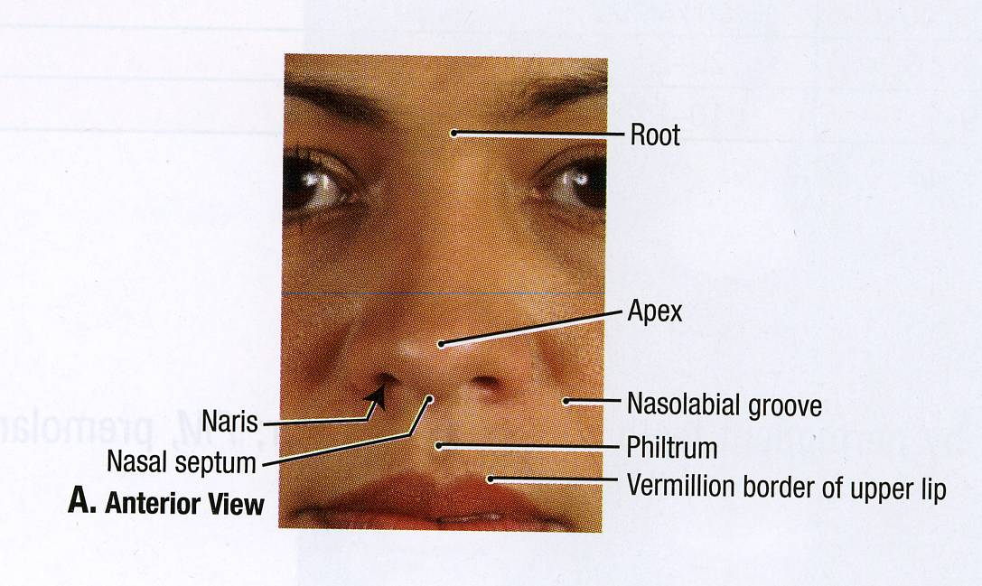
ANATOMY OF THE NOSE AND OLFACTORY NERVE

Slide 2
OBJECTIVES
By the end of this lecture the students should be able to:
Describe the structures forming the walls of the nasal cavity.
List the main structures draining into the lateral wall of the nasal cavity.
Differentiate between the respiratory and olfactory regions of the nasal cavity.
List the main sensory and blood supply of the nose.
Describe the olfactory pathway.

Slide 3
Nasal cavity
It extends from nostrils anteriorly to the choanae posteriorly.
Divided into right and left parts by the nasal septum.
Each part has:
Roof
Floor
Lateral and
Medial walls.

Slide 4
Floor
Formed by:
Nasal (upper)surface of the hard (bony) palate:
Palatine process of maxilla, anteriorly.
Horizontal plate of the palatine bone, posteriorly.

Slide 5
Roof
Formed by:
Body of sphenoid, posteriorly.
Cribriform plate of ethmoid, in the middle.
Frontal, and nasal bones. Anteriorly.

Slide 6
Medial wall
The nasal septum :
Vertical plate of ethmoid.
Septal cartilage.
Vomer.

Slide 7
Lateral wall
Marked by:
3 projections; (Nasal Conchae).
Superior, middle, and inferior Nasal Conchae
The space below each concha is called Meatus.
Superior, middle, and inferior meatus.
The space (fossa) above the superior concha is the Sphenoethmoidal recess.

Slide 8
PARANASAL SINUSES
They are cavities inside the:
Frontal bone
Sphenoid bone
Ethmoid bone
Maxilla
They are:
Lined with mucoperiosteum;
Filled with air;
Communicate with the nasal cavity.
Open in the lateral wall of the nasal cavity
Function:
Lighten he skull weight
Amplify the sound as we speak.

Slide 9
SINUSES opening in lateral wall
Sphenoethmoidal recess receives the opening of sphenoidal air sinus
Superior meatus; receives the opening of posterior ethmoidal sinus.
Middle meatus; contains bulla ethmoidalis and hiatus semilunaris,
Receives the openings of maxillary, frontal, & anterior, middle ethmoidal sinuses.
Inferior meatus; receives the opening of nasolacrimal duct.

Slide 10
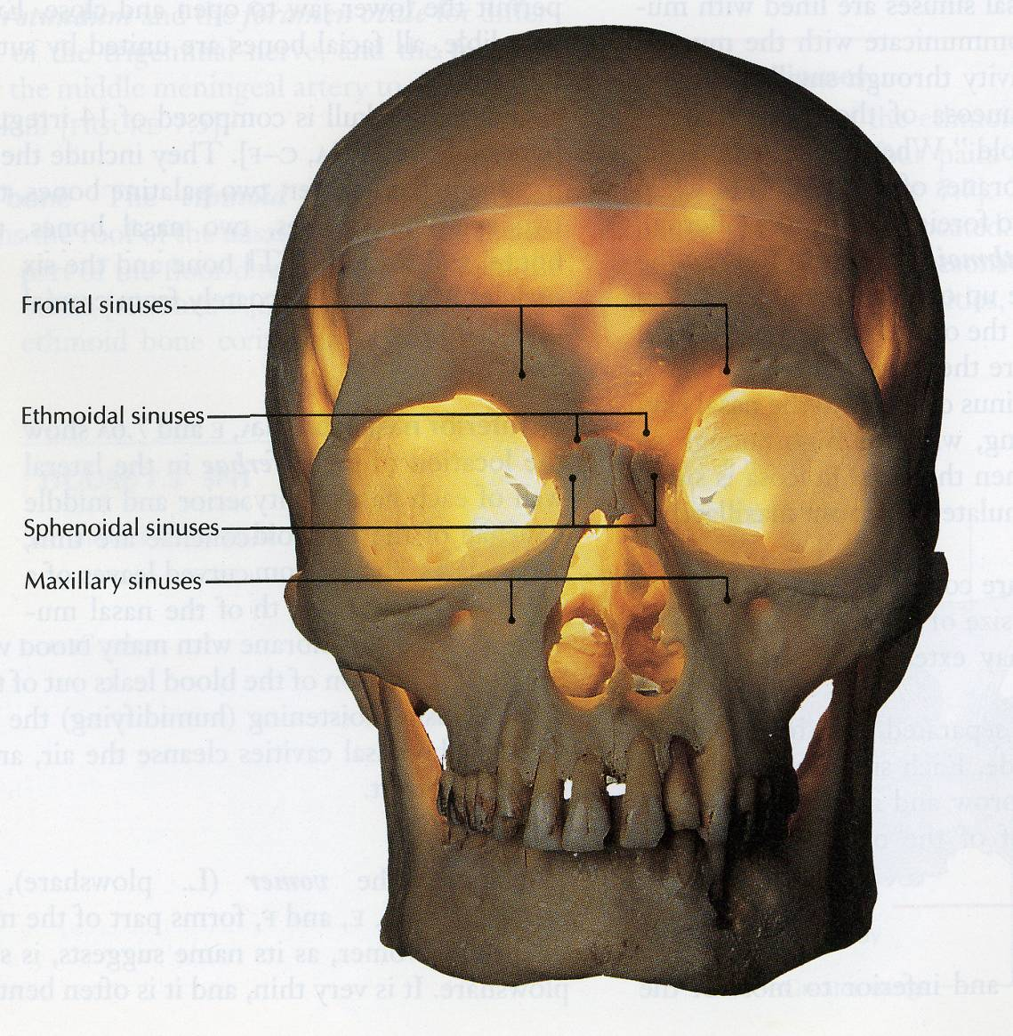
The mucosal lining of these sinuses is continuous with that in the nose and the throat.
So infection in these area tends to migrate into the sinuses causing sinusitis.
Note : all sinuses open into the middle meatus EXCEPT:
Sphenoidal sinus : in sphenoethmoidal recess.
Posterior ethmoidal sinus : in superior meatus.

Slide 11
Nasal mucosa
Olfactory :
It is delicate and contains olfactory nerve cells.
It is present in the roof, lateral wall and upper part of nasal cavity.
On the lateral wall, it lines the upper surface of the superior concha and the sphenoethmoidal recess.
On the medial wall, it lines the superior part of the nasal septum.

Slide 12
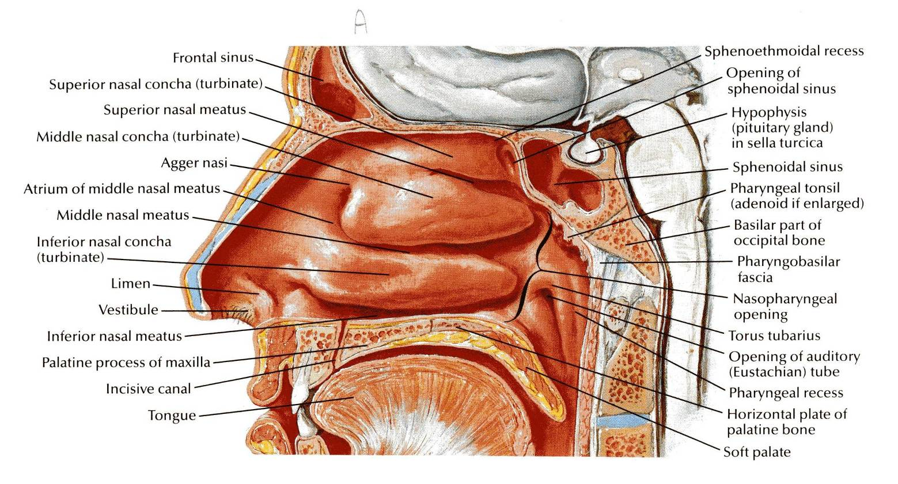
RESPIRATORY MUCOSA
It is thick, ciliated highly vascular and contains mucous glands & goblet cells
It lines the lower part of the nasal cavity (from skin of vestibule to the superior concha).
It functions to moisten, clean and warm the inspired air.
The air is moistened by the secretion of numerous serous glands.
It is cleaned by the removal of the dust particles by the ciliary action of the columnar ciliated epithelium that covers the mucosa.
The air is warmed by a submucous venous plexus.

Slide 13
Nerve supply
The nerves of General Sensation are derived from the Ophthalmic & Maxillary divisions of trigeminal nerve.
The anterior part is supplied by: Anterior Ethmoidal nerve.
The posterior part is supplied by:
1-Nasopalatine,
2- Nasal, and
3- Palatine branches of the pterygopalatine ganglion.

Slide 14
Olfactory pathway
1st neurone:
Olfactory receptors are specialized, ciliated nerve cells that lie in the olfactory epithelium.
The axons of these bipolar cells 12-20 fibers form the true olfactory nerves fibers.
Which passe through the cribriform plate of ethmoid.
They join the olfactory bulb

Slide 15
Preliminary processing of olfactory information is within the olfactory bulb, which contains interneurones and large Mitral cells; axons from the latter leave the bulb in the olfactory tract.

Slide 16
Olfactory pathway
2nd neurone:
It is formed by the Mitral cells of olfactory bulb.
The axons of these cells form the olfactory tract.
Each tract divides into 2 roots at the anterior perforated substance:
Lateral root:
Carries olfactory fibers to end in cortex of the Uncus & adjacent part of Hippocampal gyrus (center of smell).

Slide 17
Medial root :
crosses midline through anterior commissure and joins the uncrossed lateral root of opposite side.
It connects olfactory centers of 2 cerebral hemispheres.
So each olfactory centre receives smell sensation from both halves of nasal cavity.
NB. Olfactory pathway is the only sensory pathway which reaches the cerebral cortex without passing through the Thalamus.

Slide 18
Arterial supply
Sphenopalatine artery (maxillary) .
Ethmoidal anterior and posterior (ophthalmic).
Superior labial (facial).
Applied anatomy :
Rich arterial anastomosis on anterior & inferior part of nasal septum (Little’s area) is the most common site for epistaxis.

Slide 19
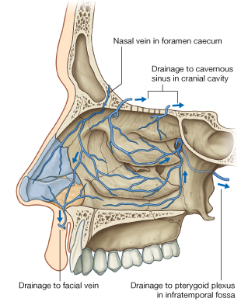
Venous drainage
Plexus in sub mucosa by veins accompanying the arteries

Slide 20
Lymph drainage
Submandibular nodes
Upper deep cervical nodes.

Slide 21
Thank you

