Slide 1
CEREBRUM
Dr. Zeenat Zaidi
Dr. Essam Eldin Salama

Slide 2
Objectives
At the end of the lecture, the student should be able to:
List the parts of the cerebral hemisphere (cortex, medulla, basal nuclei, lateral ventricle).
Describe the subdivision of a cerebral hemisphere into lobes.
List the important sulci and gyri of each lobe.
Describe different types of fibers in cerebral medulla (association, projection and commissural) and give example of each type.

Slide 3
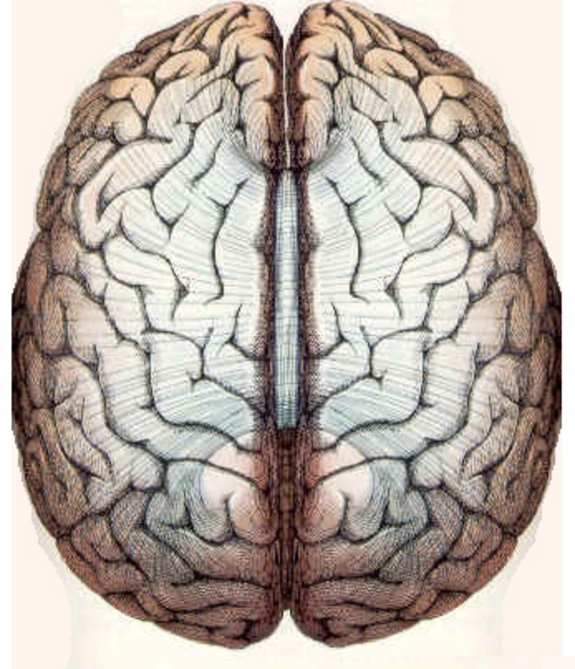
Cerebrum
Corpus callosum
Largest part of the forebrain
Divided into two halves, the cerebral hemipheres, which are separated by a deep median longitudinal fissure which lodges the falx cerebri.
In the depth of the fissure, the hemispheres are connected by a bundle of fibers called the corpus callosum.
Left hemisphere
Right hemisphere
Median longitudinal fissure

Slide 4
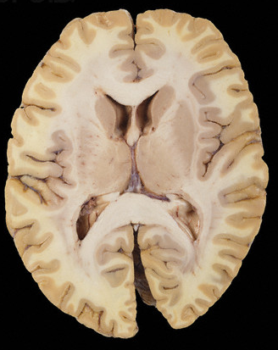
The structure of cerebral hemipheres includes:
  Superficial layer of grey matter, the cerebral cortex.
  Deeper to the cortex, axons running to and from the cells of the cortex form an extensive mass of white matter (WM).
  Burried within the white matter lie a number of nuclear masses (caudate, putamen, globus pallidus) collectively known as the basal ganglia.
  The cavity of hemisphere is called the lateral ventricle.
Cortex
Basal ganglia
WM
WM
Lateral ventricle

Slide 5
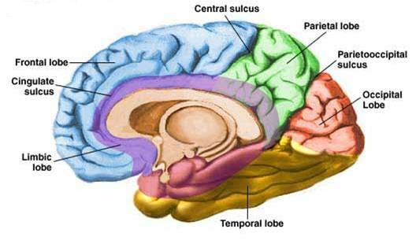
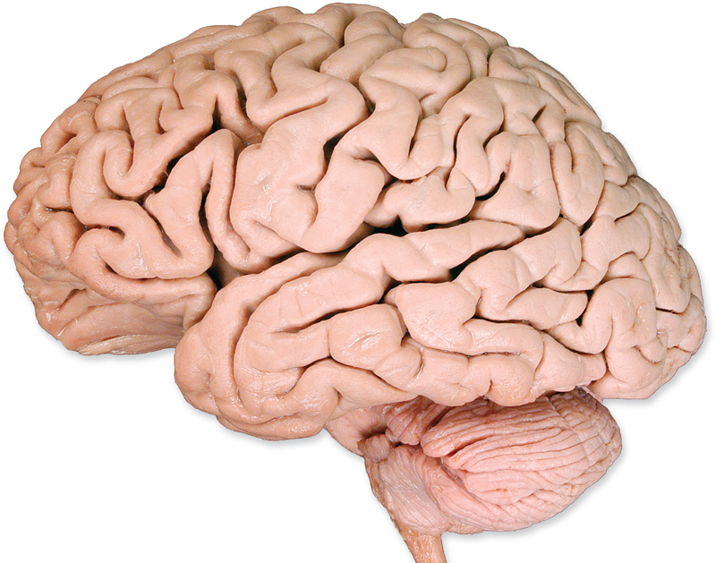
SURFACES
Medial
Superiolateral
Inferior
The superficial layer of grey matter is highly convoluted to form a complex pattern of ridges (gyri) and grooves (sulci).
This arrangement maximize the surface area of the cerebral cortex (about 70% is hidden within the depths of sulci).
S
g
g
g

Slide 6
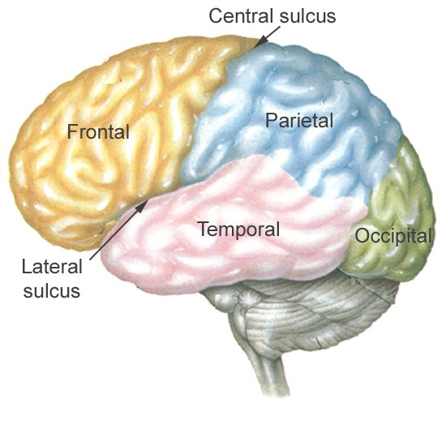
Three sulci, consistent in their position (central, lateral & parieto-occipital) are used to divide each hemisphere into lobes.
Each hemisphere is divide into FOUR lobes (named after overlying bones).
motor function, motivation, aggression, smell and mood
reception and evaluation of sensory information
visual processing
smell, hearing, memory and abstract thought

Slide 7
Functionally each hemisphere contains a ‘limbic lobe’ on the medial surface.
It is responsible for:
  Establishing emotional states
  Linking conscious intellectual functions with the unconscious autonomic functions
  Facilitating memory storage.

Slide 8
Frontal lobe:
Precentral gyrus.
Superior & inferior frontal sulci divide the lobe into superior, middle & inferior frontal gyri.
Parietal lobe:
Postcentral gyrus.
Intraparietal sulcus dividing the lobe into superior & inferior parietal lobules.
Superior , middle & inferior frontal gyri
Precentral gyrus
Postcentral gyrus
sfs
ifs
Inferior parietal lobule
Superior parietal lobule
Intraparietal sulcus

Slide 9
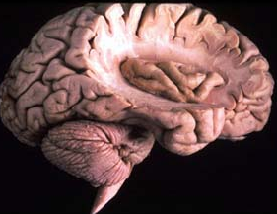
Superior, middle & inferior temporal gyri
Temporal lobe:
Superior & inferior temporal sulci giving rise to superior, middle & inferior temporal gyri.
Insula: the gyri in the depth of lateral fissure, covered by parts of frontal, parietal & temporal lobes called the opercula (removed in lower pic.).
sts
its
insula

Slide 10
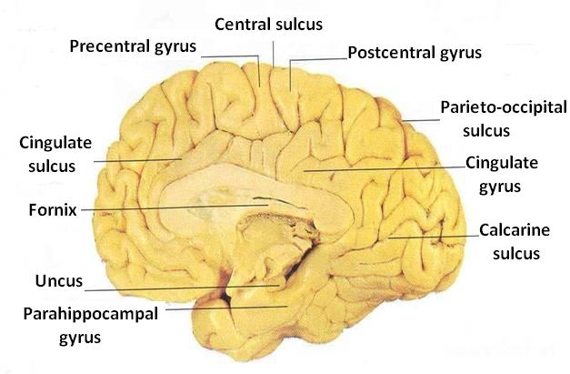
Medial Surface
Sulci: Parietooccipital, Calcarine, Cingulate
Gyri: Cingulate, Parahippocampal

Slide 11
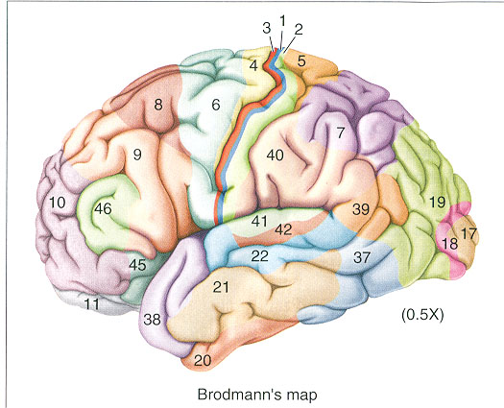
Brodmann produced a numbered, cytological map of cerebral cortex based upon its regional histological characteristics.
The basis of Brodmann's cortical localization is its subdivision into 'areas' with similar cellular and laminar structure.
Brodmann's numbering of these cortical locations has become one of the standard ways in which clinicians identify brain areas.

Slide 12
Functional Areas of the
Cerebral Cortex

Slide 13
Frontal Lobe
Premotor cortex: Located in the region immediately anterior to the precentral gyrus (Brodmann’s area 6).
Primary motor cortex: Located in precentral gyrus (Brodmann area 4).
Prefrontal cortex: Extensive region of the frontal lobe anterior to premotor area.
Broca’s (motor speech) area: Located in the inferior frontal gyrus of the dominant hemisphere, usually left (Brodmann’s area 44 & 45).
Frontal eye field: Located in the middle frontal gyrus immediately in front of premotor cortex (Brodmann’s area 8).

Slide 14
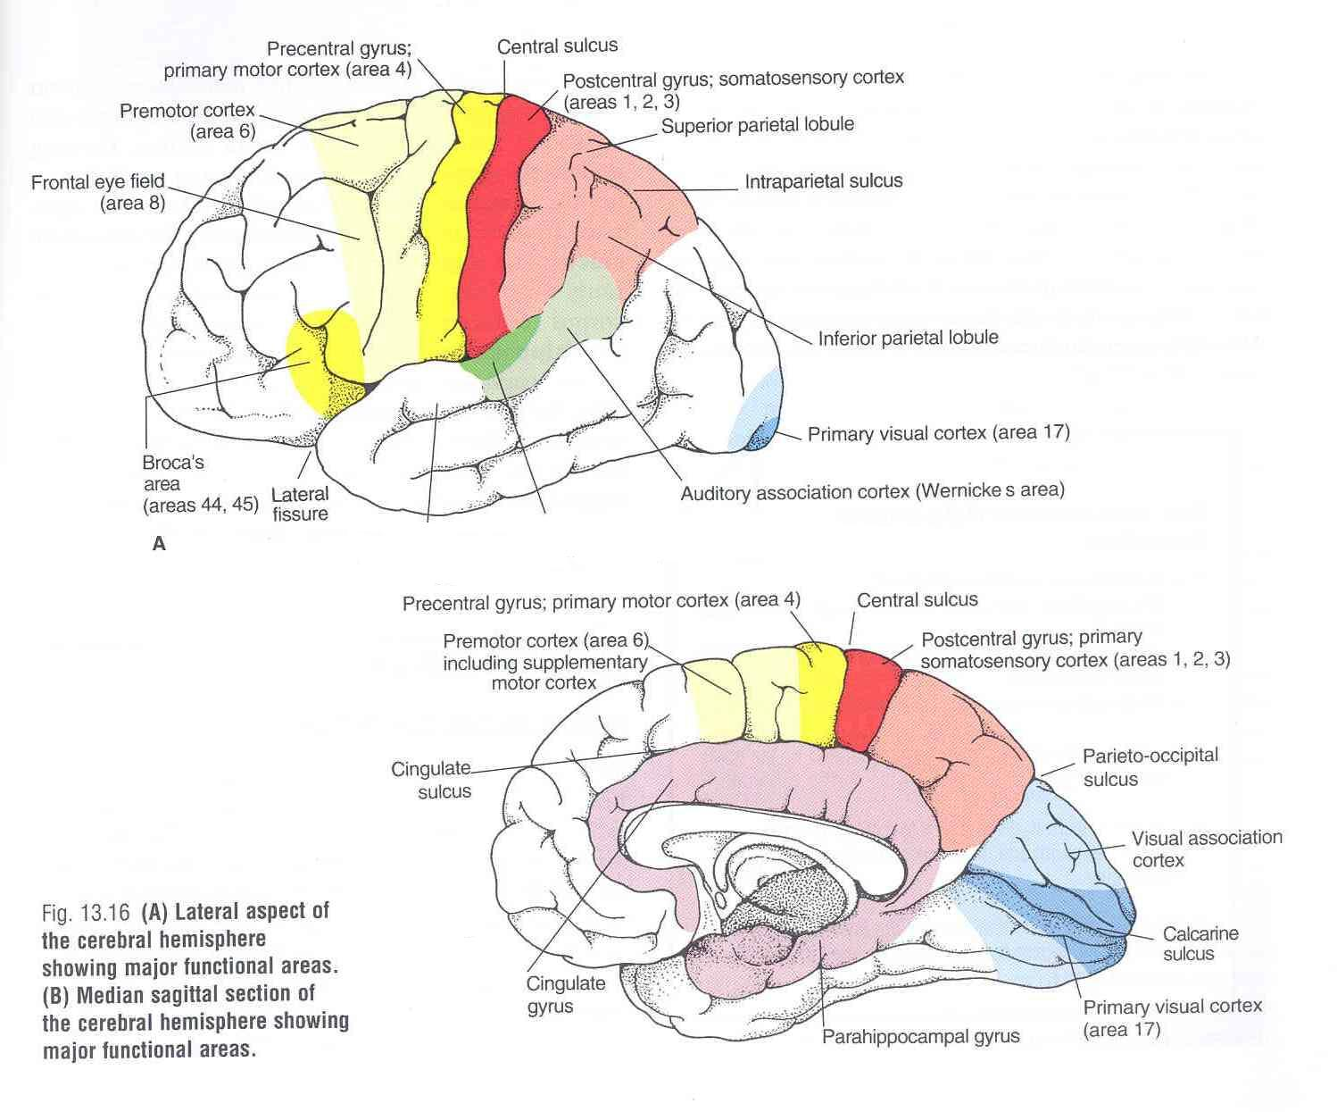
Parietal lobe
Primary somatosensory cortex: located in postcentral gyrus (Brodmann’s area 1, 2, 3).
Parietal association cortex: located posterior to primary somatosensory cortex.
Occipital lobe
Primary visual cortex: located on the medial surface of the hemisphere, in the gyri surrounding the calcarine sulcus (Brodmann’s area 17).
Visual association cortex: located around the primary visual cortex.

Slide 15
Temporal Lobe
Primary auditory cortex: located in the superior surface of the superior temporal gyrus (Brodmann’s area 41, 42)
Auditory association cortex: located immediately around the primary auditory cortex (also includes Wernick’s area)
Parahippocampal gyrus: located in the inferomedial part of temporal lobe. Deep to this gyrus lies the hippocampus and the amygdala, which are parts of limbic system

Slide 16
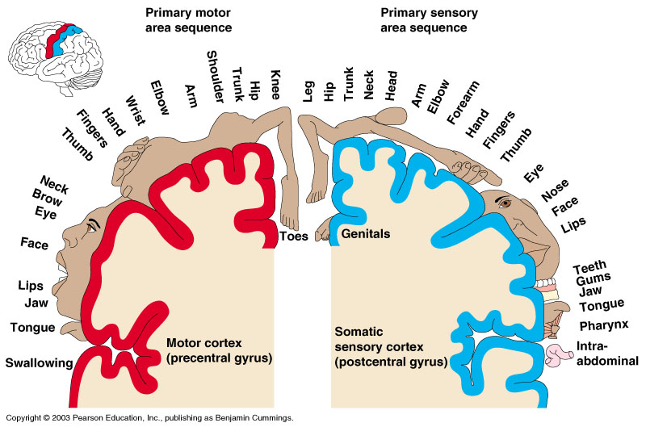

Slide 17
Language Area
Organized around the lateral fissure.
Broca’s area: concerned with expressive aspects of language.
Wernick’s area: responsible for comprehension of the spoken words.
Nearby regions of temporal lobe and parietal lobe (angular gyrus & supramarginal gyrus of the inferior parietal lobule) are important in naming, reading, writing, and calculation.

Slide 18
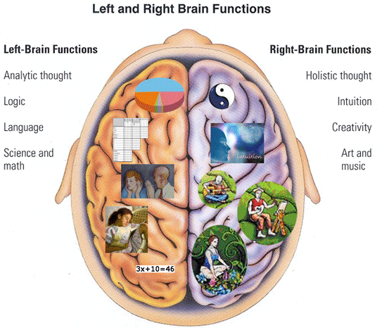
Hemispheric Dominance
The localization of speech centers & mathematical ability is the criterion for defining the dominant cerebral hemisphere.
In 96% of normal right-handed individuals and 70% of normal left-handed individuals, the left hemisphere contains the language centers. These are left hemisphere dominant.
Cerebral dominance becomes established during the first few years after birth.
Verbal Memory
Shape Memory
Hemispheres communicate via the corpus callosum

Slide 19
White Matter
Underlies the cortex
Contains:
    Nerve fibers.
    Neuroglia cells.
    Blood vessels.
The nerve fibers originate, terminate or sometimes both, within the cortex.

Slide 20
Depending on their origin & termination, these nerve fibers are classified into three types:
Association fibers: Unite different parts of the same hemisphere
Commissural fibers: Connect the corresponding regions of the two hemispheres
Projection fibers: Consisting of
Afferent fibers conveying impulses to the cerebral cortex.
Efferent fibers conveying impulses away from the cortex.

Slide 21
Association Fibers
Short association fibers
Unite different parts of the same hemisphere.
Are of two kinds:
  Those connecting adjacent gyri, short association fibers
  Those connecting more distant parts, long association fibers.
Long association fibers

Slide 22
Long Association Fibers
Uncinate fasciculus: connects frontal to temporal lobe.
Superior longitudinal fasciculus: connects the frontal, occipital, parietal, and temporal lobes.
Arcuate fasciculus: connect gyri in frontal to temporal lobes.
Inferior longitudinal fasciculus: connects occipital to temporal pole.
Cingulum: connects frontal & parietal lobes to the para-hippocampal gyrus and adjacent temporal gyri
2
5
3
1
4

Slide 23
Commissural Fibers
Connect the corresponding regions of the two hemispheres.
Include:
  Corpus callosum.
  Anterior commissure.
  Hippocampal commissure (commissure of fornix).
  Posterior commissure.

Slide 24
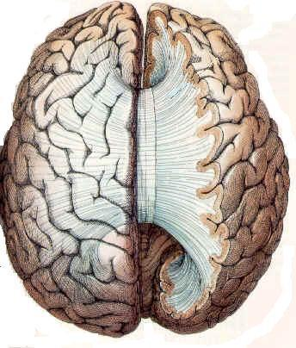
Corpus Callosum
Connects the corresponding regions of the two hemispheres except the temporal lobes, that are connected by anterior commissure.
It is shorter craniocaudally than is the hemisphere.
The callosal fibers linking the frontal poles, curve forward forming anterior forceps (forceps minor).
The callosal fibers linking the occipital poles, curve backward forming posterior forceps (forceps major).
Anterior forceps
F
C
C
P
O
Posterior forceps

Slide 25
Parts of Corpus Callosum
Body
Genu
Splenium
Rostrum

Slide 26
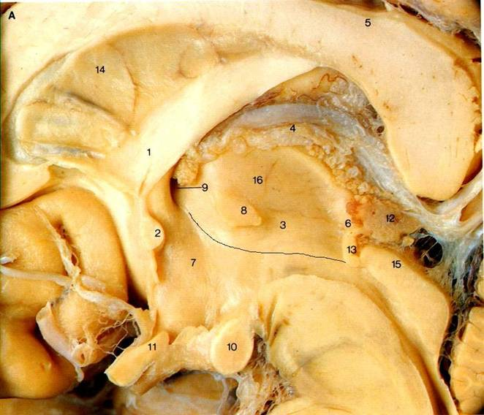
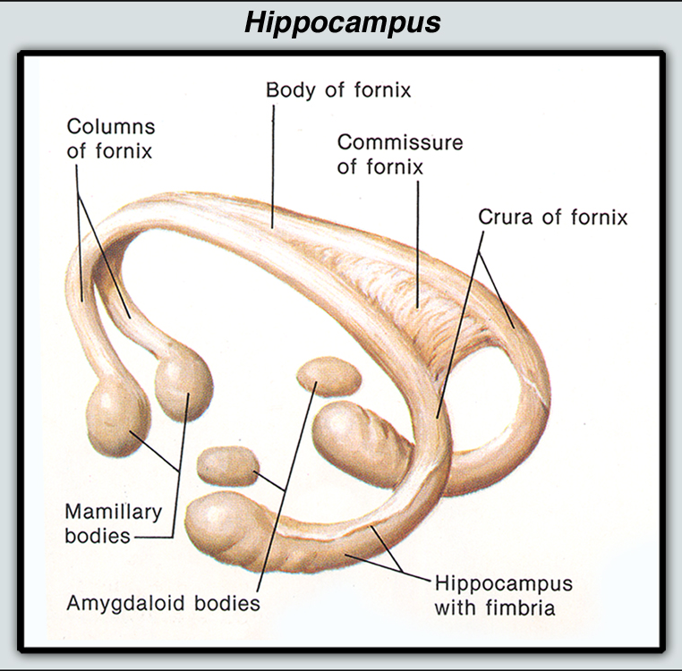
Anterior commissure: connects the inferior and middle temporal gyri & the olfactory regions of the two hemispheres
Posterior Commissure: connects the left and right midbrain Important in the bilateral pupillary reflex
Hippocampal Commissure: connect the two hippocampi with each other

Slide 27
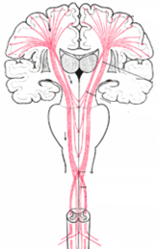
Projection Fibers
Consist of:
  Afferent fibers conveying impulses to the cerebral cortex.
  Efferent fibers conveying impulses away from the cortex.
Deeper to the cortex, these fibers are arranged radially as the corona radiata.
Then the fibers converge downward, form internal capsule, between thalamus and basal ganglia.
Continue in the crus cerebri of the midbrain, basilar part of pons, & pyramid of medulla oblongata.
corona radiata
Internal capsule
crus cerebri
pyramidal decussation

Slide 28
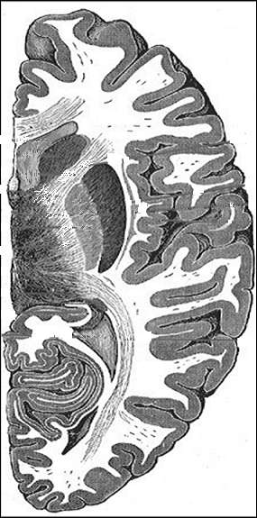
Internal Capsule
Caudate n.
Bundle of projection fibers, passes through the interval between the thalamus and the basal ganglia (caudate & lentiform nuclei)
Lentiform n.
Thalamus

Slide 29
Has 5 parts:
  Anterior limb: Thalamocortical & Frontopontine fibers
  Genu: Corticobulbar fibers
  Posterior limb: Corticospinal, Corticobulbar & Thalamocortical fibers.
  Retrolenticular part: Geniculocalcarine fibers
  Sublenticular part: Geniculo-temporal fibers.
C
1
2
L
3
T
4

Slide 30
Thank U & Good Luck

