Slide 1
Alzheimer Disease
Dr. Sumbul Fatma
Biochemistry Unit
Department of Pathology

Slide 2
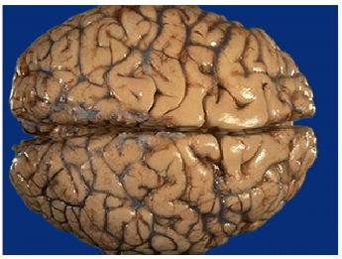
Objectives
Upon completion of this lecture, students should be able to:
Have an overview of neurodegenerative disorders
Understand the role of amyloid beta 40-42 residue peptide in Alzheimer’s disease
Get an idea of the diagnosis and therapeutic approach to treat these disorders

Slide 3
Neurodegenerative Diseases
Diseases of gray matter characterized principally by the progressive loss of neurons
The pattern of neuronal loss is selective affecting one or more groups of neurons leaving the others intact
The diseases arise without any clear inciting event in patients without previous neurological deficits

Slide 4
Neurodegenerative Diseases
A common theme is the development of protein aggregates that are resistant to normal cellular mechanisms of degradation
The aggregated proteins are generally cytotoxic

Slide 5
Alzheimer Disease
A degenerative disease with the prominent involvement of the cerebral cortex
Its principal clinical manifestation is dementia
Dementia is the progressive loss of cognitive function independent of the state of attention
Patients rarely become symptomatic before 50yrs of age, but the incidence of disease rises with age

Slide 6
Alzheimer Disease
Clinical Picture:
gradual impairment of higher intellectual function
alterations in mood and behavior
Progressive disorientation
memory loss
In 5-10 yrs, the patient becomes profoundly disabled, mute and immobile
Most cases are sporadic
At least 5% to 10% are familial

Slide 7
Diagnosis
Combination of clinical assessment and radiologic methods
For definitive diagnosis, pathologic examination of brain tissue is necessary
The major microscopic abnormalities of Alzheimer disease are neuritic plaques, neurofibrillary tangles, and amyloid angiopathy

Slide 8
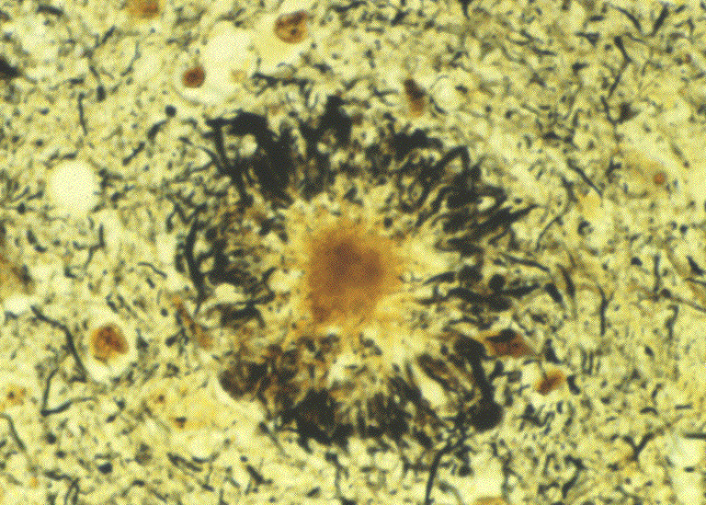
Neuritic Plaques
Are extracellular spherical structures (20-200um in diameter)
Contain paired helical filaments as well as synaptic vesicles and abnormal mitochondria
The amyloid core contains several abnormal proteins
The dominant component of the plaque core is Aβ, a peptide derived from a larger molecule, amyloid precursor protein (APP)

Slide 9
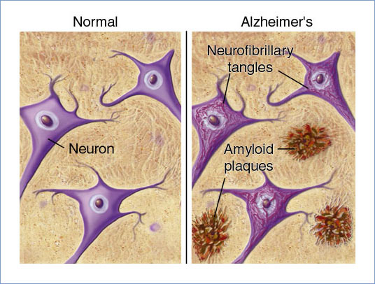
Neuritic Plaques contd..
The two dominant species of Aβ, called Aβ₄₀ and Aβ₄₂ share an N-terminus and differ in length by two amino acids.
Other proteins present in the plaque in lesser abundance are
Components of the compliment cascade
Proinflammatory cytokines
α1-antichymotrypsin
apolipoproteins

Slide 10
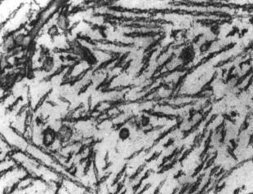
Neurofibrillary tangles
Intracellular bundles of filaments in the cytoplasm of neurons that displace or encircle the nucleus
A major component of filaments is abnormally hyperphosphorylated forms of the protein tau (a microtubule associated protein that enhances microtubule assembly)

Slide 11
Amyloid Angiopathy
Amyloid proteins build up on the walls of the arteries in the brain
The condition increases the risk of hemorrhagic stroke and dementia
An almost invariable accompaniment of Alzheimer disease but not specific for Alzheimer

Slide 12
Pathogenesis of Alzheimer
Still being intensively studied
The number of neurofibrillar tangles correlates better with the degree of dementia than does the number of neuritic plaques

Slide 13
Pathogenesis of Alzheimer
The best correlation of severity of dementia appears to be with loss of synapses
The Aβ peptide forms β-pleated sheets, aggregates readily and is resistant to degrdation and elicits an inflammatory response from astrocytes and microglia and can be directly neurotoxic

Slide 14
Aβ is a critical molecule in the pathogenesis of Alzheimer disease

Slide 15
Aβ Peptides
Are derived through the processing of APP
APP is a protein of uncertain cellular function
It is synthesized with a single transmembrane domain and expressed on the cell surface

Slide 16
Two pathways for APP processing
β α γ
β-peptide (Aβ)
Alpha-secretase
pathway
TM
Beta-secretase
pathway
APP_{Sα}
neurotrophic
α-stub
APP_{Sβ}
β-stub
γ-secretase
γ-secretase
γ-secretase
p3
Aβ40
Aβ42
neurotoxic
Notes:
6

Slide 17
Mechanism of amyloid generation
APP has potential cleavage sites for three distinct enzymes (α, β, and γ-secretases)
The Aβ domain extends from the extracellular side of protein into the transmembrane domain
When APP is cleaved by α-secretase , subsequent cleavage by γ-secretase does not yield Aβ

Slide 18
Mechanism of amyloid generation contd..
Cleavege by β -secretase , followed by γ-secretase results in production of Aβ
Aβ can then aggregate and form fibrils

Slide 20
Accumulation of Aβ
Accumulation of Aβ has several effects on neurons and neuronal function:
Small aggregates of Aβ can alter neurotransmission, and the aggregates can be toxic to neurons and synaptic endings
Larger deposits, in the form of plaques, also lead to neuronal death, elicit a local inflammatory response that can result in further cell injury

Slide 21
Tau Protein
Hyperphosphorylation of the microtubule binding protein “tau”
With this increased level of phosphorylation, tau redistributes within the neuron from the axon into dendrites and cell body and aggregates into tangles
This process also results in neuronal dysfunction and cell death

Slide 22
Genetics of AD
Mutations in APP or in components of γ-secretase (presenilin-1 or presenilin-2) lead to early onset familial Alzheimer disease by increasing the rate at which Aβ accumulates
Alzheimer disease occurs in almost all patients with trisomy 21 (Down syndrome) who survive beyond 45 years (due to APP gene dosage effects)
The gene encoding APP is located on chromosome 21

Slide 23
Genetics of AD
The search for genes associated with typical, sporadic Alzheimer disease is beginning to identify genetic associations that may provide new clues about the pathogenesis of the disease

Slide 24
Genetics of AD
Chromosome | Gene | Consequences
21 | Amyloid Precursor Protein (APP) | Early onset FAD Increased Aβ production
14 | Presenilin-1 (PS1) | Early onset FAD Increased Aβ production
1 | Presenilin-2 (PS2) | Early onset FAD Increased Aβ production
19 | Apolipoprotein E (ApoE) | Increased risk for development of AD Decreased age at onset of AD

Slide 25
Treatment of AD
Currently, no effective treatment for AD
regulating neurotransmitter activity e.g., Enhancing cholinergic function improves AD
Epidemiological studies showed that treatment with NSAIDs decreases the risk for developing AD. Unfortunately, clinical trials of NSAIDs in AD patients have not been very fruitful.

Slide 26
Treatment of AD contd..
Proinflammatory responses may be countered through polyphenols (flavonoids). Supplementation of these natural compounds may provide a new therapeutic line of approach to this brain disorder.

Slide 27
Treatment of AD contd..
Cellular therapies using stem cells offer great promise for the treatment of AD
Stem cells offer
1. Cellular replacement and/or provide environmental enrichment to attenuate
neurodegeneration.
2. Neurotrophic support to remaining cells or prevent the production or accumulation of toxic factors that harm neurons.

Slide 28
Continued Research of AD
The small aggregates of Aβ as well as larger fibrils are directly neurotoxic
They can elicit oxidative damage and alterations in calcium homeostasis
But how Aβ is related to neurodegenration of AD and how it is linked to tangles and hyperphosphorylation of tau all remain open questions

Slide 29
Take home message
Neurodegeneration is the progressive loss of structure or function of neurons, including death of neurons.
Extracellular deposition of insoluble fibrous aggregates known as amyloid in certain areas of neural tissue
The deposition of amyloid interferes with normal cellular function, resulting in cell death and eventual organ failure.
The dominant component of amyloid plaque that accumulates in Alzheimer disease is amyloid β 42(Aβ42) Peptide.

Slide 30
Further reading
Illustrated Reviews of Biochemistry by Lippincott 4th edition (pp21-22 ).
Fundamentals of Biochemistry by Voett and Voett (pp 170-174)
Stem Cell Technology for Neurodegenerative Diseases. Ann Neurol. 2011 September ; 70(3): 353–361.
A Review: Inflammatory Process in Alzheimer’s Disease, Role of Cytokines. The ScientificWorld Journal, Volume 2012, Article ID 756357,

