Slide 1
Viral infections of CNS
(CNS Block , Microbiology : 2011 )
By: Dr.Malak M. El-Hazmi
Dr. Abdulkarim Alhetheel

Slide 2
Virus neurological diseases:
Acute viral infections of the CNS.
Meningitis, paralysis & encephalitis.
Chronic virus neurological diseases.
SSPE, PML, C-J disease, tropical spastic paraparesis, HIV dementia.
Neurological diseases precipitated by viral infections.
Reye’s syndrome, Guillian-Barré syndrome.

Slide 3
OBJECTIVES;
Acute viral infections of the CNS.
aseptic meningitis & paralysis ;
enteroviruses & polioviruses
encephalitis;
herpes simplex virus
Rabies virus.
arboviruses (West Nile virus) .
structure
Epidemiology
Pathogenesis
clinical presentations
Lab diagnosis
Treatment & prevention

Slide 4
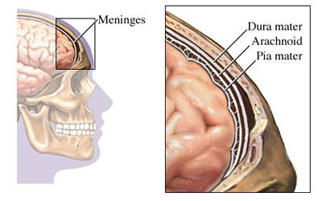
Meningitis
Caused by:
Infectious agents ;
bacteria
viruses
fungi
protozoa
Non-infectious agents.

Slide 5
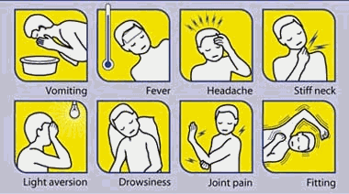
Viral Meningitis
Bacterial Meningitis
Caused by bacteria
Quite severe and may result in
a) brain damage
b) hearing loss
c) learning disability
It would also causes death!
Aseptic meningitis
Caused by virus.
Less severe
Resolves without specific
treatment within a week or two

Slide 6
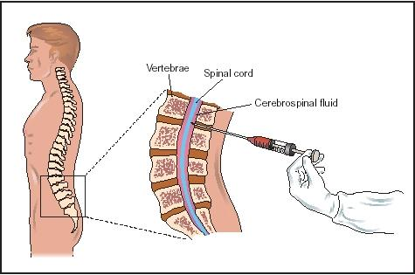
Cerebrospinal fluid (CSF) analysis ;
 | Normal | Aseptic meningitis | Septic meningitis
Colour | Clear | Clear | Cloudy
Cells/mm³ | < 5 | increase 100-1000 Lymphocytes | High/v. high 200-20,000 Neutrophils
Glucose mg/dl | 45-85 | Normal* | Low<45
Protein mg/dl | 15-45 | Normal/high 50-100 | High>100
Causes |  | Viruses* , others | Bacteria

Slide 7
Viral Meningitis (Aseptic meningitis)
Etiological Agents:
Enteroviruses .**
Other :
Mumps virus .
Arboviruses.
Herpes viruses.
Human Immunodeficiency Virus.
Lymphocytic choriomeningitis virus.

Slide 8
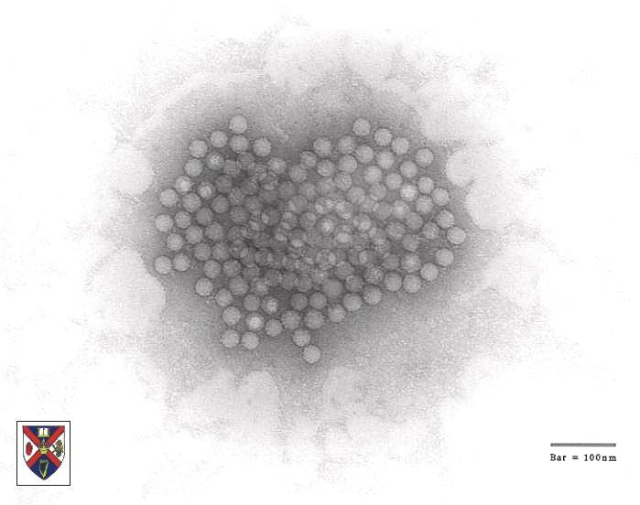
Enteroviruses
- Picornaviridae
Include ;
Poliovirus(1, 2&3 types)
Coxsackieviruses (A&B)
Echoviruses
Enteroviruses (68-71)
Nonenveloped , icosahedral , ss (+) RNA

Slide 9
Epidemiology
Reservoir : Human
Spread :
Fecal - oral route (mainly)
Inhalation of Infectious aerosols
(Crowded, Poor hygiene & Sanitation)
Age : children > adults
Seasonal distribution:
summer & fall

Slide 10
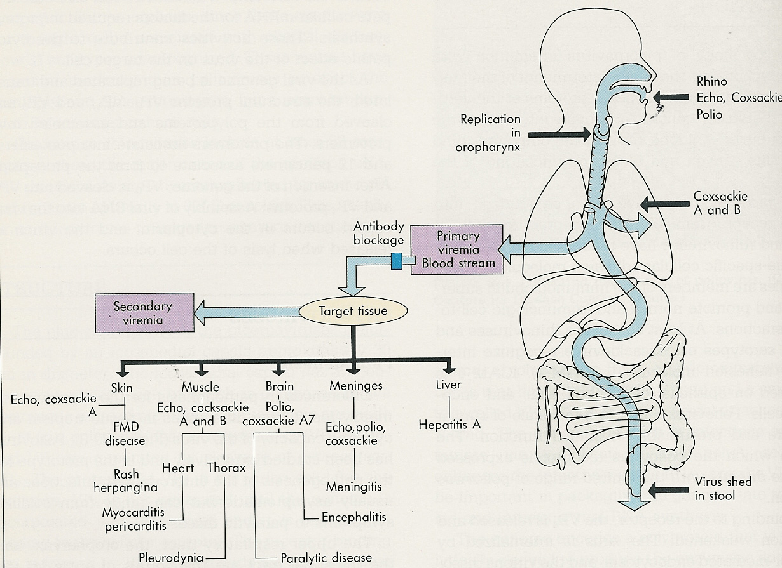
Pathogenesis
HFM
Echo,cox

Slide 11
Enteroviral infections
Asymptomatic Infections*
Diseases;
Neurologic Diseases | Poliovirus Types 1-3 | GP A COX. Types 1-24 | GP B COX. Types 1-6 | Echovirus Types 1-34 | Enterovirus Types 68-71
Aseptic meningitis Paralysis Encephalitis | 1-3 1-3 | Many 7,9 2,5-7,9 | 1-6 2-5 1-5 | Many 2,4,6,9,11,30 2,6,9,19 | 71 70,71 70,71
2-Cardiac and muscular;
Pleurodynia (epidemic myalgia)
Myocarditis, pericarditis
3- Skin and mucosa infections;
Herpangina
Hand-foot-and-mouth disease
Exanthems
3-Acute hemorrhagic conjunctivitis
4-Respiratory tract infections.
5-Others

Slide 12
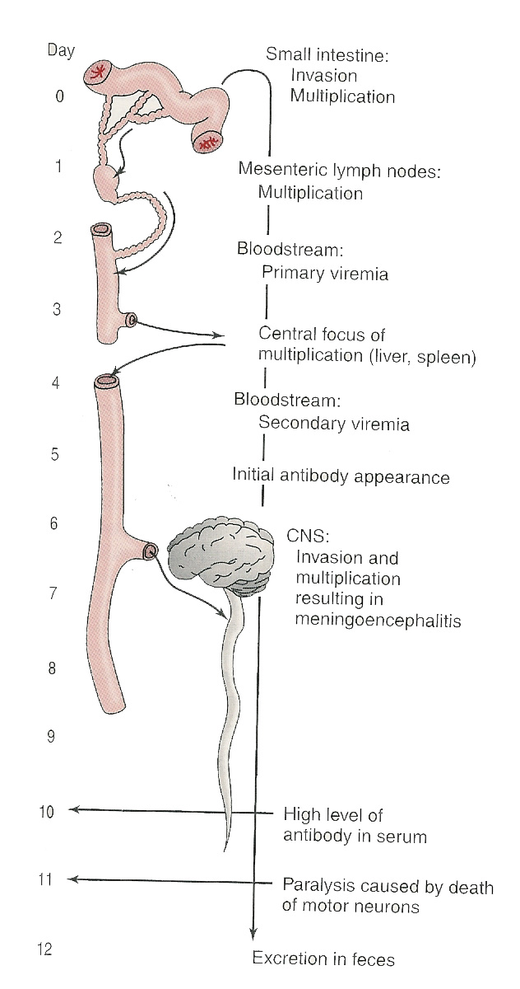
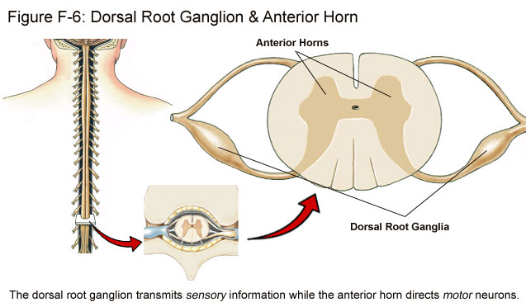
Pathogenesis of polio:
Pathway to CNS by:
Blood
Peripheral nerves
Causing destruction of
motor neurons of AHCs
Rarely affects brain stem
(bulber poliomyelitis)

Slide 13
Pathogenesis of Polio :
Immunity: IgA & IgG = Lifelong type-specific immunity

Slide 14
Poliovirus Infections
90-95%
No illness
Asymptomatic
4-8%
Minor Illness
1-2%
Abortive poliomyelitis (No CNS involvement)
Major Illness
1- Nonparalytic poliomyelitis (Aseptic meningitis)
2- Paralytic poliomyelitis: (Flaccid paralysis)

Slide 15
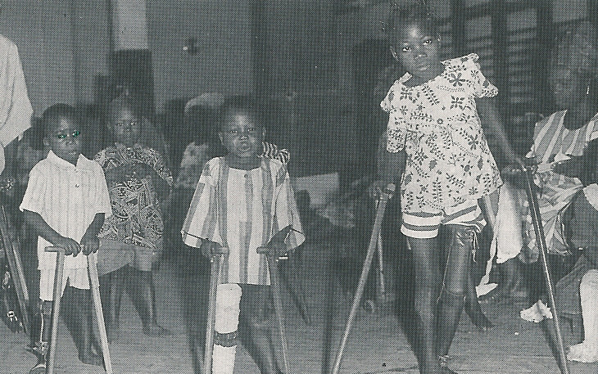

Slide 16
Lab Diagnosis of Enteroviruses
Virus isolation*:
Samples: Stool (best) .Rectal, throat swabs & CSF
Inoculate in MKC & HDF
All EVs grown except some strains of Cox A viruses
Observe for CPE
Identify the type by Neutralization Test
CSF in aseptic meningitis; lymphocytosis
Glucose level N to slightly , Protein level N or slightly
Isolation rate is variable
EV RNA detected in CSF by RT-PCR*
Serology (limited value)

Slide 17
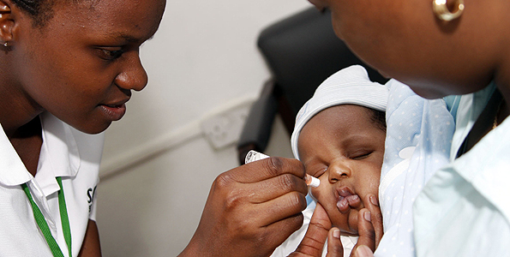
Management
Rx:
No antiviral Rx
Prevention:
Sanitation & Hygienic measures
Poliovirus vaccines
a- Inactivated polio vaccine
(IPV)
(Salk, Killed) (S/C or IM)
b- Live-attenuated polio vaccine
(OPV)
(Sabin, oral)

Slide 18
Important Features of Polio Vaccines
Attribute Killed (IPV) Live (OPV)
3 types (trivalent) Yes Yes
Prevents disease Yes Yes
Induces humoral IgG Yes Yes
Route of administration Injection Oral
Induces intestinal IgA No Yes
Interrupts transmission No Yes
Affords 2º protection by No Yes spread to others
Reverts to virulance No Yes (rarely)
Causes disease in the immun ed No Yes
Co-infection with other EVs No Yes may impair immunization
Requires refrigeration No Yes
Duration of immunity Shorter Longer

Slide 19
Poliovirus Vaccine
Adverse reactions ;
local reactions (IPV)
Vaccine -Associated Paralytic Poliomyelitis (OPV)
adult , immuno ed
4 doses of PV; 2, 4 , 6-18 ms
& 4 - 6 yrs
Pediarix contains IPV, DTaP & HB vaccines
Polio Vaccination of Adults
Indications:
Travelers to polio-endemic countries
HCWs
IPV

Slide 20
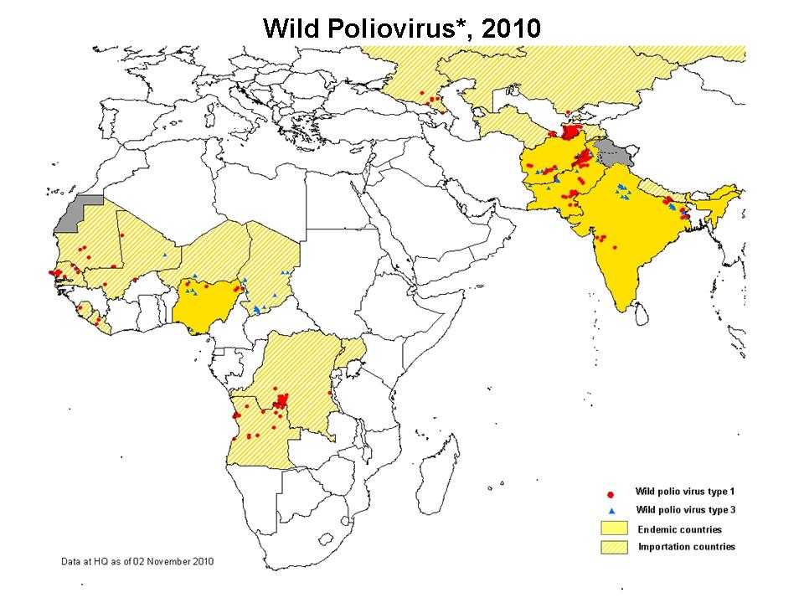

Slide 21
Viral Encephalitis
Etiological Agents:
Enteroviruses
Herpes viruses.
Rabies virus
Arboviruses.
Others

Slide 22
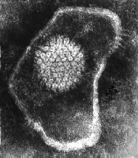
HSV encephalitis
Caused by;
Herpes simplex virus -1(HSV-1)
dsDNA , Enveloped , Icosahedral Virus
C/F;
F,H,V ,Seizures & altered mental status.
High mortality rate
Dx
MRI
CSF---Lymph, glucose-N & Protain-
---detection of HSV-1 DNA by PCR.
Rx
Acyclovir.

Slide 23
Rabies encephalitis
Rabies virus ;
Rhabdoviridae.
s.s (-)RNA genome,
Helical nucleocapsid,
Enveloped virus.
Bullet shaped virus

Slide 24
Epidemiology;
Reservoir;
Major;
Raccoons , Foxes,
Wolves & bats.
Imp ; cats & dogs
Transmission;
Common route
Bite of a rabid animal
Uncommon route
Inhalation while in a bat infested cave
Corneal transplant
Pathogenesis;

Slide 25
Rabies; A fatal acute encephalitis
zoonotic disease .
4 phase :
1-The incubation period: 1-3 m > longer
2-The prodromal phase:
F,H,M,A,N&V.
Abnormal sensation around the wound.
3-Neurological phase ;
1- encephalitis
Nervous , Lacrimation , salivation,
Hydrophobia ,
Convulsion ,coma & death .
2-Paralytic illness ; Ascending , Death , Bat.
4- Recovery; Extremely rare

Slide 26
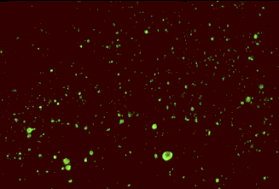
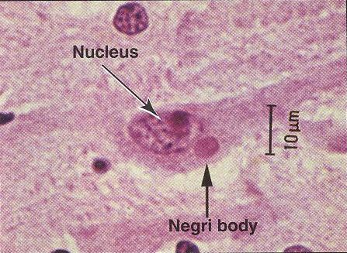
Laboratory Diagnosis
PCR; R. RNA in saliva
Rapid virus antigen detection ( IF )
Neck skin biopsy
Corneal impressions
Brain tissue
Histopathology
Virus cultivation
Rabid brain stained with
Fluorescent anti-rabies antibody
neuronal brain cells
intracytoplasmic inclusions
(Negri bodies)
Negri bodies are diagnostic of rabies.

Slide 27
Prevention
Control measures against canine rabies include;
Stray animals control.
Vaccination of domestic animals.
Pre-exposure prophylaxis (Vaccine)
Persons at increased risk of rabies
e.g. vets, animal handlers etc.
Post-exposure prophylaxis
Wound treatment
Passive immunization;
human anti-rabies immunoglobulin
around the wound & I M.
Active immunization;
Human Diploid Cell Vaccine (HDCV)**
5 - 6 doses

Slide 28
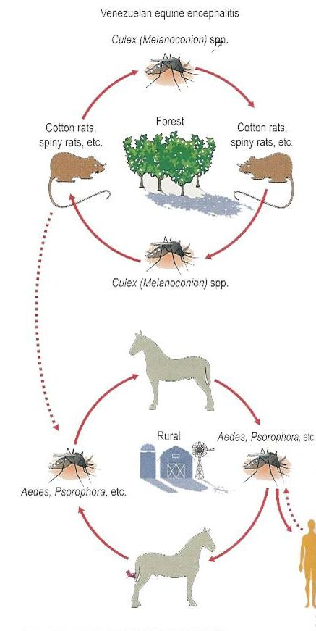
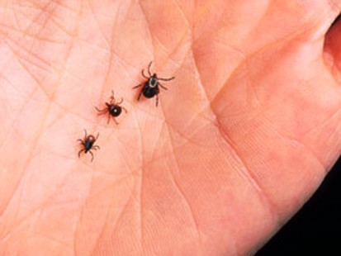
Arthropod –borne Viruses Arboviruses > 500 Vs
Epidemiology:
Reservoir: Wild birds & Mammals
Vector: Mosquito, ticks& Sandfly
Transmission: bite of infected vector
Infections
Asymptomatic Infections*
Diseases
Fever, Rash & arthralgia
Hemorrhagic fever ± hepatitis
CNS disease
(meningitis & encephalitis)

Slide 29
*ArboVs associated with CNS disease:
Virus | Vector | Reservoir | Distribution
Eastern equine encephalitis EEEV | Mosquito | Birds | America
Western equine encephalitis WEEV | Mosquito | Birds | America
Venezuelan equine encephalitis VEEV | Mosquito | Rodent | America
Japanese encephalitis V | Mosquito | Birds Pigs | Orient
Murray Valley encephalitis V | Mosquito | Birds | Australia
West Nile V | Mosquito | Birds | Europe, Africa Middle East Asia, America

Slide 30
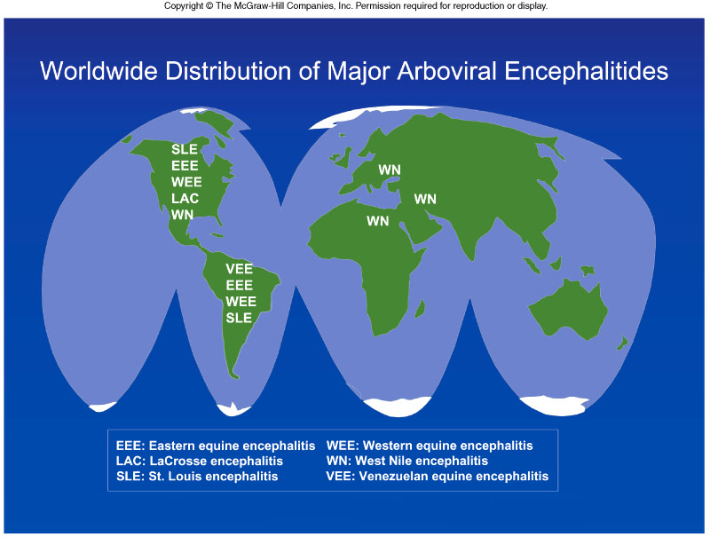
Arboviral encephalitis is prevalent worldwide

Slide 31
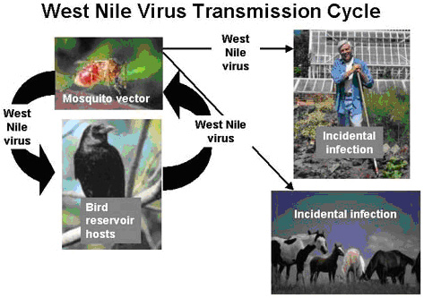
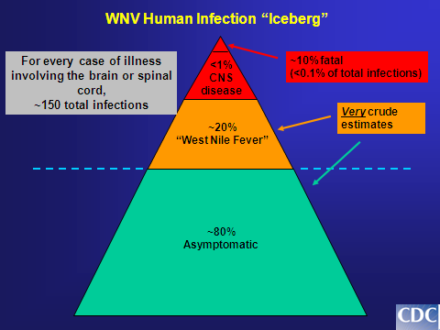
West Nile virus
Flaviviridae
Febrile illness meningitis , encephalitis

Slide 32
Dx.
Lab. Methods :
Isolation (Gold standard ) (Reference Lab)
Samples: blood, CSF, Viscera .
Cell culture CPE
Identify by IF
B - IgM -AB* - EIISA, IF: (most used)
C - Arbovirus RNA by RT-PCR

Slide 33
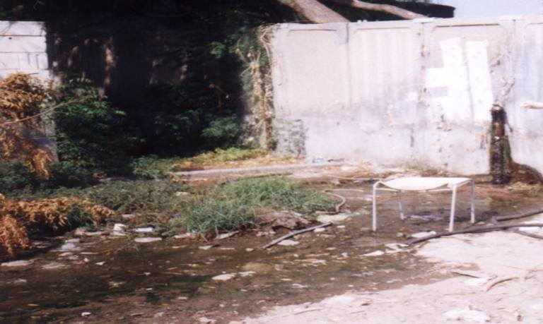
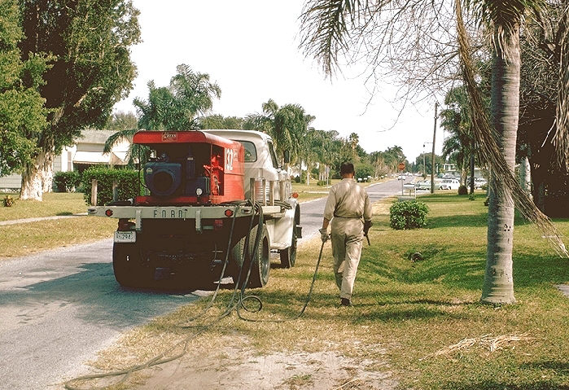
Prevention
Vector Control:
Elimination of
vector breading sites
using insecticides
Avoidance contact
with vectors
( repellants , net )
Vaccines:
Tick-borne encephalitis vaccine
Japanese encephalitis vaccine

Slide 34
Reference books &the relevant page numbers
Notes on Medical Microbiology
By ; Morag C. Timbury, A. Christine McCartney, Bishan Thakker and Katherine N. Ward
(2002)
Pages; 345 - 351, 392-399, 406-410, 414-419
Review of Medical Microbiology and Immunology.
By: Warren Levinson.
10th Edition, 2008.
Pages; 280-281, 284-288, 302-305

