Slide 1
Lecture Title:
Fungal Infections of Central Nervous System
(CNS Block, Microbiology)
Lecturer name:
Dr. Ahmed M. Albarrag
Lecture Date: Oct-2012

Slide 2
Fungal infections of central nervous system (CNS)
CNS infections are both diagnostic challenge and medical emergency
Delay in diagnosis and initiation of appropriate therapy will lead to high mortality rate or in permanent, severe neurological damage
Fungal infections of the CNS are not common
Notes:
2

Slide 3
Risk factors
HIV/AIDS
Hematopoietic stem cell transplant (HSCT)
Solid organs transplantation
Malignancies
Neutropenia
Hereditary immune defects
Immunosuppressive medications
Diabetes mellitus
Surgery or trauma
Indwelling catheters (e.g. candidemia CNS seeding)
Notes:
3

Slide 4
How fungi reach the central nervous system
Fungi reach the central nervous system by different mechanisms:
Hematogenous spread
Local extension from the paranasal sinuses, the ear, or the orbits.
Traumatic introduction
Surgical procedures
Head trauma
Injections
lumbar punctures
Notes:
4

Slide 5
Clinical syndromes
Meningitis
Sub acute
Chronic
Brain abscess
With or without vascular invasion
These clinical syndromes can occur either alone or in combination.
Certain clinical syndromes are specific for certain fungi
Notes:
5

Slide 6
Etiology
Several fungal agents can cause CNS infections.
Yeast:
Candida spp
Cryptococcus spp
Dimorphic
Histoplasma spp
Blastomyces spp
Coccidioides spp
Paracoccidioides spp
Penicillium marneffei
Mould
Aspergillus spp
Zygomycetes
Fusarium spp
Exophiala spp
Cladophialophora bantiana
Curvularia, Bipolaris
Rhinocladiella mackinziei
and Others
Notes:
6

Slide 7
Cryptococcal meningitis
AIDS is the leading predisposing factor
Etiology:
Cryptococcus neoformans is the most common etiology
Capsulated yeast cells
Naturally in Pigeon habitats
Acquired by inhalation
Mainly meningitis
Notes:
7

Slide 8
Candidiasis
Candida species are the fourth most common cause of hospital acquired blood stream infections
Candida can reach the CNS
Hematogenously,
Surgery, Catheters
Indwelling catheter and fever unresponsive to antibacterial agents
Clinical syndromes
Cerebral microabscesses
Cerebral abscesses
Meningitis
Vascular complications ( infarcts, hemorrhage)
Etiology:
Candida albicans, and other species including C. glabrata, C. tropicalis C. parapsilosis, and C. krusei.
Notes:
8

Slide 9
CNS Aspergillosis Usually brain abscesses (single or multiple)
A severe complication of hematological malignancies and cancer chemotherapy, transplantation
Spread Hematogenously
may also occur via direct spread from the anatomically adjacent sinuses,
Angiotropism (infraction and hemorrhagic necrosis)
Mortality rate is high
Etiology:
Aspergillus fumigatus, A. flavus, but also other Aspergillus species
Notes:
9

Slide 10
CNS Zygomycosis (mucoromycosis)
The rhinocerebral form is the most frequent presenting clinical syndrome in CNS zygomycosis.
Diabetics with ketoacidosis, in addition to other risk factors
The clinical manifestations of the rhinocerebral form start as sinusitis, rapidly progress and involve the orbit, eye and optic nerve and extend to the brain
Facial edema, pain, necrosis, loss of vision, black discharge
Angiotropism; As angio-invasion is very frequent
Mortality is high
Progression is rapid,
To improve the outcome:
Rapid diagnosis
Control the underlying disease
Early surgical debridement
Appropriate antifungal therapy
Etiology: Zygomycetes e.g. Rhizopus, Absidia, Mucor
Fast growing fungi
Notes:
10

Slide 11
Pheohyphomycosis
Fungal infections caused by dematiaceous fungi
Neurotropic fungi
CNS infections: Usually brain abscess, and chronic
Reported in immunocompetent hosts
Etiology:
Rhinocladiella mackenziei ( Mainly reported from Middle East)
Cladophialophora, Exophiala , Curvularia, Fonsecaea ,
Notes:
11

Slide 12
Other Infections
Histoplasmosis
Blastomycosis
Coccidiodomycosis
Paracoccidiodomycosis
Caused by primary pathogens
Sub acute or chronic Meningitis (common), and brain abscess
Following a primary infection, mainly respiratory
Notes:
12

Slide 13
Diagnosis
Clinical features (history, risk factors, etc)
Not Specific
Neuro-imaging
Good value in diagnosis and therapy monitoring
Lab Investigations
CSF examination (cell count, chemistry)
Histopathology
Microbiology
Notes:
13

Slide 14
Lab Diagnosis
Clinical Samples
CSF
Biopsy
Pus, aspirate
Blood (for serology)
1. CSF abnormalities
Cell count
Glucose level (low)
Protein level (high)
Not specific for Fungal infections
Notes:
140 ML
14

Slide 15
Lab Diagnosis
2. Direct Microscopy
Fungal stains: Giemsa, GMS, PAS, India ink (Cryptococcus neoformans)
3. Culture
Fungal media: SDA, BHI, other media if needed.
4. Serology
Candida
Aspergillus
Cryptococcus
Histoplasma
Blastomyces
Coccidioides
Paracoccidioides
5. PCR
Notes:
15

Slide 16
Lab. Diagnosis
Serology* | Culture | Direct microscopy | CNS infection
Cryptococcal Ag (capsule) Latex agglutination | Yeast | Yeast cells Capsulated (India ink) | Cryptococcal meningitis
Manann Ag (cell wall) | Yeast | Yeast cells and pseudohyphae | Candidiasis
Galactomannan Ag | Hyaline mould | Septate branching hyphae | Aspergillosis
No serology available | Hyaline mould Fast growing | Broad non-septate hyphae | Zygomycosis
 | Dematiaceous mould | Brown septate hyphae | Pheohyphomycosis
Notes:
16

Slide 17
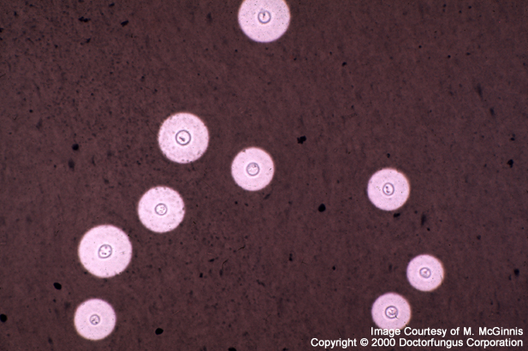
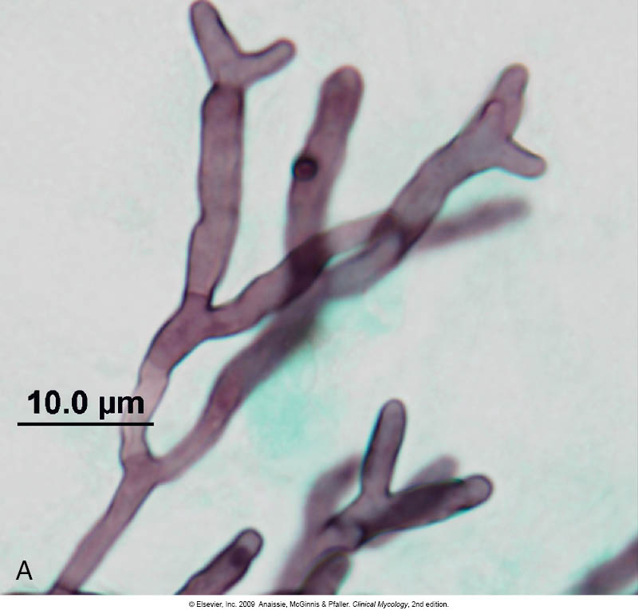
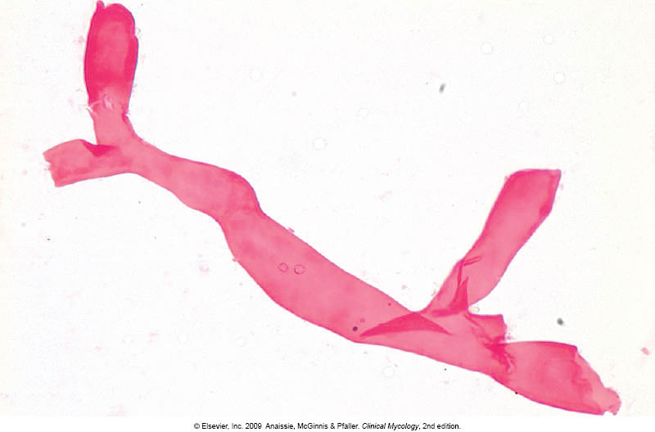

Slide 18
Management
1. Control of the underlying disease
2. Reduce immunosuppresion, restore immunity if possible
3. Start antifungal therapy promptly
Polyenes
Azoles
Echinocandins
Consider surgery in certain situations
Notes:
18

Slide 19
Antifungal therapy
Treatment | CNS fungal infection
Amphotericin B (combination with Flucytosine) | Cryptoccocal meningitis
Amphotericin B, Caspofungin, Fluconazole, Voriconazole, | CNS Candidiasis
Voriconazole, Amphotericin B, Caspofungin, Posaconazole (Combination of Voriconazole and Caspofungin) | CNS Aspergillosis
Amphotericin B, Posaconazole | CNS Zygomycosis
Notes:
19

