Slide 1
CEREBRAL MALARIA
Professor Ahmed A. Adeel

Slide 2
Objectives
By the end of this session the student should be able to :
List the main complications of malaria.
Define cerebral malaria.
Describe the main pathophysiological mechanisms underlying complications of severe malaria , including cerebral malaria.
Describe the main clinical features of cerebral malaria.
Outline the main steps in management of a case of cerebral malaria.

Slide 3
Malaria Species
Four species of malaria :
Plasmodium falciparum: malignant tertian malaria
Plasmodium vivax: benign tertian malaria
Plasmodium ovale : benign tertian malaria
Plasmodium malariae: quartan malaria

Slide 4
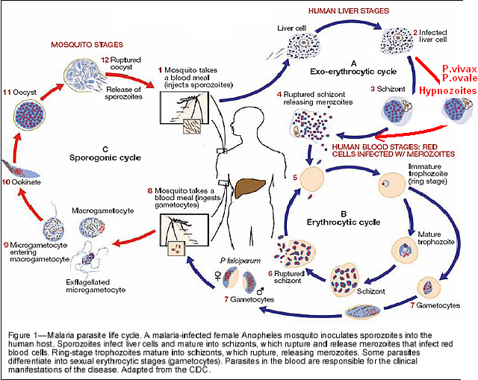
Life cycle of malaria
Life cycle of malaria

Slide 5
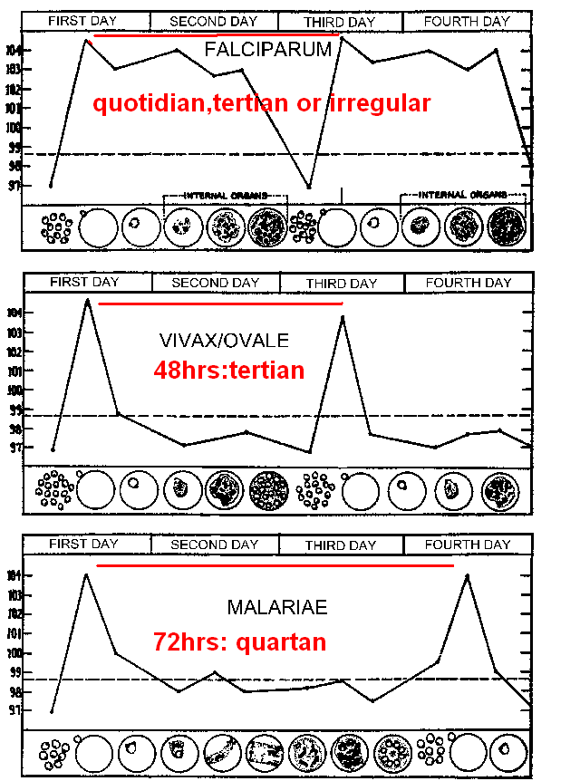
Periodicity of malaria paroxysms
Plasmodium falciparum
Plasmodium vivax ,
Plasmodium ovale
Plasmodium malariae

Slide 6
Clinical stages of a malaria paroxysm
Hot stage
Sweating
Cold stage

Slide 7
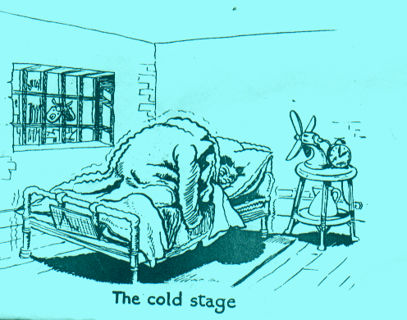
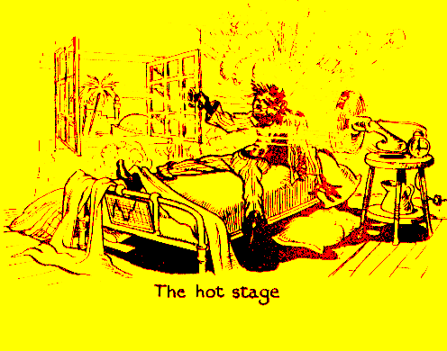
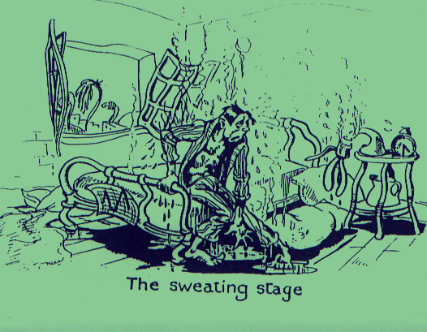
Malarial Paroxysm
(1) cold stage feeling of intense cold vigorous shivering lasts 15-60 minutes (2) hot stage intense heat dry burning skin throbbing headache lasts 2-6 hours (3) sweating stage profuse sweating declining temperature exhausted and weak → sleep lasts 2-4 hours

Slide 8
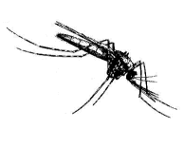
Components of the Malaria Life Cycle
Sporogonic
cycle
Infective
Period
Mosquito bites
uninfected
person
Mosquito Vector
Parasites visible
Human Host
Mosquito bites
gametocytemic
person
Prepatent
Period
Symptom onset
Recovery
Incubation Period
Clinical Illness

Slide 9
Pathogenesis of malaria

Slide 10
Evolution of the clinical picture in malaria
Chronic Disease
Acute Disease
NON-IMMUNE
IMMUNE
Non-severe
Acute Febrile
disease
Chronic
Asymptomatic
Infection
Infection
During
Pregnancy
Placental
Malaria
Cerebral
Malaria
Anemia
Low
Birth weight
Developmental
Disorders;
Transfusions;
Death
Increased
Infant
Mortality
Death

Slide 11
Definition of uncomplicated malaria
Uncomplicated malaria is defined as:
Symptomatic infection with malaria parasitemia without signs of severity and/or evidence of vital organ dysfunction.

Slide 12
Definition of severe malaria
Severe malaria is defined as symptomatic malaria in a patient with P. falciparum asexual parasitaemia with one or more of the following complications:
Cerebral malaria (unrousable coma not attributable to other causes).
Generalised convulsions (> 2 episodes within 24 hours)
Severe normocytic anaemia (Ht<15% or Hb < 5 g/dl)
Hypoglycaemia (glood glucose < 2.2 mmol/l or 40 mg/dl )
Metabolic acidosis with respiratory distress (arterial pH < 7.35 or bicarbonate < 15 mmol/l)
Fluid and electrolyte disturbances
Acute renal failure (urine <400 ml/24 h in adults; 12 ml/kg/24 h in children)
Acute pulmonary oedema and adult respiratory distress syndrome
Abnormal bleeding
Jaundice
Haemoglobinuria
Circulatory collapse, shock, septicaema (algid malaria)
Hyperparasitaemia (>10% in non-immune; >20% in semi-immune)

Slide 13
Clinical signs in severe malaria
Prostration : Inability to sit unassisted in a child normally able to do so. In infants, it is defined as the inability to feed.
Impaired consciousness: This is based on the Blantyre Coma Scale The term cerebral malaria is applied to children with a scale below 2 or those with a higher scale but unable to "localize a painful stimulus". Coma may be difficult to distinguish from the impaired consciousness observed following convulsions (e.g. febrile convulsions)
Respiratory distress (or acidotic breathing) :
Deep breathing involving an abnormally increased amplitude of chest excursion (as judged by a degree of intercostal indrawing or "recession") and an increased rate of breathing (tachypnoea) or, in very severe cases, a decreased rate as the breathing changes from "panting" to "air hunger".
High fever :
High fever may increase the risk of convulsions and coma. Signs such as abnormal bleeding, jaundice and pulmonary oedema, which are common in severe malaria in adults, are less common in children

Slide 14
Main causes of death in severe malaria
Death from P. falciparum in children living in areas of high transmission (stable) malaria:
cerebral malaria,
malarial anaemia,
metabolic acidosis,
In non-immune adults:
acute renal insufficiency,
cerebral malaria,
pulmonary edema
disseminated intravascular coagulation

Slide 15
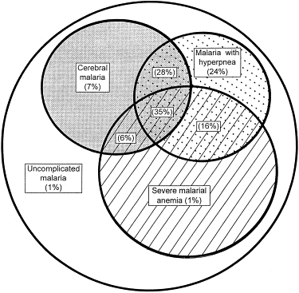
Clinical syndromes in severe malaria : Example from Kenya
Prevalence, overlap, and mortality for the major clinical syndromes of severe malaria in 1844 children presenting to Kilifi District Hospital, Kenya. Mortality is given as a percentage of the total number.
Credits: Marsh et al., New Engl J Med 1995, 332: 1399-1404

Slide 16
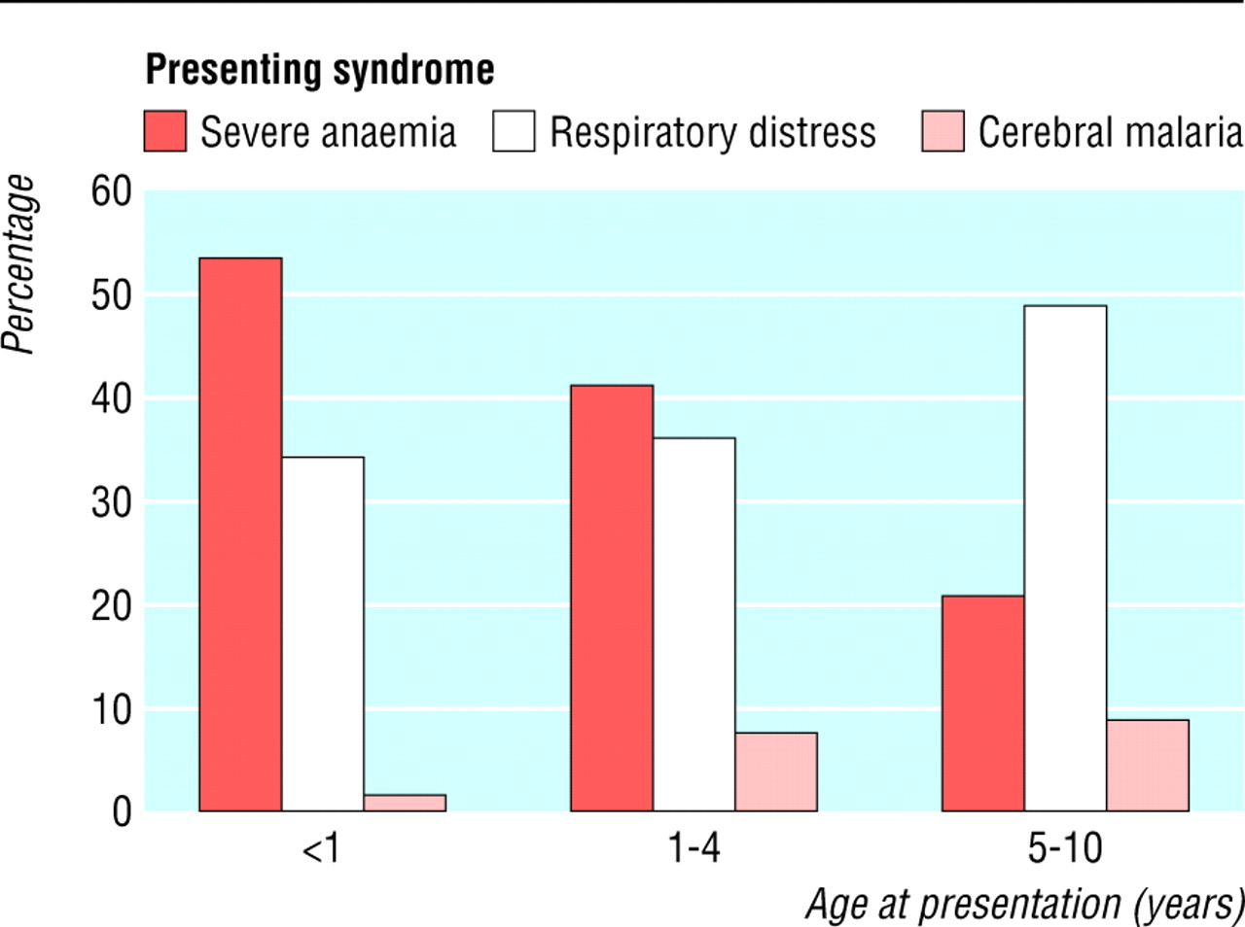
Clinical syndromes in severe malaria : Example from Yemen
Presentation of children with severe malaria in Yemen by age

Slide 17
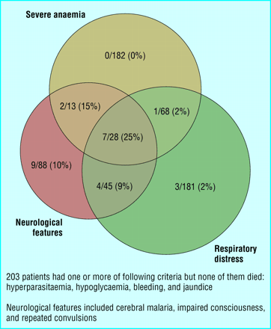
Clinical syndromes in severe malaria : Example from Yemen
Number of deaths in children with severe malaria by clinical pattern on
presentation in two sites in Yemen

Slide 18
A simple clinical triage
If the child…
• is fitting (having a convulsion)
• is prostrated, meaning that he or she is unable to:
– sit up unaided (if age 1 year or above) or
– drink or breast feed (if age < 1 year)
• has respiratory distress, meaning:
– deep, rapid breathing or
– indrawing of the lower chest wall S/he MUST be brought to the top of the queue for immediate assessment and treatment

Slide 19
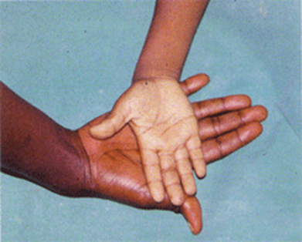
Clinical syndromes in severe malaria Severe anemia
Credits: J. Crawley/WHO/TDR
Severe anaemia in malariais due to:
1. An increased destruction of normal erythrocytes by erythro-phagocytosis, particularly in the spleen
2. Impaired production of new erythrocytes in the bone marrow

Slide 20
Clinical syndromes in severe malaria Renal involvement
Proteinuria:
Proteinuria is found in 20% of cases, but acute glomerulonephritis is usually transient and disappears after antimalarial treatment and appropriate fluid replacement. Some patients may progress to acute renal failure (by acute tubular necrosis
The sequestration of parasites in the glomerulus can occur and might contribute to the pathology observed

Slide 21
Clinical syndromes in severe malaria: Renal involvement
Immunofluorescent evidence of immune complex deposition in quartan malarial nephropathy
Credits: Image collection Liverpool School of Tropical Medicine

Slide 22
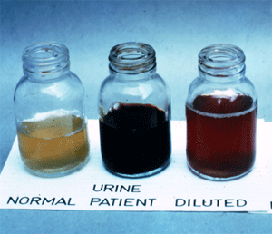
Clinical syndromes in severe malaria : Renal involvement
Blackwater fever
The combination of severe intravascular haemolysis, haemoglobinuria and renal failure is known as blackwater fever. The pathophysiology of the syndrome is obscure, but is believed to have an immunopathological component.

Slide 23
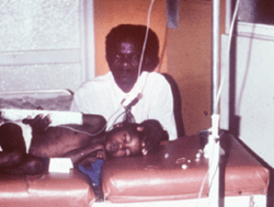
Cerebral malaria: definition
Cerebral malaria. Severe falciparum malaria with coma . Malaria with coma persisting for >30 minutes after a seizure is considered to be cerebral malaria.

Slide 24
Cerebral malaria : definition
Definition: the term cerebral malaria is restricted to the syndrome in which altered consciousness (or "coma") is associated with P. falciparum infection in a situation where other aetiologies have been excluded (febrile convulsions, hypoglycaemia, sedative drugs, viral, bacterial or fungal meningoencephalopathies and septicaemia)

Slide 25
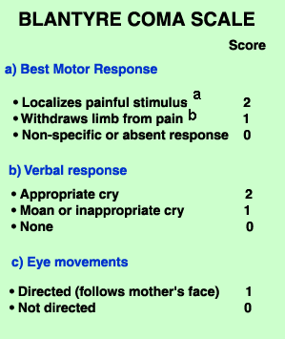
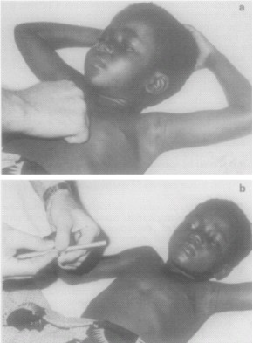
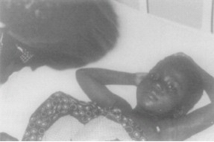
Cerebral Malaria Blantyre coma scale
A state of unrousable coma is reached at a score of <3.
This scale can be used repeatedly to assess improvement or deterioration.
a Rub knuckles on patient's sternum. b Firm pressure on thumbnail bed with horizontal pencil.

Slide 26
Cerebral Malaria :
Blantyre coma scale
The Blantyre coma scale is a modification of the Glasgow coma scale suitable to use in preverbal children. The scale uses motor and crying responses to pain and includes the ability to watch. It can be used to assess young children with cerebral malaria.
Blantyre coma scale = (best motor response score)+ (best verbal response score) + (eye movement score)
Interpretation:
• minimum score: 0 (poor)
• maximum score: 5 (good)
• abnormal: score <= 4

Slide 27
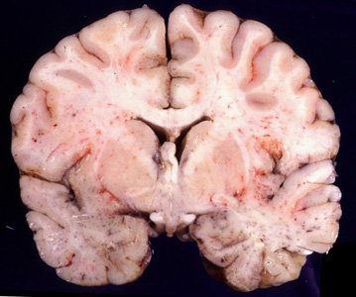
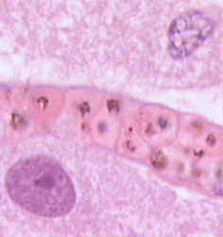
Cerebral malaria: pathogenesis
Section of a brain of fatal case of cerebral malaria

Slide 28
Cerebral malaria: clinical picture
Intracranial pressure is increased in the majority of children. While it is not considered a cause for the coma, it contributes to the risk of fatal outcome.
Hypoglycaemia is often a presenting feature of cerebral malaria in children (while this is far less common in adults).

Slide 29
Cerebral malaria: clinical picture
Anomalies of the muscles can be either of the flaccid type ("broken neck syndrome") or of the hypertonic type ("opithotonos" resembling tetanus).
The grinding of teeth is frequent ("bruxism").
The convulsions are common before or after the onset of coma; they are significantly associated with morbidity and sequelae

Slide 30
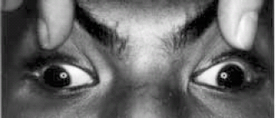
Cerebral malaria: clinical picture
Disconjugate gaze in a patient with cerebral malaria:
optic axes are not parallel in vertical and horizontal planes

Slide 31
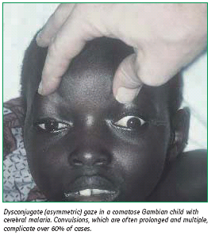
Cerebral malaria: clinical picture

Slide 32
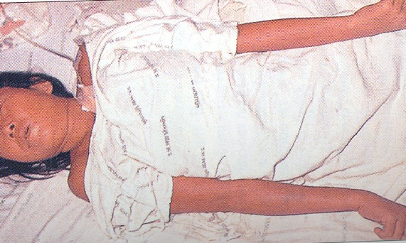
Cerebral malaria: clinical picture
Decerebrate rigidity in a patient with cerebral malaria complicated by hypoglycaemia

Slide 33
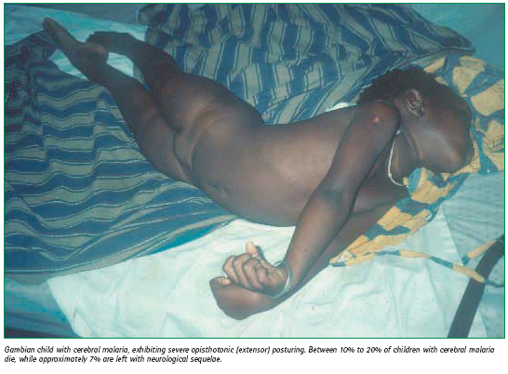
Cerebral malaria: clinical picture

Slide 34
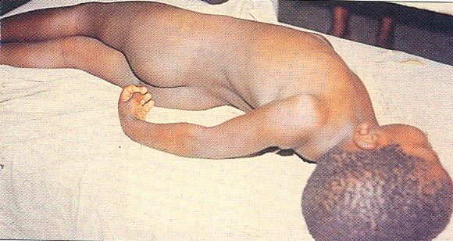
Cerebral malaria: clinical picture

Slide 35
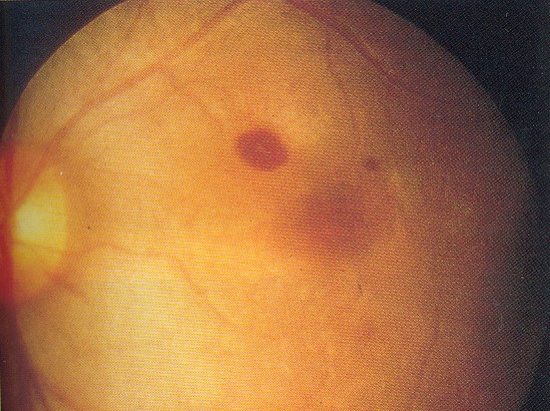
Cerebral malaria: clinical picture
Retinal haemorrhages in cerebral malaria

Slide 36
Cerebral malaria: importance of excluding other conditions
It is particularly important to
detect and treat hypoglycemia in any child with impaired consciousness.
In addition, all children should have a lumbar
puncture , to exclude meningitis. concurrent bacterial meningitis was found in 4% of children with
cerebral malaria, the proportion rising to 14% in children
below the age of 1 year. Children with cerebrospinal fluid
results suggestive of meningitis, and all children in whom LP is not possible, should be treated for meningitis.

Slide 37
Summary of Adjunctive Treatment
Manifestation/complication | Immediate management
Coma (cerebral malaria) | Maintain airway, nurse on side, excluded other treatable causes of coma, (e.g. hypoglycaemia, bacterial meningitis); avoid harmful ancillary treatment such as corticosteroids, heparin and adrenaline, intubate if necessary
Hyperpyrexia | Tepid sponging, fanning, cooling blanket and antipyretic drugs
Convulsions | Maintain airways; treat promptly with diazepam or paraldehyde
Hypoglycaemia (Blood glucose <2.2 mmol/l, or < 40 mg/dl) | Measure blood glucose, correct hypoglycaemia and maintain with glucose containing infusion
Severe anaemia (Hb <5g%, or PCV <15%) | Transfuse with screened fresh whole blood or packed cells

Slide 38
Summary of Adjunctive Treatment
Complication | Immediate management
Acute pulmonary oedema | Prop up at 45º, give oxygen, give diuretic, stop intravenous fluids, intubate and add positive pressure ventilation in life threatening hypoxaemia; haemofilter.
Acute renal failure | Exclude pre-renal causes, check fluid balance, urinary sodium; if in established renal failure; haemofilter or haemodialysis or peritoneal dialysis. Benefits of diuretics/dopamine in ARF are not proven.
Spontaneous bleeding and coagulopathy | Transfused screened fresh whole blood (cryoprecipitate, /fresh frozen plasma and platelets if available; vitamin K injection
Metabolic acidosis | Exclude or treat hypoglycaemia, hypovolaemia and septicaemia
Shock | Suspect gram negative septicaemia, make blood cultures; give parenteral antimicrobials, correct haemodynamic disturbances.
Hyperparasitaemia (e.g. >10% of circulating erythrocytes parasitized) | Monitor closely for the first 48 hours after starting treatment; start total or partial exchange transfusions

Slide 39
General Management of cerebral malaria
The comatose patient should be given meticulous nursing care
• Insert a urethral catheter using a sterile technique, unless the patient is anuric.
• Insert a nasogastric tube and aspirate stomach contents.
• Keep an accurate record of fluid intake and output.
• Monitor and record the level of consciousness (using the Glasgow, or Blantyre coma scale, temperature, respiratory rate and depth, blood pressure and vital signs.
• Treat convulsions if and when they arise with diazepam or paraldehyde. A slow intravenous injection of diazepam (0.15 mg/kg of body weight, maximum 10 mg for adults) or intramuscular injection of paraldehyde (0.1 ml/kg of body weight), will usually control convulsions. Diazepam can also be given intrarectally (0.5–1.0 mg/kg of body weight) if injection is not possible.
Important: Paraldehyde should if possible be given from a sterile glass syringe. A disposable plastic syringe may be used provided that the injection is given immediately the paraldehyde is drawn up, and that the syringe is never reused.

Slide 40
Simple treatment algorithm for the management
of severe malaria
SEVERE MALARIA
IMPAIRED CONSCIOUSNESS?
YES
NO
IS ORAL ADMINISTRATION OF DRUG FEASIBLE?
PARENTERAL ARTEMETHER*, ARTESUNATE*
OR
QUININE
PLUS SUPPORTIVE CARE
GIVE ANTIMALARIAL AND TREAT MAIN COMPLICATIONS
NO
YES

Slide 41
Evolution of cerebral malaria
Cerebral malaria carries a mortality of around 20% in adults and 15% in children. Residual deficits are unusual in adults (<3%). About 10% of the children (particularly those with recurrent hypoglycemia, severe anemia, repeated seizures and deep coma), who survive cerebral malaria may have persistent neurological deficits.

