Slide 1
Meningitis
Pathology

Slide 2
CNS Infections
Portals of entry of infection into the CNS:
Hematogenous spread
the most common
Direct implantation
traumatic or in congenital CNS malformation
Local extension
occurs secondary to an established infection in a near by organ (air sinus, an infected tooth or middle ear)
Through the peripheral nervous system into the CNS
certain viruses, such as rabies and herpes zoster.

Slide 3
CNS Infections Meningitis
An inflammatory process of the leptomeninges and CSF within the subarachnoid space.
→ Meningoencephalitis?

Slide 4
CNS Infections Pyogenic meningitis
Medical emergency
The causative microorganisms (2010 Robbins):
Neonates : Escherichia coli and group B streptococci
Infants: Streptococcus pneumoniae
Adolescents and young adults: ,Neisseria meningitidis (Meningococcal meningitis) and Haemophilus influenzae (becoming less due to immunization)
Elderly: listeria monocytogenes and Streptococcus pneumoniae

Slide 5
CNS Infections Pyogenic meningitis
CSF Findings in spinal tap:
cloudy or frankly purulent CSF
as many as 90,000 neutrophils /mm
raised protein level
markedly reduced glucose content
bacteria may be seen on a Gram stained smear or can be cultured, sometimes a few hours before the neutrophils appear

Slide 6
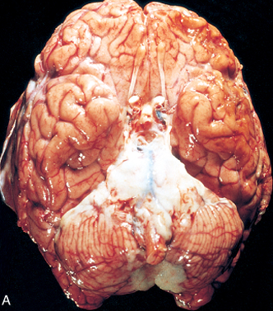
Acute meningitis

Slide 7
CNS Infections Meningitis Clinical Features
Systemic non-specific signs of infection
Meningeal irritation signs and neurologic impairment:
Headache, photophobia, irritability, clouding of consciousness and neck stiffness
Untreated, pyogenic meningitis can be fatal
Effective antimicrobial agents markedly reduce mortality associated with meningitis

Slide 8
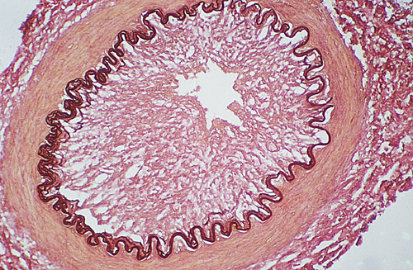
CNS Infections Meningitis Complications
Phlebitis may → venous occlusion → hemorrhagic infarction of the underlying brain
Leptomeningeal fibrosis → hydrocephalus
Septicemia → hemorrhagic infarction of the adrenal glands and cutaneous petechiae (known as Waterhouse-Friderichsen syndrome, particularly common with meningococcal and pneumococcal meningitis)
Focal cerebritis & seizures
Cerebral abscess
Cognitive deficit
Deafness
What is this complication →

Slide 10
CNS Infections Brain abscess
Streptococci and staphylococci are the most common organisms identified in non-immunosuppressed populations
Predisposing conditions:
Acute bacterial endocarditis (usually give multiple microabscesses)
Cyanotic congenital heart disease in which there is a right-to-left shunt
Loss of pulmonary filtration of organisms ( e.g, bronchiectasis)
Most common on cerebral hemispheres

Slide 11
CNS Infections Brain abscess
Morphologically,
Liquefactive necrosis
The surrounding brain is edematous , congested & contains reactive astrocytes & perivascular inflammatory cells
Present clinically with progressive focal neurologic deficits in addition to the general signs of raised intracranial pressure
The CSF
Contain only scanty cells
↑ protein
Normal level of glucose
Complications of Brain abscess:
Herniation
Rupture of abscess into subarachnoid space or ventricle

Slide 12
Epidural and Subdural Infections
These spaces can be involved with bacterial or fungal infections, usually as a consequence of direct local spread
Epidural abscess, commonly associated with osteomyelitis, arises from an adjacent focus of infection, such as sinusitis or a surgical procedure
When the process occurs in the spinal epidural space, it may cause spinal cord compression and constitute a neurosurgical emergency

Slide 13
Infections of the skull or air sinuses may also spread to the subdural space, producing subdural empyema. The underlying arachnoid and subarachnoid spaces are usually unaffected, but a large subdural empyema may produce a mass effect. In addition, thrombophlebitis may develop in the bridging veins that cross the subdural space, resulting in venous occlusion and infarction of the brain
Symptoms include those referable to the source of the infection. Most patients are febrile, with headache and neck stiffness, and if untreated may develop focal neurologic signs, lethargy, and coma
With treatment, including surgical drainage, resolution of the empyema occurs from the dural side; if resolution is complete, a thickened dura may be the only residual finding. With prompt treatment, complete recovery is usual

Slide 15
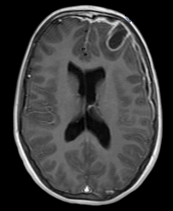
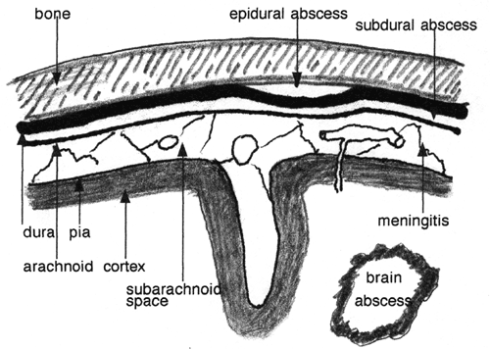

Slide 16
CNS Infections Tuberculosis
The subarachnoid space contains a fibrinous exudate, most often at the base of the brain
Tuberculoma is well-circumscribed intraparenchymal mass
Rupture of tuberculoma into subarachnoid space results in tuberculus meningitis
A tuberculoma may be up to several centimeters in diameter, causing significant mass effect
Always occurs after hematogenous dissemination of organism from primary pulmonary infection
On microscopic examination, there is usually a central core of caseous necrosis surrounded by a typical tuberculous granulomatous reaction

Slide 17
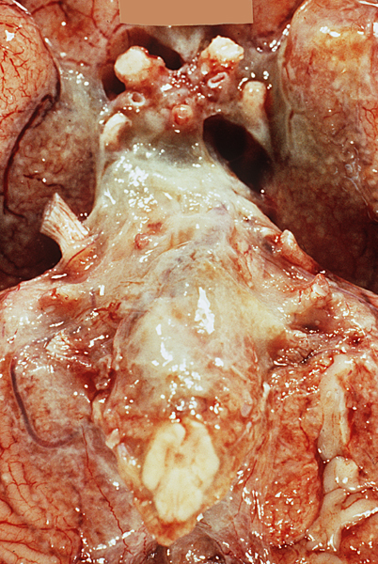
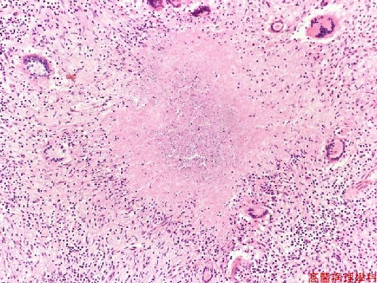
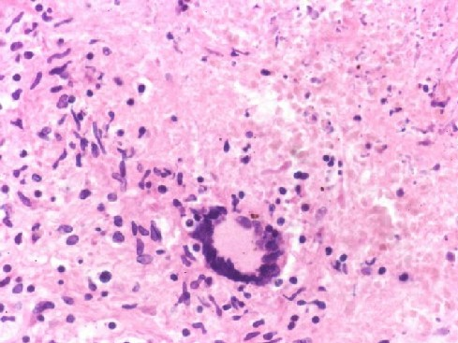
TB meningtis Exudate at the base of the brain

Slide 18
CNS Infections CSF in TB
There is only a moderate increase in cellularity of the CSF (pleiocytosis) made up of mononuclear cells, or a mixture of polymorphonuclear and mononuclear cells
The protein level is elevated, often strikingly so
The glucose content typically is moderately reduced or normal

Slide 20
Aseptic Meningitis (Viral Meningitis)
Aseptic meningitis is a misnomer
it is a clinical term for an illness comprising meningeal irritation, fever, and alterations of consciousness of relatively acute onset without recognizable organisms
The clinical course is less fulminant than in pyogenic meningitis, is usually self-limiting, and most often is treated symptomatically
The CSF shows an increased number of lymphocytes (pleiocytosis), the protein elevation is only moderate, and glucose content is nearly always normal
In approximately 70% of cases, a pathogen can eventually be identified, most commonly an enterovirus
There are no distinctive macroscopic characteristics except for brain swelling, seen in only some instances
On microscopic examination, there is either no recognizable abnormality or a mild to moderate infiltration of the leptomeninges with lymphocytes.

Slide 21
Homework
Create a table of CSF findings in Meningitis, aseptic meningitis, TB meningitis, Brain abscess and multiple sclerosis!

