Slide 1
Neurotransmissions in the Central Nervous System

Slide 2
What is the importance of understanding the type of neurotransmitter in the CNS?
- To understand the etiology of diseases.
- To suggest the best drugs to be used.
- To understand the other clinical uses of any particular drug.

Slide 3
Norepinephrine ( NE)

Slide 4
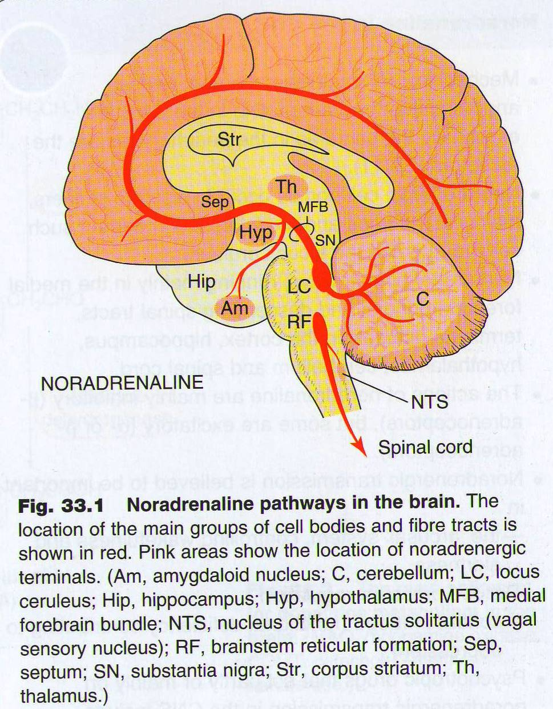

Slide 5
Mode Disorders and NE
NE N E
Mania Depression

Slide 6
SEROTONIN

Slide 7
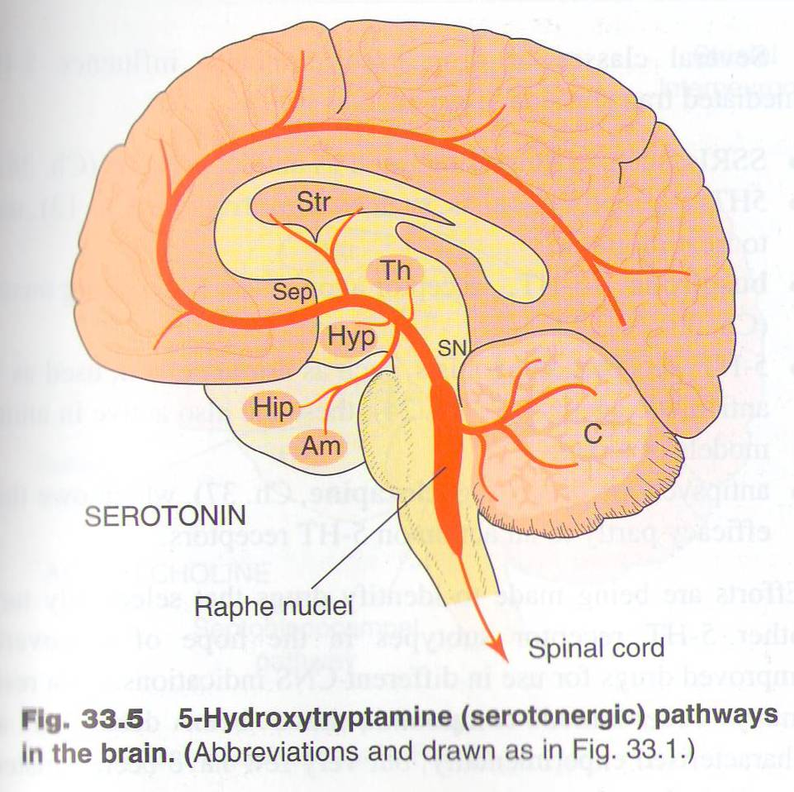

Slide 8
Serotonin ( 5HT)
Although the CNS contains less than 2% of the total serotonin in the body, serotonin plays a very important role in a range of brain functions including :
Mood control
Regulation of sleep
Pain perception

Slide 9
Diseases that are influenced by derangement of 5-HT:
Affective Disorders
Schizophrenia
Obsessive Compulsive Disorders
Generalized Anxiety
Nausea and Vomiting ( treated by 5-HT3 antagonists )

Slide 10
Dopamine

Slide 11
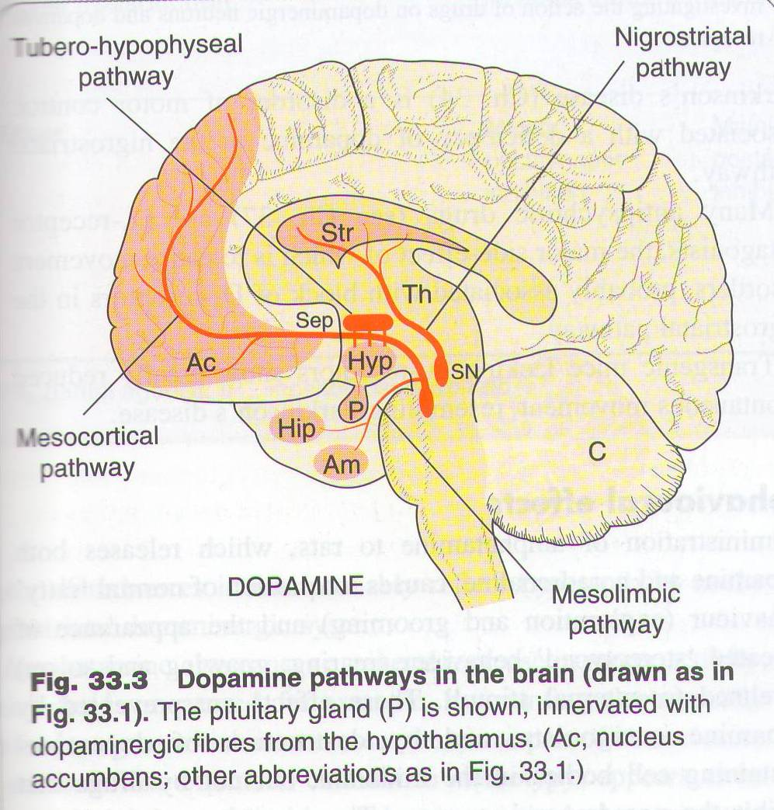

Slide 12
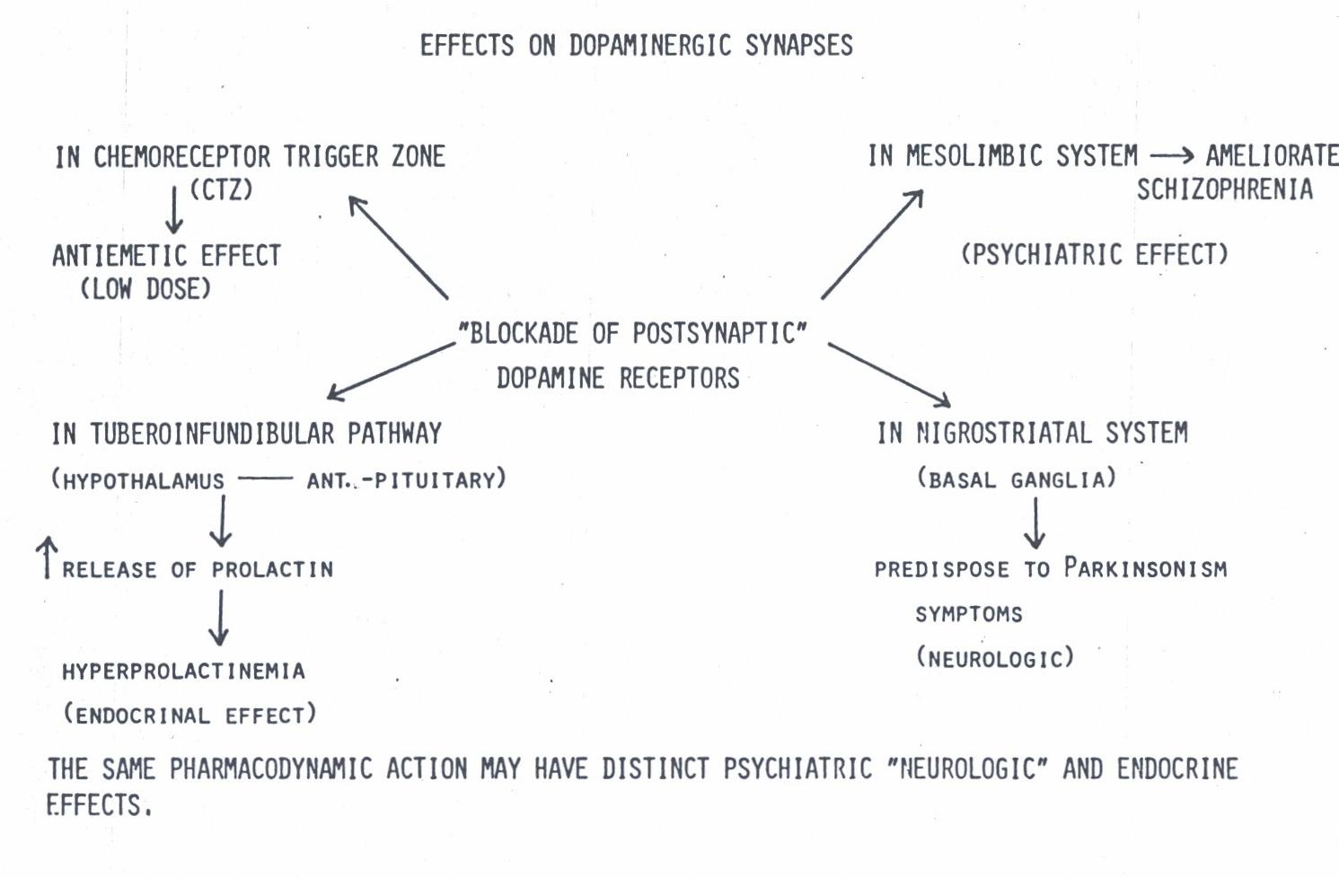

Slide 13
What are the diseases that influenced by dopamine level ?

Slide 14
Acetylcholine:
Acetylcholine is an inhibitory & excitatory neurotransmitter
Role of acetylcholine in the CNS
Diseases that linked to ACH derangement

Slide 15
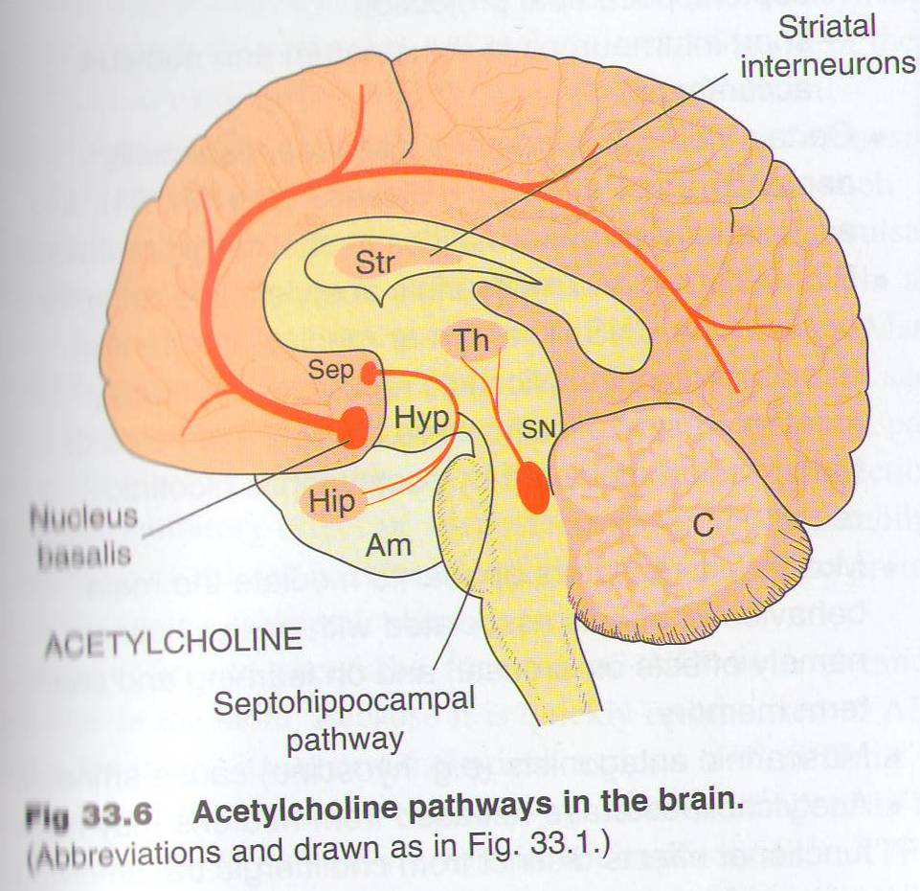

Slide 16
Role of Acetylcholine in the CNS
ACH is thought to be involved in cognitive functions such as :
memory
arousal
attention.

Slide 17
What are the CNS diseases that linked to ACH derangement ?
Damage to cholinergic receptors ( muscarinic) is associated with memory deficits as in Alzheimer,s disease
Muscarinic antagonists as hyoscine cause amnesia.

Slide 18
What are the CNS diseases that linked to ACH derangement ?
Increase brain level of ACH predispose to Parkinson,s disease

Slide 19
Glutamic acid
Glutamic acid
is an excitatory neurotransmitter
Increase in its level predispose
to epilepsy

Slide 20
Potential therapeutic effect of glutamate antagonists
Reduction of brain damage following strokes & head injury
Treatment of epilepsy
Drug dependence
Schizophrenia

Slide 21
GABA
GABA
is the main inhibitory transmitter in the brain.
Present throughout the brain; there is very little in peripheral tissues

Slide 22
Pathophysiological role of GABA
Decrease GABA brain content is associated with :
Epilepsy
Anxiety
Convulsions
Insomnia

Slide 23
Conclusion:
Without understanding the involvement of neurotrasmittors in the etiology of CNS diseases, Doctors could not select the proper drug for any particular disease.

Slide 24
