Slide 1
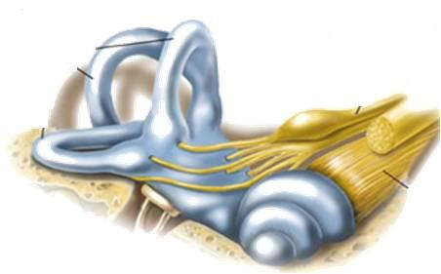
DRUGS RELATED TO BALANCE
BALANCE
BALANCE
Prof. Dr. OMNIA NAYEL
Ass. Prof. Osama Yousif
BALANCE
BALANCE
BALANCE

Slide 2
DRUGS RELATED TO BALANCE
ILOs:
BALANCE
Recognize causes and symptoms of balance disorders.
Identify the transmitters involved in vestibular transmission
Segregate classes of drugs used in the management protocols to control or prevent vertigo
Identify drugs that can precipitate vertigo
BALANCE
BALANCE
BALANCE
BALANCE

Slide 3
Drugs used to control or prevent vertigo episodes

Slide 4
THERAPEUTIC MANAGEMENT
Vestibular Suppressants
Prevent Recurrence
Intend to dull
brain response
to vestibular signals
from inner ear
Intend to suppress acute attacks [ tame vertigo episodes]
Diuretics (but not loop diuretics)
Corticosteroids
L-type Ca Channel Blockers
( fluid retention)
Spinning
+
Emesis
(inflammation)
(  vasodilatation)
○ cinnarazine, flunnarazine, verapamil
NB. If migraine is also present → add on its treatment

Slide 5
VESTIBULAR SUPRESSANTS
Emesis
ANTIEMETICS
H₁ antagonist
Antihistamine Anticholinergic
Meclizine
Dimenhydrinate

Phenothiazines

+ Dopamine antagonists + Sedation
Prochlorperazine
Promethazine
Dopamine Antagonists

Dopamine Antagonist
+ Gastroprokinetic
Metoclopramide Domperidone  NO cross BBB

Slide 6
VESTIBULAR SUPRESSANTS
Spinning
H₁ agonists
???
Betahistine
H₃ antagonists
Benzodiazepines
promote & facilitate central vestibular compensation via GABA modulation
Lorazepam
Clonazepam
Diazepam

Slide 7
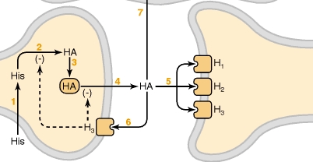
Betahistine
H istamine
Mediator
Neurotransmitter
Antagonist
Agonist
CNS
ANS
H ₁
+
H ₂
+
H ₁
H ₃
+
H ₃
-ve presynaptic autoregulation

Slide 8
VESTIBULAR SUPRESSANTS
BETAHISTINE
H₁ agonist
H₃ antagonist
Weak agonist at H₁ receptors → regulates inner ear fluid homeostasis (labyrinthine circulation ) → inducing vaso-dilatation in middle ear → relieves pressure in inner ear
Strong antagonism of H₃ autoreceptors → ↑ augmenting effects on H₁ receptors in the brain →
- ↑ H synthesis in tuberomammillary nuclei of the posterior hypothalamus to promote & facilitate central vestibular compensation
- ↑ H release in vestibular nuclei
↑levels of neurotransmitters such as 5HT in the brainstem, which inhibits the activity of vestibular nuclei.

Slide 9
VESTIBULAR SUPRESSANTS
BETAHISTINE
Pharmacokinetics
Tablet form , rapidly & completely absorbed
t½=2-3h
Partially metabolized ( active) & excreted in urine
ADRs
Contraindications
Headache
Nausea
Gastric effects
↓ appetite and weight loss
Peptic ulcer
Pheocromocytoma
Bronchial asthma

Slide 10
ANTIEMETICS
DIMENHYDRINATE
(Dramamine)
H₁ antagonist
Antihistamines
> antiemetic < sedating
than Meclizine
Block H₁ receptors in CRTZ
Sedative effects
Weak anticholinergic effects
Indications
In vertigo
In control of MOTION SICKNESS by ↓ excitability in the labyrinth & blocking conduction in vestibular-cerebellar pathways.
ADRs
Contraindications
Sedation
Dizziness
Anticholinergic side effects
Glaucoma
Prostatic enlargement

Slide 11
ANTIEMETICS
PROCHORPERAZINE
A Piperazine Phenothiazines
Block dopamine receptors at CRTZ
Antipsychotic , some sedation + antiemetic
Indications
One of the best antiemetics in vertigo
(sedating & has some vestibular suppressant action)
METOCLOPRAMIDE
Dopamine Antagonists
A potent central antiemetic acting on CRTZ
Has some sedating action
Has potent gastroprokinetic effect
Indications
In vertigo
ADRs
Restlessness or drowsiness
Extrapyramidal manifestations on prolonged use

Slide 12
Drugs inducing vertigo

Slide 13
DRUGS INDUCING VERTIGO
Are those drugs (or chemicals) producing destructive damaging effects on structure or function of labyrinthine hair cells &/ or their neuronal connections
VESTIBULOTOXINS
MIXED OTOTOXINS
Drugs altering fluid & electrolyte Diuretics
Antihypertensives ….
Drugs altering vestibular firing
Anticonvulsants
Antidepressants
Sedative hypnotics
Alcohol
Cocaine
FUNCTIONAL

Slide 14
DRUGS INDUCING VERTIGO
MIXED OTOTOXINS
Aminoglycoside antibiotics; gentamycin, kanamycin, neomycin, streptomycin, tobramycin, netlimycin
Fluroquinolines, Vancomycin, Polymixin
Quinine, chloroquine, quinidine
Nitrogen mustard
Loop diuretics
NSAIDs
Tobacco
STRUCTURAL
FUNCTIONAL

Slide 15
DRUGS INDUCING VERTIGO
Aminoglycoside antibiotics; streptomycin, kanamycin, neomycin, gentamycin, tobramycin, netlimycin
STRUCTURAL
Apoptosis
Neomycin → activate caspases → Death Receptor Pathway
Gentamycin → evoke free radicals → Mitochondrial Pathway
↓local blood flow → biochemical changes → alter electromechanical transduction
Quinine, chloroquine, quinidine
Loop diuretics
NSAIDs
Firing of impulses
FUNCTIONAL

Slide 16
G
O
O
D
L
U
C
K

