Slide 1

ANTIDEPRESSANTS
ILOs
OLD & NEW
Realize neurotransmitter defects in different types of depression
Elaborate on how antidepressants generally act
Classify the existing antidepressant into elder (TCAs & MAO Is) and
newer groups (SSRIs, SNRIs, NRIs, NAASs, NDRIs, SARIs)
Expand on pharmacology of each group; setting examples,
discussing pharmacodynamic potentials, pharmacokinetic differences,
varied indications, contraindications and side effects
Enumerate augmenter drugs used in depression

Slide 2
ANTIDEPRESSANTS
The concept of action of all drugs relay on extracellular biogenic amines in the brain indirectly by blocking their catabolism or directly by preventing their uptake + altering receptor firing.
All drugs take weeks to manifest their clinical effect [to control depressive manifestations], even though their pharmacological actions starts immediately indicating that secondary adaptive changes must occur before the benefit is gained
The delay presentstime needed for inhibitory somatodendritic autoregulatory 5HT_{1A} receptors or axonal autoregulatory 5HT_{1D} to be sensitized [down regulated] to permit more synthesis & release of transmitter at synaptic cleft with enhanced signaling at postsynaptically serotonergic & adrenergic > (β) neurones → therapeutic effect.

Slide 3
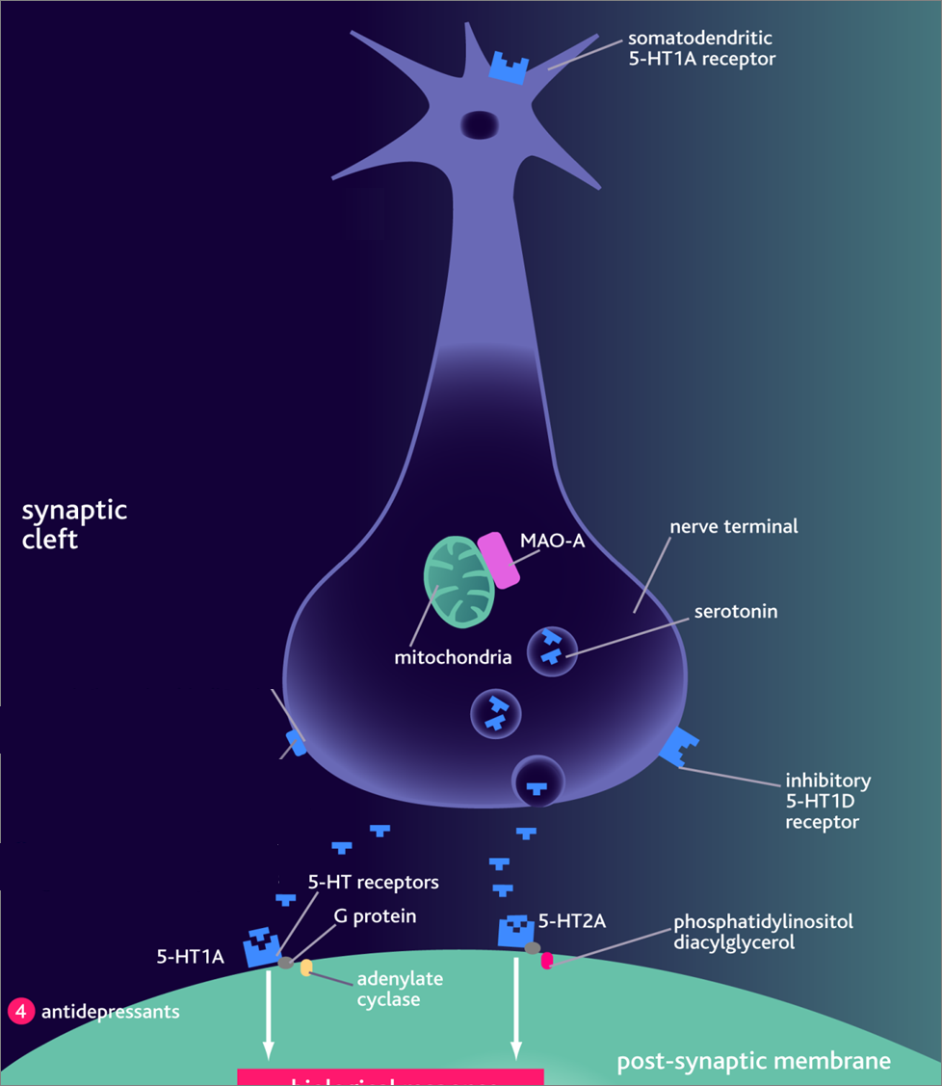
Treatment should continue
6 months at full therapeutic
doses before withdrawal.
Withdrawal of drugs must
be very gradual otherwise
withdrawal symptoms
Agitation
Worsening of the disease
Withdrawal manifestation
They mediate therapeutic effects

Slide 4
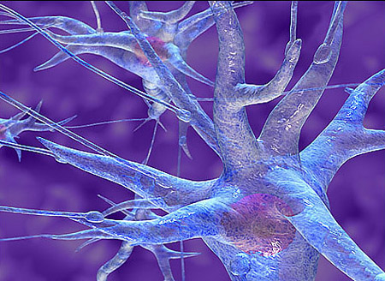
MONOAMINE
OXIDASE
INHIBITORS

Slide 5
MAO is a mitochondrial enzyme found in nearly all tissues
Two forms of monoamine oxidase exist:
  MAO-A responsible for NE, 5-HT catabolism. It also metabolizes tyramine of ingested food
  MAO-B is more selective for dopamine metabolism
MONOAMINE OXIDASE INHIBITORS
Non Selective Inhibitors (MAO-A & MAO-B)
Irreversible ➔Phenelzine, long acting [persists 2w after stop]
Reversible ➔ Tranylcypromine, [persists 7 days after stop]
Selective Reversible Inhibitors
➔ Moclobemide, (MAO-A)
➔ Selegiline, (MAO-B)
Seldom used now because;
➔ADR, Food & Drug Interactions
➔ Low antidepressant efficacy
= Low benefit/risk ratio;
All are well absorbed, metabolized & excreted in urine

Slide 6
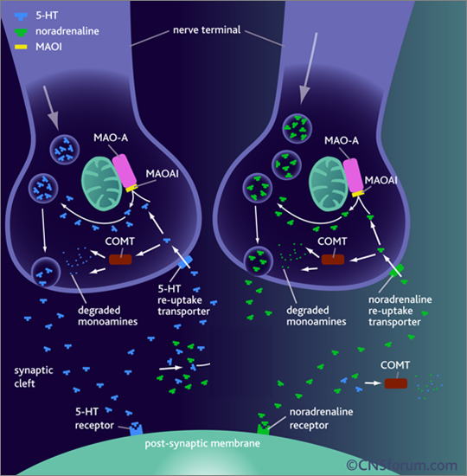
MAOIs ➔⬇ activity of MAO ➔ preventing monamine break down ➔⬆ availability indirectly
Possess both α Adrenoceptor & mAch blocking effects
Indications
MAOIs ➔ now only reserved in atypical depression and depression resistant to other therapy
In treatment of social anxiety (agrophobia)

Slide 7
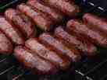
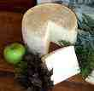
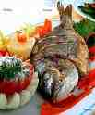

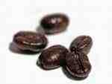
ADRs
1. Antimuscarinic effects.
2- Postural hypotension.
3- Sexual dysfunction mainly with phenelzine.
4- Sedation , sleep disturbance.
5- Weight gain
6- Hepatotoxicity ( phenelzine)
Food interactions
Many foods containing tyramine are normally degraded in the gut by MAO-A
MAOIs inhibit this process  tyramine is absorbed taken up into adrenergic neurons  converted into a false transmitter  replaces NE in vesicles & allows its massive release ➔
results in hypertensive crisis.
Distribution of 5-HT2 receptors
So avoid foods rich in
Tyramine ; Aged cheese, liver, sausages, fish , some meat & yeast extracts.
Levodopa ; Broad beans, FAVA beans.

Slide 8
Drug interactions
1. If with (indirect acting sympathmimetic, flue medications, local anesthetics & TCA) ➔ severe hypertension ➔ hypertensive crisis
2- If with SSRI ➔ fatal serotonin syndrome [hyperthermia, muscle rigidity, cardiovascular collapse ] ➔ so keep 6 weeks space between their use
3- If with pethidine ➔ -ve its metabolism ➔↑ its levels ➔ toxcity ➔leads to hyperpyrexia, irritability, hypotension and coma.
Distribution of 5-HT2 receptors

Slide 9
TRICYCLIC ANTIDEPRESSANTS

Slide 10
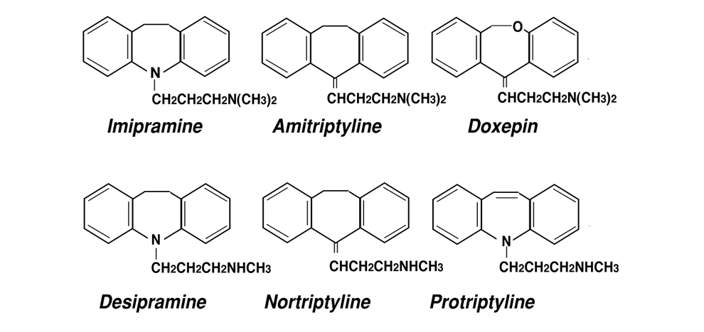
1st Generation Tricyclic Antidepressants
 have three-ring nucleus structure
Tertiary amines
Block 5HT& NE reuptake
More side effects
Imipramine (Tofranil)
Amitriptyline (Elavil)
Secondary amines
More selective to NE
Less side effects
Desipramine (Norpramin)
Nortriptyline (Pamelor)
+ Block ADR (α₁), Histamine (H₁) & Ach (M₁)receptors.

Slide 11
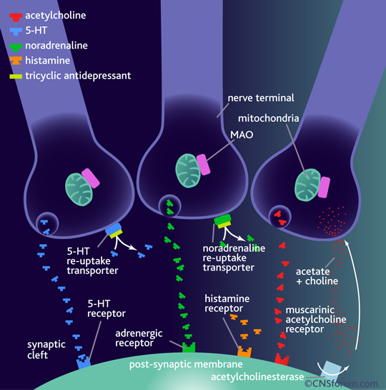
+ block adrenergic (α₁), histamine (H₁) & muscarinic (M₁)receptors.

Slide 12
Given once daily
Some of them give active metabolites
  Imipramine  Desipramine
  Amitriptyline Nortriptyline
Pharmacokinetics
Clinical Indications
1- Treatment of depression;
Used for long duration without loss of
effectiveness [preferable to MAOIs]
> In resistant depression if others fail
  Elevate mood
  Improve mental alertness.
  Increase physical activity
- With lithium in depressed phase of bipolar depression
- With antipsychotics in depressed psychotic patients.

Slide 13
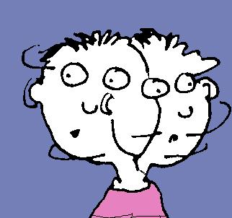
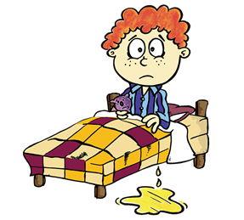
2-Other psychiatric disorders;
Obsessive-compulsive disorders (OCD)
(OCD;  DA & NE in the brain's prefrontal cortex.)
Generalized anxiety disorders
Panic disorders
Anorexia nervosa
3-Other disorders;
Control bed-wetting in children; Imipramine  contraction of
internal sphincter of bladder . Better desmopressin
Gradually withdrawn / Treatment period do not exceed 3 months.
Neuropathic pain; better Tertiary amines > → modulate endorphins
Give in smaller doses than that prescribed for depression.
Prophylaxis of migraine

Slide 14

ADRs
Anti-cholinergic: Dry mouth, blurred vision, constipation & urine
retention, aggravation of glaucoma
Anti-histaminic: Sedation, confusion. Stop sedatives 1-2 w before use
Anti-adrenergic (>α)  C.V.S ; Postural hypotension, arrhythmias
conduction defects ( prolonged Q-T interval - heart block )
Weight gain, sexual dysfunction & impotence
Lower seizure threshold
Aggravation of psychosis
EARLY IN USE  During 1st month  aggravate suicidal thoughts specially in young aged. Can happen less upon change of dose.
DURING USE  narrow therapeutic index  toxicity can develop
Excitement, delirium , convulsions, respiratory depression , coma, atropine like- effects, cardiac arrhythmias, sudden death. DIALYSIS
STOPAGE OF USE  Withdrawal Symptoms; characterized by cholinergic rebound, flu-like symptoms.

Slide 15
Interactions
Being strongly bound to plasma proteins  toxicity enhanced
by aspirin, phenylbutazone, ….etc
Being metabolized by hepatic microsomal enzymes  toxicity
enhanced by enzyme inhibitors.
With MAOIs, SSRIs or any sympathomimetic drugs  cause
hypertensive crisis
Additive to sedatives or other CNS depressants  respiration
Additive to antipsychotics & anti parkinsonisms  anti-
cholinergic effects.
Glaucoma
Heart disease
Liver disease
Seizure disorder
Thyroid disease
Prostate hypertrophy
Pheochromocytoma
Chronic bronchitis
Contraindications

Slide 16
ANTIDEPRESSANTS
New Antidepressants

Slide 17
Fluoxetine
Fluvoxamine
Citalopram Sertraline
Paroxetine
Selective Serotonin Reuptake Inhibitors SSRIs
Venalafaxine
Serotonin Norepinephrine Reuptake Inhibitors (SNRIs)
Reboxetine
Norepinephrine Reuptake Inhibitors (NRIs)
Noradrenergic & Specific Serotonergic Antidepressants (NaSSAs)
Mirtazapine
Bupropion
Norepinephrine Dopamine Reuptake Inhibitors (NDRIs)
Serotonin Antagonists & Reuptake Inhibitors (SARIs)
Trazodone
Nefazodone

Slide 18
SSRIs

Slide 19
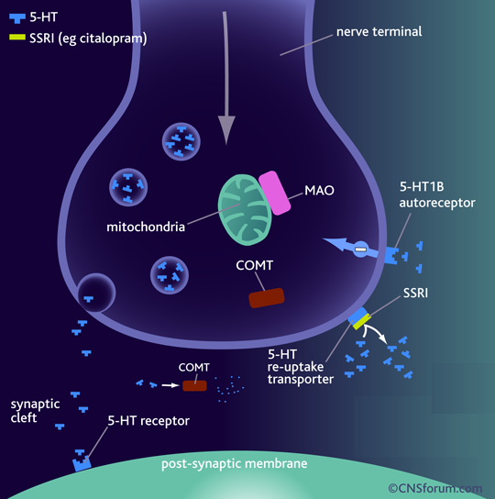
Fluoxetine
Fluvoxamine
Citalopram Sertraline
Paroxetine
Binds to SERT ➔  5-HT levels in synapse
No effect on NET
No block to mAch, H, or α₁ Adrenoceptor ➔ so no antimuscarinic nor sedative effects
They are nearly of comparable efficacy but of preferential response in each individual

Slide 20
Pharmacokinetics
    t_{1/2} :
    Too long (3-11 days): Fluoxetine (Prozac)
     Moderate length (~24hr): Sertraline, Paroxetine, Citalopram.
Metabolism: P450 then conjugation
They are enzyme inhibitors
 Weak inhibitors < Sertraline, Citalopram  interaction
 Strong inhibitors > Fluoxetine, Paroxetine  metabolism
of TCA, neuroleptic, some antiarrhythmic, β-blockers.
Primarily excreted through kidney; not paroxetine & sertraline
undergo partially fecal excretion.
Fluoxetine differs from others members of this class in :
1- It has a longer t_{1/2} (50hrs).
2- Available  as sustained release preparations once weekly.
3- Metabolite norfluoxetine = potent as parent drug t_{1/2} 10 days.

Slide 21
Clinical Indications
First choice for most depression. Comparable efficacy as TCAs but much safer < sedation & antimuscarinic side effects
< toxicity in over doses
Fluoxetine is approved in children, adolescence, elderly males with prostatic hypertrophy & relatively safe in pregnancy.
Used in:
Anxiety and panic disorders
Obsessive-compulsive disorders
Some eating disorders (bulimia)
Pain associated with diabetic neuropathy
Premature ejaculation
Premenstrual syndrome.
Alcohol abuse.
Anorexia nervosa.
Generalized anxiety disorder (GAD).

Slide 22
ADRs
Insomnia, anxiety, agitation, nervousness > fluoxetine >
citalopram
 useful in fatigued patients
Sedation & lassitude > paroxetine, sertraline
 useful in patients with difficult sleep .
GIT upset ( nausea, vomiting, diarrhea) (indirect stimulation of
5-HT₃ receptors in the enteric nervous system )
Anorexia & weight loss
Impotence & sexual dysfunction; loss libido, delayed
ejaculation (Indirect CNS stimulation of 5-HT₂)
 useful in patients who have premature ejaculation.
Mild CV & minimal antimuscarinc side effects unlike TCAs
Withdrawal manifestation < intensity than TCAs

Slide 23
Interactions
Serotonin Syndrome if combined with MAOIs > other ADDs
[Autonomic instability (changes in BP, pulse, hyperthermia), muscle rigidity, respiratory depression, mental confusion, shivering, sweating and diarrhea ]
Enzyme inhibitors  metabolism =  toxicity of TCA, neuroleptic, some antiarrhythmic, β-blockers.

Slide 24
Reuptake Inhibitors & Mixed Action Novel ADDs

Slide 25
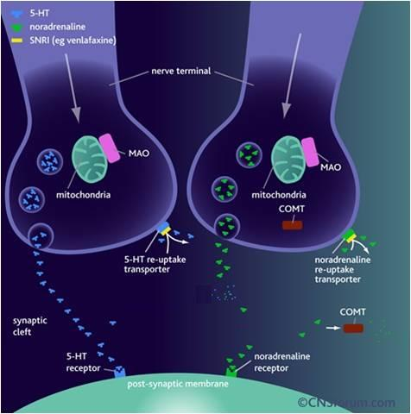
Serotonin Norepinephrine Reuptake Inhibitors [ SNRIs ]
Venalafaxine
Restore the levels of NE & 5HT in the synaptic cleft by binding to NET & SERT Has mild antimuscarinic effect
Short t_{1/2}
HR & BP
Side effects similar to SSRI drugs but may be withdrawal manifestations on discontin-uation  may need dosage tapering

Slide 26
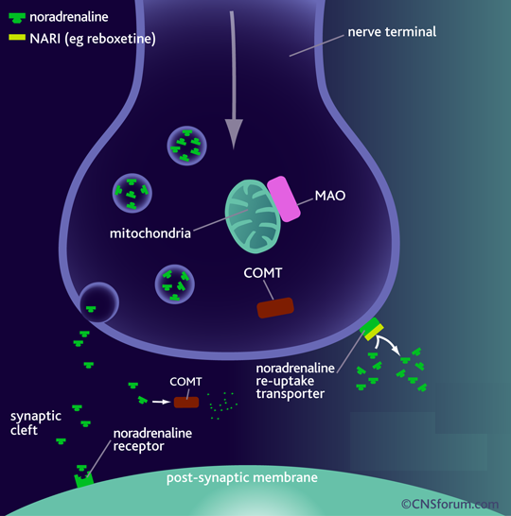
Norepinephrine Reuptake Inhibitors [ NRIs ]
Reboxetine
Block only NET
No affinity for 5HT, DA, ADR, H, mAch receptors
So, has positive effects on the concentration and motivation in particular.
Safe to combine with SSRIs
Minimal side effects only related to activation of ADR system as tremor, tachycardia, and urinary hesitancy

Slide 27
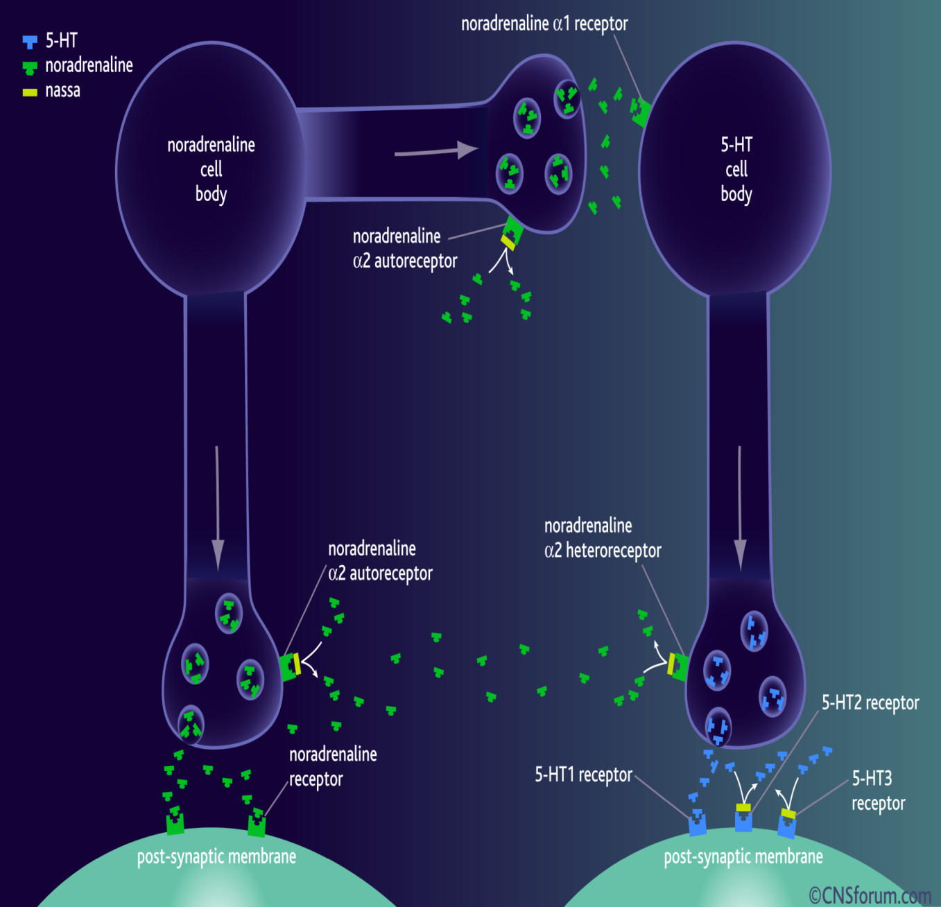
Noradrenergic & Specific Serotonergic Antidepressants [ NaSSAs ]
Mirtazapine
Blocks presynaptic α₂ adrenoceptors
+ 5HT₃ > 5HT₂ receptors
Preferred in cancer patients because:
1. Improves appetite
2- nausea & vomiting ( 5-HT₃ blocking)
3-  body weight
4- Sedation (potent antihistaminic)
5- Less sexual dysfunction (5-HT₂ blocking)
6- Has no anti-muscarinic effect .
Side effects; drowsiness, appetite, and weight gain.

Slide 28
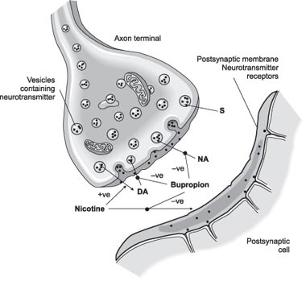
Norepinephrine Dopamine Reuptake Inhibitors (NDRIs)
Bupropion
Is unique in possessing significant potency as NE and DA reuptake inhibitor, with no direct action on 5HT. Acts as a nAch antagonist
Therapeutic uses:
1- Treatment of major depression and
bipolar depression.
2- Can be used for smoking cessation.
As it reduces the severity of nicotine
craving & withdrawal symptoms
Advantages: No sexual dysfunction given in young
No weight gain [ No 5HT effect ]
No orthostatic hypotension.
Side effects: Seizures; it  threshold of neuronal firing

Slide 29
Serotonin Antagonists & Reuptake Inhibitors (SARIs)
Trazodone
Nafazodone
Psychtropic drug Trazodone is its precursor
Weak block of SERT > NET
Block 5-HT₂
α- blocking effect ( hypotension) No
Potent H₁- blocker( sedation ) No
High protein bound
Extensive hepatic metab Inhibit Cyt450
Urine excretion
Cause priapism (α antagonisim ) Hepatic failure [Black
Arrythmogenic box labelling]

Slide 30
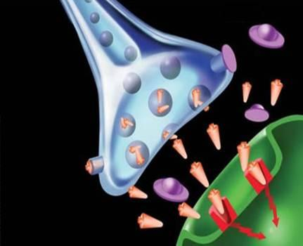
Augmenter drugs
Some antidepressants work better in some patients when used in combination with another drug.
This "augmenter" drugs include:
Buspirone
Antipsychotics; typical or atypical
Lithium; is used to augment ADDs
in resistant unipolar depression
Trazadone, Nafazodone, Bupropion are sometimes included among augmenters but there use as such should be under strict clinical supervision

Slide 31
Antidepressants when block other postsynaptic receptors can confer side effects. Such receptors include mainly histaminergic [H₁], muscarinic, [a₁]-adrenergic.
Histaminergic antagonism has been associated with sedation and drowsiness. Can contribute to increased appetite & weight gain.
Muscarinic-receptor antagonism is responsible for gastrointestinal disturbances; constipation, dry mouth, tachycardia, blurred vision, urine retention
Block of the [a₁]-adrenergic receptor may be responsible for dizziness and orthostatic hypotension
Antidepressants increase variably the availability of 5HT & NE at synapes
Increased NE transmission tremors, insomnia
Increased 5HT transmission  sedation, and a decrease in sexual drive.
Antidepressants & sexual dysfunction?
Through acting on 5HT₂ → sexual dysfunction (loss of sexual desire and impaired sexual response (ejaculatory delay, erectile dysfunction, anorgasmia)
ADDs with
5HT₂ blocking action as mirtazipine, has minimal action on sexual dysfunction.
With > NE than 5HT as Bupropion , have minimal sexual side effects
Trazodone, nafazodone,
With dual action are better than SSRIs with respect to sexual side effects

Slide 32
Antidepressants & Sedation
 Sedating ADDs are; Amitryptyline, Paroxiteine, Sertraline, Mirtazapine, Trazadone, So better given near bed time
 Less Sedating ADDs are; Bupropion, Venalafoxine , MOA Is,
So can be given in the morning as some cause insomnia as side effect.
Antidepressants and appetite???
DA is responsible for eating. 5HT action on 5HT₂ halts dopamine release so suppress appetite.
Depression is accompanied more by weight loss.
SSRIs by ↑ 5HT availability to act on 5HT₂  could suppress appetite. At least no weight gain with SSRIs.
Most TCAs have dual reuptake inhibition + sedation + antihistaminic effects  ↑ weight gain
Mirtazepine blocks 5HT₂  so cannot shut off dopamine signals  ↑ weight gain
N.B. Antidepressants isn't always a direct cause to cause alteration in weight. Other contributing factors to weight gain during antidepressant therapy are for example: ↑ day time sleep, ↑ craving for food when mood alleviates,
Nausa & Vomiting by SSRIs  ↑ 5HT availability  act on 5HT3  nausea & vomiting

Slide 33
Antidepressants safe combinations;
 Bupropion + Desipramine
 SSRIs + Mertazepine, Reboxetine or any other NRIs / SNRIs/
Antidepressant approved for use in children; fluoxetine
Antidepressants good for elderly are SSRIs because they can be used at lower dosage giving least side effects in this age group
SSRIs use is more than TCAs because they are better tolerated by patients
Antidepressants dangerous combinations;
 MAO Is + SSRIs  Serotonin syndrome
 Paroxetine / Fluoxetine / Nefazodone / + Desipramine, Nortryptiline  severe sedation
or > toxicity
Enuresis  Imipramine
Chronic pain  TCAs (Tertiary better than 2ndry amines )  Duloxetine
SSRIs not effective
Bulimia  Fluoxetine
Obsessive convulsive disorder SSRIs
Cancer associated depression  Mirtazapine
Depression in Adolescence and young adults Bupropion
Depressive phase of bipolar add? Lamotrigine (anticonvulsant) or lithium

Slide 34
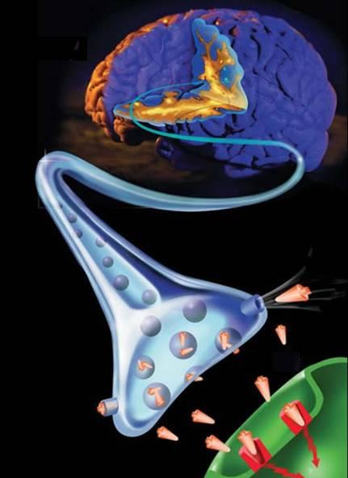
ANTIDEPRESSANTS
L
G
U
O
C
O
K
D
ANTIDEPRESSANTS

