Slide 1
Neurotransmissions in the Central Nervous System
Prof. Alhaider

Slide 2
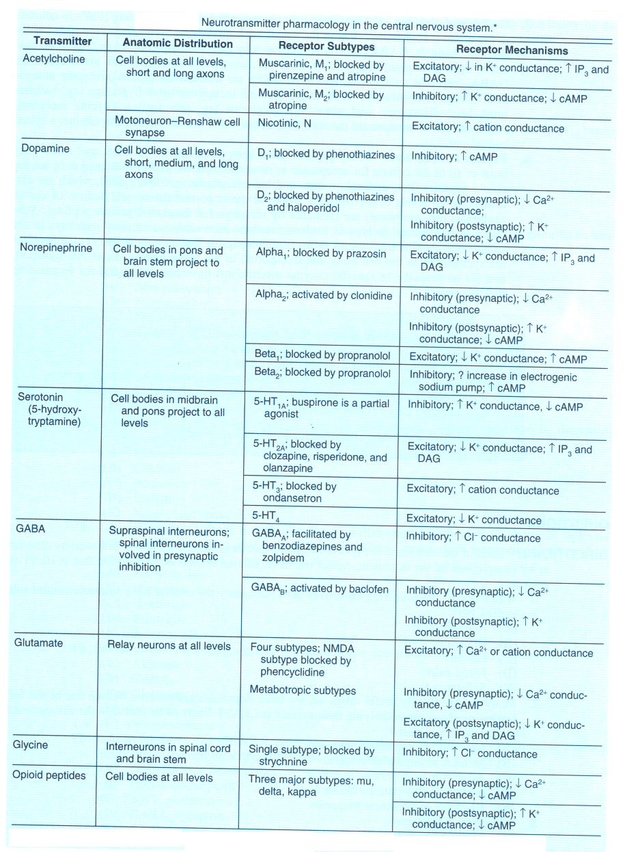

Slide 3
What is the importance of understanding the type of neurotransmitter in the CNS?
- To understand the etiology of diseases.
- To suggest the best drugs to be used.
- To understand the other clinical uses of any particular drug.

Slide 4
Norepinephrine ( NE)

Slide 5
Mode Disorders and Neurotransmissions
Affective Disorders
NE NE
Mania Depression
Rx Drugs that decrease NE Drugs that increase NE
What is the evidence to support this theory?.

Slide 6
Serotonin ( 5HT)
Although the CNS contains less than 2% of the total serotonin in the body, serotonin plays a very important role in a range of brain functions including :
Mood control
Regulation of sleep
Pain perception

Slide 7
Diseases that are influenced by derangement of 5-HT:
Affective Disorders
Schizophrenia
Obsessive Compulsive Disorders
Generalized Anxiety
Nausea and Vomiting (Rx by 5-HT3 antagonists)

Slide 8
Dopamine

Slide 9
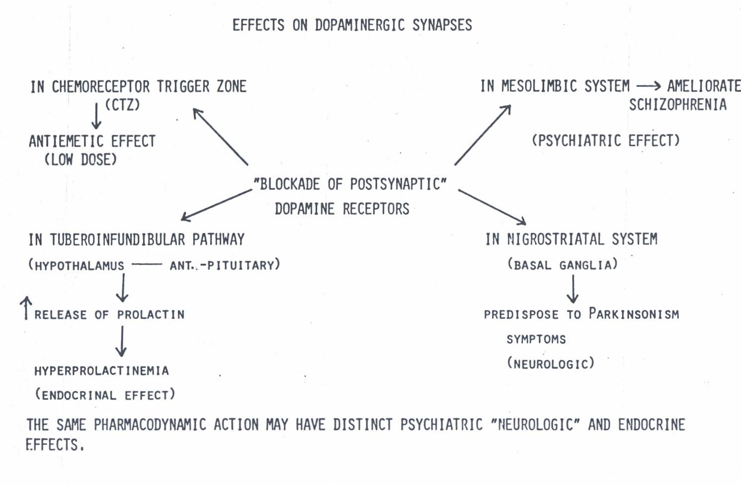

Slide 10
What are the diseases that influenced by dopamine?
Schizophrenia
Parkinson Disease
Nausea and Vomiting
Infertility

Slide 11
Acetylcholine:
Is Acetylcholine an inhibitory or excitatory neurotransmitter?
Does acetylcholine has any role in the CNS?
What are the CNS diseases that linked to ACH derangement?

Slide 12
Role of Acetylcholine in the CNS
ACH is thought to be involved in cognitive functions such as :
memory
arousal
attention.

Slide 13
What are the CNS diseases that linked to ACH derangement ?
Damage to cholinergic receptors (muscarinic) is associated with memory deficits as in Alzheimer,s disease
Increase brain level of ACH predispose to Parkinson,s disease

Slide 14
Glutamic acid
Glutamic acid
is an excitatory neurotransmitter
Increase in its level predispose
to epilepsy

Slide 15
GABA
GABA
is an inhibitory neurotransmitter
Decrease in GABA level is
associated with epilepsy .

Slide 16
Conclusion:
Without understanding the involvement of neurotrasmittors in the etiology of CNS diseases, Doctors could not select the proper drug for any particular disease.

