Slide 1
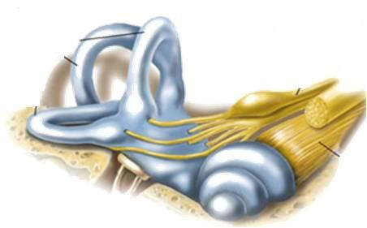
DRUGS RELATED TO BALANCE
BALANCE
BALANCE
BALANCE
BALANCE
BALANCE

Slide 2
DRUGS RELATED TO BALANCE
ILOs:
BALANCE
Recognize causes and symptoms of balance disorders.
Identify the transmitters involved in vestibular transmission
Segregate classes of drugs used in the management protocols to control or prevent vertigo
Identify drugs that can precipitate vertigo
BALANCE
BALANCE
BALANCE
BALANCE

Slide 3
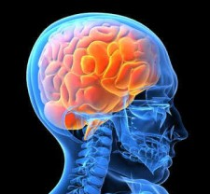
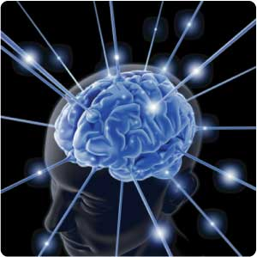
Head Move
Fluid in the semi-circular canal [in plane of the movement] lags→ stimulating nerve endings → firing impulses along the vestibular nerve
Impulses come also from eyes, touch and position sensors in the neck, spine and limbs
Neck spine & limbs to control posture and movement
Eye muscles to stabilize
+
+
Conscious brain interpreted as a sense of position in space
+
+
+
+
llllllllllllllll
+
+
+
+
To vestibular nuclei → relay stations
The processed output goes

Slide 4
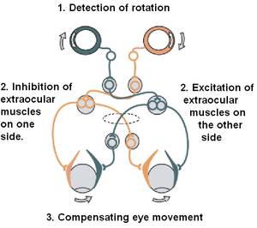
COMPENSATING / STABILIZING MOVEMENTS

Slide 5
TRANSMITTERS INVOLVED IN VESTIBULAR FIRING
Main Transmitters
Glutamates
Acetylcholine
Glycine
GABA
Modulatory Transmitters
Histamine
Noradrenaline
+
+
+
+
+
+
+
+

Slide 6
When disorder sets in = BALANCE DISORDER
The individual will feel unsteady when standing or walking
DIZZINESS ?
Lighted headedness
VERTIGO?
It is a type of dizziness that creates the sense
That you or your environment is SPINNING
Sensation of disorientation or motion (spinning) +
Nausea or vomiting,
sweating,
abnormal eye movements (nystagmus)

Slide 7
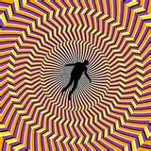

Slide 8
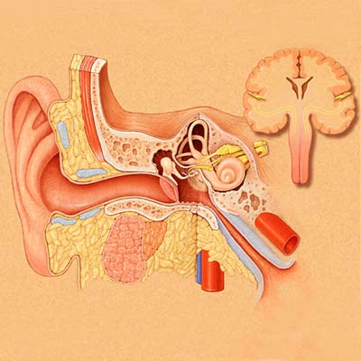
CAUSES
CNS
Impact on vestibular nuclei , afferent inputs or efferent outputs
MENIERE’S
Inner ear
Vestibular hair cell stimulation unrelated to head and body motions
Others
Low tolerance for vehicular motion such as cars, boats, cruise ships, and airplanes that cause MOTION SICKNESS.
Fluid / Electrolyte / Ca disturbances; ↑ BP, ↑ cholesterol
diabetes, anemia , calcium disorders …..
↓ equalization of air pressure in middle ear due to blocking or swelling of Eustachian tube → undue pressure on inner ear

Slide 9
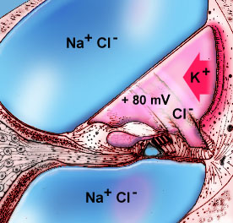
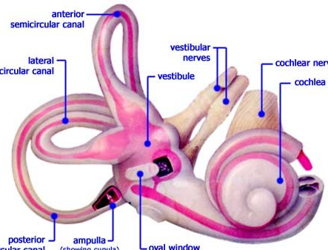
PATHOPHYSIOLOGY
Inner ear
Perilymph
Endolymph
Inner ear chamber is filled with
perilymph & endolymph.
↑endolymphatic pressure ( hydrolymphatic hydrops )→ microscopice breaks of separating membrane often with vestibular hair loss → depolarization and functional loss
Ménière's disease is a disorder of the inner ear that can affect hearing and balance.
It is characterized by episodes of vertigo, tinnitus and progressive hearing loss .
Ménière's disease; disorder of control of inner ear fluid homeostasis

Slide 10
Drugs used to control or prevent vertigo episodes

Slide 11
THERAPEUTIC MANAGEMENT
Vestibular Suppressants
Prevent Recurrence
Intend to dull
brain response
to vestibular signals
from inner ear
Intend to suppress acute attacks [ tame vertigo episodes]
Diuretics (but not loop diuretics)
Corticosteroids
L-type Ca Channel Blockers
( fluid retention)
Spinning
+
Emesis
(inflammation)
(  vasodilatation)
○ cinnarazine, flunnarazine, verapamil
NB. If migraine is also present → add on its treatment

Slide 12
VESTIBULAR SUPRESSANTS
Emesis
ANTIEMETICS
H₁ antagonist
Antihistamine Anticholinergic
Meclizine
Dimenhydrinate

Phenothiazines

+ Dopamine antagonists + Sedation
Prochlorperazine
Promethazine
Dopamine Antagonists

Dopamine Antagonist
+ Gastroprokinetic
Metoclopramide Domperidone  NO cross BBB

Slide 13
VESTIBULAR SUPRESSANTS
Spinning
H₁ agonists
???
Betahistine
H₃ antagonists
Benzodiazepines
promote & facilitate central vestibular compensation via GABA modulation
Lorazepam
Clonazepam
Diazepam

Slide 14
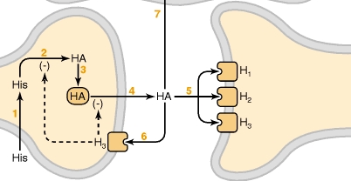
Betahistine
H istamine
Mediator
Neurotransmitter
CNS
ANS
H ₁
+
H ₂
+
H ₁
H ₃
+
H ₃
-ve presynaptic autoregulation

Slide 15
VESTIBULAR SUPRESSANTS
BETAHISTINE
H₁ agonists
H₃ antagonists
Weak agonist at H₁ receptors → regulates inner ear fluid homeostasis (labyrinthine circulation ) → inducing vaso-dilatation in middle ear → relieves pressure in inner ear
Strong antagonism of H₃ autoreceptors → ↑ augmenting effects on H₁ receptors in the brain →
- ↑ H synthesis in tuberomammillary nuclei of the posterior hypothalamus to promote & facilitate central vestibular compensation
- ↑ H release in vestibular nuclei
↑levels of neurotransmitters such as 5HT in the brainstem, which inhibits the activity of vestibular nuclei.

Slide 16
VESTIBULAR SUPRESSANTS
BETAHISTINE
Pharmacokinetics
Tablet form , rapidly & completely absorbed
t½=2-3h
Partially metabolized ( active) & excreted in urine
ADRs
Contraindications
Headache
Nausea
Gastric effects
↓ appetite and weight loss
Peptic ulcer
Pheochromocytoma
Bronchial asthma

Slide 17
ANTIEMETICS
DIMENHYDRINATE
(Dramamine)
H₁ antagonist
Antihistamines
> antiemetic < sedating
than Meclizine
Block H₁ receptors in CRTZ
Sedative effects
Weak anticholinergic effects
Indications
In vertigo
In control of MOTION SICKNESS by ↓ excitability in the labyrinth & blocking conduction in vestibular-cerebellar pathways.
ADRs
Contraindications
Sedation
Dizziness
Anticholinergic side effects
Glaucoma
Prostatic enlargement

Slide 18
ANTIEMETICS
PROCHlORPERAZINE
A Piperazine Phenothiazines
Block dopamine receptors at CRTZ
Antipsychotic , some sedation + antiemetic
Indications
One of the best antiemetics in vertigo
(sedating & has some vestibular suppressant action)
METOCLOPRAMIDE
Dopamine Antagonists
A potent central antiemetic acting on CRTZ
Has some sedating action
Has potent gastroprokinetic effect
Indications
In vertigo
ADRs
Restlessness or drowsiness
Extrapyramidal manifestations on prolonged use

Slide 19
Drugs inducing vertigo

Slide 20
DRUGS INDUCING VERTIGO
Are those drugs (or chemicals) producing destructive damaging effects on structure or function of labyrinthine hair cells &/ or their neuronal connections
VESTIBULOTOXINS
MIXED OTOTOXINS
Drugs altering fluid & electrolyte Diuretics
Antihypertensives ….
Drugs altering vestibular firing
Anticonvulsants
Antidepressants
Sedative hypnotics
Alcohol
Cocaine
FUNCTIONAL

Slide 21
DRUGS INDUCING VERTIGO
MIXED OTOTOXINS
Aminoglycoside antibiotics; gentamycin, kanamycin, neomycin, streptomycin, tobramycin, netlimycin
Fluroquinolines, Vancomycin, Polymixin
Quinine, chloroquine, quinidine
Nitrogen mustard
Loop diuretics
NSAIDs
Tobacco
STRUCTURAL
FUNCTIONAL

Slide 22
DRUGS INDUCING VERTIGO
Aminoglycoside antibiotics; streptomycin, kanamycin, neomycin, gentamycin, tobramycin, netlimycin
STRUCTURAL
Apoptosis
Neomycin → activate caspases → Death Receptor Pathway
Gentamycin → evoke free radicals → Mitochondrial Pathway
↓local blood flow → biochemical changes → alter electromechanical transduction
Quinine, chloroquine, quinidine
Loop diuretics
NSAIDs
Firing of impulses
FUNCTIONAL

Slide 23
G
O
O
D
L
U
C
K

