Slide 1
Physiology of Sleep and EEG
Dr. Eman El Eter

Slide 2
Objectives:
Difference between sleep & coma.
Why do we sleep?
Types of sleep: NREM & REM.
EEG waves.
Stages of NREM sleep.
Importance of REM sleep.
Sleep cycle and effect of age.
Sleep/awake cycle (Role of SCN).
Mechanism of sleep (centers/ neurotransmitters).
Sleep disorders.

Slide 3
Definition
Sleep is a state of loss of consciousness from which a subject can be aroused by appropriate stimuli.
Coma is a state of unconsciousness from which a subject cannot be aroused

Slide 4
Why do we sleep?
Restoration, or repair:
Waking life disrupts homeostasis
Sleep may conserve some energy
Protection with the circadian cycle
Circadian synthesis of hormones, ……
Consolidation of learning?
Remodelling of synaptic function

Slide 5
EEG waves
The frequencies of brain waves range from 0.5-500 Hz.
The most clinically relevant waves:
Alpha waves - 8-13 Hz
Beta waves - Greater than 13 Hz
Theta waves - 3.5-7.5 Hz
Delta waves - 3 Hz or less

Slide 6
Alpha waves
Seen in all age groups but are most common in adults.
Most marked in the parieto-occipital area.
Occur rhythmically on both sides of the head but are often slightly higher in amplitude on the nondominant side, especially in right-handed individuals
Occur with closed eyes , relaxation, wondering mind.

Slide 7
Alpha block
Alpha activity disappears normally with attention (eg, mental arithmetic, stress, opening eyes, any form of sensory stimulation).
Then become replaced with irregular low voltage activity.
Called arousal or alerting response.
Also called desynchronization as it represents breakup of synchronized neuronal activity!!!!
An abnormal exception is alpha coma, most often caused by hypoxic-ischemic encephalopathy of destructive processes in the pons (eg, intracerebral hemorrhage). In alpha coma, alpha waves are distributed uniformly both anteriorly and posteriorly in patients who are unresponsive to stimuli

Slide 8
Beta waves
Seen in all age groups.
Small in amplitude , usually symmetric and more evident anteriorly.
Drugs, such as barbiturates and benzodiazepines, augment beta waves.
> 13 Hz/sec

Slide 9
Theta waves
Normally seen during sleep at any age.
In awake adults, these waves are abnormal if they occur in excess.
Theta and delta waves are known collectively as slow waves.

Slide 10
Delta waves
Slow waves, have a frequency of ≤ 3Hz or less.
Normally seen in deep sleep in adults as well as in infants and children.
Delta waves are abnormal in the awake adult.
Often, have the largest amplitude of all waves.
Delta waves can be focal (local pathology) or diffuse (generalized dysfunction).

Slide 11
Sleep spindles
Spindles are groups of waves that occur during many sleep stages but especially in stage 2.
They have frequencies in the upper levels of alpha or lower levels of beta.
Lasting for a second or less, they increase in amplitude initially and then decrease slowly. The waveform resembles a spindle.
They usually are symmetric and are most obvious in the parasagittal regions.

Slide 12
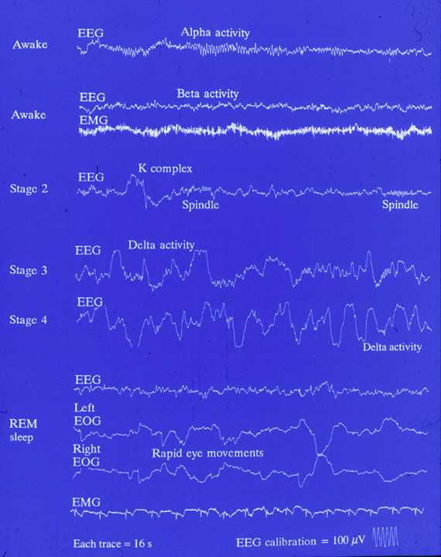

Slide 13
Types of sleep Depending on EEG criteria:
1. Slow-wave sleep (non-REM):
-75% of sleep time.
- restful.
- Decrease in vascular tone.
- Decrease in BP (10-30%)
- Decrease in Resp. rate.
- Decrease in BMR
It is not associated with rapid eye movement.
EEG: Theta + delta waves.
-If dreams occur they are not remembered as they are not consolidated in memory.

Slide 14
Types of sleep, continued,…
2- Rapid Eye Movement Sleep (REM):
Is so called because of rapid eye moevement.
-Occur in episodes of 5-30 min, recurring every 90 min.
-Tiredness shortens the duration of each episode.
-As you become restful through the night, the duration of each episode increases.
-Active dreaming, remembered later.

Slide 15
REM, continued,….
Decrease in muscle tone (due to excitation of reticular inhibitory centers).
HR & RR are irregular.
Rapid rolling movement of the eyes.
Erection of penis.
Engorgement of clitoris.
Twitches of facial & limb muscles.
More difficult to awake a person than in slow-wave sleep.

Slide 16
REM, continued,…
EEG: B-waves, indicating a high level of activity in the brain during REM (That is why it is called paradoxical sleep).
PGO spikes stimulate the Inhibitory Reticular Area leading to Hypotonia:
Exception: Respiratory + Eye muscles.
In sleep apnea, respiratory muscles are inhibited.

Slide 17
Importance of REM sleep
1. Expression of concerns in the sub-consciousness (Through dreams),
2. Long-term chemical and structural changes that the brain need to make learning & memory possible.

Slide 18
Sleep Classification is Based on EEG Features
(A) NREM Sleep (SWS) :
Is divided into 4 stages :
(1) Stage 1 NREM → when a person is initially falling asleep . Characterized by low-amplitude, fast activity (α-waves).
(2) Stage 2 NREM →
Marked by appearance of Sleep Spindles . These are bursts of alpha-like 10-14 z , 50 uV waves .
(3) Stage 3 NREM →
Lower frequency ( mainly theta) , higher amplitude EEG waves .
(4) Stage 4 NREM →
Still slower frequency ( mainly delta ) & still higher amplitude waves .
(B) REM Sleep :
(1) Low-voltage , fast activity (β-waves)

Slide 19
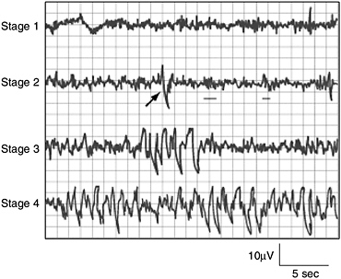
Sleep stages (NREM)

Slide 20
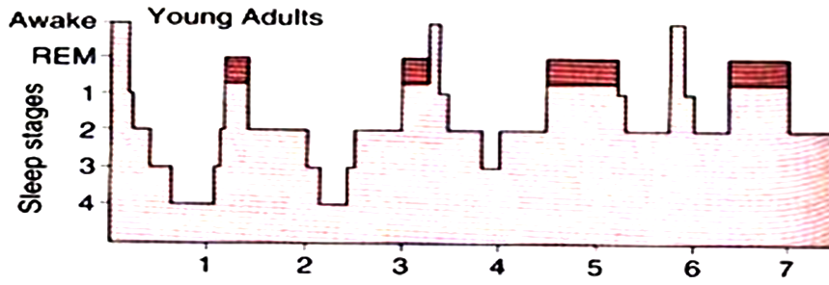
Distribution of Sleep Stages
While NREM occupies ( around 75-80n%) , it is interrupted by intervening REM sleep periods,
every 90 minutes .
In a typical night of sleep , a young
adult (1) first enters NREM sleep , passes
through stages 1 , 2 , 3 and 4 , then
(2) goes into the first REM sleep episode.
This cycle is repeated at intervals of
about 90 minutes throughout the
8 hours or so of a night sleep.
Therefore , there are 4-6 sleep cycles
per night ( and 4-6 REM periods per night)
As the night goes on → there is progressive reduction in stages 3 and 4 sleep and a progressive increase in REM sleep .
REM sleep periods are shown in red
In a young adult NREM occupies 75-80% of a night sleep time , & REM sleep occupies 20-25 % of the sleep time

Slide 21
Distribution of sleep stages in a typical night
Premature infants:
REM sleep occupies 80% of total sleep time.
Full term neonates:
50% of sleep time is occupied by REM.
Aged/elderly:
Thereafter , the proportion of REM sleep falls rapidly and plateaus at about 25 % (20-69ys) until it falls further in old age .
Children have more sleep time and stage 4 than adults

Slide 22
Sleep/wakefulness rhythm
Periods of sleep and wakefulness alternate about once a day.
A circadian rhythm consist typically of 8h sleep and 16 h awake.
This rhythm is controlled by the biological clock function of suprachiasmatic (SCN) nucleus in the hypothalamus.
Within sleep portion of this circadian cycle NREM and REM sleep alternate.

Slide 23
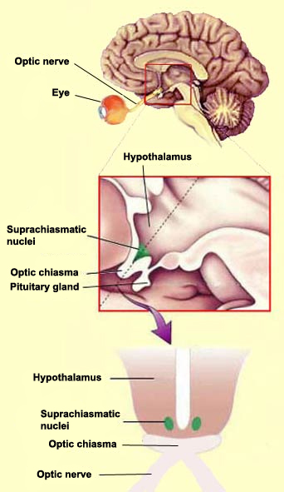
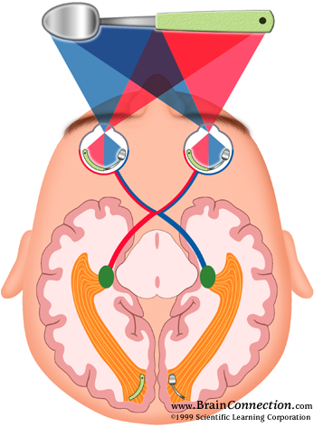
SCN

Slide 24
Mechanism of Sleep
Genesis of slow-wave sleep:
Active process produced by inhibition of areas in RAS responsible for alert conscious state of wakefulness.
Sleep Zones:
Stimulation of the following sites will lead to sleep and synchronization of slow –wave sleep EEG:
1. Diencephalon :
-suprachiasmatic region of post hypothalamus.
-diffuse thalamic nuclei: intra-laminal & ant.thalamic

Slide 25
Mechanism of sleep, continue.,
Slow frequency stim of diencephalon…….sleep.
High frequency stim of diencephalon…….arousal.
2. Medulla oblongata:
Medullary synchronizing zone at the level of NTS.
3. Basal forebrain: pre-optic area:
High or slow frequency stim……synchronization + sleep.
1,2&3 are connected together and with reticular area of the brain stem.

Slide 26
: Genesis of REM sleep
The mechanism producing REM sleep is located in pontine reticular formation.
Large cholinergic ponto-geniculo-occipital (PGO) spikes arise in this area and are thought to initiate sleep.
Discharge of noradrenergic neurons of locus ceruleus + discharge of serotonergic neurons of midbrain raphe causes wakefulness. They become silent when PGO active during REM.

Slide 27
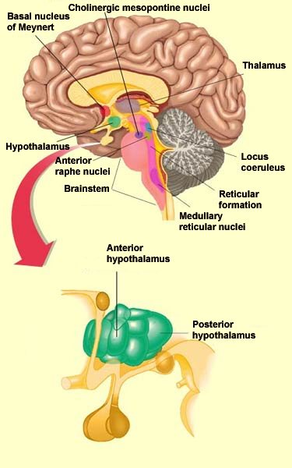

Slide 28
Role of neurotransmitters
Serotonin:
-Agonist: (-) sleep.
-antagonist: (+) slow-wave sleep.
Serotonin appears to modulate sleep through its effect on other hypnogenic factors in the anterior hypothalamus and suprachiasmatic nucleus
Serotonin is a melatonin precursor

Slide 29
Neurotransmitters, cont.,,,
Melatonin is synthesized and released by the pineal gland through sympathetic activation from the retino-hypothalamic tract.
Melatonin enhances sleep
prolonged bright light stimulation suppresses melatonin and sleep while subsequent melatonin injections can restore normal sleep patterns.
Adenosine: sleep inducing factor. It accumulates in brain with prolonged wakefulness. Adenosine antagonists e.g. caffiene ……(+) alertness.

Slide 30
Working Together in Sleep
Brainstem Nucleus Neurotransmitter Activity State of Nucleus
Wakefulness
Peduncularpontine ACh Active
Locus coeruleus NE Active
Raphe 5-HT Active
Non-REM Sleep
Peduncularpontine ACh Silent
Locus coeruleus NE Decreased Activity
Raphe 5-HT Decreased Activity
REM Sleep On
Peduncularpontine ACh Active as REM Approaches
Locus coeruleus NE Become Silent
Raphe 5-HT Inactive
REM Sleep Off
Locus coeruleus NE Become Active
Raphe 5-HT Become Active

Slide 31
Sleep disorders:
Insomnia.
Fatal familial insomnia: impaired autonomic & motor functions, dementia, death.
Disorders during NREM;
-Sleep walking.
-Bed wetting.
-Night terros.
Narcolepsy: episodic sudden loss of muscle tone… irresistible urge to sleep during day time (Bursts of REM).
Sleep apnea; airway obstruction.

Slide 32
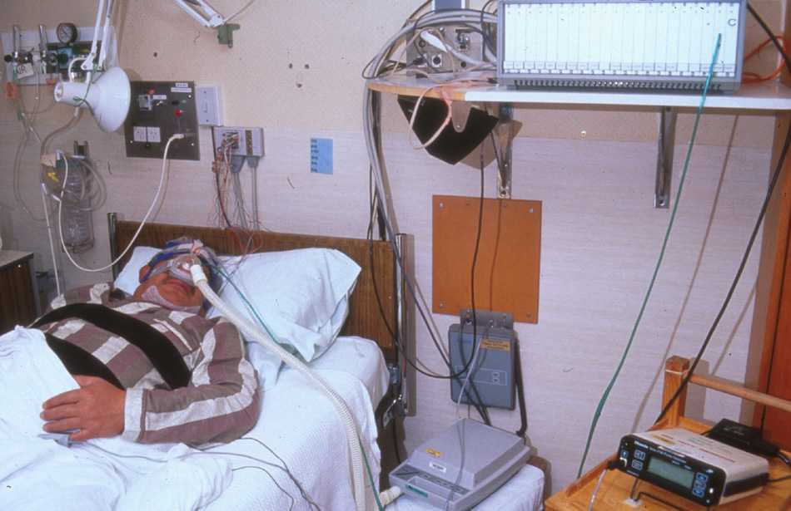
Sleep Lab

Slide 33
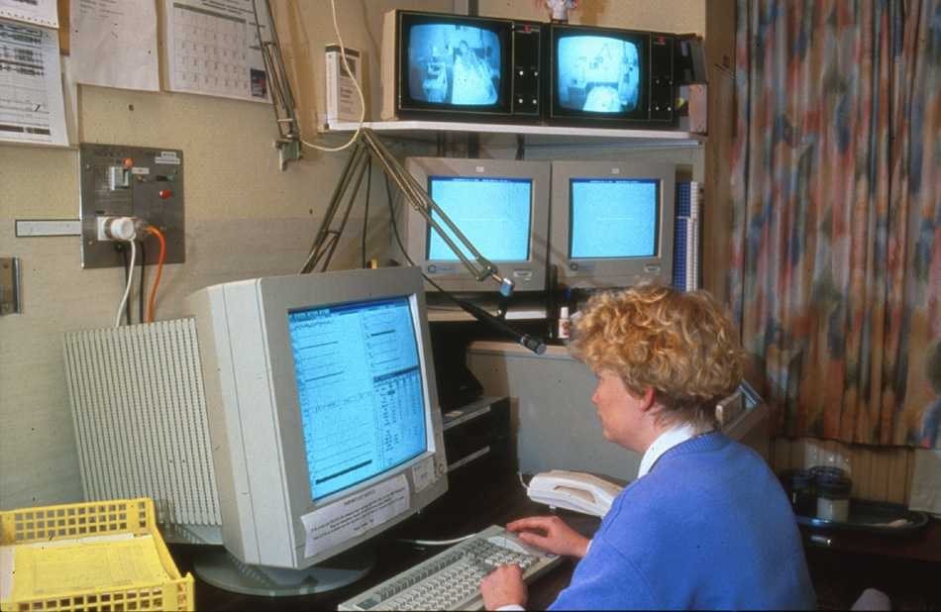
Sleep Lab

Slide 34
Great eaters and great sleepers are incapable of doing anything that is great.
William Shakespeare
“Henry IV”

