Slide 1
Speech and Language

Slide 2
It is the highest function of the nervous system
Involves understanding of spoken & printed words
It is the ability to express ideas in speech & writing

Slide 3
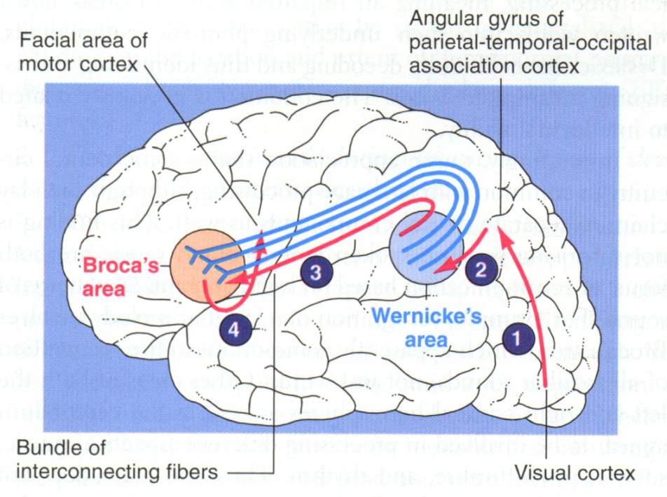

Slide 4
Areas involved
1- Wernicke`s area:
At the posterior end of the superior temporal gyrus
Closely associated with 1 & 2 auditory areas
Responsible about comprehension of auditory & visual information, then project it to Broca`s area via arcuat fasiculus

Slide 5
1- Wernicke`s area (cont.)
Interpretations of sensory experience
Formation of thought in response to sensory experience
Choice of words to express thoughts

Slide 6
2- Broca`s area:
At the lower end of premotor area
Process information received from W. area into detailed & co-ordinated pattern for vocalization
Then project it to motor cortex to initiate the appropriate movement of the lips & larynx to produces speech

Slide 7
2- Broca`s area (cont.):
In adult who learn second language during adulthood. The MRI shows portion of Broca`s area concerned with it is adjacent to but separate from area concerned with the native language
But in children who learn second language early in life there is only single area involved for both languages

Slide 8
3- Arcuate fasiculus

Slide 9
4- Agular Gyrus
Leis behind Wernikes area fused posteriorly into the visual cortex
Function: interpretation of information obtained from reading from visual cortex

Slide 10
W. area receive information from both auditory & visual areas
Project it to B. areas via arcuat fasiculus
Broca`s area process information received into co-ordinated pattern of vocalization & then project that pattern to the motor area

Slide 11
Initiation of movement of muscle of speech in tongue, larynx & lips.

Slide 12
If writing is concerned, then information received from W. area is processed in the area of hand skills
»»»»»» co-ordinated pattern of muscle movement projected to the arms & hand region of the motor cortex
»»»»»» initiation of necessary muscle movement in the hand & arms required for writing a particular word

Slide 13
Aphasia
Abnormality of language function due to injury of language centres in cerebral cortex. Comprehension or expression of words will be affected
Due to thrombus or embolism of cerebral vessels, trauma

Slide 14
Types of Aphasia

Slide 15
1- Motor or Broca`s aphasia (non fluent):
Lesion of Broca`s area
Patient will understand spoken & written words but find it difficult to speech or to write
Poorly articulated speech, slow with great effort & abnormal rhythm
In some cases speech may be limited to 2-3 words

Slide 16
2- Sensory or Wernikes aphasia (fluent):
Lesion of wernikes area +/- arcuate fasucul
Impaired comprehension
Loss of intellectual function
Failure to interprets meaning of written or spoken words
Meaningless & excessive talk (in sever cases)

Slide 17
3- Conductive aphasia (fluent):
Lesion of nerve fibres of arcuate fasiculus
Patient understand speech of others but can not repeat it
Meaningless speech

Slide 18
4- Anomic aphasia:
Lesion of angular gyrus, thus B. & W. are intact
Speech & auditory comprehension is normal but visual comprehension is abnormal, due to visual information is not processed & not transmitted to W. area
Dyslexia (word blindness) interruption in the flow of visual experience into W. area from visual area

Slide 19
Right Hemisphere
(the representational hemisphere)
The right hemisphere controls the left side of the body
Temporal and spatial relationships
Analyzing nonverbal information
Communicating emotion
Left Hemisphere
(the categorical hemisphere)
The left hemisphere controls the right side of the body
Produce and understand language

