Slide 1
Physiology of Consciousness
Dr. Eman El Eter

Slide 2
Objectives
Levels of consciousness/ definition
Functional divisions of RF.
Overview of functions of RF.
Anatomical components of RAS.
Connections of RAS.
Neurotransmitters of RAS.
Functions of RAS.

Slide 3
What is Consciousness ?
Is the brain state in which a person is being aware of the self and surroundings .
It is a product of electrical activity of the brain
(a person with a flat EEG can not be conscious ! )
Notes:
Aware : واع ، مدرك ، مطلع
Consciousness : الوعي
Perception : الأدراك ،

Slide 4
What are the levels of consciousness?
(1) Normal Consciousness
(state of normal arousal , being fully awake and aware of the self and surroundings )
(2) Clouded consciousness : person conscious but mentally confused ( e.g., in cases of drug or alcohol intoxication , high fever associated with malaria or septicemia , dementia , etc ) .
(3) Sleep : person unconscious ( in relation to the external world & surroundings ) , but is arousable ( can be aroused ) .
(4) Coma : person unconscious and not arousable
Notes:
Aware : واع ، مدرك ، مطلع
Consciousness : الوعي
Perception : الأدراك ،

Slide 5
What are brain Structures involved in the conscious state?
Consciousness depends upon interactions between :
(1) Reticular Formation ( RF) .
(2) Thalamus
(3) Cortical Association areas .

Slide 6
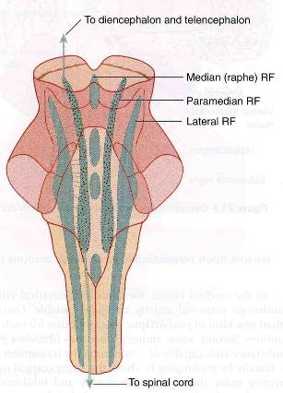
Reticular formation
This regulates many vital functions including the sleep/awake cycle. It is a polysynaptic network located in the pons, midbrain and upper medulla and is poorly differentiated. It consists of 3 parts:
Lateral Reticular Formation
Has small neurones
Receives information from ascending tracts for touch and pain.
Receives vestibular information from median vestibular nerve.
Receives auditory information from superior olivary nucleus.
Visual information from superior colliculus.
Olfactory information via medial forebrain bundle

Slide 7
Reticular Formation, cont.,,
Paramedian Reticular Formation
Has large cells.
Receives signals from lateral reticular formation.
Projects onto cerebral hemispheres.
Nucleus coeruleus contains noradrenergic neurones and projects onto the cerebral cortex.
Ventral tegmental nucleus contains dopaminergic neurones that project directly onto the cortex.
Cholinergic neurones project onto the thalamus

Slide 8
Reticular formation, cont.,,
Raphe nuclei (Median RF)
In the midline of the reticular formation
Contain serotonergic projections to the brain and spinal cord.

Slide 9
What are the Functions of reticular formation?
1. Somatic motor control (Reticulospinal tracts)
2. Cardiovascular control - The reticular formation includes the cardiac and vasomotor centers of the medulla oblongata.
3. Pain modulation - The reticular formation is one means by which pain signals from the lower body reach the cerebral cortex. It is also the origin of the descending analgesic pathways. The nerve fibers in these pathways act in the spinal cord to block the transmission of some pain signals to the brain.

Slide 10
Functions of RF, continued,….
4. Sleep and consciousness - The reticular formation has projections to the thalamus and cerebral cortex . It plays a central role in states of consciousness like alertness and sleep. Injury to the reticular formation can result in irreversible coma.
5. Habituation - This is a process in which the brain learns to ignore repetitive, meaningless stimuli while remaining sensitive to others. A good example of this is when a person can sleep through loud traffic in a large city, but is awakened promptly due to the sound of an alarm .

Slide 11
Thalamus:
The thalamus is contained in the mid-part of the diencephalon and is split up into a number of different nuclei which perform 3 main tasks:
Cholinergic projections excite the individual thalamic relay nuclei which lead to activation of the cerebral cortex.
Cholinergic projections to the intralaminar nuclei, which in turn project to all areas of the cortex .
Cholinergic projections to reticular nuclei to regulate flow of information through other thalamic nuclei to the cortex.
Tuberomammillary nucleus in the hypothalamus projects to the cortex and is involved in maintaining the awake state.
The cholinergic projections to the thalamus stimulates the cerebral cortex.

Slide 12
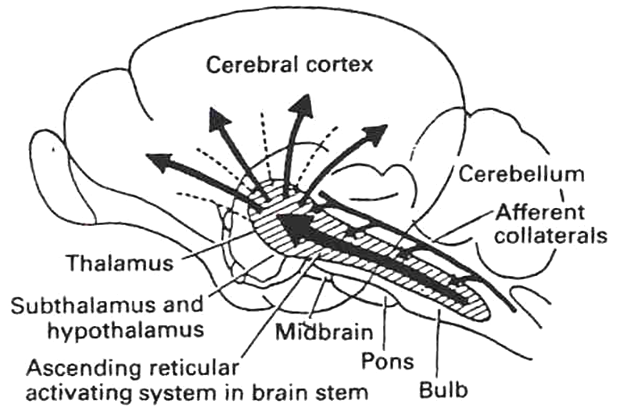
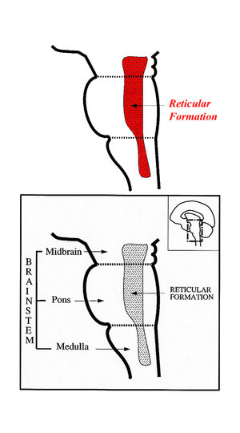
RAS
Lesion in the mid-pons makes the animal spends the rest of its life unconscious .
This means that areas in the upper pons and midbrain are essential for wakefulness . That area called Bulboreticular Facilitory ( Excitatory ) Area of the reticular formation .

Slide 13
Anatomical components of RAS
The RAS is composed of several neuronal circuits connecting the brainstem to the cortex . These pathways originate in the upper brainstem reticular core and project through synaptic relays in the rostral intralaminar and thalamic nuclei to the cerebral cortex. As a result, individuals with bilateral lesions of thalamic intralaminar nuclei are lethargic or somnolent.
Several areas traditionally included in the RAS are:
Midbrain Reticular Formation.
Mesencephalic Nucleus (mesencephalon)
Thalamic Intralaminar nucleus
Dorsal Hypothalamus.
Tegmentum.

Slide 14
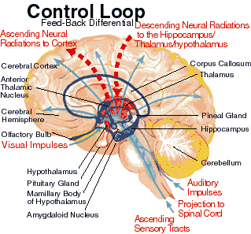
Sensory inputs to RAS

Slide 15
Functions of RAS: Regulating sleep-wake transitions
The main function of the RAS is to modify and potentiate thalamic and cortical functions resulting in (EEG) desynchronization.
Low voltage fast burst brain waves (EEG desynchronization) are associated with wakefulness and REM sleep ,
During non-REM sleep, neurons in the RAS will have a much lower firing rate large voltage slow waves .
The physiological change from a state of deep sleep to wakefulness is reversible and mediated by the RAS.
Stimulation of the RAS produces EEG desynchronization by suppressing slow cortical waves.
In order that the brain may sleep, there must be a reduction in ascending afferent activity reaching the cortex by suppression of the RAS.

Slide 16
Attention
The reticular activating system also helps mediate transitions from relaxed wakefulness to periods of high attention. There is increased regional blood flow in the midbrain reticular formation (MRF) and thalamic intralaminar nuclei during tasks requiring increased alertness and attention.

Slide 17
RAS and learning
The RAS is the center of balance for the other systems involved in learning, self-control or inhibition, and motivation.
When functioning normally, it provides the neural connections that are needed for the processing and learning of information, and the ability to pay attention to the correct task.

Slide 18
What happens if RAS is not working properly?
If the RAS doesn't excite the neurons of the cortex as much as it ought to, then we see the results of :
* An under-aroused cortex, with difficulty learning, poor memory, little self-control, and so on.
* If RAS failed to activate the cortex at all one would see a lack of consciousness or even coma.
What would happen if the RAS was too excited, and aroused the cortex or other systems of the brain too much?
*Then we would see individuals with excessive startle responses, hyper-vigilance, touching everything, talking too much, restless, and hyperactive.

Slide 19
Indices of Level of Consciousness
Appearance & Behavior :
posture ( sitting , standing ? ) , open eyes ? . Facial expression ? , responds to stimuli ( including the examiner’s questions about name , orientation in time & place ? & other general Qs like who is the president ? )
Vital signs :
Pulse , BP, respiration , pupils , reflexes , particularly brainstem reflexes , etc )
EEG → Each of these states ( wakefulness , sleep , coma and death ) has specific EEG patterns .
Evoked potentials ( in cases of Brain Death ).

Slide 20
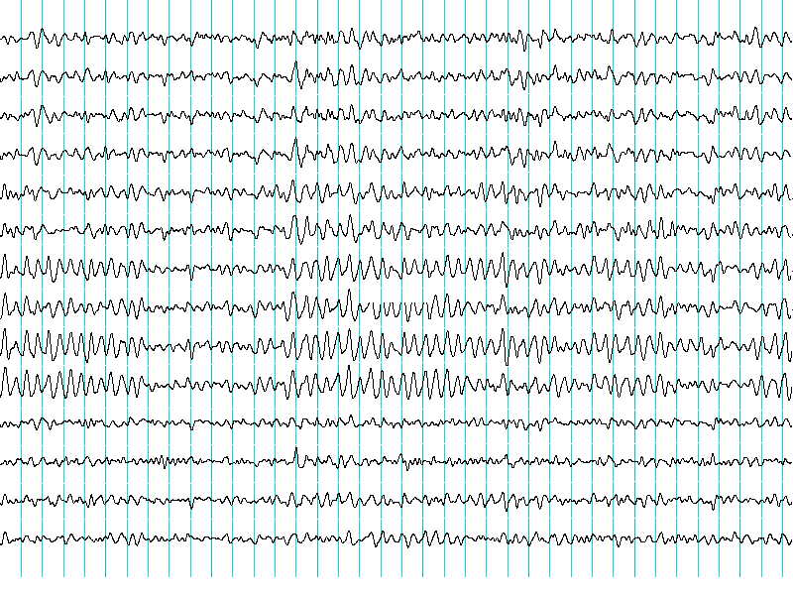
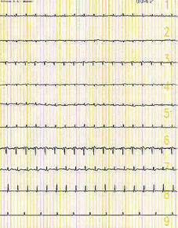
Brain Death Confirmatory Testing with EEG
Normal EEG ( at normal magnification )
Brain Death ( Flat EEG ,at very high magnification )

Slide 21
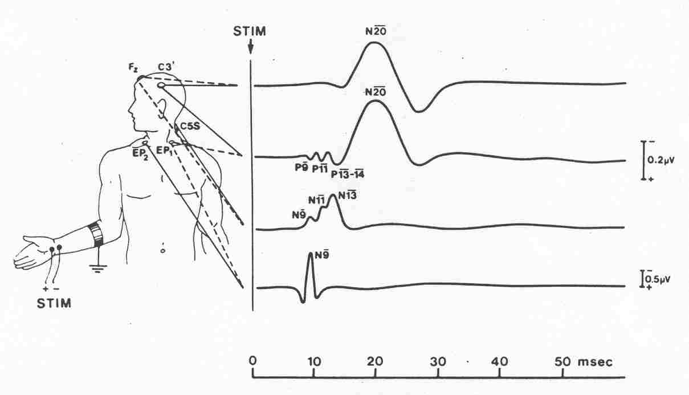
Brain Death Confirmatory Testing with Somatosensory Evoked Potentials
Stimulation of a sense organ can evoke a cortical response that can be recorded by scalp electrode over the primary receiving cortical area for that particular sense .

