Slide 1
The Autonomic Nervous System
BASAL GANGLIA
Physiology of basal ganglia and regulatory mechanisms
Dr Fawzia Al-Rouq
Department of Physiology
College of Medicine
King Saud University

Slide 3
Objectives
Physiology of basal ganglia and regulatory mechanisms
At the end of this lectutre the student should be able to:-
1-appreciate different nuclei of basal ganglia
2-know different neurotransmitters that have a role in basal ganglia functions
3-know Basal Ganglia connections & their functions
4-appreciate general functions of basal ganglia
5-diagnose basal ganglia disorders

Slide 4
INTRODUCTION

Slide 5
The basal ganglia (or basal nuclei) are a group of nuclei of varied origin.
They are situated at the base of the forebrain and are strongly connected with the cerebral cortex, thalamus and other brain areas.
The basal gangli functions:
voluntary motor control, procedural learning relating to routine behaviors or "habits" , eye movements, and cognitive, emotional functions.

Slide 6
Experimental studies show that the basal ganglia exert an inhibitory influence on a number of motor systems, and that a release of this inhibition permits a motor system to become active
The "behavior switching" that takes place within the basal ganglia is influenced by signals from many parts of the brain, including the prefrontal cortex, which plays a key role in executive functions

Slide 7
Objectives
Physiology of basal ganglia and regulatory mechanisms
At the end of this lectutre the student should be able to:-
1-appreciate different nuclei of basal ganglia
2-know different neurotransmitters that have a role in basal ganglia functions
3-know Basal Ganglia connections & their functions
4-appreciate general functions of basal ganglia
5-diagnose basal ganglia disorders

Slide 8
the four principle nuclei of the basal ganglia are the:
striatum
globus pallidus
substantia Nigra- pars compacta,reticulata
subthalamic nucleus

Slide 9
The striatum
the striatum consists of three subdivisions, the:
caudate nucleus
putamen
ventral striatum (which includes the nucleus accumbens)
a major collection of fibers, called the internal capsule, separates the caudate nucleus and putamen

Slide 10
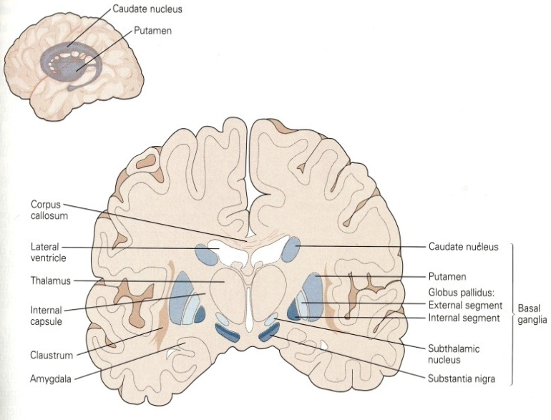
subthalamic nucleus
The subthalamic nucleus is a diencephalic gray matter portion of the basal ganglia, and the only portion of the ganglia that actually produces an "excitatory," glutamate neurotransmitter.
The role of the subthalamic nucleus (STN) is to stimulate the SNr-GPi complex and it is part of the "indirect pathway".

Slide 11
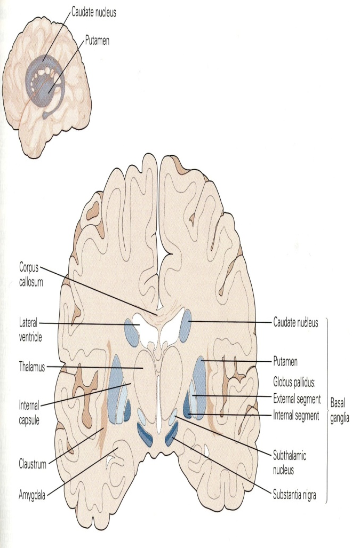
substantia nigra
a mesencephalic gray matter portion of the basal ganglia that is divided into SNr (reticulata) and SNc (compacta).
SNr often works in unison with GPi, and the SNr-GPi complex inhibits the thalamus.
Substantia nigra pars compacta (SNc) however, produces the neurotransmitter dopamine, which is very significant in maintaining balance in the striatal pathway.

Slide 12
Globus palldus
The pallidum receives its most important input from the striatum (either directly or indirectly), and sends inhibitory output to a number of motor-related areas, including the part of the thalamus that projects to the motor-related areas of the cortex

Slide 13
Globus palldus
The external segment, or GPe, receives input mainly from the striatum, and projects to the subthalamic nucleus. The internal segment, or GPi, receives signals from the striatum via two pathways, called "direct" and "indirect". Pallidal neurons operate using a "disinhibition" principle.
neurons fire at steady high rates in the absence of input, and signals from the striatum cause them to "pause". Because pallidal neurons themselves have inhibitory effects on their targets, the net effect of striatal input to the pallidum is a reduction of the tonic inhibition exerted by pallidal cells on their targets

Slide 14
substantia nigra
One part of substantia nigra, the reticulata (SNr), functions similarly to the pallidum, and another part (compacta or SNc) provides the source of the neurotransmitter dopamine's input to the striatum.
The subthalamic nucleus (STN) receives input mainly from the striatum and cortex, and projects to a portion of the pallidum (interna portion or GPi). Each of these areas has a complex internal anatomical and neurochemical organization

Slide 15
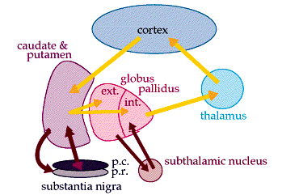
MAIN INPUT TO THE BASAL GANGLIA
The comes from the cerebral cortex (motor area) and projects to the NEOSTRIATUM
(a term for the caudate nucleus and putamen)
THE MAIN OUTPUT
Is via the thalamus to the cerebral cortex
(motor area)

Slide 16
Neurotransmitters
In most regions of the brain, the predominant classes of neurons use glutamate as neurotransmitter and have excitatory effects on their targets.
majority of BG neurons use GABA as neurotransmitter and have inhibitory effects on their targets.
The inputs from the cortex and thalamus to the striatum and STN are glutamatergic,
but the outputs from the striatum, pallidum, and substantia nigra pars reticulata all use GABA.
Thus, following the initial excitation of the striatum, the internal dynamics of the basal ganglia are dominated by inhibition and disinhibition.
Other neurotransmitters have important modulatory effects. The most intensively studied is dopamine, which is used by the projection from the substantia nigra pars compacta to the striatum, and also in the analogous projection from the ventral tegmental area to the nucleus accumbens.
Acetylcholine also plays an important role, being used both by several external inputs to the striatum, and by a group of striatal interneurons.
striatum has one of the highest acetylcholine concentrations of any brain structure

Slide 17
Circuit connections
In order to understand the complex circuitry of the basal ganglia, one has to first understand the important participants in this circuit.
Parts of the basal ganglia are in direct communication with the thalamus and the cortex.The cortex, thalamus, and the basal ganglia are, therefore, the three main participants in the circuit created by the basal ganglia.

Slide 18
These cortical neurons release the neurotransmitter glutamate, which is excitatory in nature. Once excited by glutamate, the cells in the striatum project in two different directions giving rise to two major pathways: The "direct" and the "indirect" pathways:

Slide 19
Connectivity diagram showing excitatory glutamatergic pathways as red, inhibitory GABAergic pathways as blue, and modulatory dopaminergic pathways as magenta. (Abbreviations: GPe: globus pallidus external; GPi: globus pallidus internal; STN: subthalamic nucleus; SNc: substantia nigra compacta; SNr: substantia nigra reticulata)

Slide 20
direct pathway
cortical cells project excitatory inputs to the striatum, which in turn projects inhibitory neurons onto the cells of the SNr-GPi complex.
The SNr-GPi complex projects directly onto the thalamus through the inhibitory pathway.
This results in a net reduction of inhibition of the thalamus via the striatum.
The thalamus projects excitatory glutamatergic neurons to the cortex itself.
The direct pathway, therefore, results in the excitation of the motor cortex by the thalamus. Once stimulated, the cortex projects its own excitatory outputs to the brain stem and ultimately muscle fibers via the lateral corticospinal tract.

Slide 21
indirect pathway
Striatum stimulated by the cortex,
striatum project inhibitory axons onto the cells of the globus pallidus externa (GPe), which tonically inhibits the subthalamic nucleus (STN).
This results in the net reduction of inhibition of the STN. The STN, in turn, projects excitatory inputs to the SNr-GPi complex (which inhibits the thalamus).
The end-result is decreased stimulation of the motor cortex by the thalamus and reduced muscle activity.

Slide 22
direct pathway:
Cortex (stimulates) → Striatum (inhibits) → "SNr-GPi" complex (less inhibition of thalamus) → Thalamus (stimulates) → Cortex (stimulates) → Muscles, etc. → (hyperkinetic state)
indirect pathway:
Cortex (stimulates) → Striatum (inhibits) → GPe (less inhibition of STN) → STN (stimulates) → "SNr-GPi" complex (inhibits) → Thalamus (is stimulating less) → Cortex (is stimulating less) → Muscles, etc. → (hypokinetic state

Slide 23
The antagonistic functions of the direct and indirect pathways are modulated by the substantia nigra pars compacta (SNc), which produces dopamine.
Special D1-receptors in basal ganglia are excited by dopamine, favoring the direct pathway.
D2-receptors in the basal ganglia are inhibited in presence of dopamine and favor the indirect pathway.
Through these mechanisms the body is able to maintain balance between excitation and inhibition of motion. Lack of balance in this delicate system leads to pathologies such as Parkinson's disease.

Slide 24
Eye movement
Eye movement is influenced by an extensive network of brain regions that converge on a midbrain area called the superior colliculus (SC).
eye movements begin with activation in the caudate nucleus, which inhibits the SNr via the direct GABAergic projections, which in turn disinhibits the SC

Slide 25
Basic Circuits of basal ganglia
A motor loop (putamen circuit) concerned with learned movment.
Cognitive loop (Caudate circuit) concerned with cognitive control of sequences of motor pattern. Basically it is concerned with motor intentions.
(Note: cognition means thinking process using sensory input with information already stored in memory.)

Slide 26
Limbic loop: involved in giving motor expression to emotions like, smiling, aggressive or submissive posture.
Occulomotor loop concerned with voluntary eye movement [ saccadic movement]

Slide 27
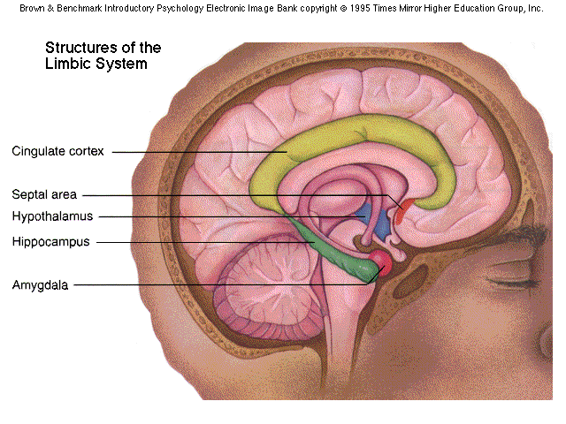
THE LIMBIC SYSTEM

Slide 28
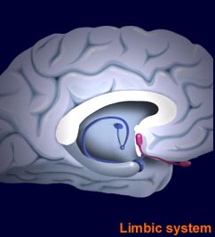
FUNCTIONS OF THE LIMBIC SYSTEM
Cingulate cortex:
Coordination of sensory signals
Emotion
Septal area:
Sexual arousal
Hippocampus:
Long-term memory development
Amygdala:
Aggression and fear
Hypothalamus:
Endocrine regulation
Body temperature
Regulation of thirst and hunger
Regulation of circadian rhythms

Slide 29
Putamen circuit has indirect connection to cortex via thalamus
Putamen circuit is inhibitory.
Executes skilled motor activities for example cutting paper with a scissor,
hammering on nail, shooting a basket ball & like throwing a base ball.
.

Slide 30
caudate has direct conection to the cortex from thalamus.
Caudate circuit is excitatory, has instinctive function which works without thinking and need quick response.
eg. response after seeing a lion

Slide 31
Neurotransmitters of basal ganglia
Dopamine pathway: from substantia nigra to caudate nucleus and putamen.
Gama amino butyric acid pathway from caudate nucleus and putamen to globus pallidus and substantia nigra.
Acetylcholine pathway from cortex to the caudate nucleus to putamen.
Glutamate that provide the excitatory signals that balance out the large no. of the inhibitory signals transmitted specially by the dopamin, GABA & serotonin inhibitory transmitters.

Slide 32
FUNCTIONS OF BASAL GANGLIA
Voluntary motor activities
Regulatory
Procedural learning
Routine behaviors (Habits)

Slide 33
FUNCTIONS OF BASAL GANGLIA
Procedural learning
Routine behavior ( habits)

Slide 34
Functions
1. Planning & programming (discharge before movement begins ) .
2. Motor control of the final common pathway .
3. Muscle tone (lesion increases).
4. Cognitive functions (Frontal cortex) Lesions disrupt performance .
5. Speech , lesion of left caudate results in disturbed speech dysarthria .

Slide 35
Disorders of movement in Basal ganglia disease
1. Hyperkinetic – excessive abnormal movement i.e. chorea, athetosis, ballism .
2. Hypokinetic – slow movements i.e. akinesia , bradykinesia .

Slide 36
HYPERKINESIA
1. CHOREA
Rapid involuntary “ dancing” movements .

Slide 37
2. Athetosis
Continuous , slow writhing movments .

Slide 38
3. Ballism (Hemiballismus)
Involuntary flailing , intense and violent movements .

Slide 39
Hypokinesia
1. Akinesia :
Difficulty in initiating movement .
2. Bradykinesia :
Slowness of movement .

Slide 40
Parkinson’s disease Paralysis Agitans
James Parkinson .
1. Degeneration of dopaminergic nigrostriatal neurons (60-80 %).
2. Phenthiazines(tranquilizers drugs) .
3. Methyl-Phenyl-Tetrahydro-Pyridine (MPTP). The oxidant MPP+ is toxic to SN.

Slide 41
Cont.
Rigidity
agonists and antagonists ( spacticity).
Lead-pipe rigidity
cogwheel -catches
(mixture of tremer and rigidity) .
Tremers . At Rest , 8Hz of antagonists.

Slide 42
Features
Akinesia –Bradykinesia are marked.
Absence of associated unconcious movements(swinging of arms during walking .
Facial expression is masked.
Rigidity
Tremors(static T)

Slide 43
Pathogenesis
Excitation imbalance Inhibition
loss of dopamine inhibition of putamen
increases in inhibitory output to GBes
decreases inhibitory output of STN
increases excitatory output GBis
increases inhibitory output to thalamus
reduces excitatory drive to cerebral cortex

Slide 44
Parkinson’s Disease: Treatment
Drug Therapy
L-DOPA
Cholinergic
Pallidectomy
Electrical stimulation of Globus pallidus
Tissue transplants

Slide 45
Huntington’s Disease (Chorea)
Rare
onset 30-40s
early as 20s
Degeneration of Striatum
Caudate
Putamen
GABA & ACh neurons

Slide 46
Huntingtons Disease
Hereditory , autosomal dominant .
Disease of caudate & putamen.
Jerky movement of hands toward end of reaching an object .
Chorea
Slurred speech and incomprehensive .
Progressive Dementia -

Slide 47
Cont. Huntingtons
Loss of GABA – Cholinergic neurons .
The loss of GABAergic neurons leads to chorea
Loss of Dopaminergic neurons leads to
Parkinson”s disease .

Slide 48
Summary of functions and disfunctionof basal ganglia
It play important motor function in starting and stopping motor functions and inhibiting unwanted movement.
It changes the timing and scales the intensity of movements.
Putamen circuit is inhibitory. Executes skilled motor activities for example cutting paper with a scissor, hammering on nail, shooting a basket ball & like throwing a base ball.
Putamen circuit has indirect connection to cortex via thalamus.while caudate has direct conection to the cortex from thalamus.

Slide 49
Cont…
Caudate circuit is excitatory, has instinctive function which works without thinking and need quick response. eg. response after seeing a lion.
[Note: effects of basal ganglia on motor activity are generally inhibitory.]
Lesions of the basal ganglia produce effects on contra lateral side of the body
Damage to basal ganglia does not cause paralysis. However it results in abnormal movements

Slide 50
Movement Disorder | Features | Lesion
Chorea | Multiole quick, random movements, usually most prominent in the appendicular muscles | Atrophy of the striatum. Huntington Chorea
Athetosis | Slow writhing movements,which are usually more severe in the appendicular muscles | Diffuse hypermyelination of corpus striatum and thalamus
Hemiballismus | Wild flinging movements of half of the body | Hemorrhagic destruction of contralateral subthalamic n. Hypertensive patients
Parkinsonism | Pill rolling tremor of the fingers at rest, lead pipe rigidity and akinesia | Degenration of Substantia Nigra

