Slide 1
Special senses

Slide 2
Vision
Hearing
Smell
Taste

Slide 6
Smell
Anatomy
Olfactory mucus: in the roof of nasal cavity near the septum
Contain olfactory receptors (bipolar neurone)
Axons collected in bundles called fila olfactoria

Slide 7
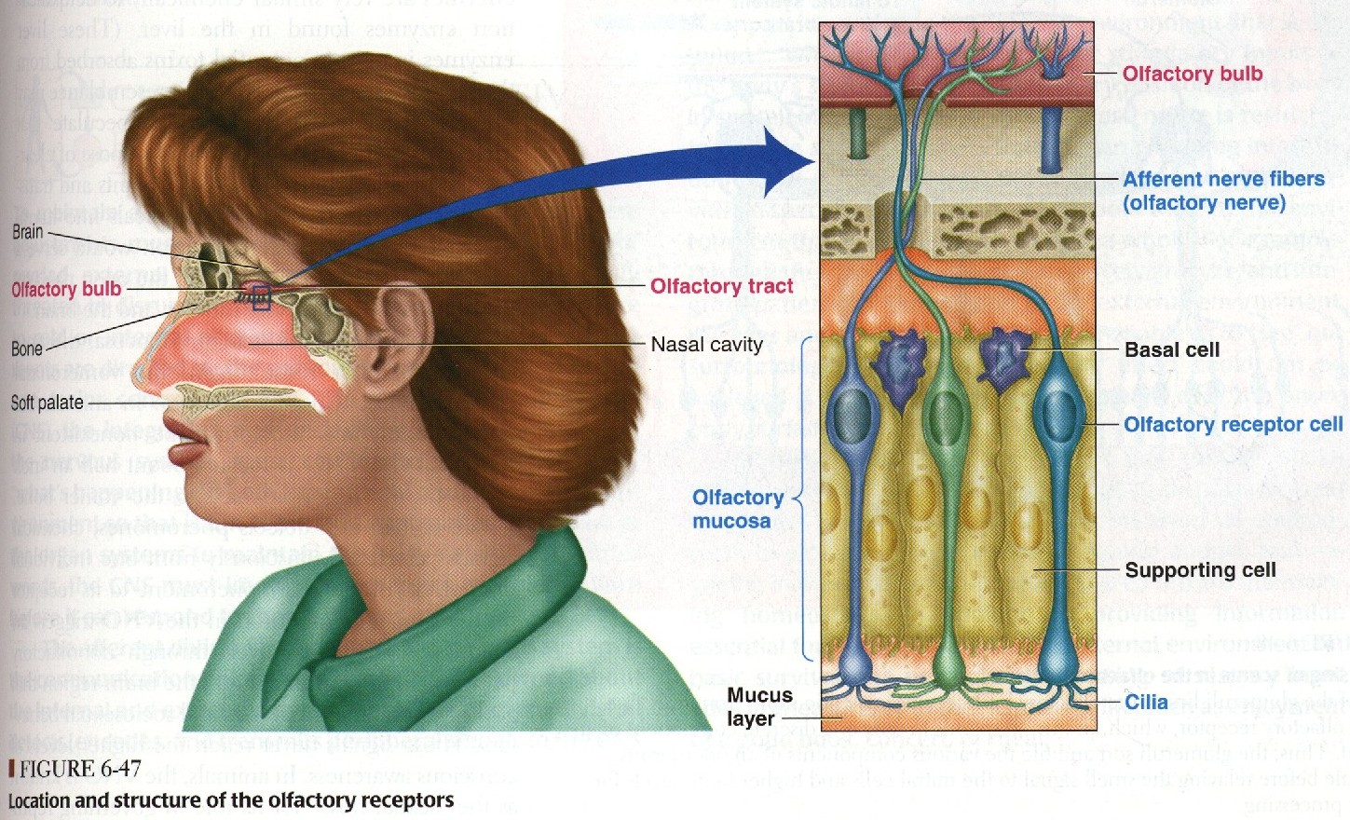

Slide 8
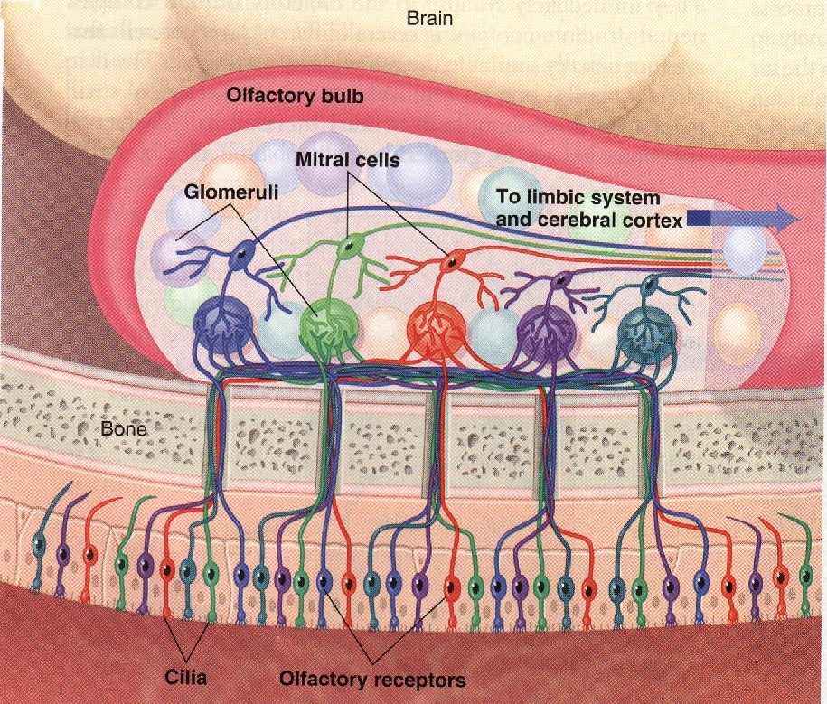

Slide 10
Olfactory pathway
Fila olfactoria inter olfactory bulb »»»» synapse with mitral and tufted cells :

Slide 11
»»»» from mitral cells lateral and intermediate stria start »»»» end on ipsilateral cortex

Slide 12
»»»» from tufted cells medial strai start then cross the midline & end on granular cells in opposite side (contralateral)

Slide 14
Impulses travel along the olfactory tracts to the limbic system
(also involved in emotions and memory
Impulses are interpreted in olfactory cortex
Deep in temporal lobe and base of frontal lobe

Slide 15
Physiology of olfaction
Molecules dissolve in mucus layer »»»» combine with receptors on cilia
»»»» stimulate adenylat cyclase »»»» increase intracellular cAMP
»»»» opening of Na channels »»»» receptors potential »»»» AP in olfactory pathway

Slide 16
Physiology of olfaction
Human can differentiate between 2000-4000 odours
Adaptation can occur to pleasant and nasty smells due to changes both in receptors and central connections

Slide 17
Pathophysiology
Anosmia: loss of smell sensation
Due to damage to olfactory epithelium

Slide 18
Pathophysiology
Parosmia (dysosmia)
Alteration in smell sensation

Slide 19
Pathophysiology
Hyperosmia (increase in smell sensation)
Adrenal insufficiency

Slide 20
Pathophysiology
Hyposomia (decreased smell sensation)
Vitamin A deficiency

