Slide 1
Taste

Slide 2
Taste bud is specialised receptors in the oral cavity but mainly on the tongue, some on the palate

Slide 3
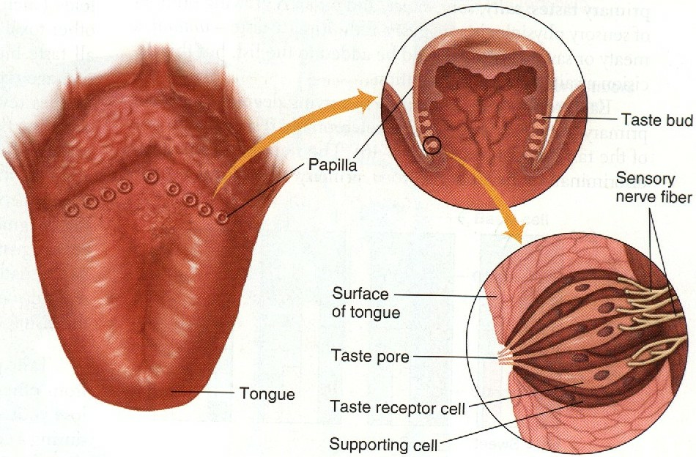

Slide 4
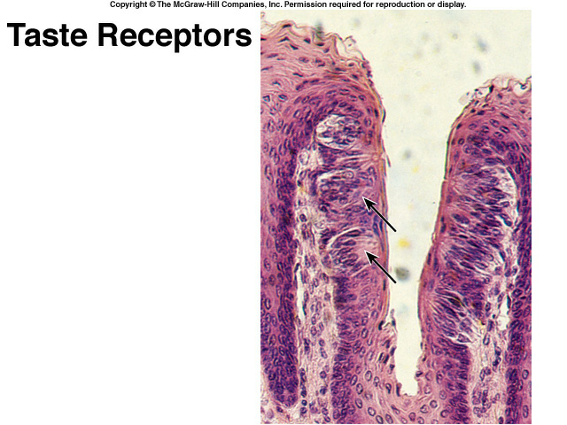

Slide 5
Types of papillae (projection)
Filiform
Fungiform
Circumvallate
No taste buds on the mid dorsum of the tongue

Slide 7
Anatomy
Taste bud : gustatory cells with microvilli (gustatory hair)
They are receptors cells with cilia projected through taste pore in between there are supporting cells

Slide 9
Taste bud:
When stimulated produce nerve impulse to specific brain area through:
Anterior 2/3 of the tongue »»»»» VII
Posterior 1/3 of the tongue »»»»» IX
Receptors on the palate, pharynx, epiglottis »»»»» X

Slide 10
Taste pathway
First order neurone:
  Taste fibres from the three cranials nerves form tractus solitarius »»»»» end in the nucleus of tractus solitarius (medulla)
Second order neurone:
  From TS cross the midline to ascend in the medial lemniscus to the thalamus

Slide 11
Third order neuron:
  from thalamus project the cerebral cortex through thalamic radiation

Slide 12
Taste sensation
Molecules dissolve in the saliva »»»»» attached to receptors on cillia of gustatory cells »»»»» receptors potential »»»»» action potential
Combination between molecules and receptors are week (since taste can be easily abolished by washing mouth with water)

Slide 13
Sweet receptors respond to »»»»» sugar, saccharine, some amino acids
Sour receptors respond to »»»»» H ion
Salty receptors respond to »»»»» salts

Slide 14
Distribution of taste buds on tongue not uniform
  sweet - tongue tip
  sour - tongue margins
  bitter - back of tongue
  salt - widely distributed

Slide 15
Pathophysiology
Ageusia (complete loss of taste)

Slide 16
Dysgeusia (disturbed taste)

Slide 17
Hypogeusia

Slide 18
Hypergeusia
Adrenal insufficiency

