Slide 1
Central nervous system block practical revision

Slide 3
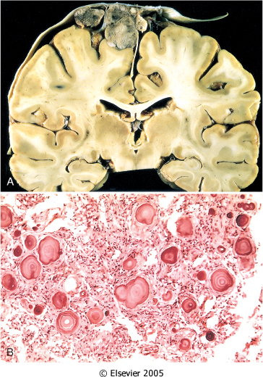
A, parasagittal multilobular meningioma attached to the dura with compression of underlying brain.
B, Meningioma with a whorled pattern of cell growth and psammoma bodies (arrows) (psammomatous meningioma).

Slide 4
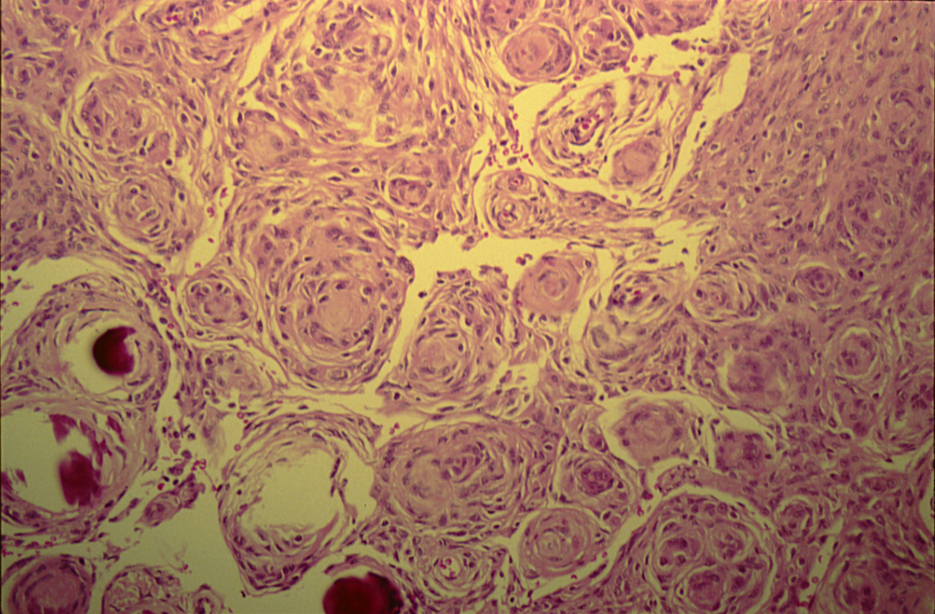
MENINGIOMA(Syncytial meningioma)

Slide 5
Meningioma: Section of tumour shows:
Whorls of fibrocellular tissue (red arrows).
Cells are oval, spindle shape or elongated and lack mitosis.
Psammoma bodies (spherical calcified particles) are also seen within the tumour (blue arrows).

Slide 6
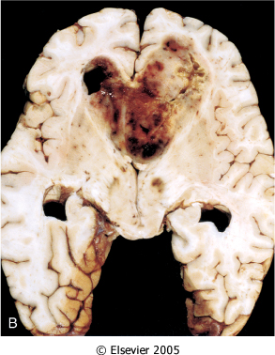
Glioblastoma multiforme appearing as a necrotic, hemorrhagic, infiltrating mass.

Slide 7
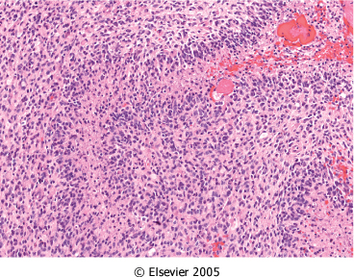
Glioblastoma. Foci of necrosis (blue arrow) with pseudopalisading of malignant nuclei (black arrow).

Slide 8
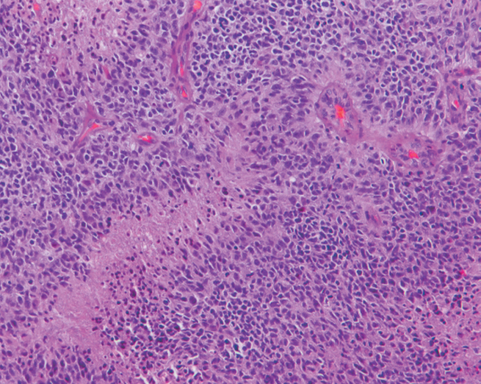
Glioblastoma. Foci of necrosis with pseudopalisading of malignant nuclei and endothelial cell proliferation (blue arrow)

Slide 9
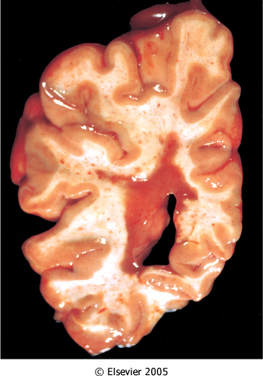
What is your provisional diagnosis?
Multiple sclerosis. Section of fresh brain showing brown plaque around occipital horn of the lateral ventricle.

Slide 10
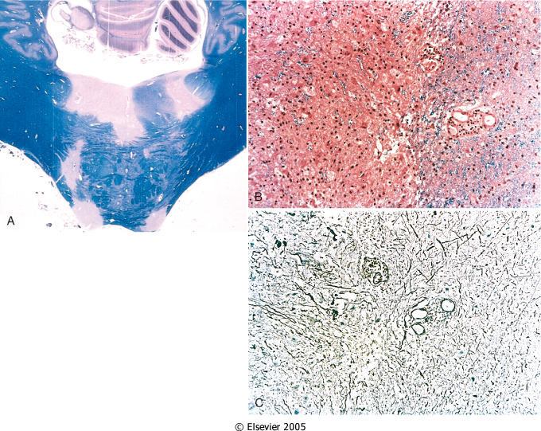
Multiple sclerosis. A, Unstained regions of demyelination (MS plaques) around the fourth ventricle (Luxol fast blue PAS stain for myelin).
B, Myelin-stained section shows the sharp edge of a demyelinated plaque and perivascular lymphocytic cuffs.
C, The same lesion stained for axons shows relative preservation
*.
Notes:
Multiple sclerosis. A, Unstained regions of demyelination (MS plaques) around the fourth ventricle (Luxol fast blue PAS stain for myelin) Myelin will stain blue, and the demilinated areas are pink.
B, Myelin-stained section shows the sharp edge of a demyelinated plaque (*) and perivascular lymphocytic cuffs.
C, The same lesion stained with sliver stain for axons to show relative preservation .

Slide 11
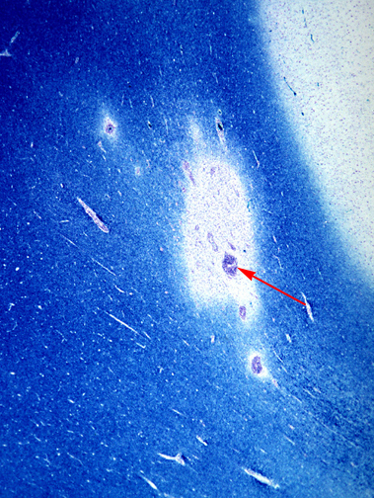
This is a myelin stain (luxol fast blue/PAS) of an early lesion of pale demyelinated area. The lesion is centered around a small vein (arrow) which is surrounded by inflammatory cells .

Slide 12
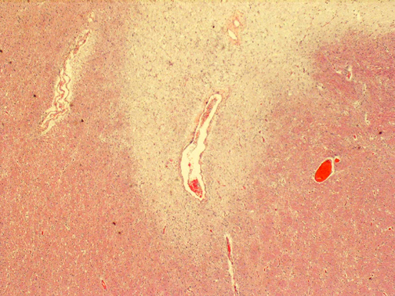
This is an H&E stained sections from a patient with long-standing MS. This lesion is centered on a vein. In this older lesion, however, there is very little inflammation around the vein.
You can see the loss of myelin even without a special stain: it is lighter pink than the normal white matter surrounding it.

Slide 13
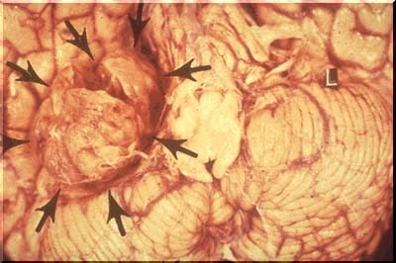
Notes:
Mass at the cerebello-pontine angle .

Slide 14
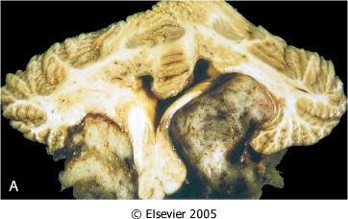
Schwannoma. A, Bilateral eighth nerve schwannomas.
What syndrome is suggested by such finding?
NF2

Slide 15
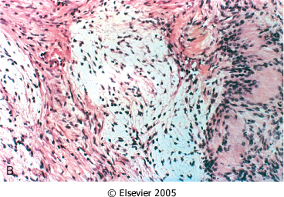
*
*
Schwannoma. B, Tumor showing cellular areas (Antoni A), including Verocay bodies (*), as well as looser, myxoid regions (Antoni B) (*).

Slide 16
A schwannoma. typically has dense areas called Antoni A (black arrow) and looser areas called Antoni B (blue arrows). The cells are elongated (spindle shaped) and the nuclei have a tendency to line up as seen here in the Antoni A area.
Notes:
A schwannoma is a benign tumor which can be cured by local excision .

Slide 17
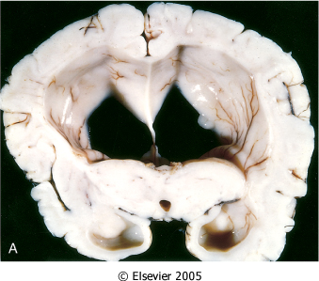
Hydrocephalus. Dilated lateral ventricles seen in a coronal section through the midthalamus.
Notes:
Hydrocephalus is secondary to increased production, or decreased reabsorption or obstruction of the CSF, which leads to increased intracrinal pressure and then herniation and death.

Slide 18
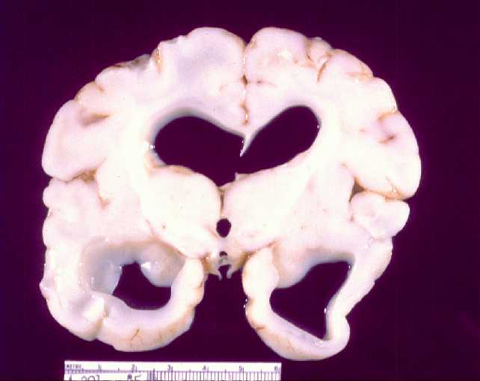

Slide 19
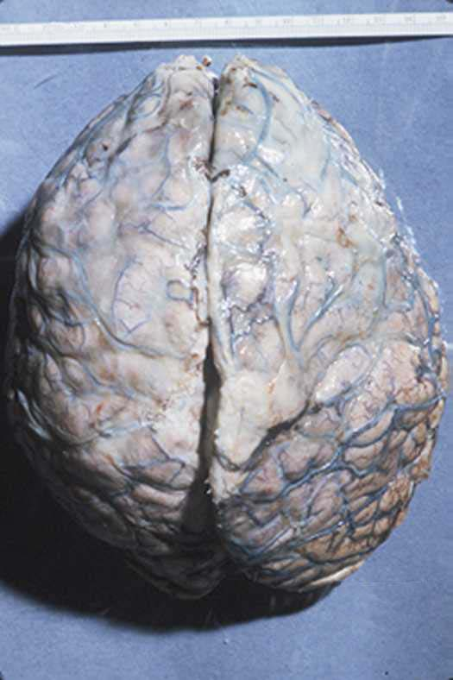
Notes:
Gross picture of brain covered by inflamed meninges and engorged vessels.

Slide 20
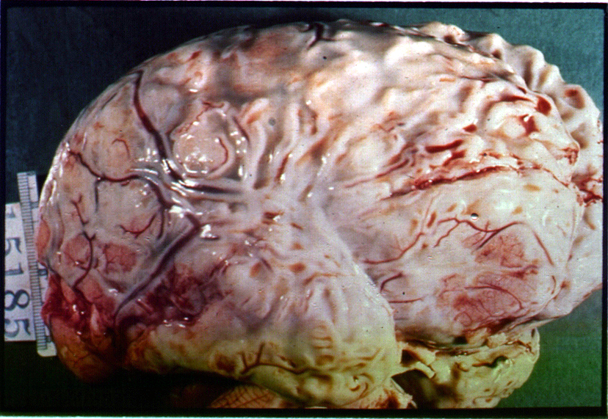
Notes:
Gross picture of the brain showing purulent exudate covering all the meninges.

Slide 21
Brain abscess surrounded by granulation tissue capsule.

Slide 22
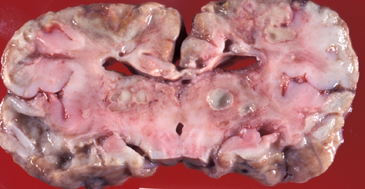
Multiple brain abscesses surrounded by granulation tissue capsules.

Slide 23
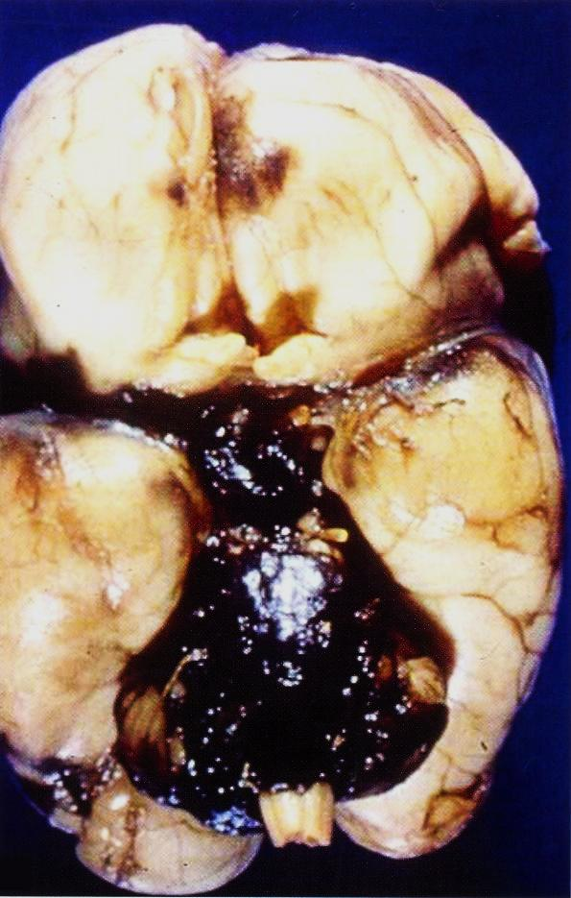
Ruptured berry aneurysm causing subarachnoid Hemorrhage
Notes:
Other causes of subarachnoid hemorrhage could be vascular malformation , trauma ,rupture of an intracerebral hemorrhage into the ventricular system , hematologic disturbances and tumors .

Slide 24
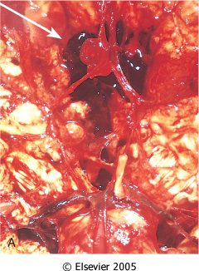
View of the base of the brain, dissected to show the circle of Willis with an aneurysm of the anterior cerebral artery (arrow).

Slide 25
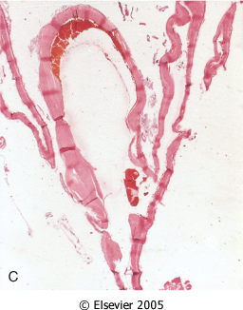
C, Section through a saccular aneurysm showing the hyalinized fibrous vessel wall.

Slide 26
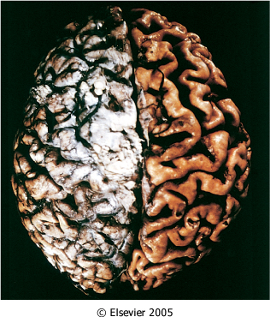
Alzheimer disease with cortical atrophy most evident on the right, where meninges have been removed with thin gyri and prominent sulci

Slide 27
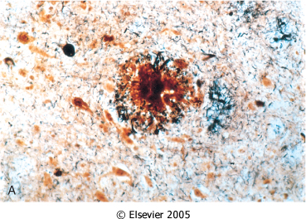
*
Alzheimer disease. A, Neuritic plaque with a rim of dystrophic neurites (arrow) surrounding an amyloid core (white *)

Slide 28
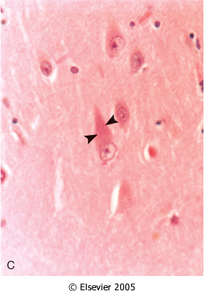
Alzheimer Disease. C, Neurofibrillary tangles (arrowheads) are present within the neurons.

Slide 29
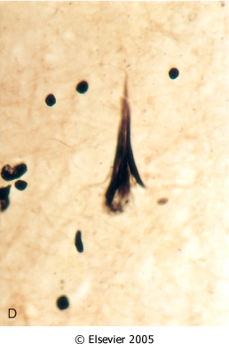
Alzheimer Disease. D, Silver stain showing a neurofibrillary tangle within the neuronal cytoplasm.

Slide 30
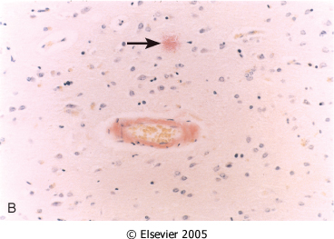
Alzheimer Disease. B, Congo red stain of the cerebral cortex showing amyloid deposition in the blood vessels (amyloid angiopathy) and the amyloid core of the neuritic (senile) plaque (arrow)

Slide 31
Parkinsonism
Parkinsonism is a clinical syndrome characterized by diminished facial expression, stooped posture, slowness of voluntary movement, abnormal gait rigidity, and a "pill-rolling" tremor.
Degeneration of neurons of the substatia nigra and locus ceruleus →
leading to motor disturbance.

Slide 32
Morphology
The typical macroscopic findings are pallor of the substantia nigra and locus ceruleus.
M/E: there is loss of the pigmented neurons in these regions, associated with gliosis.
Lewy bodies may be found in some of the remaining neurons.
These are single or multiple, cytoplasmic inclusions
Ultrastructurally, Lewy bodies are composed of fine filaments, composed of α-synuclein

Slide 33
B) Loss of the dark pigmentation of the substantia nigra and locus ceruleus
C)Lewy bodies: Single or multiple, intracytoplasmic, eosinophilic, round to elongated inclusions that often have a dense core surrounded by a pale halo
A) Normal Mid brain

Slide 34
CNS Infections Tuberculosis
Tuberculoma is well-circumscribed intraparenchymal mass and tuberculous meningitis .
On microscopic examination, there is usually a central core of caseous necrosis surrounded by a typical tuberculous granulomatous reaction

Slide 35
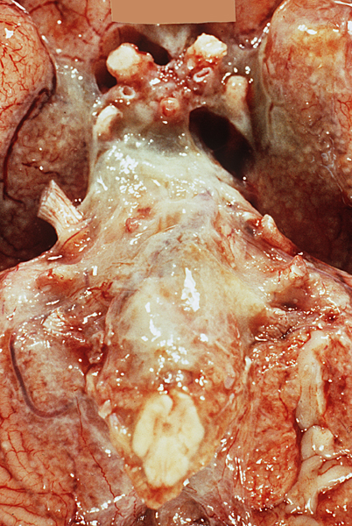
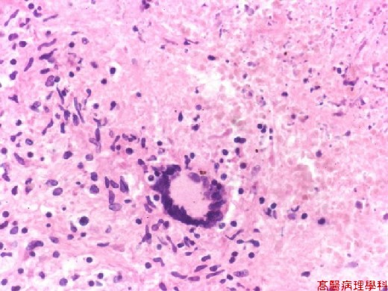
TB meningtis Exudate at the base of the brain
*
Notes:
M/E: Granuloma with epithelioid cells (Red arrow), langhan’s gaint cells (blue arrow), and caseous necrosis (*).

Slide 36
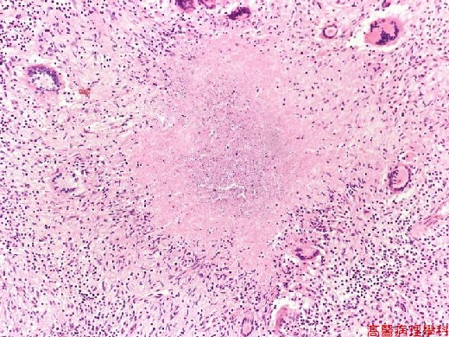
*
Notes:
Granuloma with epithelioid cells (Red arrow), langhan’s gaint cells (blue arrow), and caseous necrosis (*).

