Slide 1
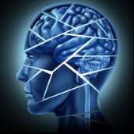
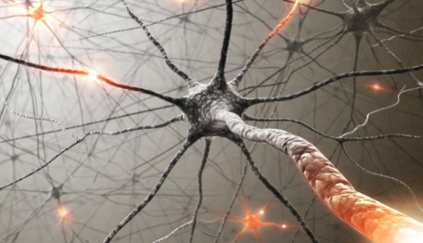
Introduction to Neuropsychiatric Disorders
Dr. Khalid Bazaid, MB BS, FRCPC
Department of Psychiatry
College of medicine
King Saud University

Slide 2
Outline
Neuropsychiatric Disorder
Definition
Delirium
Epidemiology
Etiology
Diagnosis
Management
Dementia
Epidemiology
Etiology
Diagnosis
Management
Course and Prognosis
How to differentiate between Delirium and Dementia
Amnestic Disorder
Diagnosis
Etiology
Management

Slide 3
Neuropsychiatric Disorder
It is the medical science dealing with both organic and psychic disorder of the nervous system.

Slide 4
Definition
Cognitive disorders are characterized by significant impairment in function such as memory, judgment, language, and attention. This impairment represent a change from base line.
Cognitive disorders reflect disruption in one or more of the above domains, and are also frequently complicated by behavioral symptoms.
Cognitive disorders represent the complex interface between neurology, medicine, and psychiatry.
Organic mental disorders or organic brain disorders vs functional disorders.
Advances in molecular biology, diagnostic techniques, and medication management have significantly improved the ability to recognize and to treat cognitive disorders.

Slide 5
Delirium
Delirium is an impairment of consciousness ( short-term confusion and changes in cognition).
It is a syndrome
Usually accompanied by global impairment of cognitive functions, associated with emotional lability, hallucinations or illusions and in-appropriate behavior.
It is an acute reversible condition.
Notes:
Delirium or acute confusional state is a transient global disorder of cognition. The condition is a medical emergency associated with increased morbidity and mortality rates. Early diagnosis and resolution of symptoms are correlated with the most favorable outcomes. Therefore, it must be treated as a medical emergency.
Delirium is not a disease but a syndrome with multiple causes that result in a similar constellation of symptoms. Delirium is defined as a transient, usually reversible, cause of cerebral dysfunction and manifests clinically with a wide range of neuropsychiatric abnormalities. The clinical hallmarks are decreased attention span and a waxing and waning type of confusion.
Delirium often is unrecognized or misdiagnosed and commonly is mistaken for dementia, depression, mania, an acute schizophrenic reaction, or part of old age (patients who are elderly are expected to become confused in the hospital).
The word delirium is derived from the Latin term meaning "off the track." This syndrome was reported during Hippocrates' time, and, in 1813, Sutton described delirium tremens. Later, Wernicke described the encephalopathy that bears his name.

Slide 6
Epidemiology
Common among hospitalized patients, about 10% of all hospitalized patients.
Very young and elderly are more susceptible to delirium.
Patients with history of delirium or brain injury are more likely to have an episode of delirium than the general population
Notes:
Based on the state of arousal, 3 types of delirium are described. Hyperactive delirium is observed in patients in a state of alcohol withdrawal or intoxication with phencyclidine (PCP), amphetamine, and lysergic acid diethylamide (LSD). Hypoactive delirium is observed in patients in states of hepatic encephalopathy and hypercapnia. In mixed delirium, individuals display daytime sedation with nocturnal agitation and behavioral problems.
United States
Delirium is common in the United States. It has been found in 14-56% of elderly patients who are hospitalized. Delirium is present in 10-22% of elderly patients at the time of admission, with an additional 10-30% of cases developing after admission. Delirium has been found in 40% of patients admitted to intensive care units. Prevalence of postoperative delirium following general surgery is 5-10% and as high as 42% following orthopedic surgery. As many as 80% of patients develop delirium near death. Delirium is extremely common among nursing home residents.
Mortality/Morbidity
In patients who are admitted with delirium, mortality rates are 10-26%.^{[10]}
Patients who develop delirium during hospitalization have a mortality rate of 22-76% and a high rate of death during the months following discharge.^{[11]}
In patients who are elderly and patients in the postoperative period, delirium may result in a prolonged hospital stay, increased complications, increased cost, and long-term disability.^{[12}

Slide 7
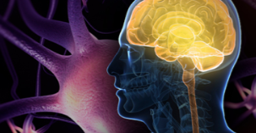
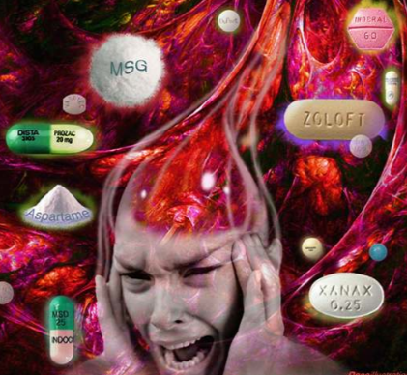
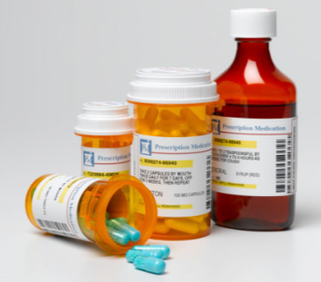
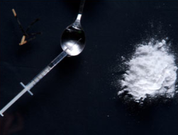
Etiology
Major causes include systemic disease, CNS disease, and either intoxication with or withdrawal from prescribed medications or drug of abuse.
Delirium is thought to involve dysfunction of reticular formation and acetyl-choline transmission.
Noradrenergic hyperactivity has been associated with alcohol withdrawal delirium.
Notes:
The mechanism of delirium still is not fully understood. Delirium results from a wide variety of structural or physiological insults. The neuropathogenesis of delirium has been studied in patients with hepatic encephalopathy and alcohol withdrawal. Research in these areas still is limited. The main hypothesis is reversible impairment of cerebral oxidative metabolism and multiple neurotransmitter abnormalities. The following observations support the hypothesis of multiple neurotransmitter abnormalities.
Acetylcholine
Data from animal and clinical studies support the hypothesis that acetylcholine is one of the critical neurotransmitters in the pathogenesis of delirium.^{[1]} A small prospective study among patients who have undergone elective hip replacement surgery showed reduced preoperative plasma cholinesterase activity in as many as one quarter of patients. In addition, reduced preoperative cholinesterase levels were significantly correlated with postoperative delirium.^{[2]}
Clinically, good reasons support this hypothesis. Anticholinergic medications are a well-known cause of acute confusional states, and patients with impaired cholinergic transmission, such those with Alzheimer disease, are particularly susceptible. In patients with postoperative delirium, serum anticholinergic activity is increased.
Dopamine
In the brain, a reciprocal relationship exists between cholinergic and dopaminergic activities. In delirium, an excess of dopaminergic activity occurs. Symptomatic relief occurs with antipsychotic medications such as haloperidol and other neuroleptic dopamine blockers.
Other neurotransmitters
Serotonin: Human and animal studies have found that serotonin is increased in patients with hepatic encephalopathy and septic delirium. Hallucinogens such as LSD act as agonists at the site of serotonin receptors. Serotoninergic agents also can cause delirium.
Gamma-aminobutyric acid (GABA): In patients with hepatic encephalopathy, increased inhibitory GABA levels also are observed. An increase in ammonia levels occurs in patients with hepatic encephalopathy, which causes an increase in the amino acids glutamate and glutamine, which are precursors to GABA. Decreases in CNS GABA levels are observed in patients with delirium resulting from benzodiazepine and alcohol withdrawal.
Cortisol and beta-endorphins: Delirium has been associated with the disruption of cortisol and beta-endorphin circadian rhythms. This mechanism has been suggested as a possible explanation for delirium caused by exogenous glucocorticoids.
Disturbed melatonin disturbance has been associated with sleep disturbances in delirium.^{[3]}
Inflammatory mechanism
Recent studies have suggested a role for cytokines, such as interleukin-1 and interleukin-6, in the pathogenesis of delirium. Following a wide range of infectious, inflammatory, and toxic insults, endogenous pyrogen, such as interleukin-1, is released from the cells. Head trauma and ischemia, which frequently are associated with delirium, are characterized by brain responses that are mediated by interleukin-1 and interleukin-6.^{[4, 5]}
Stress reaction mechanism
Studies indicate psychosocial stress and sleep deprivation facilitate the onset of delirium.
Structural mechanism
The specific neuronal pathways that cause delirium are unknown. Imaging studies of metabolic (eg, hepatic encephalopathy) and structural (eg, traumatic brain injury, stroke) factors support the hypothesis that certain anatomical pathways may play a more important role than others. The reticular formation and its connections are the main sites of arousal and attention. The dorsal tegmental pathway projecting from the mesencephalic reticular formation to the tectum and the thalamus is involved in delirium.
Disrupted blood-brain barrier can allow neurotoxic agents and inflammatory cytokines to enter the brain and may cause delirium. Contrast-enhanced MRI can be used to assess the blood-brain barrier.^{[6, 7]}
Visuoperceptual deficits in delirium such as hallucinations and delusions are not due to the underlying cognitive impairment.^{[8]} Visual hallucinations during alcohol-withdrawal delirium are seen in subjects with polymorphisms of genes coding for dopamine transporter and catechol-O-methyltransferase

Slide 8
Diagnosis
Substance withdrawal delirium
Substance intoxication delirium
Delirium due to medical condition
Key features: disturbance of consciousness, change in cognition, or the development of perceptual disturbance, over a a short period of time and tend tit fluctuate during the day.
Notes:
It is (cognitive disorders + organic disorders) diagnosed according to etiology

Slide 9
Management
Laboratory Tests:
Delirium is a medical emergency, its cause must be identified as quick as possible.
Treatment:
Identify and treat the underlying cause.

Slide 10
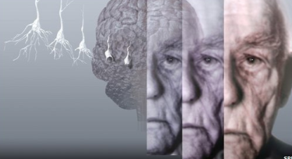
Dementia
It is characterized by server multiple cognitive deficits including MEMORY LOSS.
Consciousness is NOT impaired.
The major defects involve orientation, memory perception, intellectual functioning, and reasoning.
The defects represent a change from baseline and interfere with functioning.

Slide 11
Dementia …cont’d
Marked changes in personality, affect, and may be associated with behavioral problems.
Dementias are commonly accompanied by hallucinations (20 – 30%), and delusions (30 – 40 %).
Symptoms of depression and anxiety are present in 40 – 50% pts with dementia.

Slide 12
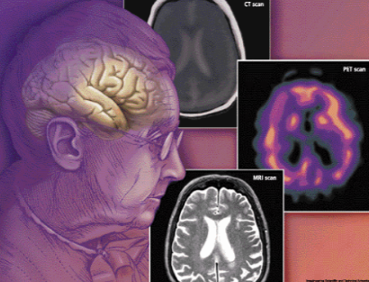
Epidemiology
A syndrome of elderly, 5% of Americans over the age of 65 have sever dementia, and 15% have mild dementia.
Increasing age is the most important risk factor.
15% of dementia cases are reversible.

Slide 13
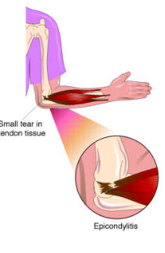
Etiology
Most common cause is Alzheimer’s disease (50 – 60%) followed by vascular disease.
Other common causes include head trauma, alcohol, movement disorders ( such as Huntington’s disease and parkinsonism) and HIV infection.

Slide 14
Diagnosis
Dementia of the Alzheimer’s type, which usually occurs in persons over 65 years of age and is manifested by progressive intellectual disorientation and dementia, delusions, or depression.
Vascular dementia, caused by vessel thrombosis or hemorrhage.
Other medical conditions, (e.g human immunodeficiency virus HIV disease, head trauma, Pick’s disease, head trauma, Pick’s disease, Creutzfeldt-Jakob disease, which is caused by a slow-growing transmittable virus).
Substance induced, caused by toxin or medication (e.g. gasoline fumes, atropine).
Multiple etiologies.
Not otherwise specified (if cause is unknown).

Slide 15
Management
Potentially reversible causes for the dementia (hypothyroidism, CNS syphilis, subdural hematoma, vita B12 deficiency, uremia, hypoxia).
Identify other treatable medical conditions that may worsen the dementia.
Supportive measures to the patient and care givers.
Ensure proper treatment of any underlying medical problems or associated disruptive symptoms.
Maintain proper nutrition, exercise, and daily activities.
Provide an environment with frequent cues for orientation to day, date, place, and time.
As functioning decreases, nursing home placement may be necessary.

Slide 16
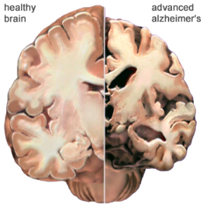
Course and Prognosis
Dementia may be progressive, remitting, or stable.
In reversible causes of dementia the course depends on how quickly the cause is reversed.
For Dementia of Alzheimer’s type the course is likely to be one of slow deterioration.

Slide 17
How to differentiate between Delirium & Dementia
Dementia
Delirium
History of Chronic disease.
Insidious onset.
Duration months/years.
Progressive course, majority irreversible.
Level of consciousness Normal early on.
Normal level of arousal.
Usually in nursing homes and psychiatric hospitals.
History of Acute disease.
Rapid onset.
Duration days/weeks.
Fluctuating course, often reversible.
Fluctuating level of consciousness.
Agitation or stupor.
In medical, surgical and neurological words.

Slide 18
Amnestic Disorder
Impaired recent short term and long term memory attributed to a specific organic cause (drug or medical disease) patient is normal in other areas of cognition.
Diagnosis
The development of memory impairment as manifested by impairment in the ability to recall previously learned information.
The memory impairment cause significant impairment in social or occupational functioning.
The memory impairment dose not occur during the course of a delirium or dementia.
The disturbance is due to general medical condition or substance.
Notes:
The amnestic disorders are a group of disorders that involve loss of memories previously established, loss of the ability to create new memories, or loss of the ability to learn new information. As defined by the mental health professional's handbook, the Diagnostic and Statistical Manual of Mental Disorders , fourth edition, text revision (2000), also known as DSM-IV-TR , the amnestic disorders result from two basic causes: general medical conditions that produce memory disturbances; and exposure to a chemical (drug of abuse, medication, or environmental toxin). An amnestic disorder whose cause cannot be definitely established may be given the diagnosis of amnestic disorder not otherwise specified. Read more: Amnestic disorders - causes, DSM, functioning, therapy, withdrawal, drug, person, people http://www.minddisorders.com/A-Br/Amnestic-disorders.html#ixzz28XvjTEg5
Description
The amnestic disorders are characterized by problems with memory function. There is a range of symptoms associated with the amnestic disorders, as well as differences in the severity of symptoms. Some people experience difficulty recalling events that happened or facts that they learned before the onset of the amnestic disorder. This type of amnesia is called retrograde amnesia. Other people experience the inability to learn new facts or retain new memories, which is called anterograde amnesia. People with amnestic disorders do not usually forget all of their personal history and their identity, although memory loss of this degree of severity occurs in rare instances in patients with dissociative disorders.
Causes and symptoms
Causes
In general, amnestic disorders are caused by structural or chemical damage to parts of the brain . Problems remembering previously learned information vary widely according to the location and the severity of brain damage. The ability to learn and remember new information, however, is always affected in an amnestic disorder.
Amnestic disorder due to a general medical condition can be caused by head trauma, tumors, stroke , or cerebrovascular disease (disease affecting the blood vessels in the brain). Substance-induced amnestic disorder can be caused by alcoholism, long-term heavy drug use, or exposure to such toxins as lead, mercury, carbon monoxide, and certain insecticides. In cases of amnestic disorder caused by alcoholism, it is thought that the root of the disorder is a vitamin deficiency that is commonly associated with alcoholism, known as Korsakoff's syndrome. The causes of transient global amnesia, or TGA, are unclear.
Symptoms
In addition to problems with information recall and the formation of new memories, people with amnestic disorders are often disoriented with respect to time and space, which means that they are unable to tell an examiner where they are or what day of the week it is. Most patients with amnestic disorders lack insight into their loss of memory, which means that they will deny that there is anything wrong with their memory in spite of evidence to the contrary. Others will admit that they have a memory problem but have no apparent emotional reaction to their condition. Some persons with amnestic disorders undergo a personality change; they may appear apathetic or bland, as if the distinctive features of their personality have been washed out of them.
Some people experiencing amnestic disorders confabulate, which means that they fill in memory gaps with false information that they believe to be true. Confabulation should not be confused with intentional lying. It is much more common in patients with temporary amnestic disorders than it is in people with long-term amnestic disorders.
Transient global amnesia (TGA) is characterized by episodes during which the patient is unable to create new memories or learn new information, and sometimes is unable to recall past memories. The episodes occur suddenly and are generally short. Patients with TGA often appear confused or bewildered.
Demographics
The overall incidence of the amnestic disorders is difficult to estimate. Amnestic disorders related to head injuries may affect people in any age group. Alcohol-induced amnestic disorder is most common in people over the age of 40 with histories of prolonged heavy alcohol use. Amnestic disorders resulting from the abuse of drugs other than alcohol are most common in people between the ages of 20 and 40. Transient global amnesia usually appears in people over 50. Only 3% of people who experience transient global amnesia have symptoms that recur within a year.
Diagnosis
Amnestic disorders may be self-reported, if the patient has retained insight into his or her memory problems. More often, however, the disorder is diagnosed because a friend, relative, employer, or acquaintance of the patient has become concerned about the memory loss or recognizes that the patient is confabulating, and takes the patient to a doctor for evaluation. Patients who are disoriented, or whose amnesia is associated with head trauma or substance abuse, may be taken to a hospital emergency room.
The doctor will first examine the patient for signs or symptoms of traumatic injury, substance abuse, or a general medical condition. He or she may order imaging studies to identify specific areas of brain injury, or laboratory tests of blood and urine samples to determine exposure to environmental toxins or recent consumption of alcohol or drugs of abuse. If general medical conditions and substance abuse are ruled out, the doctor may administer a brief test of the patient's cognitive status, such as the mini-mental state examination or MMSE. The MMSE is often used to evaluate a patient for dementia , which is characterized by several disturbances in cognitive functioning (speech problems, problems in recognizing a person's face, etc.) that are not present in amnestic disorders. The doctor may also test the patient's ability to repeat a string of numbers (the so called digit span test) in order to rule out delirium . Patients with an amnestic disorder can usually pay attention well enough to repeat a sequence of numbers where as patients with delirium have difficulty focusing or shifting their attention. In some cases the patient may also be examined by a neurologist (a doctor who specializes in disorders of the central nervous system)
If there is no evidence of a medical condition or substance use that would explain the patient's memory problems, the doctor may test the patient's memory several times in order to rule out malingering or a factitious disorder . Patients who are faking the symptoms of an amnestic disorder will usually give inconsistent answers to memory tests if they are tested more than once.
DSM-IV-TR specifies three general categories of amnestic disorders. These are: amnestic disorder due to a general medical condition, substance-induced persisting amnestic disorder, and amnestic disorder not otherwise specified. The basic criterion for diagnosing an amnestic disorder is the development of problems remembering information or events that the patient previously knew, or inability to learn new information or remember new events. In addition, the memory disturbance must be sufficiently severe to affect the patient's social and occupational functioning, and to represent a noticeable decline from the patient's previous level of functioning. DSM-IV-TR also specifies that the memory problems cannot occur only during delirium, dementia, substance use or withdrawal.
Treatments
There are no treatments that have been proved effective in most cases of amnestic disorder, as of 2002. Many patients recover slowly over time, and sometimes recover memories that were formed before the onset of the amnestic disorder. Patients generally recover from transient global amnesia without treatment. In people judged to have the signs that often lead to alcohol-induced persisting amnestic disorder, treatment with thiamin may stop the disorder from developing.
Prognosis
Amnestic disorders caused by alcoholism do not generally improve significantly over time, although in a small number of cases the patient's condition improves completely. In many cases the symptoms are severe, and in some cases warrant long-term care for the patient to make sure his or her daily needs are met. Other substance induced amnestic disorders have a variable rate of recovery, although in many cases full recovery does eventually occur. Transient global amnesia usually resolves fully.
Prevention
Amnestic disorders resulting from trauma are not generally considered preventable. Avoiding exposure to environmental toxins, refraining from abuse of alcohol or other substances, and maintaining a balanced diet may help to prevent some forms of amnestic disorders.
See also Dissociative amnesia
Resources
BOOKS
American Psychiatric Association. Diagnostic and Statistical Manual of Mental Disorders. 4th ed. text revised. Washington DC: American Psychiatric Association, 2000.
Sadock, Benjamin J. and Virginia A. Sadock, eds. Comprehensive Textbook of Psychiatry. 7th ed. Vol. 2. Philadelphia: Lippincott Williams & Wilkins, 2000.
PERIODICALS
Corridan, Brian J., S. N. Mary Leung, I. Harri Jenkins. "A Case of Sleeping and Forgetting." The Lancet 357, no. 9255 (February 17, 2001): 524.
Jernigan, Terry L., Arne L. Ostergaard. "When Alcoholism Affects Memory Functions." Alcohol Health & Research World 19 no. 2 (Spring 1995):104-108.
Kesler, Roman, Richard Zweifler. "Confusion and Memory Loss." Patient Care 34, no. 4 (February 29, 2000): 117.
Weiner, Richard D. "Retrograde Amnesia With Electroconvulsive Therapy." Archives of General Psychiatry 57, no. 6 (June 2000): 591.
ORGANIZATIONS
American Academy of Child and Adolescent Psychiatry. P. O. Box 96106, Washington, D.C. 20090. (800) 333-7636. <www.aacap.org> .
Tish Davidson, A.M.
Read more: Amnestic disorders - causes, DSM, functioning, therapy, withdrawal, drug, person, people http://www.minddisorders.com/A-Br/Amnestic-disorders.html#ixzz28XwhXK7o

Slide 19
Amnestic Disorder..cont’d
Etiology
Most common form is caused by thiamine deficiency associated with alcohol dependence.
Many also result from head trauma, tumor, surgery, hypoxia, infraction, seizures and herpes simplex encephalitis.
Typically any process that damages certain diencephalic structures (lympic system, hypothalamus, thalamus) and temporal structures (mamillary bodies, fornix, hippocampus) can cause the disorder.
Management
Identify the cause and reverse it if possible, otherwise, institute supportive medical procedures.

Slide 20
References
Further reading (Prescribed book):
Kaplan and Sadock's Synopsis is of Psychiatry10th edition.
Basic Psychiatry 2nd edition Prof. Alsughayir.
http://www.youtube.com/watch?v=9RKApLb3bRQ
http://www.youtube.com/watch?v=ZelSHnxMD4w

