Slide 1
Schizophrenia
Noor Al-Modihesh
MBBS, SSC-Psych, ABC-Psych
Lecturer
King Saud University

Slide 2
Definition:
is a mental disorder characterized by a breakdown of thought processes and by poor emotional responsiveness.
It is not a single disease but a group of disorders with heterogeneous etiologies

Slide 3
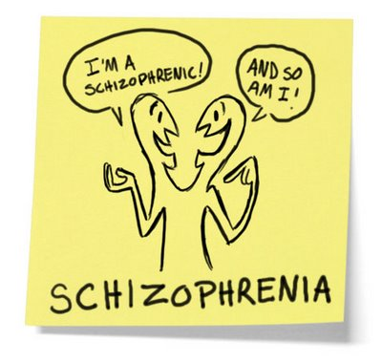

Slide 4
Found in all societies and countries with equal prevalence & incidence worldwide.
A life prevalence of 0.6 – 1.9 %
Peak age of onset are 10-25 years for ♂ & 25-35 years for ♀

Slide 5
Etiology
Exact etiology is unknown.
1- Stress-Diathesis Model:
Integrates biological, psychosocial and environmental factors in the etiology of schizophrenia.
Symptoms of schizophrenia develop when a person has a specific vulnerability that is acted on by a stressful influence

Slide 6
2- Neurobiology
Certain areas of the brain are involved in the pathophysiology of schizophrenia: the limbic system, the frontal cortex, cerebellum, and the basal ganglia.
a- Dopamine Hypothesis;
Too much dopaminergic activity ( whether it is ↑ release of dopamine, ↑ dopamine receptors, hypersensitivity of dopamine receptors to dopamine, or combinations is not known ).
b- Other Neurotransmitters;
Serotonin, Norepinephrine, GABA, Glutamate & Neuropeptides

Slide 7
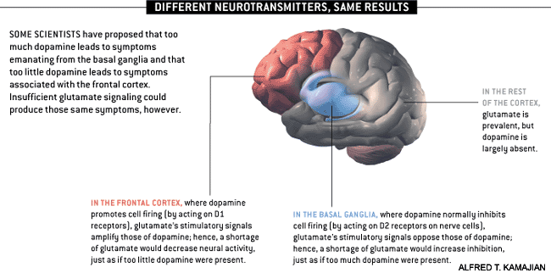

Slide 8
c- Neuropathology
Neuropathological and neurochemical abnormalities have been reported in the brain particularly in the limbic system, basal ganglia and cerebellum. Either in structures or connections

Slide 9
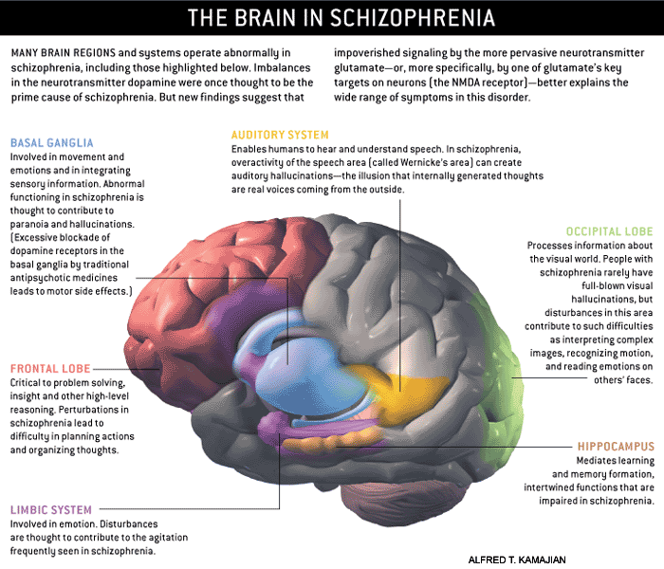

Slide 10
d- Psycho-neuro-immunology;
↓ T-cell interlukeukin-2 & lymphocytes, abnormal cellular and humoral reactivity to neurons and presence of antibrain antibodies.
These changes are due to neurotoxic virus ? or endogenous autoimmune disorder ?
e- Psycho-neuro-endocrinology;
Abnormal dexamethasone-suppression test
↓ LH/FSH
A blunted release of prolactin and growth hormone on stimulation.

Slide 11
3- Genetic Factors
A wide range of genetic studies strongly suggest a genetic component to the inheritance of schizophrenia that out weights the environmental influence
- These include: family studies, twin studies and chromosomal studies

Slide 13
Schizophrenia: genes plus stressors
Schizophrenia is mostly caused by various possible combinations of many different genes (which are involved in neurodevelopment, neuronal connectivity and synaptogenesis) plus stressors from the environment conspiring to cause abnormal neurodevelopment.
There is also abnormal neurotransmission at glutamate synapses, possibly involving
hypofunctional NMDA receptors .
Stephen M The Genetics Of Schizophrenia Converge,Upon,The NMDA Glutamate Receptor, CNS Spectr.

Slide 14
4- Psychosocial Factors;
In family dynamics studies, no well-controlled evidence indicates specific family pattern plays a causative role in the development of schizophrenia.
High Expressed Emotion family : increase risk of relapse.

Slide 15
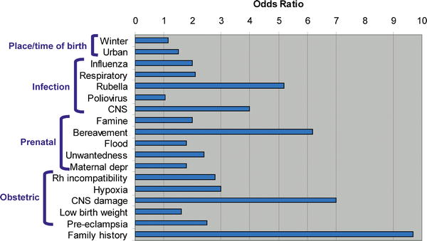

Slide 16
Diagnosis
DSM-IV-TR Diagnostic Criteria for Schizophrenia:
A- ≥ two characteristic symptoms
1- Delusions
2- Hallucinations
3- Disorganized speech
4- Disorganized behavior
5- Negative symptoms

Slide 17
B- Social / Occupation dysfunction
C- Duration of at least 6 months
D- Schizoaffective & mood disorder exclusion
E- Substance / General medical condition exclusion
F- Relationship to pervasive developmental disorders

Slide 18
types
Paranoid type
Disorganized type
Catatonic type
Undifferentiated type
Residual type

Slide 19
Clinical Features
No clinical sign or symptom is pathognomonic for schizophrenia
Patient's history & mental status examination are essential for diagnosis.
Premorbid history includes schizoid or schizotypal personalities, few friends & exclusion of social activities.
Prodromal features include obsessive compulsive behaviors

Slide 20
Picture of schizophrenia includes positive and negative symptoms.
- Positive symptoms like: delusions & hallucinations.
- Negative symptoms like: affective flattening or blunting, poverty of speech, poor grooming, lack of motivation, and social withdrawal.

Slide 21
Mental status examination
- Appearance & behavior ( variable presentations)
- Mood, feelings & affect ( reduced emotional responsiveness, inappropriate emotion)
- Perceptual disturbances ( hallucinations, illusions )
- Thought: Thought content ( delusions)
Form of thought ( looseness of association)
Thought process ( thought blocking, poverty of thought content, poor abstraction, perseveration )
- Impulsiveness, violence, suicide & homicide
- Cognitive functioning
- Poor insight and judgment

Slide 22
course
Acute exacerbation with increased residual impairment
Full recovery: very rare
Longitudinal course: downhill

Slide 23
Prognosis
Poor P.F | Good P.F
Young age of onset Insidious onset Lack of P.F. Multiple relapses Low IQ Poor premorbid personality Negative symptom Positive family history | Late age of onset Acute onset Obvious precipitating factors Presence of mood component Good response to Tx Good supportive system

Slide 24
Differential Diagnosis
Psychiatric disorders: | Nonpsychiatric disorders
Schizophreniform disorder Brief psychotic disorder Delusional disorder Affective disorders Schizoaffective disorder Personality disorders ( schizoid, schizotypal & borderline personality) Malingering & Factitious disorders | Substance-induced disorders Epilepsy ( TLE) CNS diseases Trauma Others

Slide 25
Treatment
What are the indications for hospitalization?
Diagnostic purpose
Patient & other's safety
Initiating or stabilizing medications
Establishing an effective association between patient & community supportive systems

Slide 26
Biological therapies
Antipsychotic medications are the mainstay of the treatment of schizophrenia.
Generally, they are remarkably safe.
Two major classes:
-Dopamine receptor antagonists ( haloperidol, chlorpromazine )
-Serotonin-dopamine receptor antagonists ( Risperidone, clozapine, olanzapine ).
Other drugs:
-Anticonvulsants
-Lithium
-Benzodiazepines
Depot forms of antipsychotics eg. Risperidone Consta is indicated for poorly compliant patients.
- Electroconvulsive therapy (ECT) for catatonic or poorly responding patients to medications

Slide 27
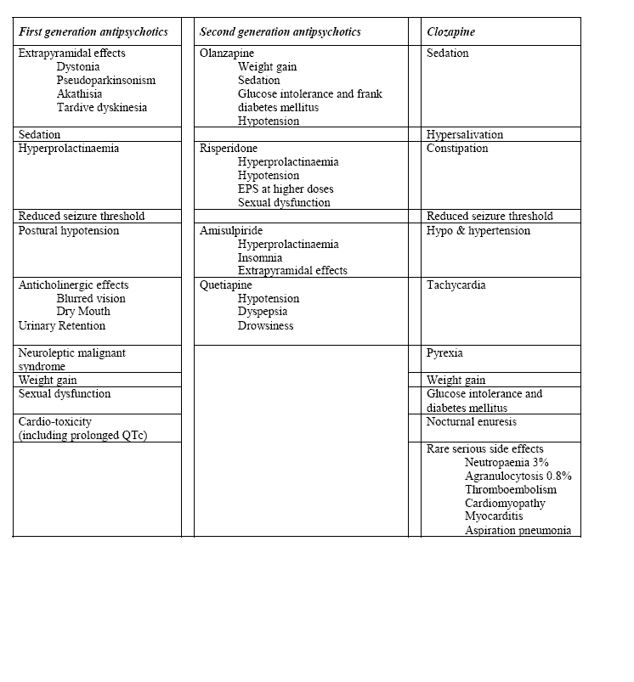

Slide 28
Psychosocial therapies
Social skills training
Family oriented therapies
Group therapy
Individual psychotherapy
Assertive community treatment

