Slide 1
ANATOMY OF THE LARGE INTESTINE
Dr. Ahmed Fathalla Ibrahim
Associate Professor of Anatomy
College of Medicine
King Saud University
E-mail: ahmedfathala@hotmail.com
Dr. Jameela Al-Medany
Associate Professor of Anatomy
College of Medicine
King Saud University

Slide 2
OBJECTIVES
At the end of the lecture, students should:
List the different parts of large intestine.
List the characteristic features of colon.
Describe the anatomy of different parts of large intestine regarding: the surface anatomy, peritoneal covering, relations, arterial & nerve supply.

Slide 3
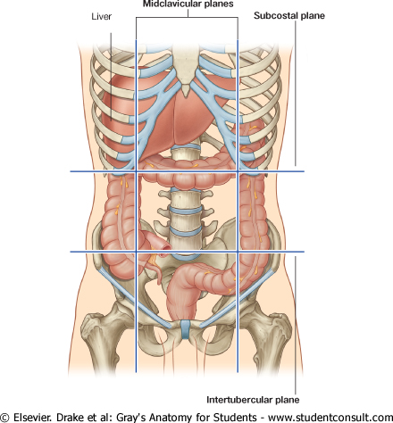
PARTS OF LARGE INTESTINE
CECUM
APPENDIX
ASCENDING COLON
TRANSVERSE COLON
DESCENDING COLON
SIGMOID COLON
RECTUM
ANAL CANAL
Abdomen
ABDOMEN
PELVIS
Pelvis
Perineum
PERINEUM

Slide 4
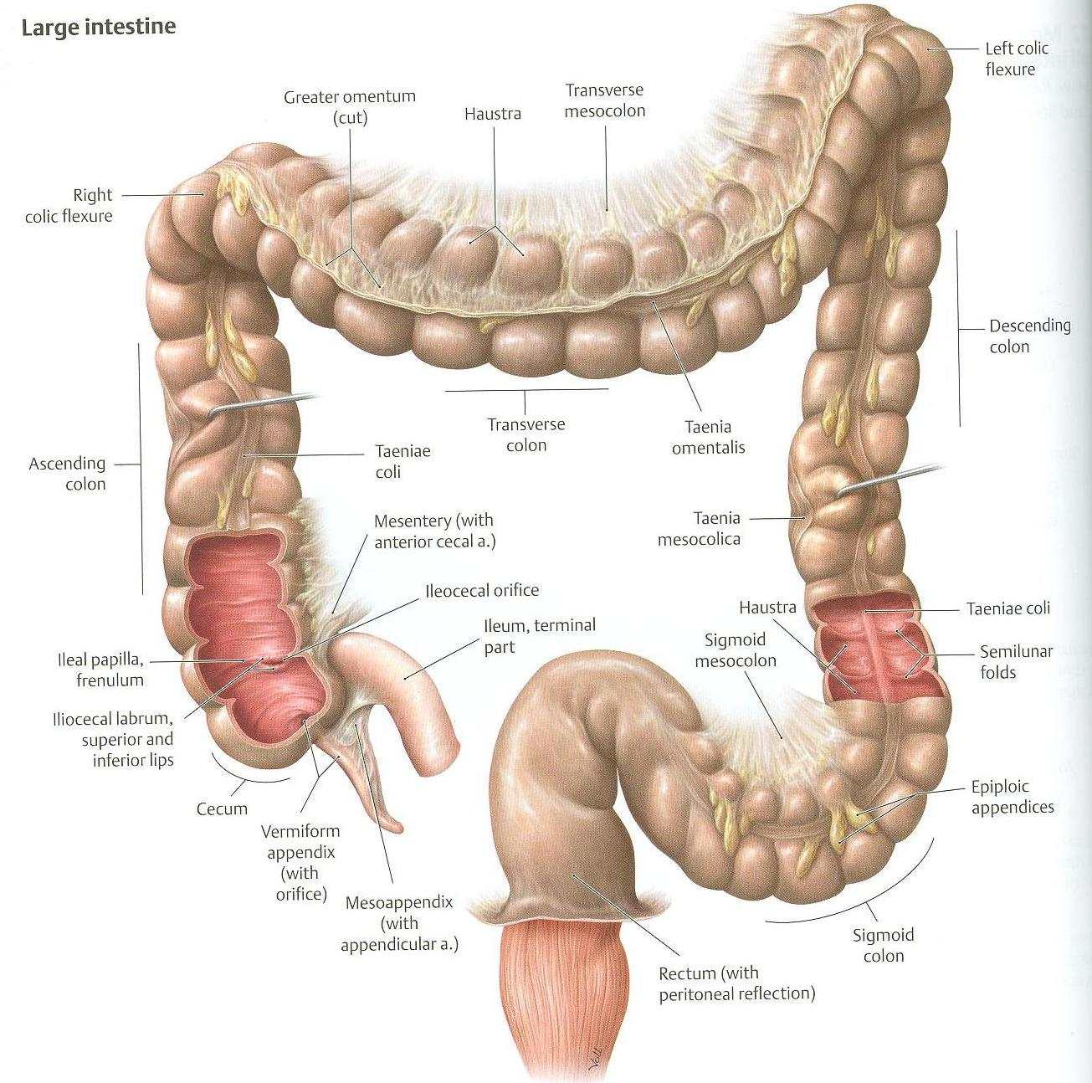

Slide 5
CHARACTERISTICS OF COLON
(NOT FOUND IN RECTUM & ANAL CANAL)
Teniae coli: 3 longitudinal muscle bands
Sacculations (haustra): teniae coli are shorter than large intestine
Epiploic Appendices : short peritoneal fold filled with fat

Slide 6
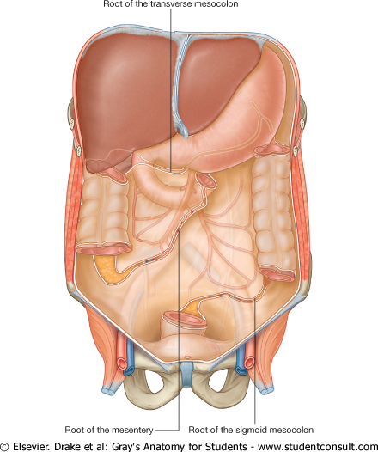
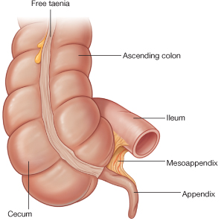
PERITONEAL COVERING
PARTS WITH MESENTERY:
Transverse colon
Sigmoid colon
Appendix
Cecum
RETROPERITONEAL PARTS:
Ascending colon
Descending colon

Slide 7
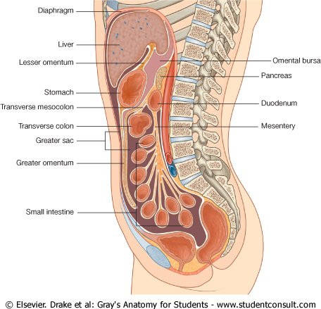
PERITONEAL COVERING
RETROPERITONEAL PARTS
3. Upper 2/3 of rectum
PARTS DEVOID OF PERITONEAL COVERING:
Lower 1/3 of rectum
Anal canal
Rectum
Anal
canal

Slide 8
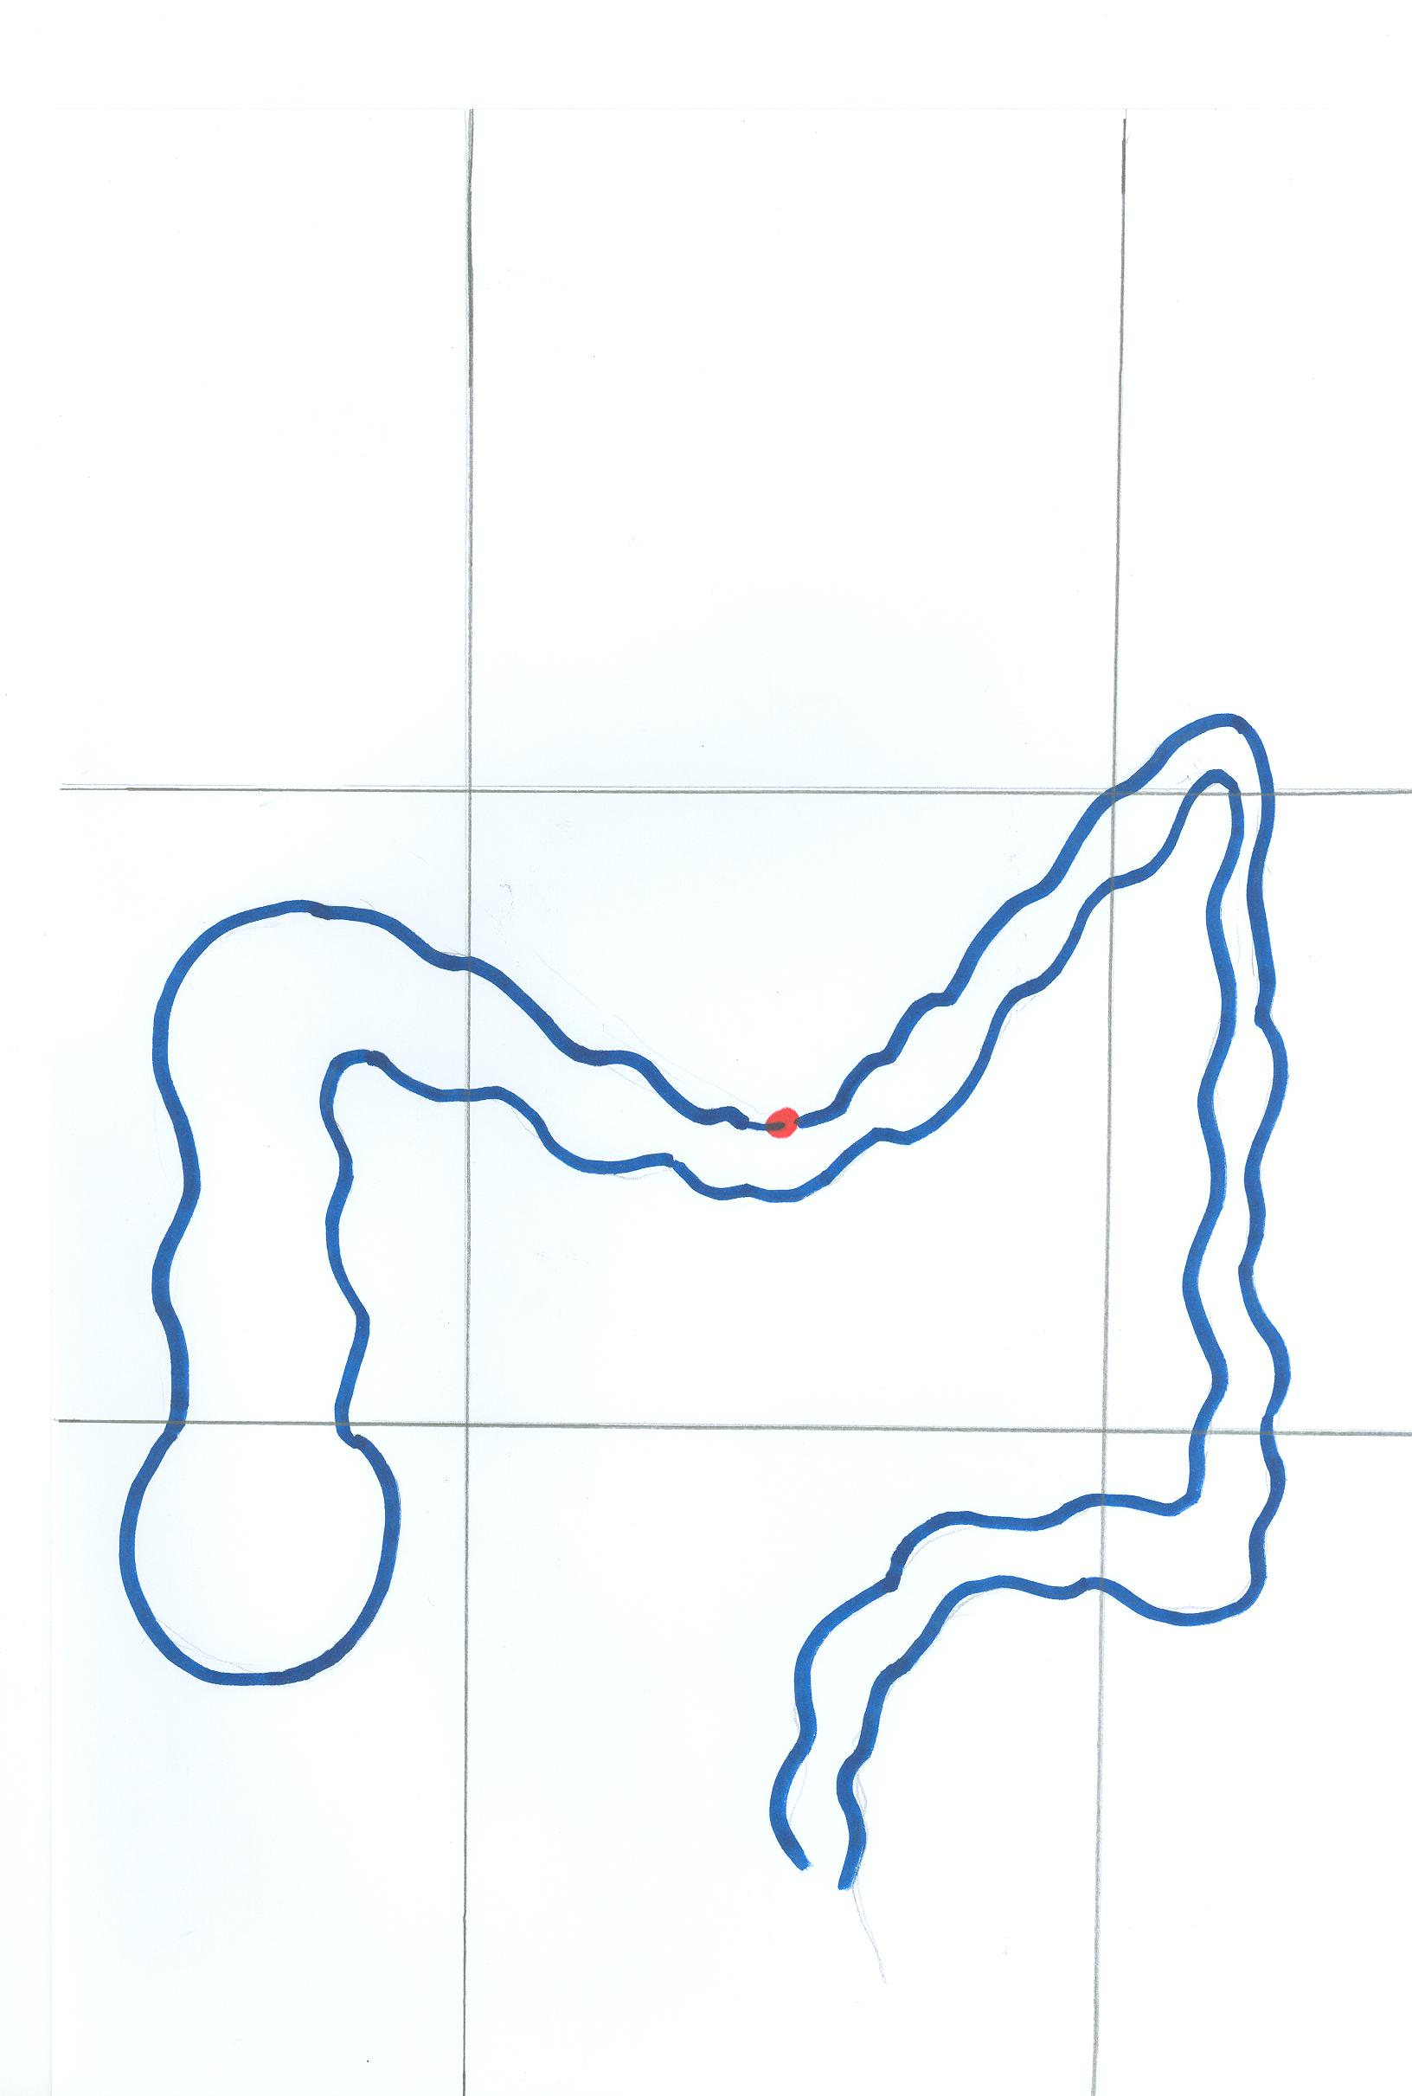
SURFACE ANATOMY
Right hypochondrium
Epigastrium
Left hypochondrium
Right lumbar region
Umbilical region
Left lumbar region
2/3
McBurney’s point
1/3
ASIS
Right iliac fossa
Hypogastrium
Left iliac fossa

Slide 9
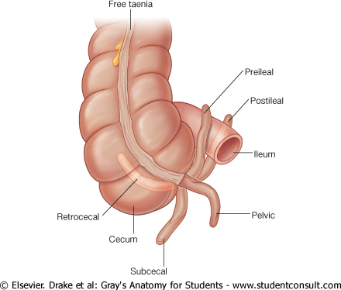
APPENDIX
Surface anatomy: the base of appendix is marked by Mc’Burney’s point: A point at the junction of lateral 1/3 & medial 2/3 of a line traced from right anterior superior iliac spine to umbilicus
Opening: at posteromedial aspect of cecum, 1 inch below ileo-cecal junction
Positions:
1.Retrocecal: most common
2.Pelvic
3.Subcecal
4.Preilieal
5.Postileal: least common
(4)
(5)
(1)
(2)
(3)

Slide 10
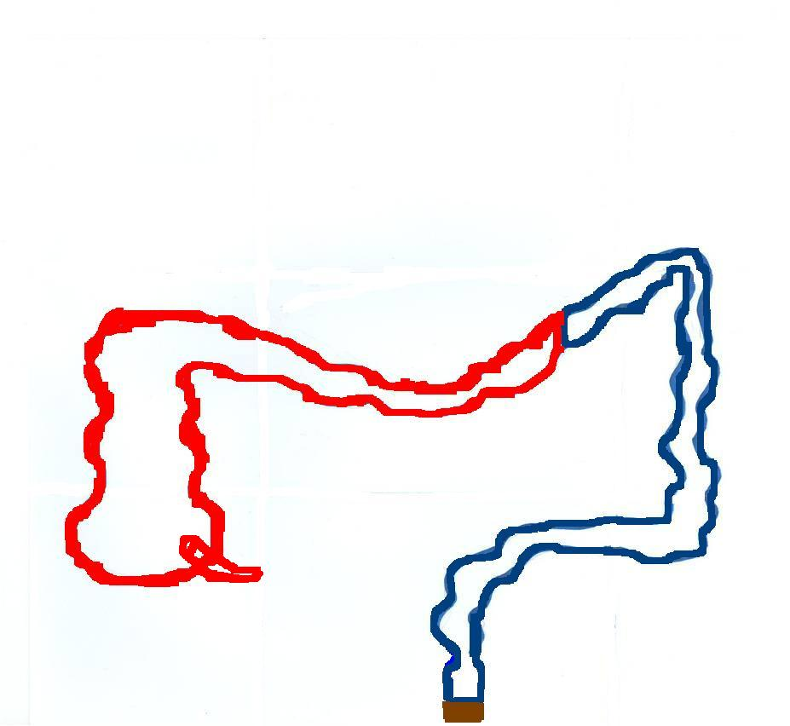
RELATION BETWEEN EMBRYOLOGICAL ORIGIN & NERVE SUPPLY
Origin: Midgut (endoderm)
Nerve: Autonomic:
Sympathetic + vagus
Origin: Hindgut (endoderm)
Nerve: Autonomic:
Sympathetic + pelvic splanchnic nerves
Left 1/3
Right 2/3
Origin: ectoderm
Nerve: Somatic: inferior rectal
Lower part of anal canal

Slide 11
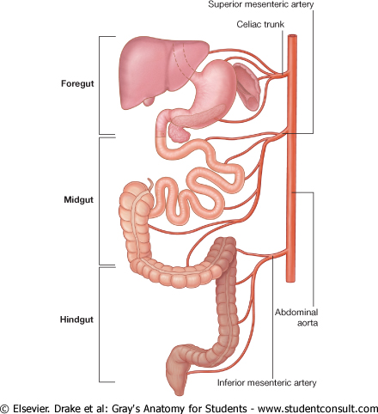
RELATION BETWEEN EMBRYOLOGICAL ORIGIN OF GUT & ITS ARTERIAL SUPPLY

Slide 12
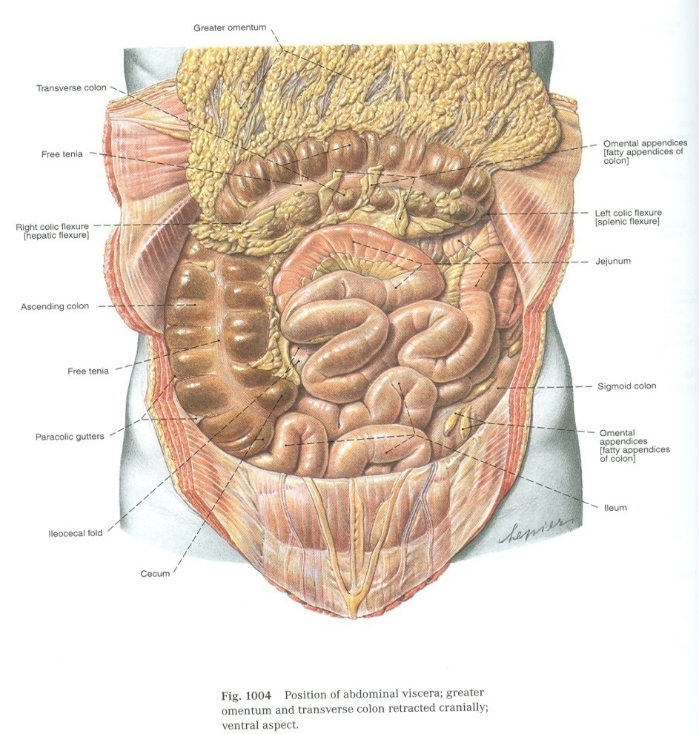
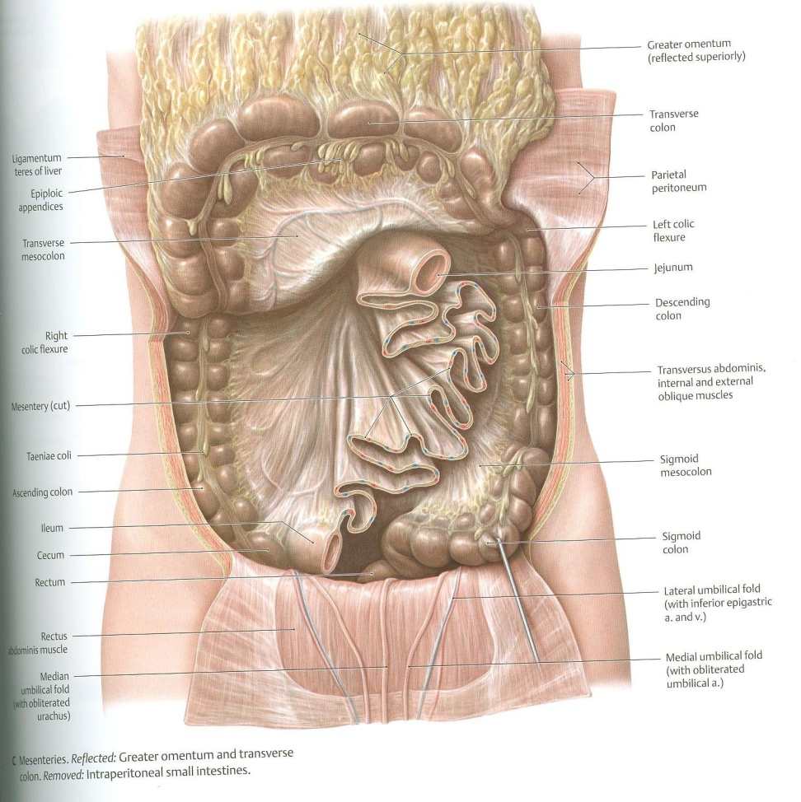
CECUM – ASCENDING & DESCENDING COLONS (ANTERIOR RELATIONS)
Coils of small intestine
Greater omentum
Anterior abdominal wall

Slide 13
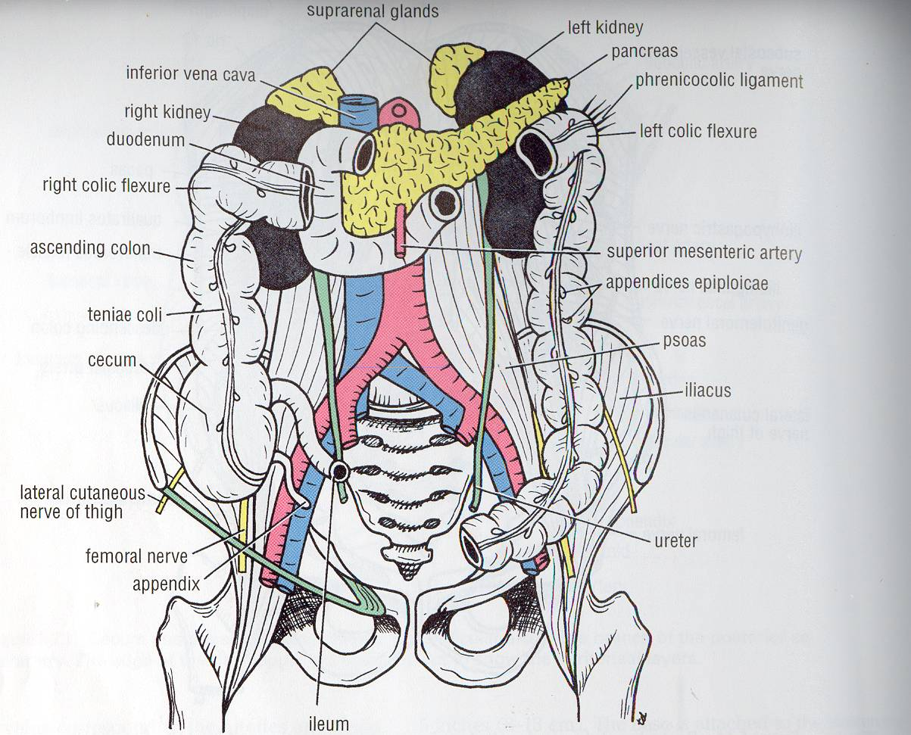
CECUM – ASCENDING & DESCENDING COLONS (POSTERIOR RELATIONS
Cecum:
Psoas major
Iliacus
Ascending colon:
Iliacus
Quadratus lumborum
Descending colon:
Left kidney
Quadratus lumborum
Iliacus
Psoas major
Quadratus lumborum

Slide 14
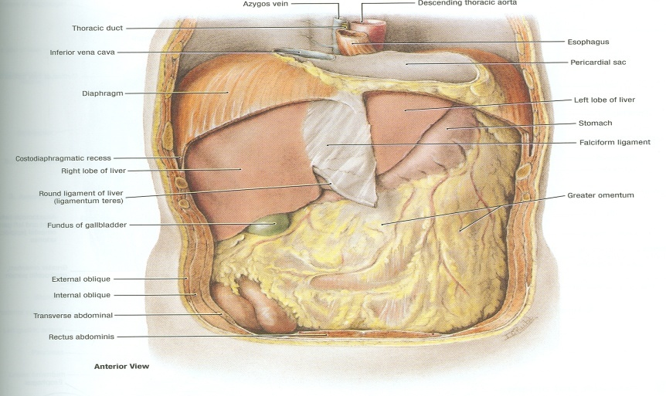
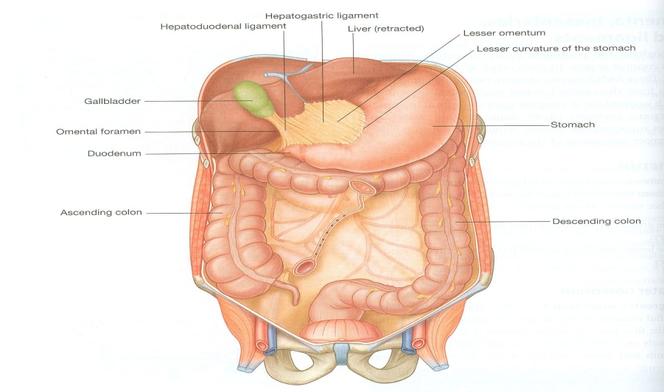
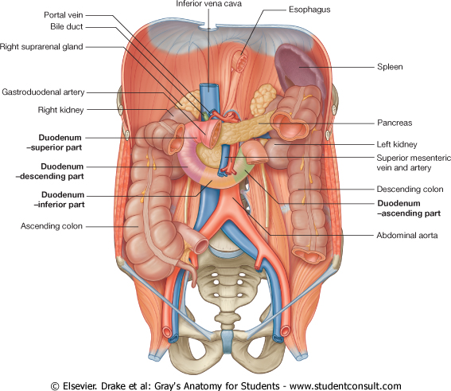
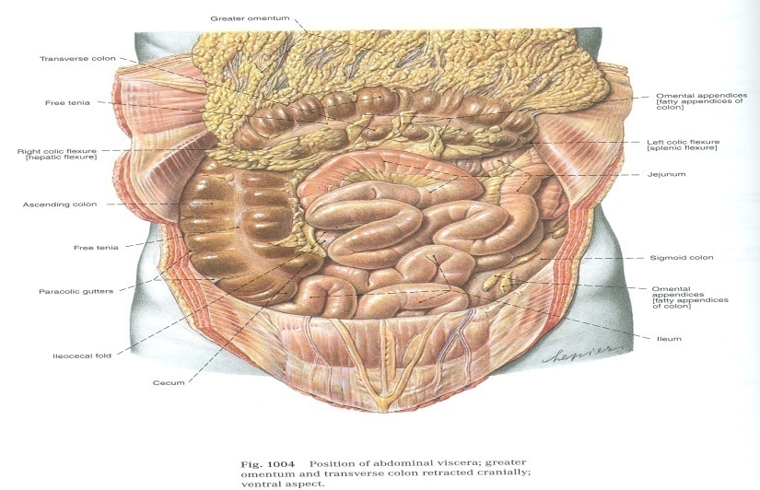
RALATIONS OF TRANSVERSE COLON
Anterior: greater omentum, anterior abdominal wall
Superior: liver, gall bladder, stomach
Inferior: coils of small intestine
Posterior: 2nd part of duodenum, pancreas

Slide 15
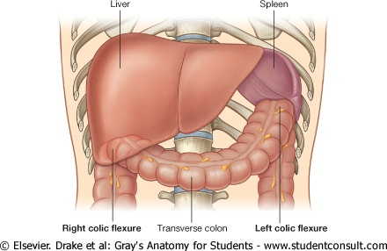
COLIC FLEXURES

Slide 16
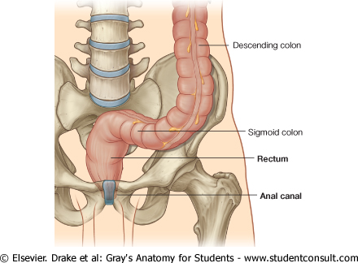
RECTUM
Beginning: as a continuation of sigmoid colon at level of S3.
Termination: continues as anal canal, one inch below & in front of tip of coccyx. Its end is dilated to form the rectal ampulla.
Length: 13 cm(5 inches)

Slide 17
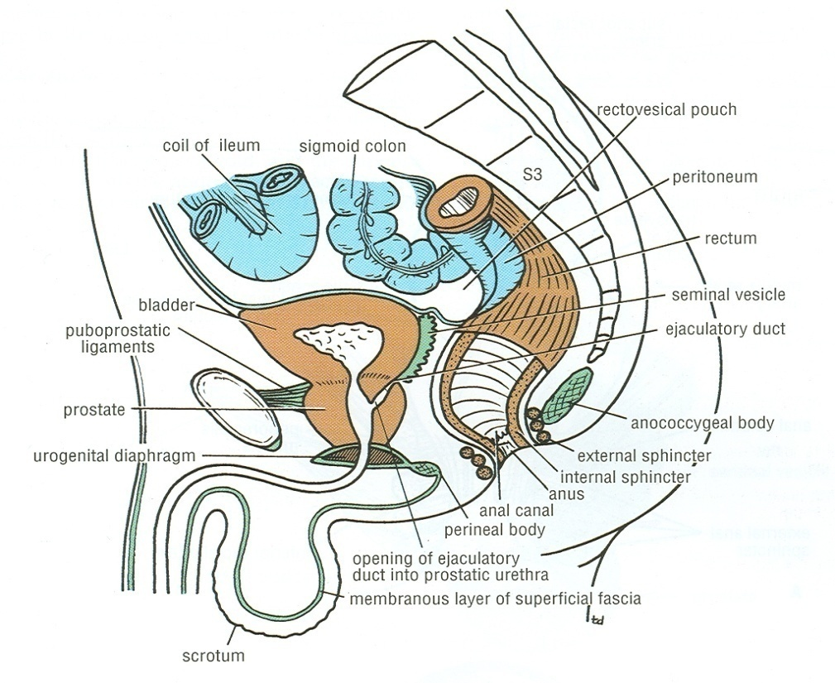
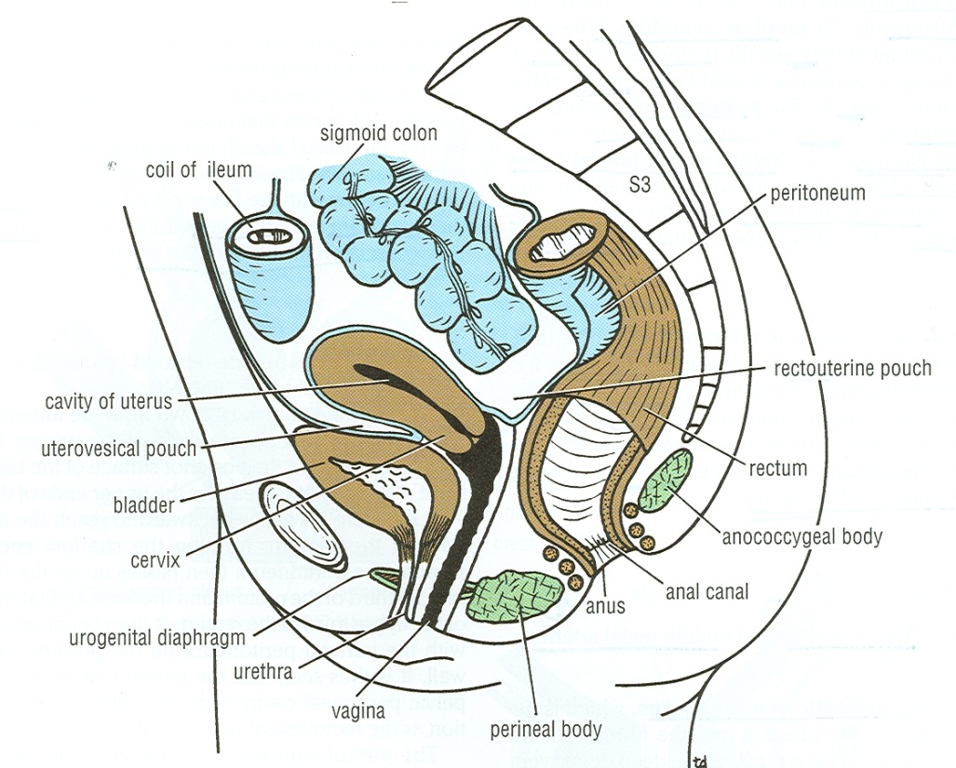
RELATIONS OF RECTUM IN PELVIS
MALE PELVIS
Anterior: seminal vesicles, posterior surfaces of urinary bladder & prostate gland
Posterior: sacrum & coccyx
FEMALE PELVIS
Anterior: posterior wall of vagina
Posterior: sacrum & coccyx
R
R

Slide 18
QUESTION 1
Which one of the following is the most common position of appendix?
Subcecal
Retrocecal
Pelvic
Preileal

Slide 19
QUESTION 2
Regarding the transverse colon, which one of the following statements is correct?
It is only supplied by the superior mesenteric artery.
It has no mesentery.
It lies behind the pancreas.
It contains taeniae coli in its wall.

Slide 20
THANK YOU

