Slide 1
Gastrointestinal Block Pathology lecture Nov 20, 2012
Peptic Ulcer Disease
Dr. Maha Arafah
Dr. Ahmed Al Humaidi

Slide 2
Objectives
Define ulcer and erosion
Describe the following aspects of acute gastric ulcers:
a. pathogenesis
b. Pathology
c. clinical features
3. Describe the following aspects of chronic peptic ulcers:
a. pathogenesis (H pylori, NSAID, Z-E syndrome)
b. clinical features
c. pathology (gross and microscopic features)
d. complications (bleeding, perforation, obstruction)

Slide 3
Book
Basic pathology, 9th edition: page 565 -569
Figure 14-13, p. 565
Figure 14-14, p. 566
Figure 14-15, p. 568
Figure 14-16, p. 571

Slide 4
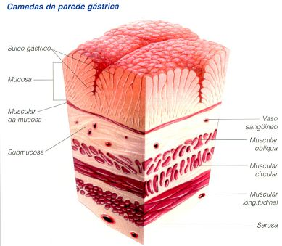
Ulcer: a breach in the mucosa of the alimentary tract extending through muscularis mucosa into submucosa or deeper.
Erosion: is a breach in the epithelium of the mucosa only.
erosion
ulcer

Slide 5
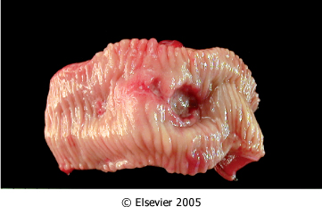
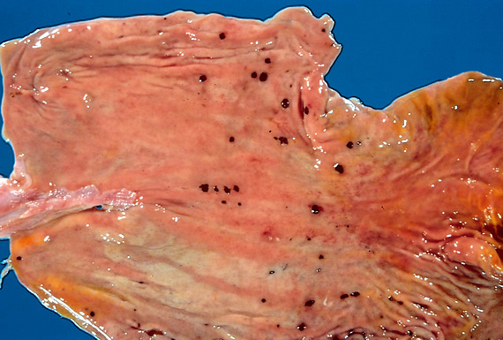
Ulcer
Ulcer: a breach in the mucosa of the alimentary tract extending through muscularis mucosa into submucosa or deeper.
Chronic Peptic ulcer
Stress ulcers (acute peptic ulcers)
Peptic ulcer
acute gastric ulcers

Slide 6
Acute peptic ulcers
cutely developing gastric mucosal defects that may appear after severe physiologic stress

Slide 7
Acute peptic ulcers Pathophysiology
As part of an acute gastritis
As a complication of a severe stress response
As a result of extreme hyperacidity.

Slide 8
Acute peptic ulcers
Pathophysiology
As part of an acute gastritis ( acute response to an irritant 'chemical' injury by drugs e.g. NSAID or alcohol )
As a complication of a severe stress response
severe burns (Curling's ulcer)
major trauma (Stress ulcer)
cerebrovascular accidents ( Cushing ulcer)
As a result of extreme hyperacidity ( Zollinger-Ellison syndrome)

Slide 9
Acute peptic ulcers
Acute stress ulcers are found anywhere in the stomach
They range in depth from very superficial lesions (erosion) to deeper lesions that involve the entire mucosal thickness (true ulceration)
The gastric mucosa can recover completely if the person does not die from the primary disease

Slide 10
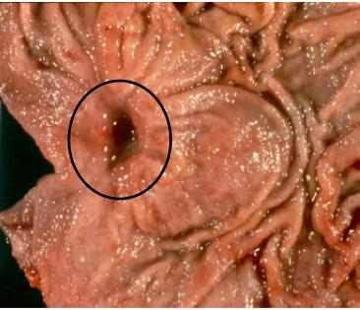
Chronic Peptic Ulcer
Ulcer: a breach in the mucosa of the alimentary tract extending through muscularis mucosa into submucosa or deeper.
Chronic Peptic Ulcers are, most often solitary
Peptic ulcer

Slide 11
Pathophysiology of Chronic Peptic Ulcers
Defensive Factors
Aggressive Factors

Slide 12
Pathophysiology of Chronic Peptic Ulcers
Defensive Factors
Mucus
bicarbonate
Blood flow
cell renewal
Prostaglandins
Phospholipid

Slide 13
Pathophysiology of Chronic Peptic Ulcers
imbalance
Defensive Factors
Mucus
bicarbonate
Blood flow,
cell renewal
Prostaglandins
Phospholipid
Aggressive Factors
H. pylori
Drugs (NSAIDs)
Acid
pepsin
Bile salts
Defensive Factors
Aggressive Factors

Slide 14
Pathophysiology
imbalance
Defensive Factors
Mucus
bicarbonate
Blood flow,
cell renewal
Prostaglandins
Phospholipid
Aggressive Factors
H. pylori
Drugs (NSAIDs)
Acid
pepsin
Bile salts
Defensive Factors
Aggressive Factors

Slide 15
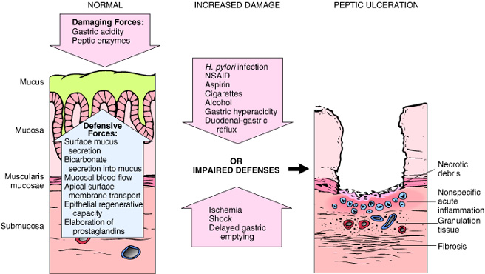

Slide 16
Pathophysiology of Chronic Peptic Ulcers
NSAID and aspirin stop prostaglandin synthesis
The protective effects of prostaglandins: enhanced bicarbonate secretion and increased vascular perfusion.
High-dose corticosteroids, which suppress prostaglandin synthesis and impair healing.
Cigarette smoking: impairs mucosal blood flow and healing
Chronic renal failure, and hyperparathyroidism: associated with hypercalcemia: stimulates gastrin production and therefore increases acid secretion

Slide 17
Chronic peptic ulcer Peptic Ulcer Disease Locations
May occur in any portion of the GI tract exposed to acidic gastric juices
98% located in first portion of duodenum or stomach, ratio duodenum : stomach = 4:1

Slide 18
Chronic peptic ulcer Peptic Ulcer Disease Other Locations
Esophagus……. as a result of GERD or acid secretion by ectopic gastric mucosa.
Gastric mucosa within a Meckel diverticulum can result in peptic ulceration of adjacent mucosa.
In Zollinger-Ellison syndrome: multiple peptic ulcerations in the stomach, duodenum, and even the jejunum.

Slide 19
Peptic Ulcer Disease Gastric ulcers
Pathophysiology
The mucosal defences against acid attack consist of:
Mucus-bicarbonate barrier
The surface epithelium.

Slide 20
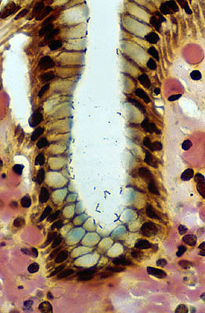
Peptic Ulcer Disease Gastric ulcers
Pathophysiology
The mucosal defences against acid attack consist of:
Mucus-bicarbonate barrier
2. The surface epithelium.
Duodeno-gastric reflux ( bile )
NSAIDs (blocking the synthesis of the prostaglandins)
H. pylori infection, ( cytotoxins and ammonia)
Thus peptic ulcers in the stomach, breakdown of mucosal defence is much more important than excessive acid production.

Slide 21
Pathophysiology of Chronic Peptic Ulcers in Stomach

Slide 22
Peptic Ulcer Disease Duodenal ulcers
Pathophysiology
Increased production of acid assumes more importance in the pathogenesis of duodenal ulceration
H. pylori-infected individuals secrete 2-6 times as much acid as non-infected controls
Helicobacter Pylori does not colonise normal duodenal epithelium
Helicobacter is involved in duodenal ulceration because there is gastric metaplasia in response to excess acid. Gastric metaplasia paves the way for colonisation by Helicobacter
+
=
Increased production of acid
Helicobacter P
Duodenal ulcers

Slide 23
Pathophysiology of Chronic Peptic Ulcers in Duodenum

Slide 24
Chronic Peptic Ulcer Disease Pathophysiology
Duodeno-gastric reflux ( bile )
Hyperacidity
Gastric
ulcers
H. pylori
Duodenal
ulcers
NSAIDs
H pylori infection of the pyloric antrum is present in nearly all patients with chronic duodenal ulcer and approximately 75% of patients with chronic gastric ulcer.
Although more than 70% of individuals with PUD are infected by H. pylori, fewer than 20% of H. pylori–infected individuals develop peptic ulcer.

Slide 25
Morphology
Gross
usually less than 20 mm in diameter but they may > 100 mm in diameter.
The classic peptic ulcer is a round to oval, sharply punched-out defect
Benign peptic ulcer

Slide 26
Morphology
Duodenal ulcers usually occur within a few centimeters of the pyloric valve at the anterior duodenal wall.
Gastric peptic ulcers are predominantly located near the interface of the body and antrum.

Slide 27
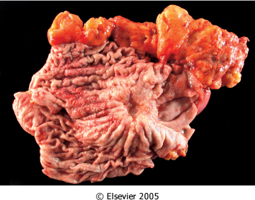
Morphology
Gross
In contrast, heaped-up margins are more characteristic of cancers
Benign peptic ulcer
Malignant peptic ulcer

Slide 28
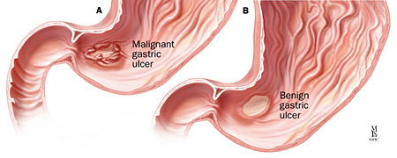

Slide 29
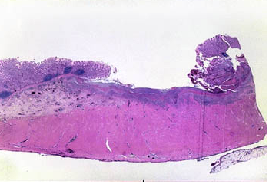
Morphology
Microscopy
the base consists of necrotic tissue and polymorph exudate overlying inflamed granulation tissue which merges with mature fibrous (scar) tissue.

Slide 30
The presence of neutrophils within the gastric glands signifies active inflammation and, most of the time, the presence of H pylori.

Slide 32
Clinical features
Epigastric pain (the most common symptom)
Gnawing or burning sensation
Occurs 2-3 hours after meals
Relieved by food or antacids
Patient awakens with pain at night.
Some present with complications such as iron deficiency anemia, frank hemorrhage, or perforation.

Slide 33
Complications of Chronic Peptic Ulcers
Hemorrhage.
Penetration. The ulcer penetrates the full thickness of the stomach or duodenal wall, progressing into adherent underlying tissue, e.g. the pancreas or liver.
Perforation. This leads to peritonitis.
Fibrous stricture. In the stomach, ulcers may cause pyloric stenosis.
Malignant change. This is extremely uncommon.

Slide 34
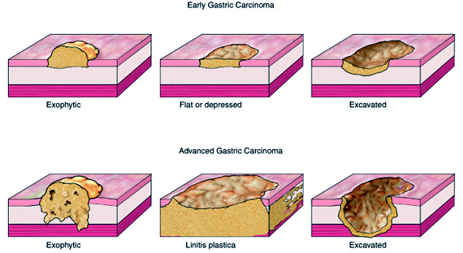

Slide 35
Therapy
Current therapies for PUD are aimed at
H. pylori eradication : Antibiotic
Acid suppression
Proton pump inhibitors
H2 blockers

