Slide 1
Gastrointestinal Block Pathology lecture Nov 25, 2012
Malabsorption
Dr. Maha Arafah
Dr. Ahmed Al Humaidi

Slide 2
Malabsorption Syndrome
Inability of the intestine to absorb nutrients adequately into the bloodstream.
Impairment can be of single or multiple nutrients depending on the abnormality.

Slide 3
Physiology
The main purpose of the gastrointestinal tract is to digests and absorbs nutrients (fat, carbohydrate, and protein), micronutrients (vitamins and trace minerals), water, and electrolytes.

Slide 4
Mechanisms and Causes of Malabsorption Syndrome
Inadequate digestion
Postgastrectomy
Deficiency of pancreatic lipase
Chronic pancreatitis
Cystic fibrosis
Pancreatic resection
Zollinger-Ellison syndrome
Deficient bile salt
Obstructive jaundice
Bacterial overgrowth
Stasis in blind loops, diverticula
Fistulas
Hypomotility states (diabetes)
Terminal ileal resection
Crohns' disease
Precipitation of bile salts (neomycin)
Primary mucosal abnormalities
Celiac disease
Tropical sprue
Whipple's disease
Amyloidosis
Radiation enteritis
Abetalipoproteinemia
Giardiasis
Inadequate small intestine
Intestinal resection
Crohn's disease
Mesenteric vascular disease with infarction
Jejunoileal bypass
Lymphatic obstruction
Intestinal lymphangiectasia
Malignant lymphoma
Macroglobulinemia
Many causes

Slide 5
Pathophysiology
Inadequate digestion
Or
Small intestine abnormalities
=
Malabsorption

Slide 6
Pathophysiology
Inadequate digestion
Postgastrectomy
Stomach
Pancreas
Deficiency of pancreatic lipase
Chronic pancreatitis
Cystic fibrosis
Pancreatic resection
Bile
Small intestine abnormalities
mucosa
Inadequate small intestine
Obstructive jaundice
Terminal ileal resection
Lymphatic obstruction

Slide 7
Pathophysiology
Inadequate digestion
Stomach
Celiac disease
Tropical sprue
Whipple's disease
Giardiasis
Pancreas
Bile
Small intestine abnormalities
mucosa
Intestinal resection
Crohn's disease
Inadequate small intestine
Lymphatic obstruction
Intestinal lymphangiectasia
Malignant lymphoma

Slide 8
Pathophysiology
Pancreas
Bile
mucosa

Slide 9
Malabsorption Syndrome Clinical features
Abnormal stools
Failure to thrive or poor growth in most but not all cases
Specific nutrient deficiencies, either singly or in combination.

Slide 10
Malabsorption Syndrome Clinical features
There is increased fecal excretion of fat (steatorrhea)
Steatorrhea is passage of soft, yellowish, greasy stools containing an increased amount of fat.
Growth retardation, failure to thrive in children
Weight loss despite increased oral intake of nutrients.

Slide 11
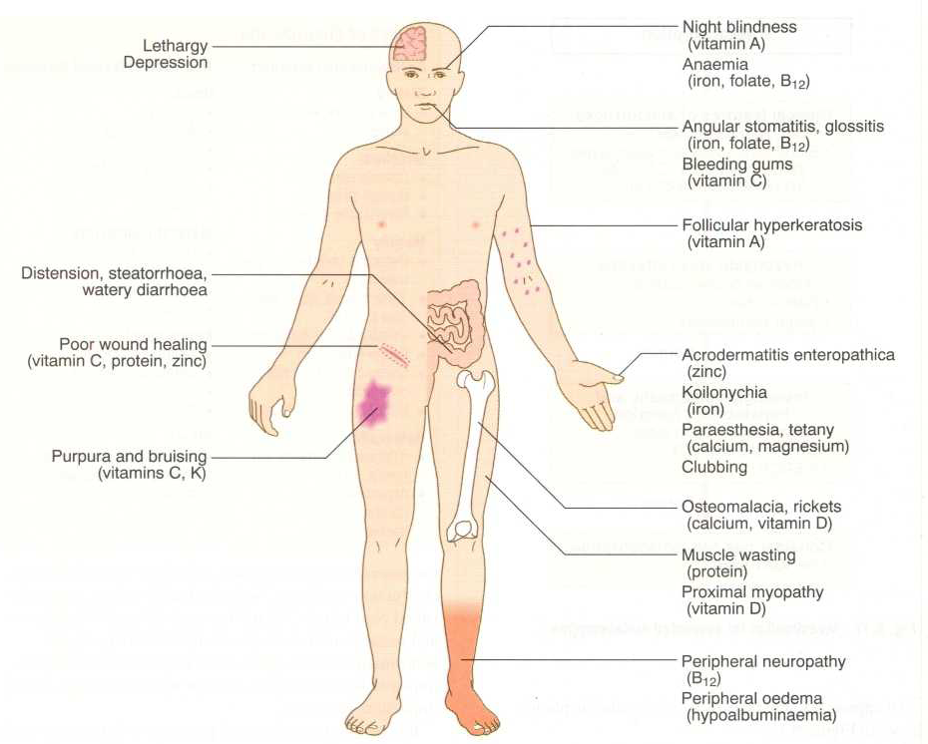
Clinical features

Slide 12
Malabsorption Syndrome Clinical features
Depend on the deficient nutrient
Swelling or edema
Muscle wasting
Protein
Anemia
B12, folic acid and iron deficiency
(fatigue and weakness
Muscle cramp
vitamin D, calcium
Osteomalacia and osteoporosis
vitamin K and other coagulation factor
Bleeding tendencies

Slide 13
Diagnosis
There is no specific test for malabsorption.
Investigation is guided by symptoms and signs.
Fecal fat study to diagnose steatorrhoea
Blood tests
Stool studies
4. Endoscopy
Biopsy of small bowel

Slide 14
Malabsorption Syndrome Celiac disease
An immune reaction to gliadin fraction of the wheat protein gluten
Usually diagnosed in childhood – mid adult.
Patients have raised antibodies to gluten autoantibodies
Highly specific association with class II HLA DQ2 (haplotypes DR-17 or DR5/7) and, to a lesser extent, DQ8 (haplotype DR-4).

Slide 15
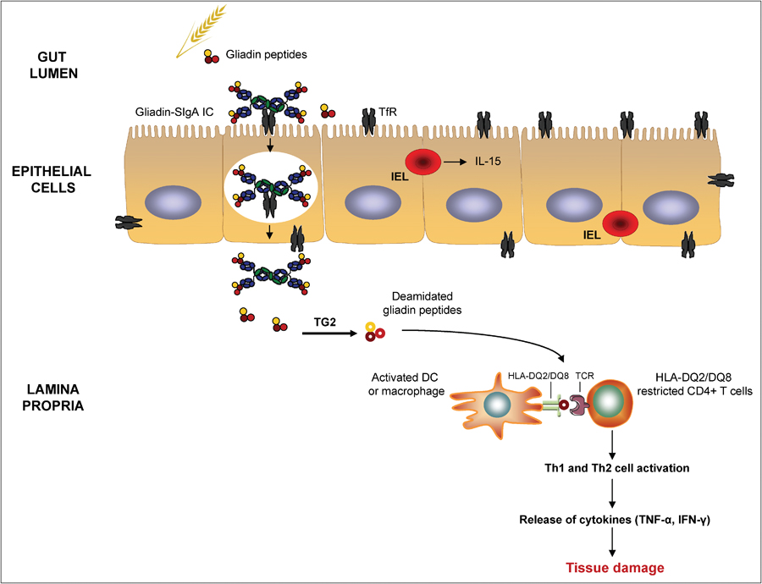
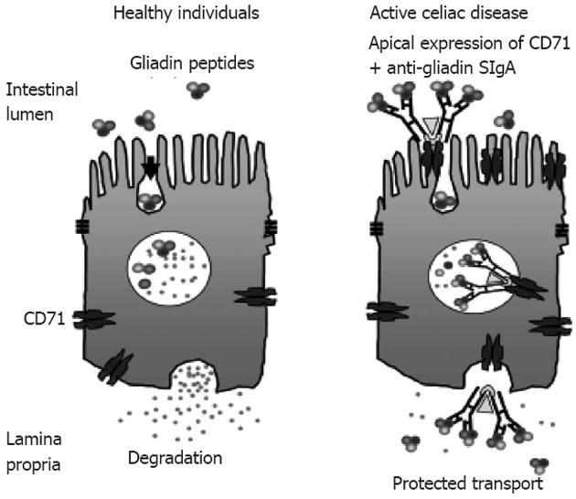
a 33-amino acid gliadin peptide that is resistant to degradation by gastric, pancreatic, and small intestinal proteases
Gliadin is deamidated by tissue transglutaminase
deamidated gliadin peptides induce epithelial cells to produce the cytokine IL-15, which in turn triggers activation and proliferation of CD8+ intraepithelial lymphocytes that can express the MIC-A receptor NKG2D.

Slide 17
Clinical features Celiac disease
Typical presentation GI symptoms that characteristically appear at age 9-24 months.
Symptoms begin at various times after the introduction of foods that contain gluten.
A relationship between the age of onset and the type of presentation;
Infants and toddlers….GI symptoms and failure to thrive
Childhood…………………minor GI symptoms, inadequate rate of weight gain,
Young adults……………anemia is the most common form of presentation.
Adults and elderly…...GI symptoms are more prevalent

Slide 18
Endoscopy
Normal
Celiac disease

Slide 19
Celiac Disease
Normal
Histology
Mucosa is flattened with marked villous atrophy.
Increased intraepithelial lymphocytosis

Slide 20
Celiac Disease
Diagnosis
Clinical documentations of malabsorption.
Stool ………. fat
Small intestine biopsy demonstrate villous atrophy.
Improvement of symptom and mucosal histology on gluten withdrawal from diet.
wheat, barley, flour
Other grains, such as rice and corn flour, do not have such an effect.

Slide 21
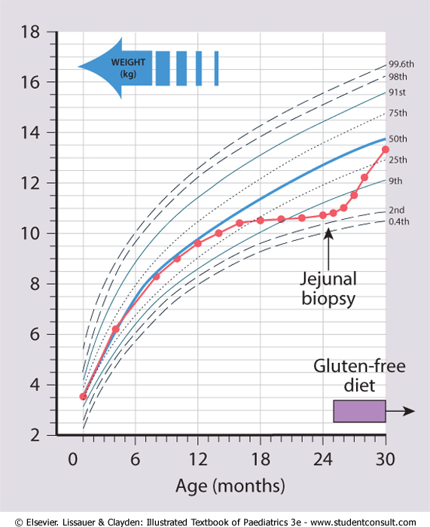

Slide 22
Celiac Disease
Complications
Osteopenia , osteoporosis
Infertility in women
Short stature, delayed puberty, anemia,
Malignancies,[intestinal T-cell lymphoma]
10 to 15% risk of developing GI lymphoma.

Slide 23
Lactose Intolerance

Slide 24
Lactose Intolerance Pathophysiology
lactase
Lactose
glucose + galactose
At the brush border of enterocytes
Lactose Intolerance
Low or absent activity of the enzyme lactase

Slide 25
Lactose Intolerance causes
Inherited lactase deficiency
Congenital lactase deficiency
Childhood-onset and adult-onset lactase deficiency
extremely rare
common
Genetically programmed progressive loss of the activity of the small intestinal enzyme lactase.
Acquired lactase deficiency
Transient
Secondary lactase deficiency due to intestinal mucosal injury by an infectious, allergic, or inflammatory process

Slide 26
Clinical
Bloating, abdominal discomfort, and flatulence
……………1 hour to a few hours after ingestion of milk products

Slide 28
Lactose Intolerance Diagnosis
Empirical treatment with a lactose-free diet, which results in resolution of symptoms;
Hydrogen breath test

Slide 29
Hydrogen breath test .
An oral dose of lactose is administered
The sole source of H₂ is bacterial fermentation;
Unabsorbed lactose makes its way to colonic bacteria, resulting in excess breath H₂.
Increased exhaled H₂ after lactose ingestion suggests lactose malabsorption.

Slide 30
A 3-week trial of a diet that is free of milk and milk products is a satisfactory trial to diagnose lactose intolerance

Slide 31
Lactose Intolerance summary
Deficiency/absence of the enzyme lactase in the brush border of the intestinal mucosa → maldigestion and malabsorption of lactose
Unabsorbed lactose draws water in the intestinal lumen
In the colon, lactose is metabolized by bacteria to organic acid, CO2 and H2; acid is an irritant and exerts an osmotic effect
Causes diarrhea, gaseousness, bloating and abdominal cramps

