Slide 1
Gastrointestinal Block Pathology lecture Nov 28 , 2012
Diarrhea
Dr. Maha Arafah
Dr. Ahmed Al Humaidi

Slide 2
8 LECTURES
Gastro-esophageal reflux disease
Peptic Ulcer Disease
Diarrhea
Malabsorption
Inflammatory bowel disease-1
Inflammatory bowel disease-2
Colonic polyps and carcinoma-1
Colonic polyps and carcinoma-2

Slide 3
DIARREAHA Objectives
Define diarrhea
Describe the pathogenesis of different types of diarrhea
3. List the causes of chronic diarrhea

Slide 4
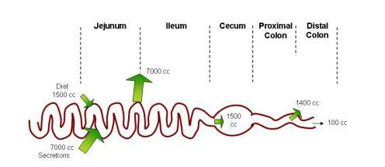
Physiology of Fluid and small intestine

Slide 5
DIARREAHA DEFINITION
World Health Organization
3 or more loose or liquid stools per day
Abnormally high fluid content of stool
> 200-300 gm/day

Slide 6
Why important?
The loss of fluids through diarrhea can cause dehydration and electrolyte imbalances
Easy to treat but if untreated, may lead to death especially in children

Slide 7
Why important?
More than 70 % of almost 11 million child deaths every year are attributable to 6 causes:
Diarrhea
Malaria
neonatal infection
Pneumonia
preterm delivery
lack of oxygen at birth.
UNICEF

Slide 8
CLASSIFICATION
Acute …………….if 2 weeks,
Persistent ……. if 2 to 4 weeks,
Chronic ………..if 4 weeks in duration.

Slide 9
Pathophysiology Categories of diarrhea
Secretory
Osmotic
Exudative (inflammatory )
Motility-related

Slide 10
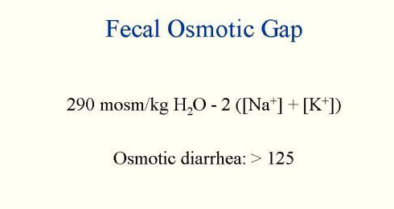
Fecal osmolarity
As stool leaves the colon, fecal osmolality is equal to the serum osmolality i.e. 290 mosm/kg.
Under normal circumstances, the major osmoles are Na⁺, K⁺, Cl–, and HCO₃–.

Slide 11
Osmotic
Excess amount of poorly absorbed substances that exert osmotic effect………water is drawn into the bowels……diarrhea
Stool output is usually not massive
Fasting improve the condition
Stool osmotic gap is high, > 125 mOsm/kg
Can be the result of
Malabsorption in which the nutrients are left in the lumen to pull in water e.g. lactose intolerance
2. osmotic laxatives.

Slide 12
Secretory
There is an increase in the active secretion of water
High stool output
Lack of response to fasting
Stool osmotic gap < 100 mOsm/kg
The most common cause of this type of diarrhea is a bacterial toxin ( E. coli , cholera) that stimulates the secretion of anions.
Other causes:
Enteropathogenic virus e.g. rotavirus and norwalk virus
Also seen in neuroendocrine tumours ( carcinoid tumor, gastrinomas)

Slide 13
Exudative (inflammatory )
Results from the outpouring of blood protein, or mucus from an inflamed or ulcerated mucosa
Presence of blood and pus in the stool.
Persists on fasting
Occurs with inflammatory bowel diseases, and invasive infections e.g. E. coli, Clostridium difficile and Shigella

Slide 14
Motility-related
Caused by the rapid movement of food through the intestines (hypermotility).
Irritable bowel syndrome (IBS) – a motor disorder that causes abdominal pain and altered bowel habits with diarrhea predominating

Slide 15
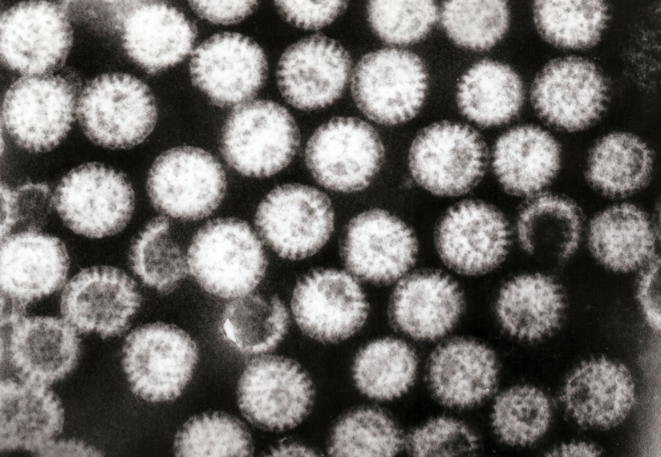
Aetiology Acute diarrhea?
Approximately 80% of acute diarrheas are due to infections (viruses, bacteria, helminths, and protozoa).
Viral gastroenteritis (viral infection of the stomach and the small intestine) is the most common cause of acute diarrhea worldwide.
Food poisoning
Drugs
Others
Rotavirus the cause of nearly 40% of hospitalizations from diarrhea in children under 5

Slide 16
Antibiotic-Associated Diarrheas
Diarrhea occurs in 20% of patients receiving broad-spectrum antibiotics; about 20% of these diarrheas are due to Clostridium difficile
Leading to pseudomembranous colitis

Slide 17
Pseudomembranous colitis

Slide 18
Chronic diarrhea Aetiology
Infection e.g. Giardia lamblia . AIDS often have chronic infections of their intestines that cause diarrhea.
Post-infectious Following acute viral, bacterial or parasitic infections
Malabsorption
Inflammatory bowel disease (IBD)
Endocrine diseases
Colon cancer
Irritable bowel syndrome

Slide 19
Complications
Fluids ………………Dehydration
Electrolytes …………….. Electrolytes imbalance
Sodium bicarbonate……. Metabolic acidosis
If persistent ……Malnutrition

Slide 20
Tests useful in the evaluation of diarrhea
Acute diarrhea
Fecal leukocytes
present
not present
Inflammatory Diarrhea
Noninflammatory Diarrhea
Suggests a small bowel source
Or colon but without mucosal injury
Suggests colonic mucosa damage caused by invasion
shigellosis, salmonellosis, Campylobacter or Yersinia infection, amebiasis)
toxin (C difficile, E coli O157:H7).
Inflammatory bowel diseases

Slide 21
Chronic diarrhea
Infection
+
Stool analysis
Ova, parasites
-
Secretory or
Noninfectious
inflammatory diarrhea
-
Stool fat test
(normal <20%)
+
Malabsorption

Slide 22
