Slide 1
Gastrointestinal Block Pathology lecture Dec, 2012
Benign Tumors of Intestine
Dr. Maha Arafah
Dr. Ahmed Al Humaidi

Slide 2
Tumors of the small and large intestines
Polyps
Carcinoma
Carcinoid tumor
Lymphoma

Slide 3
Polyps
Non-neoplastic polyps 90%
Hyperplastic polyps
Hamartomatous polyps (Juvenile & Peutz-Jeghers polyps)
Inflammatory polyps
Lymphoid polyps
Neoplastic polyps 10%
Adenoma

Slide 5
Polyps
Hyperplastic Polyp
Asymtomatic
> 50% are located in the rectosigmoid
Sawtooth surface
Star shaped crypts
Composed of well-formed glands and crypts lined by differentiated goblet or absorptive cells.
Most common type in adults
No malignant potential or polyposis syndromes

Slide 6
Hamartomatous polyps
Juvenile polyps Peutz-Jeghers (PJP) (PJP)polyps(PJP)
(1) Most common polyp in children
(2) Located in the rectum
Sometimes prolapse out of the rectum and bleed
(3) Solitary polyp
Smooth surface with enlarged cystic spaces on cut section
(4) Juvenile polyposis
(1) Autosomal dominant
(2) predominance small intestine polyps. Less common in stomach and colon

Slide 7
Non-Neoplastic Polyp
Hamartomatous polyp
Juvenile Polyps (retention polyp)
Developmental malformations affecting the glands and lamina propria
Commonly occur in children under 5 years old in the rectum.
In adult called retention polyp.
Juvenile polyps: no malignant potential
Notes:
4

Slide 8
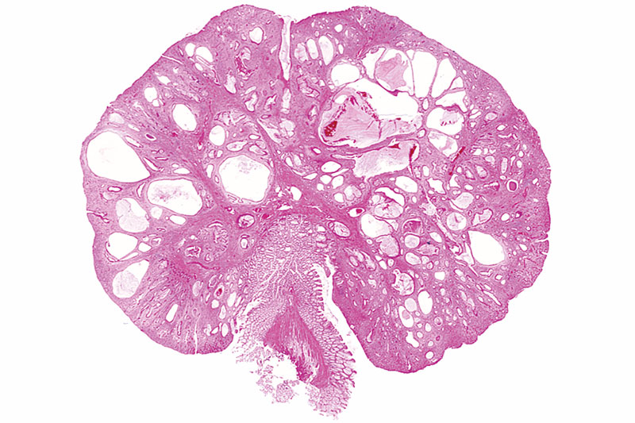
Juvenile Polyps (retention polyp)

Slide 9
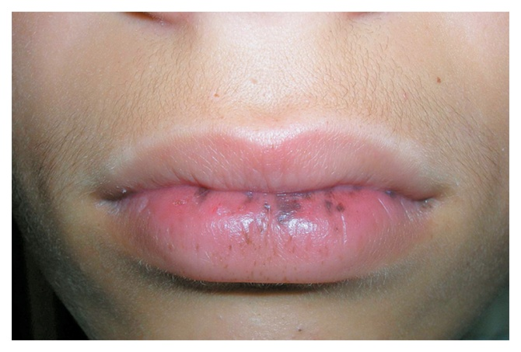
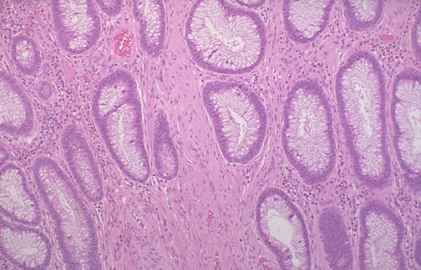
Non-Neoplatic Polyps
Hamartomatous Polyps
Peutz-Jehgers syndrome
Rare, autosomal dominant
hamartomatous polyps accompanied by mucosal and cutaneous pigmentation around the lips, oral mucosa, face and genitalia.
Polyps tend to be large and pedunculated.
Increased risk of developing carcinoma of the pancreas, breast, lung, ovary and uterus.
Notes:
5

Slide 10
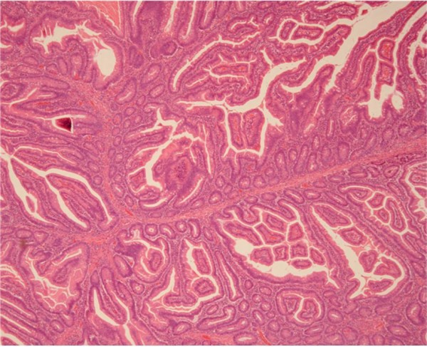
Peutz-Jehgers syndrome

Slide 11
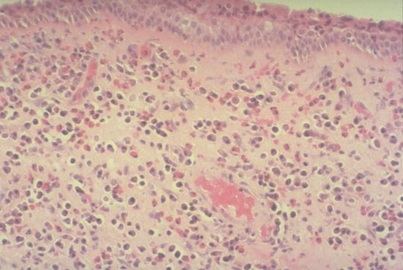
Non-Neoplastic Polyps
Inflammatory Polyps
longstanding IBD, especially in chronic ulcerative colitis.
Represent an exuberant reparative response to longstanding mucosal injury called pseudopolyps
Notes:
6

Slide 12
4] Lymphoid polyps

Slide 13
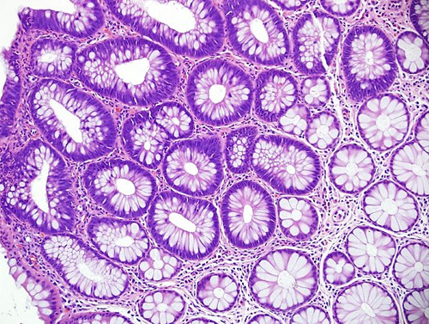
Neoplastic Polyps (Adenomas)
Adenomatous Polyp ( adenoma )
Occur mainly in large bowel.
Sporadic and familial
Vary from small pedunculated to large sessile
Epithelium proliferation and dysplasia
Notes:
7

Slide 14
Neoplastic Polyps (Adenomas)
Adenomatous Polyp ( adenoma )
Divided into:
Tubular adenoma: less than 25% villous architecture
Villous adenoma: villous architecture over 50%
Tubulovillous adenoma: villous architecture between 25 and 50%.
Notes:
7

Slide 15
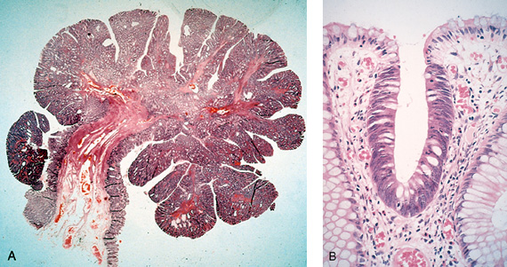
Neoplastic Polyps
1] Tubular adenoma
Represents 75% of all neoplastic polyps.
75 % occur in the distal colon and rectum.
Notes:
8

Slide 16
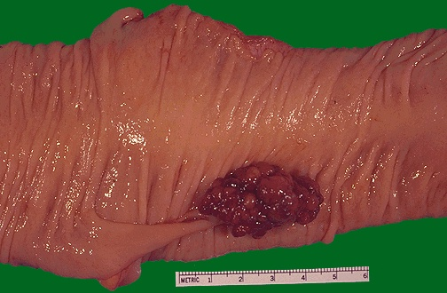
Neoplastic Polyps
Villous Adenoma
The least common, largest and most ominous of epithelial polyps.
Age: 60 to 65 years,
Present with rectal bleeding or anemia, large ones may secrete copious amounts of mucoid material rich in protein.
75% located in rectosigmoid area.
Secrete protein and potassium-rich mucusCan produce hypoalbuminemia and hypokalemia
Notes:
10

Slide 17
3] Tubulovillous adenoma
Intermmediate in size, degree of dysplasia and malignant potential between tubular and villous adenomas.

Slide 18
Adenomatous Polyp

Slide 19
Relationship of Neoplastic Polyps to Carcinoma
Adenoma to carcinoma sequence is documented by several genetic alterations.
Notes:
12

Slide 20
Adenoma to Carcinoma Pathway
Normal
Adenoma
Cancer
APC
loss
K-ras
mutation
Chrom 18
loss
p53
loss
Normal
Epithelium
Hyper-
proliferation
Early
Adenoma
Intermediate
Adenoma
Late
Adenoma
Cancer
Notes:
Polyp removal leads to CRC prevention
Polyp is surrogate marker

Slide 21
Relationship of Neoplastic Polyps to Carcinoma
Risk factors for malignancy in adenomas
(1) Adenoma > 2 cm (40% risk of malignancy)
(2) Multiple polyps
(3) Polyps with increased villous componentVillous adenoma: greatest risk for developing colon cancer
Villous adenomas have a 30% to 40% risk for malignancy.
(4) The presence of significant cytologic atypia (dysplasia) in the neoplastic cells.
Notes:
12

Slide 22
Familial Polyposis Syndrome
Patients have genetic tendencies to develop neoplastic polyps.
Familial polyposis coli (FPC)
Gardener’s syndrome
Turcot syndrome
Notes:
13

Slide 23
Familial Polyposis Syndrome
Familial polyposis coli (FPC)
Genetic defect of Adenomatous polyposis coli (APC).
Inactivation of APC gene, located on the long arm of chromosome 5 (5q21).
APC gene is a tumor suppressor gene
Innumerable neoplastic polyps in the colon (500 to 2500)
Polyps are also found elsewhere in alimentary tract
The risk of colorectal cancer is 100% by midlife.
Notes:
13

Slide 24
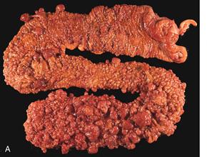
Familial polyposis coli (FPC)

Slide 25
Familial polyposis Coli(FPC)
(1) Autosomal dominant (AD)
All patients develop tubular adenomas and cancer.
(b) Polyps begin to develop between 10 and 20 years of age.
(c) Malignant transformation usually occurs between 35 and 40 years of age.
Prophylactic colectomy is recommended.

Slide 26
Familial Polyposis Syndrome
Gardener’s syndrome
Polyposis coli, multiple osteomas, epidermal cysts, and fibromatosis.
Turcot syndrome
Polyposis coli, glioma and fibromatosis
Notes:
13

Slide 28
Gastrointestinal Block Pathology lecture Dec, 2012
Malignant Tumors of Intestine
Dr. Maha Arafah
Dr. Ahmed Al Humaidi

Slide 29
Malignant Tumors of Large Intestine
Adenocarcinoma
Adenocarcinoma of the colon is the most common malignancy of the GI tract and is a major cause of morbidity and mortality worldwide.
Constitutes 98% of all cancers in the large intestine.
incidence peaks at 60 to 70 years of age
Notes:
14

Slide 30
Malignant Tumors of Large Intestine
Predisposing factors of Colon Adenocarcinoma
1) Age > 50 years old (2) Cigarette smoking
(3) Obesity, physical inactivity, heavy alcohol intake
(4) Hereditary polyposis syndromes
(5) Hereditary nonpolyposis colon cancer
(6) Family cancer syndrome
(7) First-degree relatives with colon cancer
(8) Inflammatory bowel disease: Ulcerative colitis > Crohn's dis
(9) Dietary factors: Low-fiber diet; increased saturated fats; reduced vegetable intake; Reduced intake of vit A, C & E.
Notes:
14

Slide 31
Adenocarcinoma of Large Intestine
Carcinogenesis
Two pathogenetically distinct pathways for the development of colon cancer, both seem to result from accumulation of multiple mutations:
1- The APC/B-catenin pathway ( 85 % )
2- The DNA mismatch repair genes pathway

Slide 32
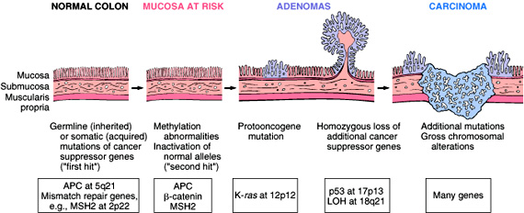
Adenocarcinoma of Large Intestine
Carcinogenesis
1- The APC/B-catenin pathway ( 85 % )
chromosomal instability that results in stepwise accumulation of mutations in a series of oncogenes and tumor suppressor genes.

Slide 33
Familial Adenomatous Polyposis
Hereditary mutation of the APC gene is the cause of familial adenomatous polyposis (FAP), where affected individuals carry an almost 100% risk of developing colon cancer by age 40 years.

Slide 34
Malignant Tumors of Large Intestine Adenocarcinoma
Carcinogenesis
2- The DNA mismatch repair genes pathway:
10% to 15% of sporadic cases.
There is accumulation of mutations (as in the APC/B-catenin schema)
Five DNA mismatch repair genes (MSH2, MSH6, MLH1, PMS1, AND PMS2)
give rise to the hereditary non polyposis colon carcinoma (HNPCC)

Slide 35
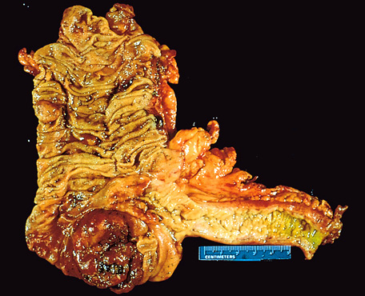
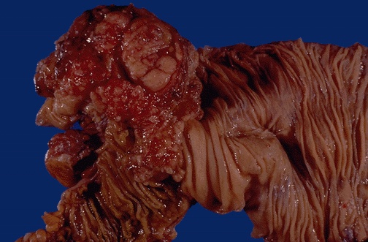
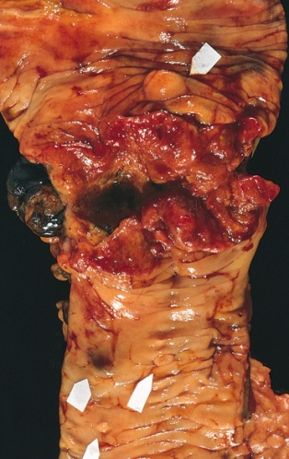
Colorectal Carcinoma
Morphology
70% are in the rectum, rectosigmoid and sigmoid colon.
Left-sided carcinomas tend to be annular, encircling lesions with early symptoms of obstruction.
Right-sided carcinomas tend to grow as polypoid, fungating masses, obstruction is uncommon.
Left-sided
Right-sided
Notes:
16

Slide 36
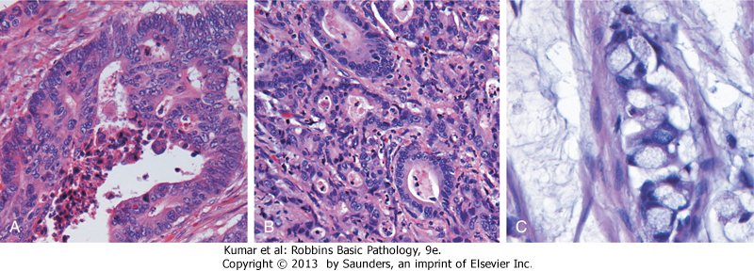
Colorectal Carcinoma Morphology
Adenocarcinoma
Mucinous adenocarcinoma secret abundant mucin that may dissect through cleavage planes in the wall.

Slide 37
Signs and symptoms
If located closer to the anus: change in bowel habit, feeling of incomplete defecation, PR bleeding
A tumor that is large enough to fill the entire lumen of the bowel may cause bowel obstruction
Right-sided lesions are more likely to bleed while left-sided tumors are usually detected later and could present with bowel obstruction.

Slide 38
Colorectal Carcinoma
Serum levels of carcinoembryonic antigen (CEA) are related to tumor size and extent of spread. They are helpful in monitoring for recurrence of tumor after resection.
TNM Staging of Colon Cancers is used for staging
Ref: Robbins Basic Pathology:

Slide 41
Prevention
Aspirin and other NSAIDs
Decreases incidence of colorectal adenomas
Annual fecal occult blood testing
Estrogens and progestins
May reduce colorectal cancer risk
Dietary alterations
(1) Decrease fat intake to 30% of total caloric intake
(2) Increase fiber
(3) Increase intake of fruits and vegetables
? Statins
May inhibit growth of colon cancer lines
Cessation of smoking

Slide 42
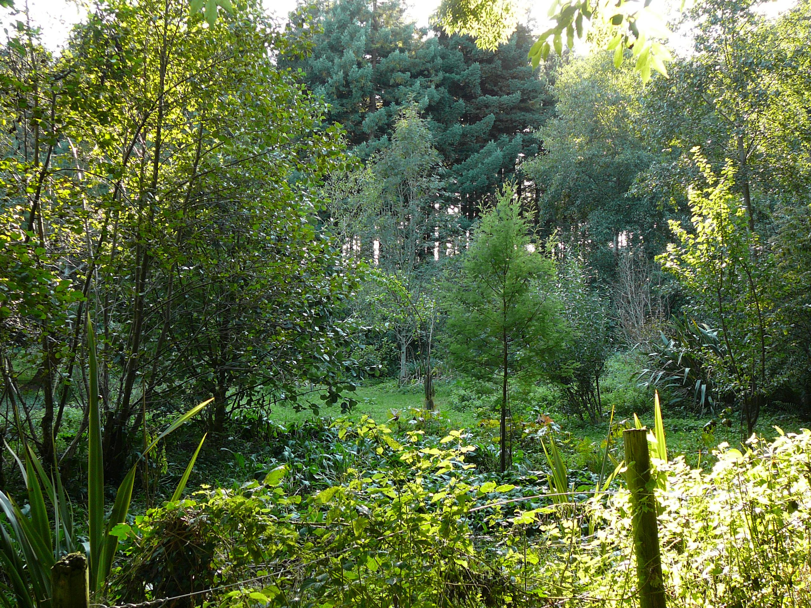

Slide 43
Malignant Small Intestinal Neoplasms
In descending order of frequency:
Carcinoid
Adenocarcinomas
Lymphomas
Leiomyosarcomas.
Notes:
20

Slide 44
Small Intestinal Neoplasms
Carcinoid Tumors
Neoplasms arising from endocrine cells found along the length of GIT mucosa.
The peak incidence :sixth decade, but they may appear at any age.
They compose less than 2% of colorectal malignancies but almost half of small intestinal malignant tumors.
60 to 80% appendix and terminal ileum: 10 to 20% rectum.
Notes:
21

Slide 45
Carcinoid Tumors Behavior
Aggressive behavior correlates with:
Site of origin:
Appendiceal and rectal carcinoids infrequently metastasize, even though they may show extensive local spread
90% of ileal, gastric, and colonic carcinoids that have penetrated halfway through the muscle wall have spread to lymph nodes and distant sites at the time of diagnosis, especially those larger than 2 cm in diameter.
Depth of local penetration
Size of the tumor

Slide 46
Small Intestinal Neoplasms
Carcinoid Tumors
Morphology
A solid, yellow-tan appearance
The cells are monotonously similar, having a scant, pink granular cytoplasm and a round-to-oval stippled nucleus.
Ultrastructral features: neurosecretory electron dense bodies in the cytoplasm
Notes:
21

Slide 47
Small Intestinal Neoplasms
Carcinoid Tumor
Clinical features
Asymptomatic
May cause obstruction, intussusception or bleeding.
May elaborate hormones: Zollinger-Ellison, Cushing’s carcinoid or other syndromes.
Notes:
22

Slide 48
Small Intestinal Neoplasms
Carcinoid tumor
Carcinoid syndrome
1% of carcinoid tumor & in 20% of those of widespread metastasis
Paroxymal flushing, episodes of asthma-like wheezing, right-sided heart failure, attacks of watery diarrhea, abdominal pain,
The principal chemical mediator is serotonin
The syndrome is classically associated with ileal carcinoids with hepatic metastases.
Notes:
23

Slide 49
Small Intestinal Neoplasms
Lymphoma
Most often low-grade lymphomas arising in mucosal-associated lymphoid tissue (MALT) lymphoma or high-grade non-Hodgkin's lymphomas of B cell type.
May occur in any part of the intestine;
The ileocecal region is a favored site for Burkitt's lymphoma.

Slide 52
Diverticulosis

