Slide 1
Gastrointestinal Block Pathology lecture Dec, 2012
Inflammatory bowel disease
Dr. Maha Arafah
Dr. Ahmed Al Humaidi

Slide 2
Inflammatory Bowel Diseases
Inflammatory bowel disease (IBD) is a chronic condition resulting from inappropriate mucosal immune activation
Crohn's disease and ulcerative colitis.
Although their causes are still not clear, the two diseases probably have an immunologic hypersensitivity basis.

Slide 3
Pathophysiology
An idiopathic disorder
The pathophysiology of IBD is under active investigation.
Persons with IBD have a genetic predisposition for the disease.
Most investigators believe that the two diseases result from a combination of
Defects in host interactions with intestinal microbes
Intestinal epithelial dysfunction
Aberrant mucosal immune responses.
For unclear reasons, research suggests that smoking increases the risk of Crohn disease but reduces the likelihood of ulcerative colitis.

Slide 4
Pathophysiology
Nucleotide-binding oligomerization domain-containing protein 1
Genetics: mutation in
NOD2……. susceptibility gene in Crohn disease.
…………. Abnormal recognition and response to intracellular pathogens
THEORY
Less effective at recognizing and combating luminal microbes
Mucosal immune responses.
Abnormal intestinal epithelial tight junction barrier function
Immunosuppression is the mainstay of IBD therapy.
Transepithelial flux of luminal bacterial components activates immune responses
Inflammation
NOD2 encodes a protein that binds to intracellular bacterial peptidoglycans

Slide 5
Nucleotide Oligomerization binding Domain 2
NOD2 encodes a protein that binds to intracellular bacterial peptidoglycans and subsequently activates NF-κB.
It has been postulated that disease-associated NOD2 variants are less effective at recognizing and combating luminal microbes, which are then able to enter the lamina propria and trigger inflammatory reactions.
Mutations in NOD2 are seen in about 15% of Crohn's disease patients but are also seen in a smaller percentage of the general population,
so mutations in NOD2 are neither necessary nor sufficient for the development of Crohn's disease

Slide 6
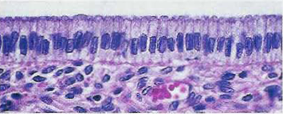
luminal bacteria

Slide 7
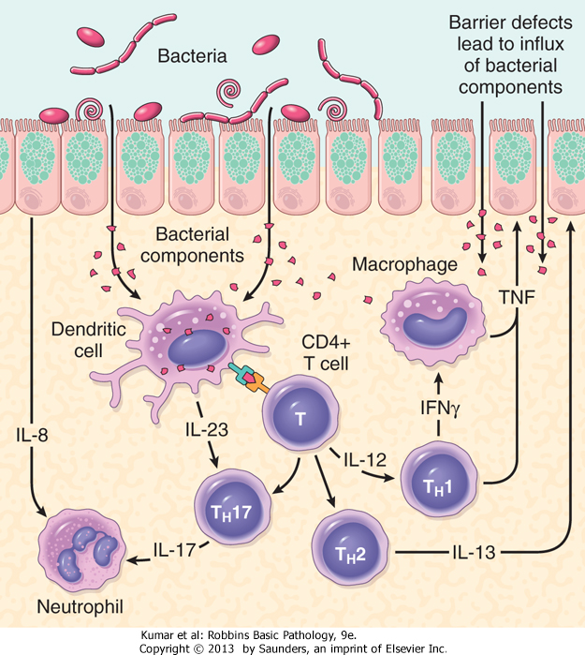
Pathophysiology

Slide 8
Clinical
The manifestations of IBD generally depend on the area of the intestinal tract involved.
Colon
Small intestine
Extraintestinal manifestations
Bloody diarrhea,
Tenesmus
Abdominal pain
Intestinal obstruction.
Steatorrhea
Arthritis
Eye manifestation
Skin manifestation

Slide 9
Crohn's disease
is a chronic inflammatory disorder that most commonly affects the ileum and colon but has the potential to involve any part of the gastrointestinal tract from the mouth to the anus.

Slide 10
Crohn's disease
Clinical Features
Any age but has its highest incidence in young adults
Extremely variable clinical feature.
Acute phase: fever, diarrhea, and right lower quadrant pain may mimic acute appendicitis.
Chronic disease : remissions and relapses over a long period of time.
Thickening of the intestine may produce an ill-defined mass in the abdomen.

Slide 11
Crohn's disease
Sites of Involvement:
Any part of the GIT from the mouth to the anus.
ileum (30%) colon (20%).
most commonly terminal ileum
Commonly (75%) have perianal lesions such as abscesses, fistulas, and skin tags.

Slide 12
Crohn's disease
Gross Appearance:
Involvement is typically segmental, with skip areas of normal intestine between areas of involved bowel.
Marked fibrosis causing luminal narrowing with intestinal obstruction.
Fissures (deep and narrow ulcers that look like stabs with a knife that penetrate deeply into the wall of the affected intestine)
fistulas (communications with other viscera).

Slide 13
Mucosa: longitudinal serpiginous ulcers separated by irregular islands of edematous mucosa. This results in the typical cobblestone effect.
FAT : In involved ileal segments, the mesenteric fat creeps from the mesentery to surround the bowel wall (creeping fat)

Slide 14
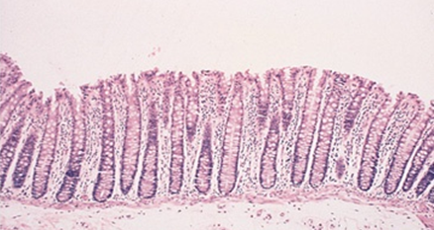
Crohn's disease
Microscopic Features
Distortion of mucosal crypt architecture,
Transmural inflammation,
Epithelioid granulomas [60%].
Fissure-ulcers and fistulas can be seen microscopically.
Normal

Slide 15
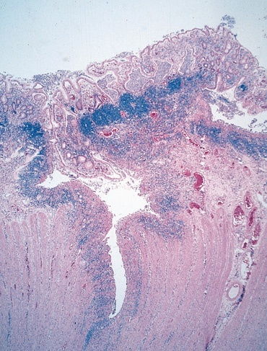
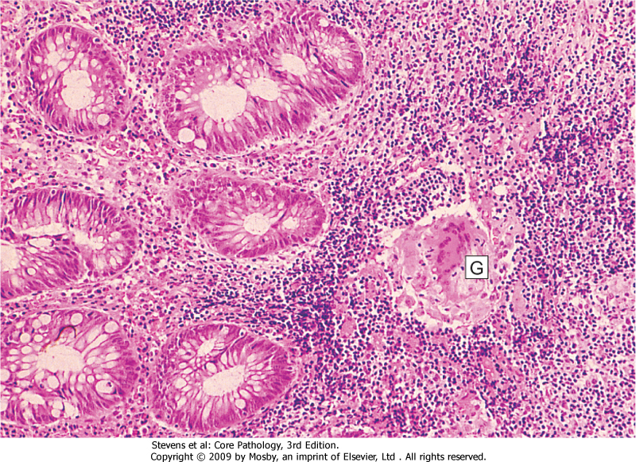
Crohn’s Disease
FISSURE
GRANULOMA

Slide 16
Crohn's disease
Complications
Intestinal obstruction
Fistula formation
between the ileum and the colon result in malabsorption
Enterovesical fistulas lead to urinary infections and passage of gas and feces with urine.
Enterovaginal fistulas produce a fecal vaginal discharge.
Extraintestinal manifestations (arthritis and uveitis)
Slight increased risk of development of carcinoma of the colon—much less than in ulcerative colitis.

Slide 17
Crohn's disease
Summary
Involvement of discontinuous segments of intestine (skip areas
Can involve any part of GIT.
Noncaseating epithelioid cell granulomas
Transmural (full-thickness) inflammation of the affected parts

Slide 18
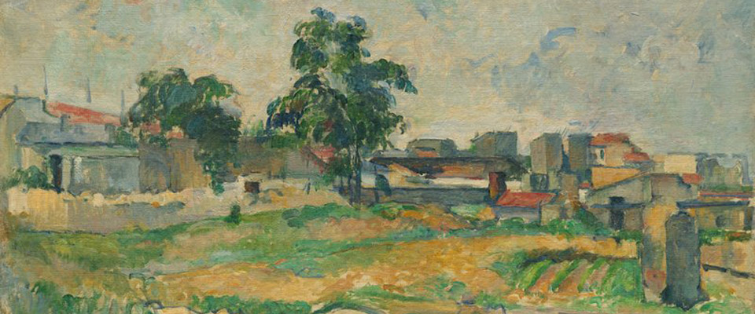

Slide 19
Ulcerative Colitis
is an inflammatory disease of uncertain cause.
It has a chronic course characterized by remissions and relapses.
20- to 30-year age group but may occur at any age

Slide 20
Ulcerative Colitis
Etiology
The cause is unknown
Antibodies that cross-react with intestinal epithelial cells and certain serotypes of Escherichia coli have been demonstrated in the serum of some patients with ulcerative colitis.

Slide 21
Ulcerative Colitis
Clinical Features
In the acute phase and during relapse, the patient has fever, leukocytosis, lower abdominal pain, bloody diarrhea and mucus in the stool.
The disease usually has a chronic course, with remissions and exacerbations.

Slide 22
Ulcerative Colitis
Sites of Involvement
Ulcerative colitis is a disease of the rectum, and the colon.
Rectum is involved in almost all cases
The disease extends proximally from the rectum in a continuous manner without skip areas.
The ileum is not involved as a rule

Slide 23
Ulcerative Colitis
Gross Appearance
Involves mainly the mucosa (diffuse hyperemia with numerous superficial ulcerations in the acute phase.
The regenerated or nonulcerated mucosa may appear polypoid (inflammatory pseudopolyps) in contrast with the atrophic areas or ulcers.

Slide 24
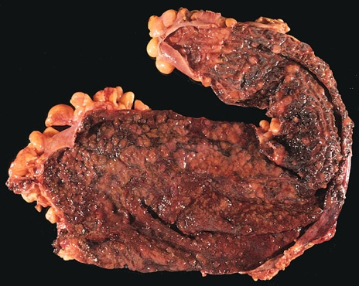
diffuse hyperemia with numerous superficial ulcerations
NO skip lesion

Slide 25
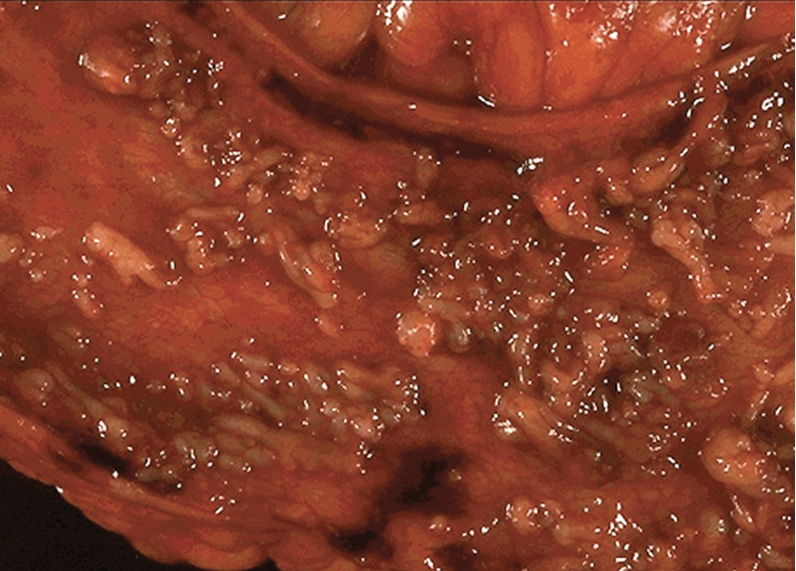

Slide 26
Ulcerative Colitis
Microscopic Appearance
The inflammation is usually restricted to the mucosa.
In the active phase….neutrophils (Cryptits, crypt abscess)
In the chronic phase…..crypt atrophy and distortion
Active inflammation correlates well with the severity of symptoms.

Slide 27
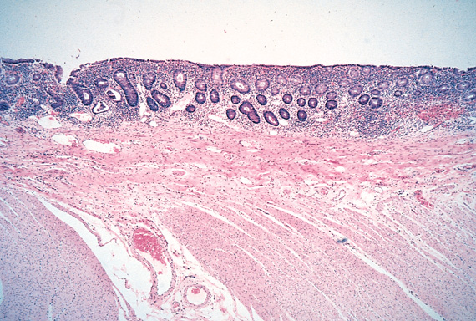
The inflammation is usually restricted only to the mucosa.
inflammation
No inflammation

Slide 28
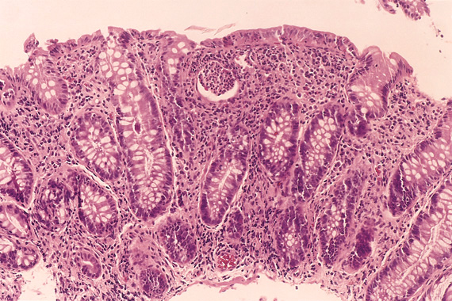
Crypt abscess
dysplasia

Slide 29
Ulcerative Colitis
Complications
Acute phase
Severe bleeding
Toxic megacolon ( dilation of the colon, with functional obstruction)
Chronic ulcerative colitis
Increase risk of developing colon carcinoma.
The presence of high-grade dysplasia in a mucosal biopsy imposes a high risk of cancer and is an indication for colectomy.
Extraintestinal manifestations
occur more commonly in ulcerative colitis than in Crohn's disease.
Arthritis
Uveitis
skin lesions (pyoderma gangrenosum),
sclerosing pericholangitis (fibrosis around bile ducts), leading to obstructive jaundice.

Slide 30
Ulcerative Colitis | Crohn's disease
Colon only | Any part of the GIT | Site
Diffuse involvement of mucosa | Skip areas of normal mucosa | Pattern
Superficial ulcers | Deep ulcers ( fissure ) | Depth of the ulcer
Mucosal inflammation only | Transmural inflammation | Extent of inflammation
No | Yes | Fistula formation
No | Yes | Creeping mesenteric fat
No | Yes | Fibrous thickening of wall
No | Yes | Granulomas
Common | rare | Dysplasia
more common (10%) | rare | Carcinoma
Pseudopolyps | Cobblestone | Mucosal appearances
Thin wall Dilated lumen | Thickened wall Narrow lumen | Bowel wall
HLA-DR2 | HLA-DR1/DQw5 | MHC Class II
Haemorrhage Electrolyte loss Toxic megacolon Systemic effects | Short gut syndrome Fistula formation Bowel perforation Stricture formation | Complications

Slide 31
Ulcerative Colitis | Crohn's disease
Colon only | Any part of the GIT | Site
Diffuse involvement of mucosa | Skip areas of normal mucosa | Pattern
Superficial ulcers | Deep ulcers ( fissure ) | Depth of the ulcer
Mucosal inflammation only | Transmural inflammation | Extent of inflammation
No | Yes | Fistula formation
No | Yes | Creeping mesenteric fat
No | Yes | Fibrous thickening of wall
No | Yes | Granulomas
Common | rare | Dysplasia
more common (10%) | rare | Carcinoma
Pseudopolyps | Cobblestone | Mucosal appearances
Thin wall Dilated lumen | Thickened wall Narrow lumen | Bowel wall
HLA-DR2 | HLA-DR1/DQw5 | MHC Class II
Haemorrhage Electrolyte loss Toxic megacolon Systemic effects | Short gut syndrome Fistula formation Bowel perforation Stricture formation | Complications

Slide 32
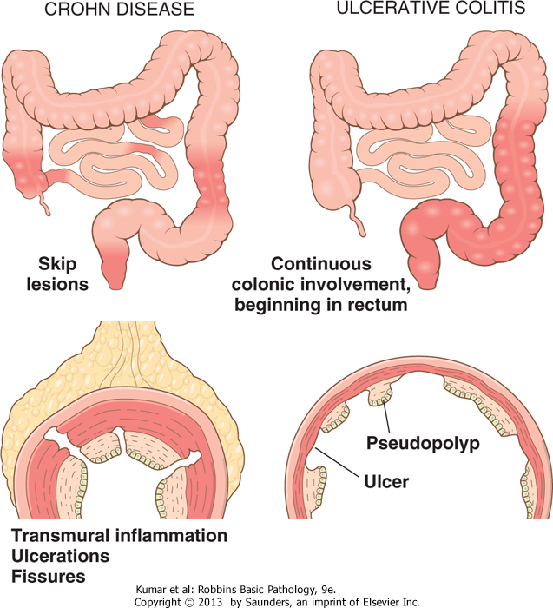

Slide 33
Crohn's disease
Ulcerative Colitis
More common in whites than blacks, in Jews than non-Jews
No sex predilection
Majority (>75%) of cases occur between 11 and 35 years of age
Smoking is a risk factor
More common in whites than blacks
No sex predilection
Occurs between 14 and 38 years of age
Lower incidence in smokers and other nicotine users

Slide 34
Crohn's disease
Ulcerative Colitis
Recurrent right lower quadrant colicky pain (obstruction) with diarrhea Bleeding occurs only with colon or anal involvement (fistulas; abscesses) Apthous ulcers in mouth Extragastrointestinal: erythema nodosum, sacroiliitis (HLA-B27 association), pyoderma gangrenosum, iritis (CD > UC), primary sclerosing cholangitis (UC > CD)
Recurrent left-sided abdominal cramping with bloody diarrhea and mucus Fever, tenesmus, weight loss Extragastrointestinal: primary sclerosing cholangitis (UC > CD), erythema nodosum, iritis/uveitis (CD > UC), pyoderma gangrenosum, HLA-B27 positive arthritis. p-ANCA antibodies > 45% of cases

Slide 35
Crohn's disease
Ulcerative Colitis
Fistulas, obstruction
Colon cancer (UC > CD)
Calcium oxalate renal calculi (increased reabsorption of oxalate through inflamed mucosa)
Malabsorption due to bile salt deficiency
Macrocytic anemia due to vitamin B₁₂ deficiency
Toxic megacolon (hypotonic and distended bowel) Adenocarcinoma: greatest risks are pancolitis, early onset, duration of disease > 10 years)

Slide 36
Inflammatory bowel diseases MATCH
Colon only
Diffuse involvement of mucosa
Superficial ulcers
Any part of the GIT
Skip areas of normal mucosa
Mucosal inflammation only
Fistula formation
Transmural inflammation
Granulomas
Deep ulcers ( fissure )
Dysplasia is common
Carcinoma is more common (10%)
Crohn's disease
Ulcerative Colitis

Slide 39
