Slide 1
Pathology and pathogenesis of pancreatitis

Slide 2
Pancreatitis
Inflammation of the pancreas.
The clinical manifestations can range in severity from a mild, self-limited disease to a lifethreatening acute inflammatory process
The duration of the disease can range from a transient attack to an irreversible loss of function.

Slide 3
Pancreatitis
Acute or chronic
In acute pancreatitis, gland can return to normal if underlying cause of the pancreatitis is removed.
By contrast, chronic pancreatitis is defined by irreversible destruction of exocrine pancreatic parenchyma.

Slide 4
Acute pancreatitis
Acute pancreatitis is a group of reversible lesions characterized by inflammation of the pancreas ranging in severity from edema and fat necrosis to parenchymal necrosis with severe hemorrhage.
80% of cases in western countries are associated with one of two conditions: biliary tract disease or alcoholism.
Gallstones are present in 35% to 60% of cases of acute pancreatitis.

Slide 5
Acute pancreatitis
Causes :
Metabolic
Mechanical
Vascular
Infectious

Slide 6
ETIOLOGIC FACTORS IN ACUTE PANCREATITIS
Metabolic
Alcoholism
Hyperlipoproteinemia
Hypercalcemia
Drugs (e.g., thiazide diuretics)
Genetic
Mechanical
Trauma
Gallstones
Iatrogenic injury
Perioperative injury
Endoscopic procedures with dye injection

Slide 7
ETIOLOGIC FACTORS IN ACUTE PANCREATITIS
Vascular
Shock
Atheroembolism
Polyarteritis nodosa
Infectious
Mumps
Coxsackievirus
Mycoplasma pneumoniae

Slide 8
Acute pancreatitis
Obstruction of the pancreatic duct system
eg. periampullary tumors, congenital cystic dilatation of the common bile duct, biliary "sludge," and parasites (particularly Ascariasis lumbricoides and Clonorchis sinensis organisms)
Medication
More than 85 drugs have been reported to cause acute pancreatitis. e.g . thiazide diuretics, estrogens, etc
Metabolic disorders
Including hypertriglyceridemia, hyperparathyroidism, and other hypercalcemic states
Acute ischemia
Vascular thrombosis, embolism, vasculitis and shock
Trauma:
Blunt trauma
Iatrogenic injury during surgery or endoscopic retrograde cholangiopancreatography

Slide 9
Acute pancreatitis: Morphology
The morphology of acute pancreatitis ranges from inflammation and edema to severe extensive necrosis and hemorrhage.

Slide 10
Acute pancreatitis: Morphology
The basic alterations are
(1) microvascular leakage causing edema
(2) necrosis of fat by lipolytic enzymes
(3) an acute inflammatory reaction
(4) proteolytic destruction of pancreatic parenchyma
(5) destruction of blood vessels with subsequent interstitial hemorrhage
Fat necrosis results from enzymatic destruction of fat cells. The released fatty acids combine with calcium to form insoluble salts that precipitate .

Slide 11
Acute pancreatitis
Pathogenesis.
autodigestion of the pancreatic substance by inappropriately activated pancreatic enzymes.
activation of trypsinogen is an important triggering event in acute pancreatitis.

Slide 12
Acute pancreatitis: Clinical Features.
Abdominal pain is the cardinal manifestation of acute pancreatitis.
Full-blown acute pancreatitis is a medical emergency .
These patients usually have the sudden onset of an "acute abdomen“ .
Characteristically, the pain is constant and intense and is often referred to the upper back.
There is leukocytosis, hemolysis, disseminated intravascular coagulation, fluid sequestration, acute respiratory distress syndrome, and diffuse fat necrosis.
Peripheral vascular collapse and shock with acute renal tubular necrosis may occur

Slide 13
Acute pancreatitis
Laboratory findings: marked elevation of serum amylase levels during the first 24 hours, followed within 72 to 96 hours by a rising serum lipase level.

Slide 14
Acute pancreatitis
The key to the management is "resting" the pancreas by total restriction of food and fluids and by supportive therapy.
Most patients recover fully. About 5% die from shock during the first week of illness. Acute respiratory distress syndrome and acute renal failure are fatal complications.
In surviving patients, sequelae include a sterile pancreatic abscess and a pancreatic pseudocyst.

Slide 15
Chronic pancreatitis
Chronic pancreatitis is characterized by inflammation of the pancreas with destruction of exocrine parenchyma, fibrosis, and, in the late stages, the destruction of endocrine parenchyma.
The chief distinction between acute and chronic pancreatitis is the irreversible impairment in pancreatic function that is characteristic of chronic pancreatitis.

Slide 16
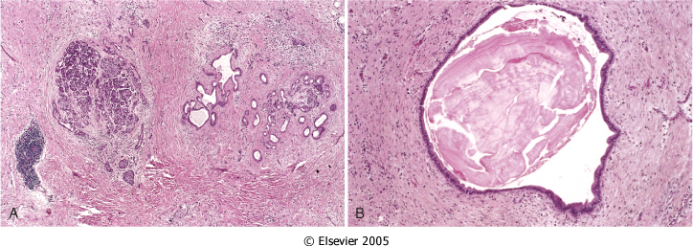
Chronic pancreatitis
Notes:
Chronic pancreatitis. A, Extensive fibrosis and atrophy has left only residual islets (left) and ducts (right), with a sprinkling of chronic inflammatory cells and acinar tissue. B, A higher-power view demonstrating dilated ducts with inspissated eosinophilic ductal concretions in a patient with alcoholic chronic pancreatitis.

Slide 17
Chronic pancreatitis
There is significant overlap in the causes of acute and chronic pancreatitis. By far the most common cause of chronic pancreatitis is long-term alcohol abuse and biliary tract disease, and these patients are usually middle-aged males.

Slide 18
Chronic pancreatitis
Less common causes of chronic pancreatitis include the following:
Hypercalcemia, hyperlipidemia.
Long-standing obstruction of the pancreatic duct by pseudocysts, calculi, trauma, neoplasms, or pancreas divisum.
Tropical pancreatitis, which is a poorly characterized disease seen in Africa and Asia. It has been attributed to malnutrition.
Hereditary pancreatitis
Idiopathic chronic pancreatitis.

Slide 19
Chronic pancreatitis: Morphology
Chronic pancreatitis is characterized by parenchymal fibrosis, reduced number and size of acini with relative sparing of the islets of Langerhans, and variable dilation of the pancreatic ducts
These changes are usually accompanied by a chronic inflammatory infiltrate around lobules and ducts.
Grossly: gland is hard, sometimes with extremely dilated ducts and visible calcification

Slide 20
Chronic pancreatitis: Clinical Features
Silent or repeated attacks of abdominal pain or persistent abdominal and back pain.
Attacks may be precipitated by alcohol abuse, overeating , or the use of opiates and other drugs.
During an attack of abdominal pain, there may be mild fever and mild-to-moderate elevations of serum amylase.
Calcifications can be seen within the pancreas by CT scan and ultrasonography.

Slide 21
Chronic pancreatitis: Clinical Features
Complications:
Severe pancreatic exocrine insufficiency
Chronic malabsorption
Diabetes mellitus (due to destruction of islets of Langerhans)
Severe chronic pain
Pancreatic pseudocysts

Slide 22
PSEUDOCYSTS OF PANCREAS
Pseudocysts are localized collections of necrotic-hemorrhagic material rich in pancreatic enzymes. Such cysts lack an epithelial lining (hence the prefix "pseudo"), and they account for majority of cysts in the pancreas.
Pseudocysts usually arise after an episode of acute pancreatitis, or of chronic alcoholic pancreatitis.

Slide 23
PSEUDOCYSTS OF PANCREAS
Morphology. Pseudocysts are usually solitary. Pseudocysts can range in size from 2 to 30 cm in diameter.
While many pseudocysts spontaneously resolve, they may become secondarily infected, and larger pseudocysts may compress or even perforate into adjacent structures.
They can produce abdominal pain and predispose to intraperitoneal hemorrhage or peritonitis.

Slide 24
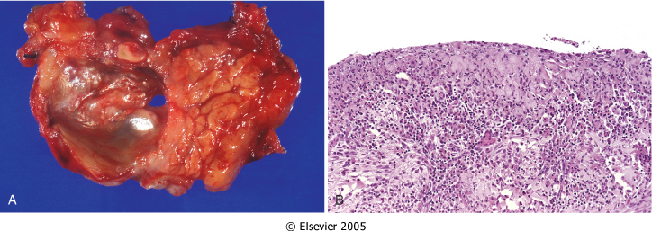
PSEUDOCYSTS OF PANCREAS
Notes:
Pancreatic pseudocyst. A, Cross-section through this previously bisected lesion revealing a poorly defined cyst with a necrotic brown-black wall. B, Histologically, the cyst lacks a true epithelial lining and instead is lined by fibrin and granulation tissue.

