Slide 1
Drugs Used For Peptic Ulcer
(H₂- Blockers and Proton Pump Inhibitors)
Prof. Abdulqader Alhaider
1434 H.

Slide 2
Drugs Used For Peptic Ulcer
Definition
(Classify as gastric, duodenal and gastro esophageal reflex disease or stress related ulcer).
Etiology: Smoking, Caffeine; Heredity; Diet; Hypersecretory states; H. pylori infection; Drugs (e.g.)
3. Pathophysiology: (see figure 1): Simply it is imbalance between Aggressive factors (Acid & Pepsin) and Defensive Factors (e.g.Prostaglandins )
However, nowadays, it seems that H. pylori theory is very important.

Slide 3
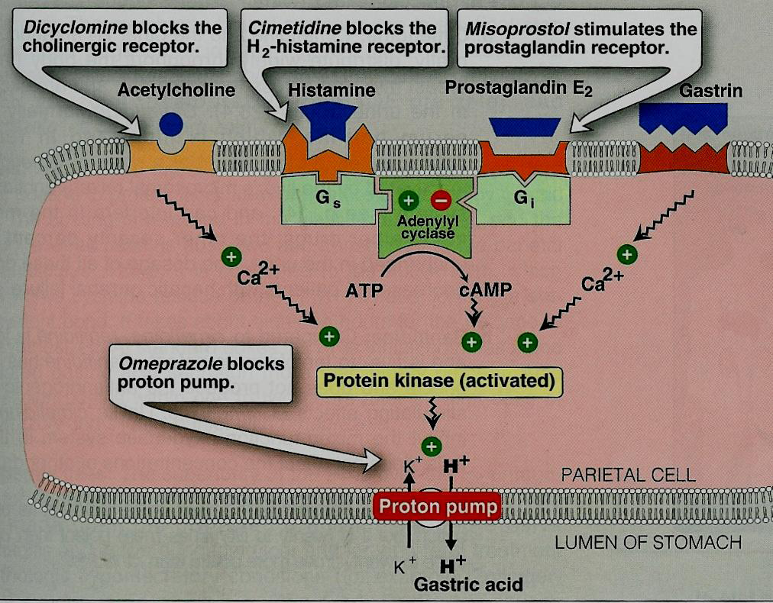
*
*
*
*

Slide 4
What is the role of gastric emptying on the formation of ulcers?
Treatment
* Objectives (Relieve pain; healing of ulcer ; prevention of further ulcer recurring)
How the above objectives could be accomplished?
1) Inhibiting the aggressive factors e.g Acid and pepsin
Enhancing mucosal resistance
Eradication of H.pylori (Best).90%

Slide 5
B. Classification of Drugs used in the treatment of peptic ulcers?
Antacids
These drugs are mainly inorganic salts (e.g.: NaHCO₃; Ca CO₃; Al (OH)₃; Mg (OH)₂
Mechanism of Action:
  (Antagonize acid; Also, Indirectly may decrease pepsin activity)
What are their side effects ?
Which one (s) produce (s) constipation?
Which one (s) produce (s) diarrhea?
What is the milk-alkali syndrome?
Why their uses have been declined?

Slide 6
2. Antisecretory Drugs (see figure)
H₂ –receptor antagonists (considered the most important discovery in the seventies)
Examples: ( Cimetidine; Ranitidine (Zantac); Famotidine; Nizatidine )

Slide 7
  MOA
They competitively & reversibly bind to H2-receptors on the parietal cells, thus decreasing the production of acid by these cells.
  Potency VS efficacy (see Table )
  Side effects and drug interactions.
What are the differences between cimetidine and Ranitidine?.

Slide 8
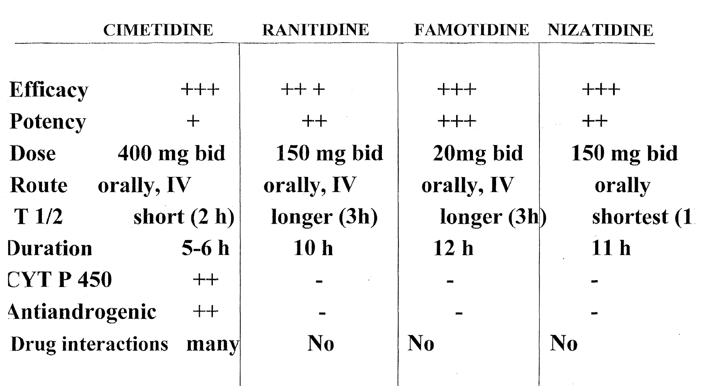
PK

Slide 9
Pharmacological actions of H2 blockers
1. Reduce basal & food-stimulated gastric acid secretion.
2. Reduce acid secretion stimulated by histamine, as well as by gastrin & cholinergic drugs.
3. Reduce pepsin activity.
4. Block 90% of nocturnal acid secretion (which
depend largely on histamine) & 60-70% of total 24 hr acid secretion. Therefore, it is better to be given before night sleep.

Slide 10
Adverse Effects of H2 blockers safe drug, adverse effects occur in less than 3% of patients
1.CNS effects:
Headache, confusion, hallucination & agitation due to IV H2 antagonists (more with cimetidine) but not with Ranitidine.
2. Endocrine effects (For Only Cimetidine )
▪Increases in serum prolactin (Galactorrhea in women)
▪Inhibits binding of dihydro-testosterone to androgen receptors (gynecomasteia –impotence).
3. All cross placenta & breast milk, should not be given in pregnancy unless it is necessary (not teratogenic) .
4. Inhbition of Ctyp450 by Cimetidine.
5.. Leukopenea and thrombocytobenia and headache

Slide 11
Clinical USES of H2 blockers
GERD (heartburn/ dyspepsia).
PUD: effective in nocturnal acid suppression & ulcer healing in moderate cases
Prevention of bleeding from stress-related gastritis.
Decrease the heartburn by NSAIDs

Slide 12
Proton pump inhibitors
Examples: Omeprazole ; Lansoprazole ; Pentoprazole ; Raprazole
MOA :
Irreversible inhibition of proton pump (H⁺/ K⁺ ATPase) that is responsible for final step in gastric acid secretion from the parietal cells.
24 hr inhibition of basal & meal stimulated-acid secretion (90-98%).
Why PPIs should not be used together with H₂-antagonists or antacids?.
Efficacy & potency: more potent than H2-blockers
Clinical Uses:
1) Gastric and duodenal ulcer (H.pylori Eradication)
2) Zolinger Elison syndrome.
3) GERD
4) NSAIDs

Slide 13
Side Effects: Headache; diarrhea; nausea; decrease gastric acid secretion lead to hypergastermeia (How?), and mucosal hyperplasia.
Prolonged acid suppression leads to:
- subnormal B12 levels
- risk of hip fracture if taking PPIs over a long
period
- colonization & infection of the stomach & intestine from ingested bacteria; increased risk of both community-acquired respiratory infections & nosocomial pneumonia.
Note: Despite all the above PPIs are very save drugs.

Slide 14
Pharmacokinetics of PPIs
They are pro-drugs
All are taken orally
Esomeprazole & pantoprazole are also available in IV formulation.
They are rapidly absorbed from the intestine & converted to active form.

Slide 15
How Gastrooesophageal Reflux could be managed?
- Definition
- Treatment:
    Decrease gastric acidity (H2 blockers or PPIs (Best).)
    Increase tone of LOS and increase gastric emptying by Metoclopramide.
    Avoid drugs or foods that trigger GEPR.
    Avoid sleeping after meal and try to use two to three pillows.

Slide 16
Eradication Of H. Pylori
Is a bacteria that causes chronic inflammation of the inner lining of the stomach.
Duodenal ulcer -Gastric ulcer
Produces enzymes (tissue damage)
Risk factor for gastric cancer.
Eradication is important to prevent recurrence of ulcer.

Slide 17
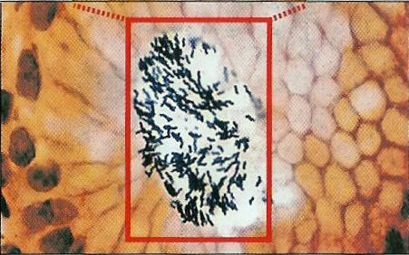
Helicobacter pylori in association with gastric mucosa

Slide 18
Eradication Of H Pylori
The best treatment regimen: Triple therapy (7-10 days)
PPIs bid
Clarithromycin, 500 mg bid (Protein synthesis inhibitor)
Amoxicillin, 1 g bid (Cell wall synthesis inhibitor)

Slide 19
May Almighty Allah guide all of us to
the right way. Good luck

