Slide 1
Drugs for Constipation (Purgatives or Laxatives )
Prof. Alhaider
Dept. of Pharmacology
1434 H

Slide 2
Definition of Constipation: Too infrequent passage of stool that may be due to decreased motility in colon or due to difficulty in evacuation.
Causes (see Table)
Diet : Decrease in water intake and fiber contents of diet.
Local Painful Conditions: Anal fissures, piles.
Lack of muscular exercise.
Drugs : Muscle relaxants, Anticholinergics,
Calcium channel blockers
However, Doctors (some times) may consider a source of chronic constipation. How?

Slide 3
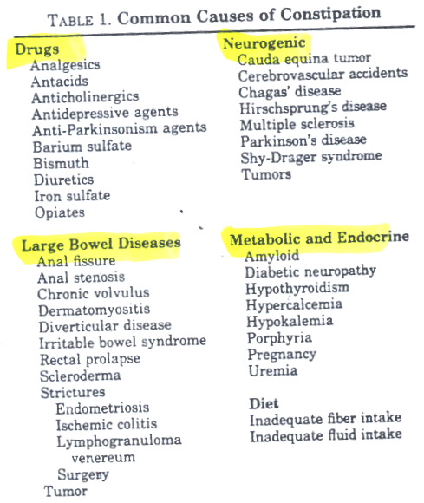

Slide 4
Treatment of Constipation
General Measures :
1. adequate fluid intake.
2. high fiber contents in diet.
3. Regular exercise
4. Regulation of bowel habit.
5. Avoid drugs causing constipation.
Drugs (laxatives, purgatives, cathartics):
Drugs that hasten the transit of food through the intestine by several methods :

Slide 5
Classification of laxatives or purgatives
1. Bulk Purgatives : Increase volume
of nonabsorbable solid residue.
2. Osmotic Purgatives : Increase water
content in large intestine.
3. Stimulant Purgatives : Increase
motility and secretion.
4. Fecal softeners (lubricants) : Alter
the consistency of feces → easier to
pass.

Slide 6
I. Bulk Purgatives
Mechanism of Action
Non absorbed hydrophilic colloids → Increase the bulk of intestinal contents by water absorption → ↑ mechanical pressure on the walls of intestine → stimulation of stretch receptors → ↑ peristalsis.
Note: 1 gm of Carrot absorbs 20 gm of water.

Slide 7
Members
1. Dietary fibers : undigested polysaccharide
vegetables, fruits, grains, bran, pectin.
2. Natural plant products & semi synthetic hydrophilic colloids (very important)
Psyllium seed, methyl cellulose
Carboxymethyl cellulose (CMC).
3. Synthetic non absorbed resins
Calcium polycarbophil.

Slide 8
Side Effects
1. Delayed onset of action ( several days 1-3).
2. Intestinal obstruction (should be taken with enough water).
3. Malabsorption syndrome, abdominal distention.
4. Interfere with other drug absorption e.g. iron, calcium, and cardiac glycosides.

Slide 9
Clinical Uses
Hemorrhoids; Pregnancy; Colostomy; ileostomy; anal fissure; IBS, UC, Chronic diarrhea ass with diverticular disease.

Slide 10
II - Osmotic Purgatives
Water Soluble but non absorbable compounds
Increase water content in large intestine.
Members
1. Organic (Sugars) : lactulose (semisynthetic disaccharide of fructose and galactose).
2. Non-organic (Saline purgatives) : Magnesium salts, sodium or potassium salts.

Slide 11
1. Organic Osmotic (Lactulose)
Metabolized by colonic bacteria into fructose and galactose.
These sugars are fermented into lactic acid and acetic acid that function as osmotic laxatives.
Side Effects
Delayed onset of action (2-3 days)
Abdominal cramps and flatulence.
Electrolyte disturbance.

Slide 12
B.
Why Lactulose is commonly used in liver cirrhosis?
Mechanism:
Lactulose Lactic acid + Acetic Acid acidification of the colon ammonia absorption
Dose: 15 ml for constipation and 30 ml for liver cirrhosis

Slide 13
2. Saline Purgatives (e.g: Magnesium)
Mechanism of Action
Are poorly absorbed salts. They remain in the bowel and retain water by osmosis thereby increasing the volume of feces → ↑ distension → ↑ peristalsis → evacuation of watery stool.
Rapid effect (within 1-3h ).
Magnesium sulphate (Epson’s salt ).
Magnesium oxide (milk of magnesia).
Sodium phosphate.

Slide 14
Uses
1. Treatment of acute constipation
2. Prevention of chronic constipation
Can you mention other uses of magnesium sulphate?
Side Effects
Intravascular volume depletion.
Electrolyte fluctuations: severe in childre

Slide 15
Contraindications
Elderly patients
Renal insufficiency.
Sodium salts in CHF.
Magnesium salts renal failure, heart block, CNS depression, neuromuscular block.

Slide 16
Balanced polyethylene glycol (PEG) Movicolc
Balanced isotonic solution of osmotically active sugar that contain: polyethyleneglycole and , NaCl, KCl, Na bicarbonate
No intravascular fluids or electrolyte shifts
No flatus or cramps
Lavage solution
Used for complete cleansing prior to gastrointestinal endoscopic procedures (4L over 2-4 hours).
Also, small doses used for treatment or prevention of chronic constipation.

Slide 17
III - Stimulant Purgatives (cathartics)
Mechanism of Action :
act via direct stimulation of enteric nervous system → peristalsis & purgation.
Members
1. Bisacodyl.
2. Anthraquinone derivatives.
3. Castor oil.

Slide 18
Bisacodyl
- Acts on large intestine ( weak ).
- Onset time 6-10 h, taken at night.
Castor Oil
Fixed oil degraded by lipase in upper small intestine → ricinoleic acid + glycerin
Ricinoleic acid irritates mucosa.
Acts on small intestine (strong ).
5-20 ml on empty stomach in the morning.
O.T. = 4 h.

Slide 19
Anthraquinone derivatives
Senna, Cascara, Aloes
In colon, glycosides are hydrolyzed by
bacteria into emodin + sugar
The absorbed emodin has direct stimulant action on myenteric plexus → ↑ smooth muscle contraction → defecation.
Bowel movements in 12 h (orally) or 2 h
(rectally).
Given at night.
Brown pigmentation of the colon (melanosis coli).

Slide 20
Side Effects of Stimulant Laxative
Abdominal cramps may occur.
Prolonged use → dependence & destruction of myenteric plexus and atonic colon. Leading to chronic constipation
Contraindications
Senna in lactation
Castor oil in pregnancy → reflex contraction of uterus → abortion.

Slide 21
IV - Fecal Softeners (Lubricants)
Are non absorbed drugs that soften the feces thus promoting defecation.
May be given orally or rectally.
Members :
1. Surfactants
decrease surface tension of feces
e.g. Docusate (sodium dioctyl sulfosuccinate).
is given orally or enema.
Is commonly prescribed in hospitalized patients to minimize straining.

Slide 22
2. Glycerin (Suppository). (Commonly used after Surgery)
3. Mineral oil (Liquid Paraffin) (good for radiology preparation)
Side effects of liquid paraffin
Not palatable
impairs absorption of fat soluble vitamins.
Increase activity of oral anticoagulant.

Slide 23
Irritable Bowel Syndrome
It is a functional bowel disorder associated by characteristic cluster of symptoms in the absence of detectable structural abnormalities. However, it is a condition of diverse pathophysiology associated with abnormalities in GIT motility (either diarrhea or constipation). Prevalence is around 15% of population. Recent work concentrated to the important role that serotonin plays in such syndrome. Therefore, many of drugs that used for Rx of IBS may act by serotonergic mechanisms (see Table).

Slide 24
1) 5-HT3 receptor antagonists (Alosetron and Cilanestron) are used for diarrhea associated IBS.
Dose: 1 mg BID
Side Effects: Constipation; Ischemic Colitis
2) 5-HT4 partial agonist (Tegaserod): This is used for constipation-predominant IBS in women and also recommended for Rx of chronic constipation.
MOA: Stim. Of 5-HT4 receptor enhances the release of ACH. The latter increases peristalsis.
Dose: 6 mg BID for 8 weeks.
Side Effects: Diarrhea; Headache
Limitation: does not have significant effect on symptoms of abdominal pain and discomfort.

Slide 26
