Slide 1
Secretory Functions of the Alimentary Tract (Secretion of Saliva)
Chapter 64; page 773-777
Mohammed Alzoghaibi, PhD
Cell Phone #: 0506338400
zzoghaibi@gmail.com

Slide 2
Learning objectives
Mastication and Chewing reflex
The functions of secretory glands
Anatomical types of glands
Salivary glands
Secretion of saliva and its characteristics
Composition of saliva
Lubricating and protective properties of mucus
Secretory unit (salivon)
Saliva and its flow rate
Functions of saliva
Control of secretion by sympathetic and parasympathetic nervous systems

Slide 3
Mastication (Chewing)
Functions:
To lubricate the bolus with salivary secretion
To breakdown the bolus to small particles
To begin digestion of carbohydrate (amylase)

Slide 4
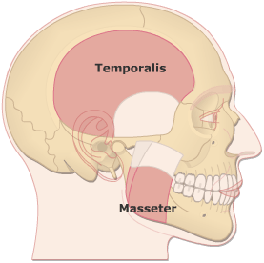
Mastication (Chewing)
Teeth organization
Anterior teeth (incisors) for cutting
Posterior teeth (molars) for grinding
Chewing muscles are innervated by CN V:
Masseter
Temporalis
Lateral Pterygoid
Medial Pterygoid
Taste center (Hypothalamus) rhythmical chewing movements
Chewing reflex & stretch reflex

Slide 5
Mastication (Chewing)
Chewing reflex & stretch reflex
The presence of a bolus of food in the mouth at first initiates reflex inhibition of the muscles of mastication, which allows the lower jaw to drop. The drop in turn initiates a stretch reflex of the jaw muscles that leads to rebound contraction.This automatically raises the jaw to cause closure of the teeth, but it also compresses the bolus again against the linings of the mouth, which inhibits the jaw muscles once again, allowing the jaw to drop and rebound another time; this is repeated again and again.

Slide 6
Secretory Functions of the Alimentary Tract
The functions of secretory glands:
Secretion of digestive enzymes
Provide mucus for lubrication and protection

Slide 7
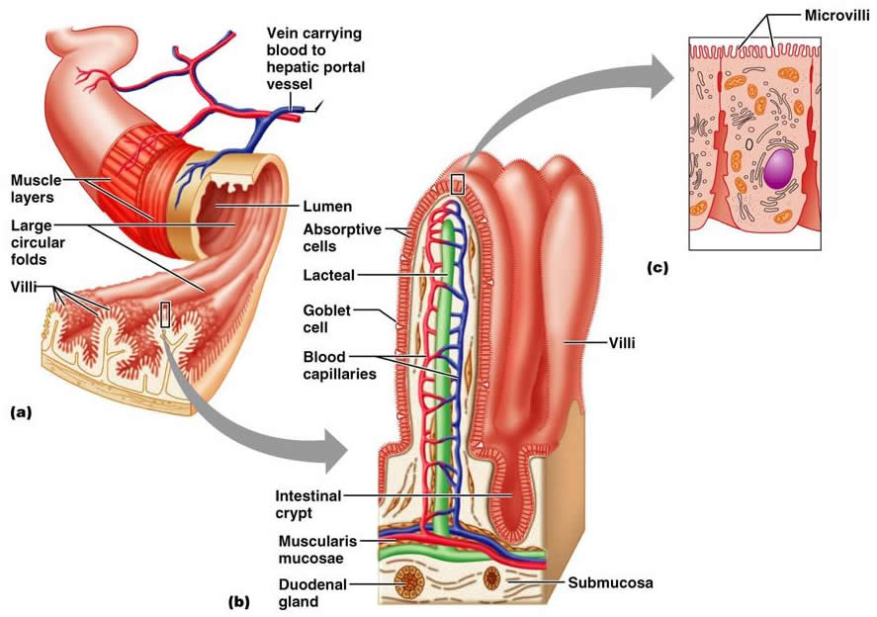
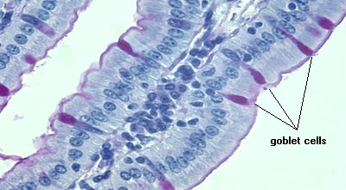
Anatomical Types of Glands
Single-cell mucous glands (goblet cells), they produce mucus.
Crypts of Lieberkühn at the mucosal pits.
Tubular glands (in the stomach and duodenum)
Salivary glands, pancreas, and liver

Slide 8
SALIVARY GLANDS
The principal glands of salivation are:
Parotid glands
Submandibular (Submaxillary) glands
Sublingual glands
Smaller glands in mucosa of tongue, palate, etc.
Daily secretion of saliva = 800-1500 mL with pH = 6-7

Slide 9
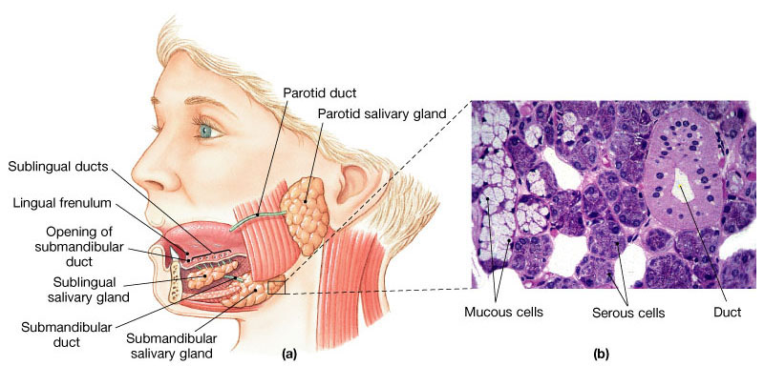
SALIVARY GLANDS

Slide 10
Secretion of Saliva and its Characteristics
Saliva contains two major types of secretion:
1. Aqueous fluids (a serous secretion)
Water, ions and enzymes such as ptyalin (an α-amylase)
Parotid, Submandibular and Sublingual glands
2. Mucus secretion (mucin)
Submandibular and Sublingual glands

Slide 11
Composition of Saliva
Aqueous Fluids
H₂O, K, HCO₃, Na, Cl, α-amylase, lingual lipase, IgA, kallikrein, muramidase (lyses muramic acid of Staphylococcus), lactoferrin and epithelial growth factor (EGF)
Hypotonic Solution
Ions Na, K, CI, HCO₃: (the concentrations of these ions are altered with altered flow rates), e.g., at low flow rate, the salivary secretions have:
High K and HCO₃
Low Na and CI−

Slide 12
Composition of Saliva (con’t)
Enzymes
α-amylase (from parotid glands)
cleaves α -1 ,4-glycosidic bonds
The optimal pH for this enzyme to work properly is 7
Inactivated at pH 4 but continues to work for sometime in unmixed food in Orad portion of stomach
Lingual lipase
hydrolyzes lipids
continues working in the duodenum
Kallikrein (protease, from acinar cells)
Catalyzes production of bradykinin (good vasodilator) from α-globulin
Increases local blood flow
Water (0.5 L saliva/day)

Slide 13
Composition of Saliva (con’t)
Mucus:
Lubricating and Protective Properties of Mucus:
Mucus is a thick secretion composed mainly of water, electrolytes, and glycoproteins
The mucus is an excellent lubricant and a protectant for the wall of the gut because of the following:
It has adherent qualities that make it adhere tightly to the food.
It has sufficient body that it coats the wall of the gut and prevents actual contact of most food particles with the mucosa.
It has a low resistance for slippage.
It causes fecal particles to adhere to one another.
It is strongly resistant to digestion by the GI enzymes.
The glycoproteins of mucus have amphoteric properties, (buffering small amounts of either acids or alkalies).

Slide 14
Secretory Unit (salivon)
The basic unit “salivon” consists of:
Acinus -initial secretory process
Intercalated duct -initial portion of duct
Striated duct -modification of secretory product
Myoepithelial cells
surround acinus and intercalated duct
contraction moves saliva, prevents development of back pressure

Slide 15
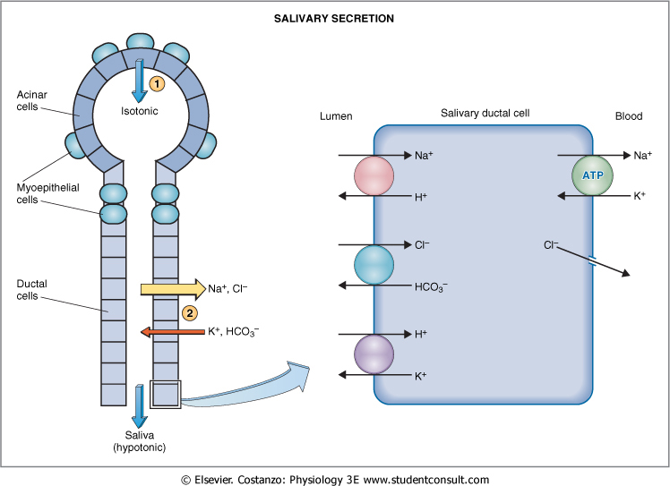

Slide 16
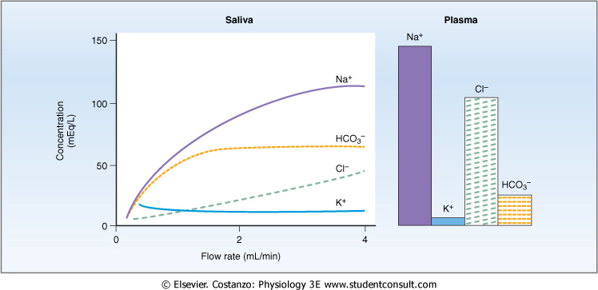
Characteristics of Saliva and Flow Rate

Slide 17
Functions of Saliva
Saliva helps prevent the deteriorative processes in the mouth in several ways:
It moistens food
It begins digestion
It adjusts salt appetite
The flow of saliva helps wash away pathogenic bacteria.
Saliva contains several factors that destroy bacteria such as thiocyanate ions, antibodies, lactoferrin which chelates iron necessary for bacterial growth and proteolytic enzymes (lysozyme):
active against bacterial walls
helps thiocyanate in entering bacterial wall where they become bactericidal.

Slide 18
Control of Secretion
Unique aspect of control of salivary secretion
secretion rate depends entirely on neural control –autonomic nervous system (ANS)
both Parasympathetic and Sympathetic lead to increase secretion
Composition modified by Aldosterone:
increases Na, Cl reabsoption
increases K secretion

Slide 19
Parasympathetic
Origin
salivary nucleus in medulla
Outflow
CN VII & IX
Transmitter
Ach
Increases stimulation in response to
conditioned reflexes (taste, smell)
Decreases stimulation due to
sleep, fear, dehydration

Slide 20
Parasympathetic
Stimulates
- the secretion (protein poor, high k and HCO₃)
- the contraction of myoepithelial cell
- the metabolic rate
- the blood flow
- the direct innervation of blood vessels
- the growth and development of different cells
Sectioning of parasympathetic markedly decreases flow & leads to atrophy

Slide 21
Sympathetic
Origin
intermediolateral gray T1-T3
Transmitter
norepinephrine
Stimulates
- secretion (mostly enzymes)
- contraction of myoepithelial cell
- metabolic rate
- growth and development of different cells
Sectioning of sympathetic nerves has minimal impact on secretion

Slide 22
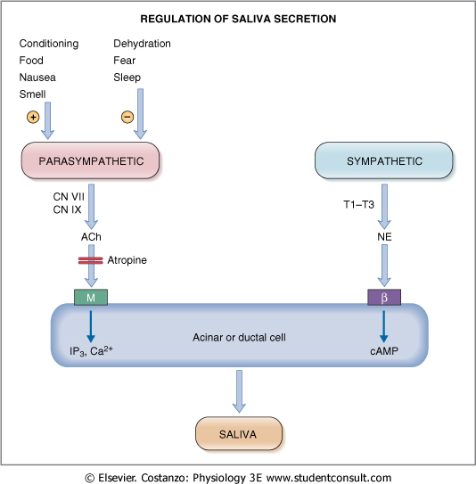

Slide 23
The End

