Slide 1
Gastrointestinal Physiology Lecture 3
Swallowing (Deglutition)
Physiology of Esophageal Motility
Chapter 63: 763-765
By
Dr. Hayam Gad
Dr. Mohammed Alzoghaibi

Slide 2
Learning Objectives
Swallowing process and its stages
Oral stage
Pharyngeal stage
Esophageal stage
Types of esophageal peristalsis
Function of lower esophageal sphincter
Prevention of esophageal reflux by valvelike mechanism
Achalasia
Incompetence of lower esophageal sphincter

Slide 3
Swallowing (Deglutition)
Swallowing is the ordered sequence of events that propel food from the mouth to the stomach.
Swallowing can be initiated voluntary, but thereafter it is almost entirely under reflex control.
This reflex inhibits respiration and prevents the entrance of food into the airway passages.

Slide 4
Stages of Swallowing
Swallowing is initiated voluntarily in the mouth, but thereafter is under involuntary or reflex control. The reflex portion is controlled by the swallowing center in the medulla.
Stages of Swallowing:
Oral Stage (voluntary)
Pharyngeal stage (involuntary)
Esophageal stage (involuntary)

Slide 5
Stages of Swallowing (Deglutition)
I- Oral stage:
The first stage of swallowing involves the voluntary rolling of the chewed food (bolus) posteriorly into the pharynx by the upward and backward pressure applied by the tongue against the palate.
the pharynx contains high density of somatosensory receptors. The activation of these receptors initiates the involuntary swallowing reflex in the medulla.

Slide 6
Stages of Swallowing (Cont.)
II- Pharyngeal stage:
At the pharynx, the bolus of food stimulates epithelial swallowing receptor areas all around the pharynx opening and impulses from this area pass to the swallowing center in brain stem and accordingly initiate a series of autonomic pharyngeal muscle contractions as follows:
(1) The soft palate is pulled upward to close the posterior nares which prevents the food from entering the nasal cavities.
(2) The palatopharyngeal folds on each side of the pharynx are pulled medially to approximate each other. These folds form a sagittal slit through which food must pass into the posterior pharynx.

Slide 7
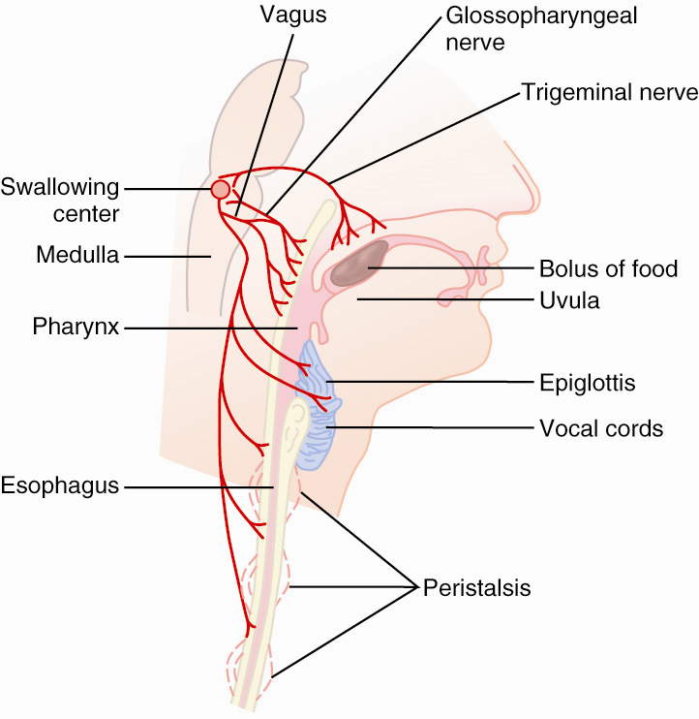
Swallowing Center medulla
Sensory input from pharnyx and esophagus
Coordinates activity from vagal nuclei with other centers (e.g., inhibits respiratory center)

Slide 8
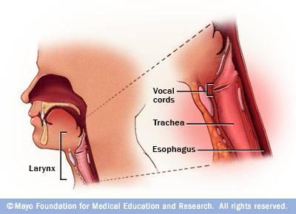
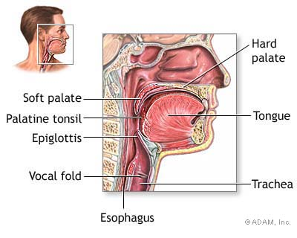
Stages of Swallowing (Cont.)
(3) The vocal cords of the larynx are strongly approximated and the larynx is pulled upward and anteriorly by the neck muscles. These actions and the ligaments that prevent the epiglottis from moving upward, cause the epiglottis to swing backward over the opening of the larynx. All these effects prevent food from going into the nose and trachea. N.B. removal of epiglottis does not cause serious debility in swallowing.
(4) The upward movement of the larynx pulls up and enlarges the opening to the esophagus. The upper esophageal sphincter (or the pharyngoesophageal sphincter) relaxes and allows food to move freely from the posterior larynx into the upper esophagus.

Slide 9
Stages of Swallowing (Cont.)
(5) Once the larynx is raised and the pharyngoesophageal sphincter relaxes, the entire muscular wall of the pharynx contracts (superior, middle, then inferior parts) propelling the food by peristalsis into the esophagus.
(6) During the pharyngeal phase, the swallowing center inhibits the respiratory center of the medulla which stops respiration during swallowing.
Summary of pharyngeal stage of swallowing:
The trachea is closed, the esophagus is opened, and a fast peristaltic wave initiated by the nervous system of the pharynx forces the bolus of food into the upper esophagus (time of process is < 2 seconds).

Slide 10
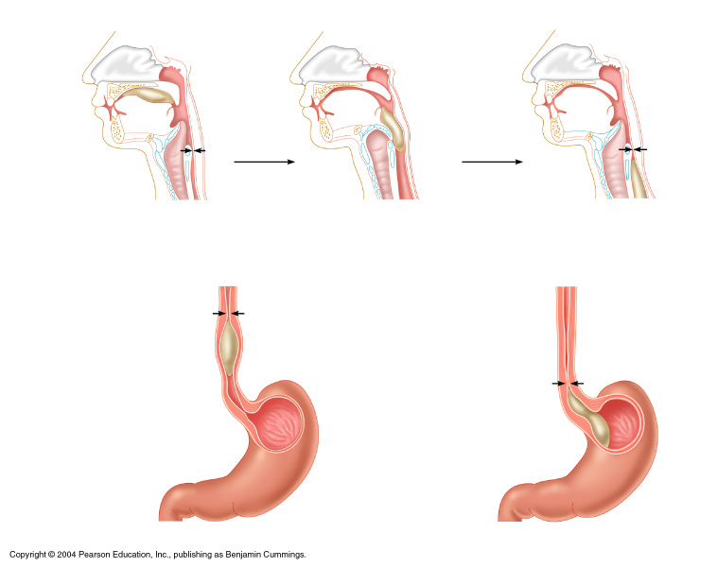
Deglutition (Swallowing)
Bolus of food
Tongue
Uvula
Pharynx
Bolus
Epiglottis
Epiglottis
Glottis
Trachea
Esophagus
Bolus
(a) Upper esophageal sphincter contracted
(b) Upper esophageal sphincter relaxed
(c) Upper esophageal sphincter contracted
Relaxed muscles
Circular muscles contract, constricting passageway and pushing bolus down
Relaxed muscles
Gastroesophageal sphincter open
Bolus of food
Longitudinal muscles contract, shortening passageway ahead of bolus
Gastroesophageal sphincter closed
Stomach
(d)
(e)

Slide 11
Nervous initiation of the pharyngeal stage of swallowing.
The most sensitive areas of the posterior mouth and pharynx for initiating the pharyngeal stage of swallowing are located in a ring around the pharyngeal opening including the tonsillar pillars.
Sensory impulses are received by the nucleus tractus solitarius (NTS) via the medulla oblongata through the 5th & 9th cranial nerves.
The successive stages of swallowing are then automatically initiated by swallowing center in medulla and lower portion of the pons.
The motor impulses to the pharynx and upper esophagus are transmitted from the swallowing center by the 5th, 9th, 10th, and 12th cranial nerves and few of the superior cervical nerves.

Slide 12
Stages of Swallowing (Cont.)
III- Esophageal stage:
The esophagus is a conduit to move food rapidly from the pharynx to the stomach. Physiologically , esophagus is divided into three functionally distinct regions:
1- Upper esophageal sphincter (UES)
2- Esophageal body
3- lower esophageal sphincter(LES)
The musculature of the upper third of the esophagus is skeletal muscle (peristaltic waves are controlled by impulses from glossopharyngeal and vagus nerves) while the musculature of the lower two thirds of the esophagus is smooth muscle (controlled by the vagus through connections with the esophageal myenteric nervous system).
When bolus of food passes through UES, the swallowing reflex closes the sphincter so food cannot reflux into the pharynx.

Slide 13
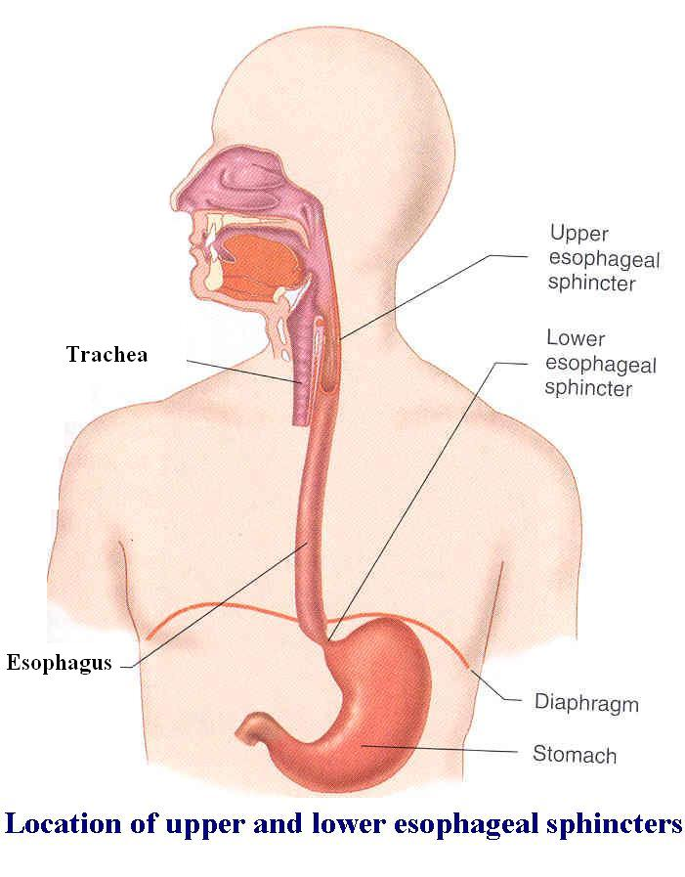

Slide 14
Stages of Swallowing (Cont.)
Types of Esophageal Peristalsis:
The esophagus exhibits two types of peristaltic movements, primary and secondary peristalsis. The primary peristalsis (coordinated by the swallowing reflex) is simply a continuation of the peristaltic wave that begins in the pharynx and spreads into the esophagus during the pharyngeal stage of swallowing. This wave passes from the pharynx to the stomach in 8-10 sec. If this primary peristaltic wave fails to move the food to the stomach, then the distention in the esophagus caused by the food will initiate secondary peristaltic wave (initiated by ENS) in response to distention which will continue until all the food is emptied into the stomach.
● Receptive Relaxation of the Stomach.
When esophageal peristaltic waves reaches the stomach, the stomach relaxes through inhibition of myenteric neurons which prepares the stomach to receive the food that is propelled into the esophagus during swallowing.

Slide 15
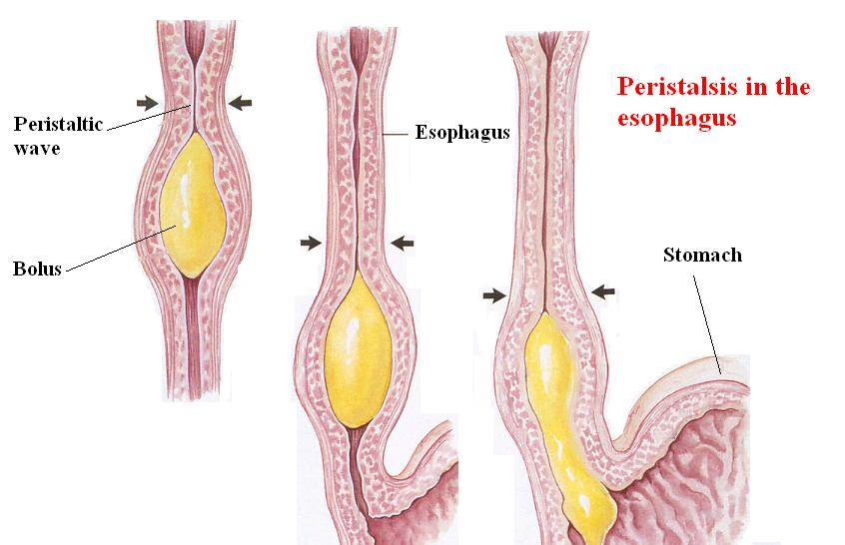

Slide 16
Differences between primary and secondary peristalsis
Primary peristalsis -
Continuation of pharyngeal peristalsis
Coordinated by swallowing center
Cannot occur after vagotomy (striated muscle)
Secondary peristalsis -
Stretch related afferent sensory input to ENS and swallowing center are both involved
Can occur after vagotomy (SM)

Slide 17
Esophageal Sphincters
1- The upper esophageal sphincter (UES)
It prevents entry of air into esophagus.
It relaxes during swallowing for about 1 second allowing the bolus to be forced through the relaxed UES.

Slide 18
1- The lower esophageal sphincter (LES)
The esophageal sphincter is formed by the esophageal circular muscle located in an area of ~ 3 cm upward of the junction with the stomach.
* With initiation of esophageal peristalsis, The LES opens mediated by impulses in vagus nerve.
* In absence of esoph. peristalsis, the sphincter remains tightly closed to prevent reflux of gastric contents into esophagus.

Slide 19
Functions of LES
* Anatomically this sphincter is not different from the remainder of the esophagus. However, physiologically it normally remains tonically constricted, in contrast to the mid and upper portions of the esophagus which normally remain completely relaxed.
* However when a peristaltic wave of swallowing passes down the esophagus, it relaxes the LES (for 7-10 sec.) and allows easy propulsion of the swallowed food into the stomach.

Slide 20
* It is necessary to have a barrier at the gastroesophageal junction (why?).
* Pressure in the esophagus is the same as the intrathoracic pressure i.e. mostly
–ve (except for a short intra-abdominal segment). So that pressure in the stomach is always higher than the esophagus.
* The principle function of the LES is to prevent reflux of stomach contents into the esophagus.

Slide 21
Competence and the antireflux functions of the LES is due to:-
1- Its resting pressure (15-30 mmHg).
2- A valve like mechanism of the distal end of the esophagus that lies immediately beneath the diaphragm and is exposed to +ve intra-abdominal pressure. This flutter-valve closure of the lower esophagus by the increased intraabdominal pressure prevents the high pressure in the stomach from forcing its contents into the esophagus.
3- The crura of the diaphragm wrap around the esoph. at the level of LES, contraction of the diaphragm helps to increase the pressure in the LES with each inspiration.

Slide 22
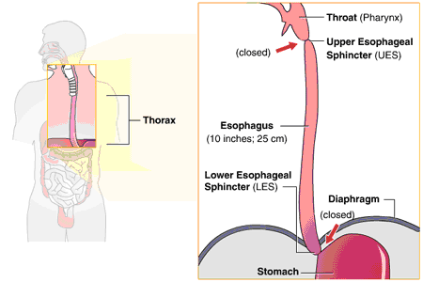
LES

Slide 23
Control of LES function
* Contraction of the circular musculature of the sphincter is regulated by nerves, (extrinsic & intrinsic), hormones and neuromodulators.
* Between swallows, tonic vagal cholinergic impulses maintain contraction to keep the sphincter closed.
* Stimulation of sympathetic nerves to the sphincter also causes the LES to contract.

Slide 24
* During swallowing, efferent impulses in the vagus are inhibitory causing the sphincter to relax. The transmitter probably being nitric oxide or vasoactive intestinal peptide (VIP).
* The hormone gastrin, released from the stomach by food, contracts LES.
* Secretin and cholecystokinine (CCK) released from the upper intestine relax the LES.

Slide 25
Achalasia
* It is a condition due to high resting pressure of the LES so; it fails to relax during swallowing. As a result, food transmission from the esophagus into the stomach is impeded or prevented.
* Physiological basis of this condition is either pathology of or absence of the myenteric plexus containing VIP & NO in the lower third of esophagus.
* The musculature of the lower esophagus instead remains contracted and the myenteric plexus has lost the ability to transmit a signal to cause relaxation of the LES.

Slide 26
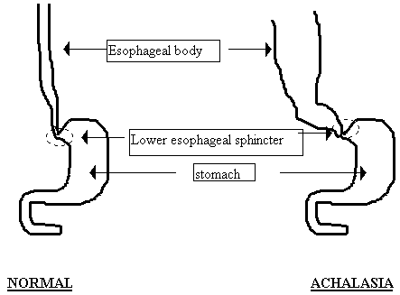
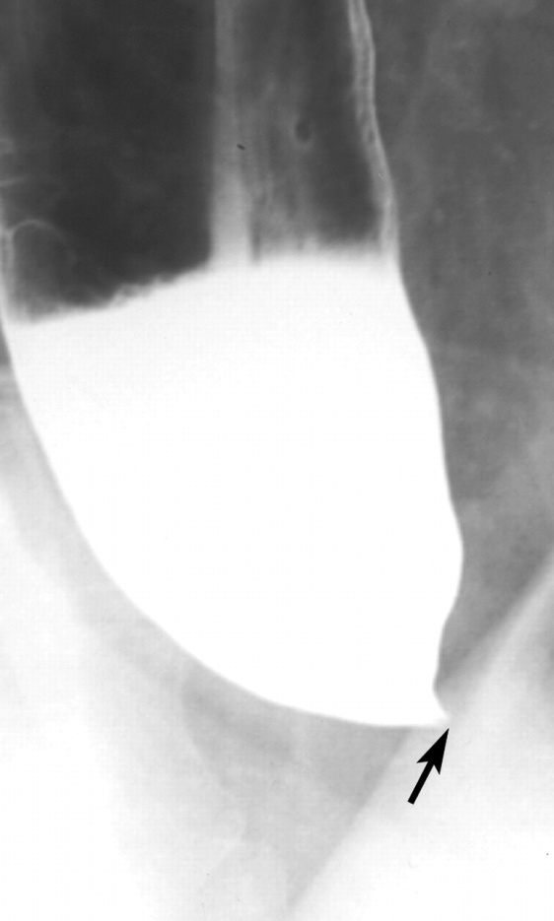
Achalesia

Slide 27
Incompetence of the LES
* Incompetence cause esophageal reflux and result in chronic exposure of esophageal mucosa to acid. The stomach contents are highly acidic and contain many proteolytic enzymes.
* The esophageal mucosa, except in the lower eighth of esophagus, is not capable of resisting for long the digestive actions of gastric secretions.
* It can lead to reflux esophagitis, heart burn, esophageal ulcer and dysplastic changes that may become cancerous.

Slide 28
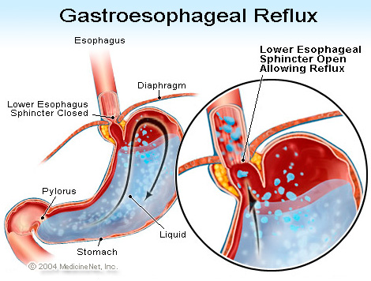

Slide 29
The End

