Slide 1
Gastrointestinal Physiology Lecture 4
Physiology of the Stomach
and Regulation of Gastric Secretions
Chapter 63; pages 765-768
Chapter 64; pages 777-780
Dr. Mohammed Alzoghaibi
Dr. Hayam Gad

Slide 2
Learning Objectives
Functions of stomach
Gastric secretion
Mechanism of HCl formation
Gastric digestive enzymes
Neural & hormonal control of gastric secretion
Phases of gastric secretion
Motor functions of the stomach
Stomach Emptying
Gastric factors that promote stomach emptying
Duodenal factors that inhibit stomach emptying

Slide 3
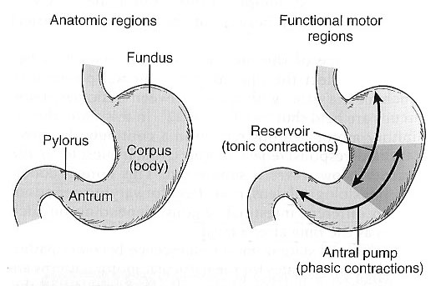
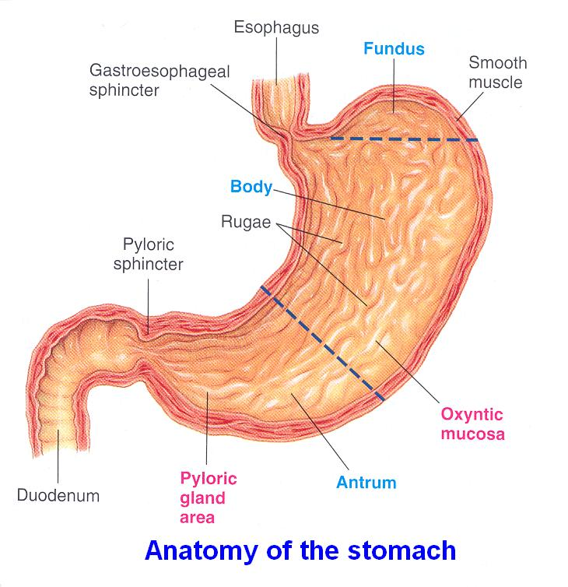
Anatomically and Physiologically Divisions of the Stomach
Anatomically the stomach is composed of the fundus, body and the antrum.
Physiologically, it is composed of :
The orad portion (fundus and upper two thirds of the body)- Reservoir part (tonic contraction)
The caudal (lower third of the body plus antrum)-Antral pump (phasic contraction).

Slide 4
Functions of stomach
1- It stores food & regulates its passage to small intestine.
2- It secretes juice that liquefies & partly digests food.
3- It produces intrinsic factor necessary for vitamin B₁₂ absorption.
4- Gastric HCl:
Kills ingested bacteria.
Is necessary for iron & Ca⁺⁺ absorption.
Catalyzes cleavage of inactive pepsinogen into active pepsin.
7- Absorption of water and lipid-soluble substances (alcohol and drugs).
8- It has endocrine function, e.g. It produces gastrin and somatostatin.

Slide 5
Gastric Secretion
Histologically gastric mucosa is divided into 3 areas:-
1- The cardiac area (10 % of mucosa)
Most of cells secrete mucus.
2- The main gastric area (70-80 %)
Includes mucosa of fundus & body. Its oxyntic glands secrete all constituents of gastric juice.
Parietal (oxyntic) cells secrete HCl & intrinsic factor.
Peptic (chief) cells secrete pepsinogen.
Mucous neck cells secrete mucus & HCO₃⁻.
3- The pyloric area (15 %)
Most of its cells are mucous cells. Contains G- cells that secrete gastrin.

Slide 6
Structure of a Gastric Oxyntic Gland

Slide 7
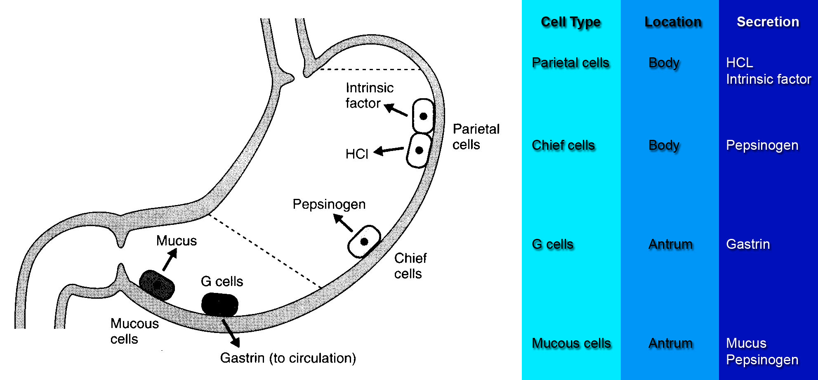
The Normal Locations of Gastric Cells

Slide 8
Gastric juice
Volume about 2-3 L/day
Main constituents are:
HCl
Digestive enzymes (Pepsinogen)
Mucus (mucus gel layer)
Electrolytes
Intrinsic factor.

Slide 9
Gastric HCL
Secreted by parietal cells, the most distinctive cells in the stomach.
They are pyramidal in shape.
Their structure is unique in that they have intracellular canaliculi as well as an abundance of mitochondria and ER.
This network consists of clefts and canals that are continuous with the lumen of the oxyntic gland.
HCl is secreted across the parietal cell microvillar membrane and flows out of the intracellular canaliculi into the oxyntic gland lumen.

Slide 10
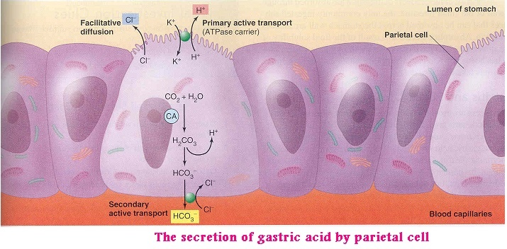
Mechanism of HCl formation

Slide 11
Mechanism of HCl formation (Cont.)
Cl⁻ is actively transported from cytoplasm into luminal canaliculi. This create –ve potential which causes passive diffusion of K⁺ from cytoplasm into canaliculi. Thus K⁺ & Cl⁻ enters canaliculi.
Intracellular H₂O dissociates into H⁺ & OH⁻.
H⁺ is actively transported across canalicular membrane against concentration gradient by H⁺-K⁺ ATPase which exchange H⁺ with K⁺. It can be inhibited by omeprazole (proton pump inhibitors).
CO₂, either formed during metabolism in the cell or entering the cell from the blood, combines under the influence of carbonic anhydrase with the OH⁻ to form HCO3⁻.
HCO₃⁻ diffuses from the cell to plasma (Alkaline tide) and CL⁻ enters via a carrier mechanism that facilitates exchange between the 2 ions.

Slide 12
Mechanism of HCl formation (Cont.)

Slide 13
Gastric digestive enzymes
Pepsin enzyme
Several types of pepsinogen secreted from chief cells. They are activated by HCl into pepsin and once activated, they can activate more pepsinogen. The optimum pH is 1.5-3.5. Pepsin breaks down proteins into peptones & polypeptides. Pepsinogen secretion is stimulated by Ach, acid, gastrin, secretin & CCK.
Lipase enzyme
Secreted from fundic mucosa. It hydrolyses TG into MG & FA. Its activity is less than pancreatic lipase.

Slide 14
Pepsin enzyme

Slide 15
Gastric mucus
It is glycoprotein. Its secretion is stimulated by mechanical & chemical irritation of mucosa.
It is about 0.2 mm thick and separate surface epithelial cells from acidic contents thus it allows neutral pH at epithelial cells despite luminal pH about 2.

Slide 16
Functions:-
1- It protects the mucosa against mechanical injury by lubricating of chyme.
2- It protects the mucosa against chemical injury by acting together with HCO₃⁻ as a barrier to HCl & pepsin. It also neutralize HCl and arrest action of pepsin.
Aspirin & nonsteroidal anti-inflammatory agents inhibit secretion of both mucus & HCO₃⁻. Prolonged use of these drugs may produce gastritis or ulcer.

Slide 17
Intrinsic factor
It is glycoprotein secreted by parietal cells.
It is the only essential function of stomach as it is essential for vitamin B₁₂ absorption.
Atrophy of gastric mucosa leads to pernicious anemia.

Slide 18
Neural & Hormonal Control of Gastric Secretion
Vagus nerve (neural effector) either by releasing Ach (direct activation of parietal cells) or by releasing gastrin releasing peptide, GRP (indirect activation).
Gastrin (hormonal effector)
Enterochromaffin-like cells release Histamine→ activates H₂ receptor (parietal cells) → increases acid secretion
Cimetidine (H₂ receptor blocker)→ peptic ulcer and gastroesophageal reflux

Slide 19
Gastric Secretion Occurs in Three Phases
The stimulation of acid secretion resulting from the ingestion of food can be divided into three phases:
Cephalic phase(30%): Smelling, Chewing and swallowing Stimulates parietal G-Cells GRP
Gastric phase (60%): Gastric distention proteins
Intestinal phase (10%): Digested proteins

Slide 20
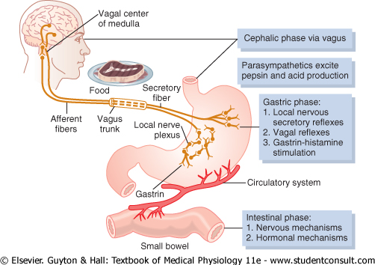
Phases of Gastric Secretion

Slide 21
1. The cephalic phase
It involves the central nervous system. Seeing, smelling, thinking of appetizing food, chewing, and swallowing food send afferent impulses to vagal nucleus which sends impulses via the vagus nerves to the parietal and G cells in the stomach.
The nerve endings release ACh, which directly stimulates acid secretion from parietal cells.
The nerves also release gastrin-releasing peptide (GRP), which stimulates G cells to release gastrin, indirectly stimulating parietal cell acid secretion.

Slide 22
II- The gastric phase
It is mediated by nervous & hormonal mechanisms. It is elicited by presence of food in stomach. The stimuli are distension of stomach and presence of amino acids & peptides.
A- Nervous mechanism
Distension of either body or antrum of stomach stimulates mechanoreceptors in gastric wall. Gastric secretion occurs by long vagovagal reflex and also by short intramural cholinergic reflexes.

Slide 23
B- Hormonal mechanism (Gastrin hormone)
Gastrin is secreted from G cells in antrum, enters the blood and stimulates gastric glands.
Stimuli of gastrin release:
1- The presence of amino acids & peptides.
2- Gastric distension,
3- Alcohol & caffeine.
4- Vagal excitation.
5- Rising of pH of gastric juice.

Slide 24
Actions of gastrin:
1- It stimulates gastric acid secretion, secretion of pepsin and intrinsic factor.
2- It stimulates intestinal secretion.
3- It stimulates pancreatic secretion of enzyme & HCO₃⁻.
4- It stimulates biliary secretion of HCO₃⁻ & H₂O.
5- It stimulates gastric motility.
6- It stimulates intestinal motility & relaxes ileocaecal sphincter.
7- It contracts LES.
8- It has trophic effect on gastric mucosa.

Slide 25
Control of HCl secretion at the level of parietal cells
Gastrin reaches parietal cells via blood stream to stimulate HCl secretion (endocrine action).
Ach is released near parietal cells by cholinergic nerve endings to stimulate HCl secretion (neurocrine action).
Histamine is released from enterochromaffin cells in gastric mucosa and diffuses to parietal cells to act on H₂ receptors to stimulate HCl secretion (paracrine action).
Cimetidine & ranitidine are H₂ receptor blockers and potent inhibitor of gastric acid secretion and both are used for treatment of peptic ulcers.

Slide 26
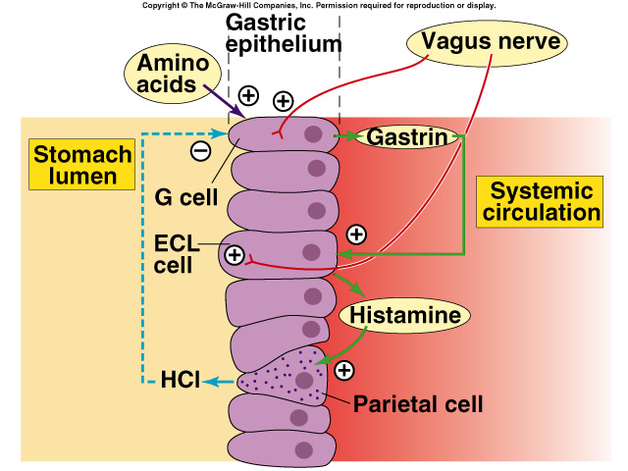
Control of HCl secretion at the level of parietal cells

Slide 27
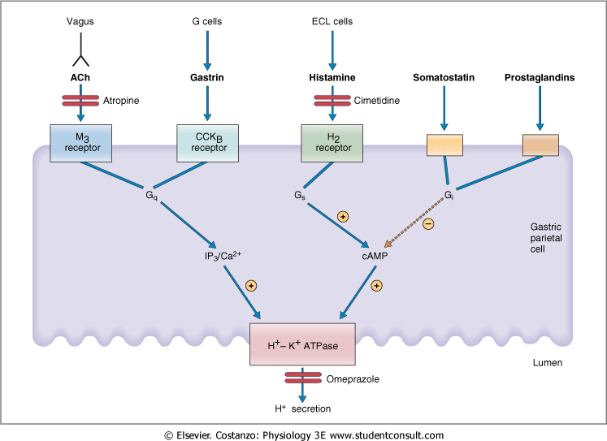
Agents that stimulate and inhibit H⁺ secretion by gastric parietal cells

Slide 28
Inhibition of Acid Secretion
Inhibitory hormones (Enterogastrones):
Somatostatin (D-cells) in antrum
Secretin (S-cells) in duodenum
Glucose-dependent insulinotropic peptide (GIP) in duodenum

Slide 29
Hormone | Site of Secretion | Stimuli for Secretion | Actions
Gastrin | G cells of the stomach | Small peptides and amino acids Distention of the stomach Vagal stimulation (GRP) | ↑ Gastric H⁺ secretion Stimulates growth of gastric mucosa
Cholecystokinin (CCK) | I cells of the duodenum and jejunum | Small peptides and amino acids Fatty acids | ↑ Pancreatic enzyme secretion ↑ Pancreatic HCO₃⁻ secretion Stimulates contraction of the gallbladder and relaxation of the sphincter of Oddi Stimulates growth of the exocrine pancreas and gallbladder Inhibits gastric emptying
Secretin | S cells of the duodenum | H⁺ in the duodenum Fatty acids in the duodenum | ↑ Pancreatic HCO₃⁻ secretion ↑ Biliary HCO₃⁻ secretion ↓ Gastric H⁺ secretion Inhibits trophic effect of gastrin on gastric mucosa
Glucose-Dependent Insulinotropic Peptide (GIP) | K cells of the Duodenum and jejunum | Fatty acids Amino acids Oral glucose | ↑ Insulin secretion from pancreatic β cells ↓ Gastric H⁺ secretion
Motilin | M cells of the duodenum and jejunum | Fat Acid Nerve | Stimulates: Gastric motility Intestinal motility

Slide 30
III-The intestinal phase

Slide 31
III- The intestinal phase
The presence of chyme in duodenum causes neural & hormonal responses that first stimulates & later inhibits gastric acid secretion.
Gastric secretion is enhanced by:-
1- Distension of duodenum stimulates G.A. secretion by means of vagovagal reflex and the release of the hormone entero-oxyntin from intestinal endocrine cells that stimulates parietal & G- cells.
2- Presence of protein digestive products in duodenum stimulates G- cells in duodenum & proximal jejunum to release gastrin.

Slide 32
The inhibitory mechanisms that limit G.A secretion
1-The presence of food in small intestine initiates enterogastric reflex, transmitted through ENS & autonomic NS that inhibits G.A secretion.
2- Drop the pH in pyloric antrum to < 2.5 reduces G.A secretion via release of somatostatin from antral & duodenal D-cells.
3- The presence of acid, fat, protein digestive products, hypertonic solution in upper intestine inhibits G.A secretion. These effects are mediated mainly by hormonal mechanisms.

Slide 33
Enterogastrones
Are hormones released from intestine and affect G.A secretion as:-
1- Bulbogastrone
2- Gastric inhibitory peptide.
3- Secretin & CCK.
4- Pancreatic glucagone.
5- Other peptides as VIP, somatostatin, and certain types of prostaglandins.
The functional purpose of the inhibition of G.A secretion by intestinal factors is to slow the release of chyme from stomach when the small intestine is already filled.

Slide 34
Phases of Gastric Secretion

Slide 35
Motor Functions of the Stomach

Slide 36
Motor Functions of the Stomach
The main functions of the upper part of the stomach (Reservoir part ):
To maintain a continuous compression
To accommodate the received food without significant gastric wall distention or pressure (Storage of food).
The stomach can store 0.8-1.5 L of food. Gastric contents may remain unmixed for 1hour in the corpus.

Slide 37
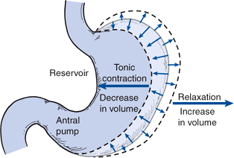
Relaxation Reflexes in Gastric Reservoir Part
Three Kinds of Relaxation Occur in the Gastric Reservoir:
A- Receptive Relaxation Reflex: Triggered by swallowing reflex. When the esophageal peristaltic waves reach the stomach, a vagovagal reflex is initiated from the stomach to the brain stem and back to the muscular wall of the stomach resulting in reduction in muscular wall tone and the stomach relaxes through inhibition of myenteric neurons which prepares the stomach to receive the food. The pressure in the stomach remains low until the volume reaches ~1.5 L of food.

Slide 38
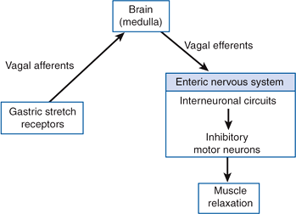
Relaxation Reflexes in Gastric Reservoir Part (Cont.)
Adaptive relaxation: Triggered by stretch receptors (vago-vagal reflex). Normally, when food stretches the stomach, a “vagovagal reflex” from the stomach to the brain stem and then back to the stomach reduces the tone in the muscular wall of the body of the stomach so that the wall bulges progressively outward, accommodating greater and greater quantities of food up to a limit (0.8 to 1.5 L). This reflex is lost in vagotomy.

Slide 39
Relaxation Reflexes in Gastric Reservoir Part (Cont.)
Feedback Relaxation: The presence of nutrients in the small intestine triggers feedback relaxation. It can involve both local reflex connections between receptors in the small intestine and the gastric ENS or hormones that are released from endocrine cells in the small intestinal mucosa and transported by the blood to signal the gastric ENS and stimulate firing in vagal afferent terminals in the stomach

Slide 40
Motor Behavior of the Antral Pump region, (phasic contraction).
Major mixing activities take place in the antrum
Contact of gastric chyme with the mucosal surface of the stomach, causes weak peristaltic constrictor waves called mixing waves once every 15-20 sec. These waves are initiated by the gut wall basic electrical rhythm of the slow spontaneous electrical waves. These waves progress from the body to the antrum and become intense forcing the chyme to mix and move under high pressure from the antrum toward the pylorus. Each time a peristaltic wave passes from to the antrum to the pylorus, few millimeters of antral content move into the duodenum through the pyloric sphincter.

Slide 41
Motor Behavior of the Antral Pump Is Initiated by a Dominant Pacemaker
Gastric action potentials are initiated by a dominant pacemaker that generates action at a frequency of 3/min and lasts about 5 seconds . They propagate rapidly around the gastric circumference and trigger a ring-like contraction.
The action potentials and associated ring-like contraction then travel more slowly toward the gastroduodenal junction.
Electrical syncytial properties of the gastric musculature account for propagation of the action potentials from the pacemaker site to the gastroduodenal junction.

Slide 42
Motor Behavior of the Antral Pump Is Initiated by a Dominant Pacemaker (Motility in the Antrum)
Electrical action potentials in gastrointestinal muscles occur in 4 phases, determined by specific ionic mechanisms.
Phase 0: Resting membrane potential.
Phase 1: Rising phase (upstroke depolarization); activation of voltage-gated Ca⁺⁺ channels and voltage-gated K⁺channels.
Phase 3: Plateau phase; balance of inward Ca⁺⁺ current and outward K⁺ current.
Phase 4: Falling phase (repolarization); inactivation of voltage-gated Ca⁺⁺ channels and activation of Ca⁺⁺-gated K⁺channels.

Slide 43
The Gastric Action Potential Triggers Two Kinds of Contractions
The gastric action potential is responsible for two components of the propulsive contractile behavior in the antral pump.
A leading contraction, which has relatively constant amplitude, is associated with the rising phase of the action potential
A trailing contraction, of variable amplitude, is associated with the plateau phase.

Slide 44
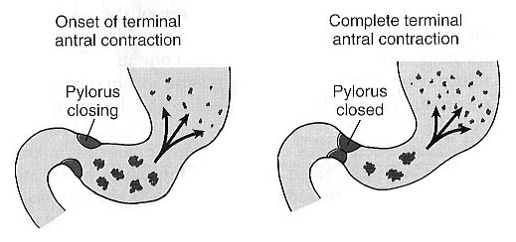
Retropulsion Phenomena
As the trailing contraction approaches the closed pylorus, the gastric contents are forced into the antral compartment of ever-decreasing volume and progressively increasing pressure. This results in jet-like retropulsion through the pyloric orifice. Repetition at 3 cycles/min reduces particle size from 1-7 mm range that is necessary before a particle can be emptied into the duodenum. These intense peristaltic contractions that cause emptying increase the pressure in the stomach.

Slide 46
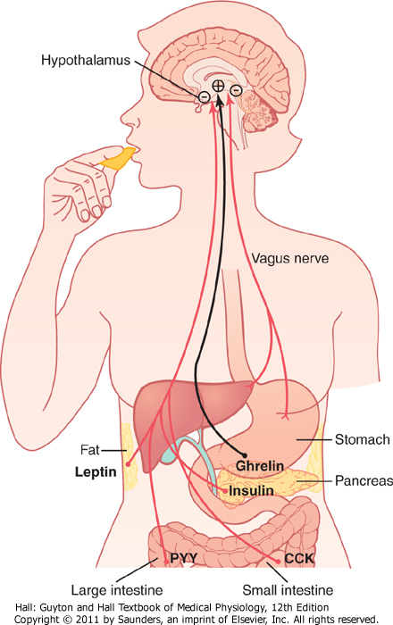
Hunger Contractions.
Hunger contractions occur when the stomach has been empty for several hours.
These are rhythmical peristaltic contractions that can become very strong and fuse to form a continuing tetanic contraction lasting 2-3 minutes.
Hunger contractions are intense in young healthy people and increase by low blood glucose levels.
Hunger pain can begin after 12-24 hr of last food ingestion.

Slide 47
The migrating motor complex
It is bursts of depolarization accompanied by peristaltic contraction that occur in empty stomach during interdigestive period.
MMC moves on a long whole length of small intestine to reach ileocaecal valve after 1.5-2 h where it disappears.
A new wave of MMC starts.
The activity of MMC terminates as soon as food is ingested.
The function of MMC is to sweep remnants in stomach & small intestine into colon.

Slide 48
Stomach Emptying
Stomach Emptying. Is the result of intense peristaltic antral contractions against resistance to passage of chyme at the pylorus.
● Role of the Pylorus in Controlling Stomach Emptying.
The pyloric sphincter is characterized by strong circular muscle (as compared to the antrum) and remains tonically contracted most of the time.
Pyloric constriction is determined by nervous and humoral reflex signals from the stomach and the duodenum.
However, during pyloric constriction, watery chyme can still pass through the pylorus into the duodenum, but not food particles.

Slide 49
Regulation of Stomach Emptying
The rate of stomach emptying is controlled by signals from the duodenum and stomach. The signals from the duodenum are far stronger and control emptying of chyme at a rate that allows the proper digestion and absorption in the small intestines.

Slide 50
Gastric Factors that Promote Stomach Emptying
1. Effect of Gastric Food Volume on Rate of Stomach Emptying. An increase in gastric food volume results in increased stretch in the stomach wall which elicits local myenteric reflexes that increase the activity of the pyloric pump and inhibit the tonic contraction of the pyloric sphincter leading to increased stomach emptying.
2. Effect of the Hormone Gastrin on Stomach Emptying. Gastrin is released from the antral mucosa in response to the presence of digestive products of meat. Gastrin promotes the secretion of acidic gastric juices from gastric glands located on the inside surface of the body and fundus of the stomach. Gastrin also increases the activity of the pyloric pump and motor stomach function (moderate effect) and probably promotes stomach emptying.

Slide 51
Duodenal Factors That Inhibit Stomach Emptying
1. Enterogastric Nervous Reflexes from the Duodenum
When food enters the duodenum, multiple nervous reflexes are initiated from the duodenal wall and pass back to the stomach to regulate stomach emptying depending on the volume of chyme in the duodenum. These duodenal reflexes are mediated by three routes:
Directly from the duodenum to stomach through the enteric nervous system in the gut wall,
Through extrinsic nerves that go to the prevertebral sympathetic ganglia and then back through inhibitory sympathetic nerve fibers to the stomach, and
Through the vagus nerves reflex to the brain stem to inhibit the normal excitatory signals that are transmitted to the stomach through the vagus nerves.
These reflexes inhibit the pyloric pump and increase the tone of the pyloric sphincter thus decreasing stomach emptying.

Slide 52
The duodenal factors that can initiate the enterogastric inhibitory reflexes and inhibit stomach emptying include:
(1) Duodenal distention
(2) Duodenal irritation
(3) Duodenal acidity activates S cells to release Secretin which constricts the antrum
(4) Hyperosmotic chyme in the duodenum
(5) Protein content of the chyme in the duodenum.
(6) Fat (monoglycerides) in the duodenum activates different cells to produce CCK and GIP that delay gastric emptying

Slide 53
Duodenal Factors That Inhibit Stomach Emptying (Cont.)
2. Hormonal Feedback from the Duodenum Inhibits Gastric Emptying – Role of Fats and the Hormone Cholecystokinin.
Fat entering the duodenum or acidity of chyme or excess quantities of chyme causes the release of cholecystokinin (CCK), and probably other inhibitory hormones such as secretin and gastric inhibitory peptide, (GIP) from the epithelium of the duodenum and jejunum.
When released, CCK (and probably secretin and GIP) circulates and inhibit the pyloric pump and increase the tone of the pyloric sphincter thus decreasing stomach emptying. CCK also acts as an inhibitor to block increased stomach motility caused by gastrin.

Slide 54
Summary Constriction of Pyloric Sphincter
Hormones promote constriction
Cholecystokinin (CCK)
Secretin
Glucose-dependent insulinotropic peptide (GIP)
Sympathetic innervation

Slide 55
The End

