Slide 1
Physiology of Gastrointestinal System
(L6)
Physiology of The Pancreas
By
Dr. Mohammed alzoghaibi
Dr. Hayam Gad

Slide 2
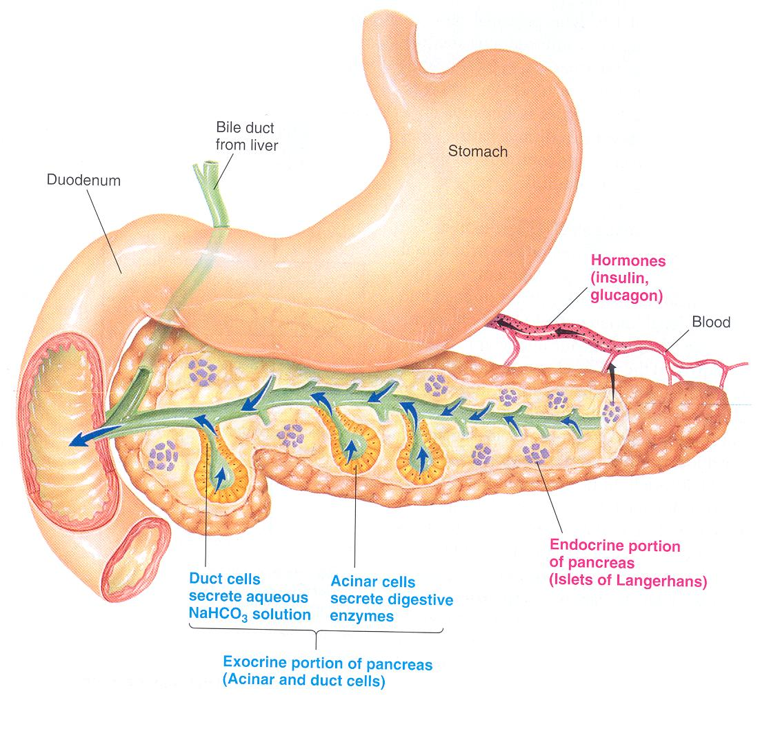
The exocrine pancreas
The pancreas, which lies parallel to and beneath the stomach is composed of:-
1- The endocrine islets of Langerhans which secrete insulin, glucagone and somatostatin.
2- Acinar gland tissues which produce pancreatic juice
( the main source of digestive enzymes).
The cells lining the acini are serous cells containing zymogen granules.

Slide 3
Pancreatic Secretion
Pancreatic juice is secreted in response to the presence of chyme in the upper portions of the small intestine.
The major functions of pancreatic secretion:
To neutralize the acids in the chyme
To produce enzymes involved in the digestion of dietary carbohydrate, fat, and protein

Slide 4
Pancreatic Secretion (Cont.)
The volume:- 1.2-1.5 L/day.
The osmolarity of pancreatic fluid is equal to that of plasma (isotonic), pH= 8 alkaline.
Composition:- 1 % inorganic materials (electrolytes)
1-2 % organic materials mostly enzymes.
The electrolytes
They are produced from the epithelial cells of the ductules and ducts and include cations Na⁺, K⁺, Ca⁺⁺ and anions HCO3⁻ and Cl⁻.
The greater bulk of electrolytes is in the form of NaHCO₃.
HCO3 concentration increases with increasing secretion rate

Slide 5
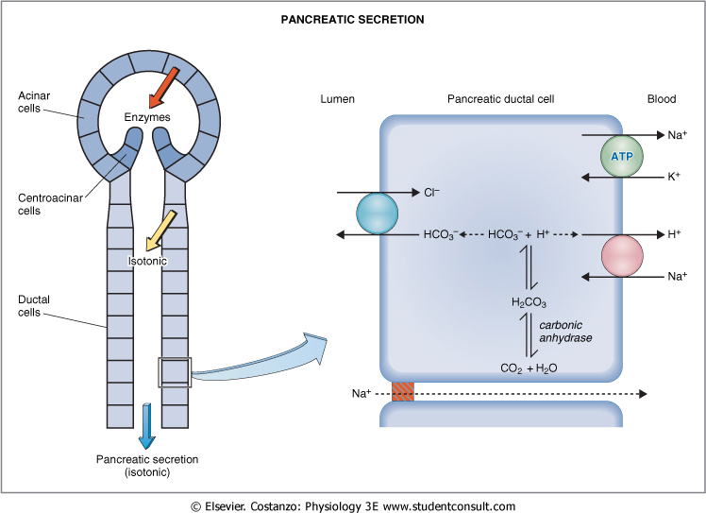

Slide 6
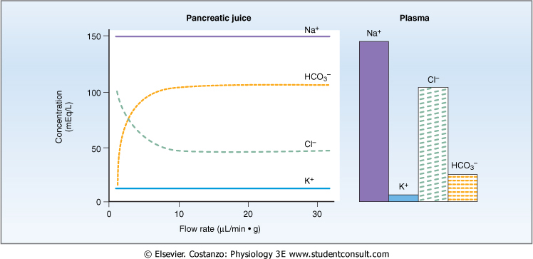
Flow Rate and Pancreatic Secretion

Slide 7
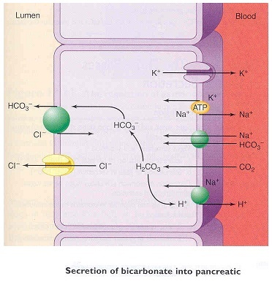
Secretion of Bicarbonate Ions into Pancreatic Juice

Slide 8
Pancreatic enzymes
The pancreas secrets enzymes that act on all major types of food stuff.
1- Pancreatic proteolytic enzymes (proteases)
Trypsin, chymotrypsin, elastase, carboxypeptidase.
They are secreted in inactive form and activated in intestinal lumen.
Trypsinogen is activated into trypsin by the enzyme enteropeptidase (enterokinase), secreted by duodenal mucosal cells.
Trypsin activates chymotrypsinogen to chymotrypsin, proelastase to elastase and procarboxypeptidase into carboxypeptidase.

Slide 9
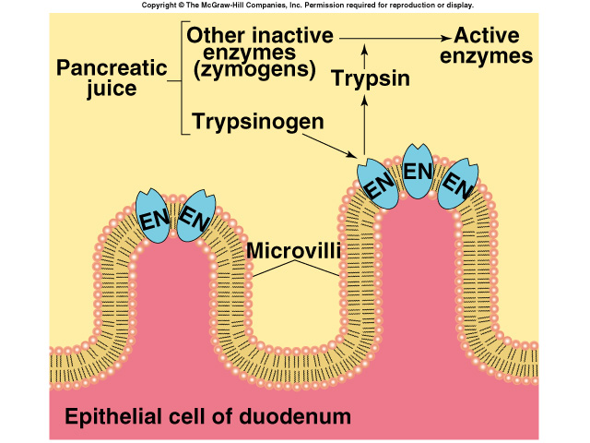

Slide 10
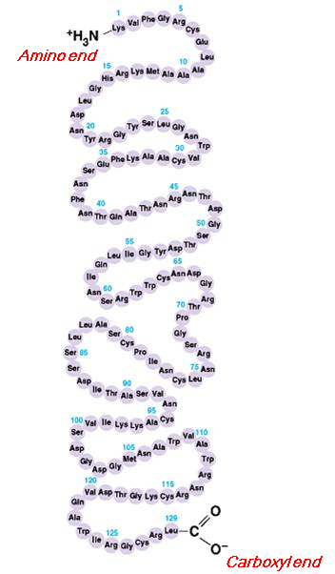
Trypsin, chymotrypsin and elastase are endopeptidases, splitting protein into shorter peptide chains.
Carboxypeptidase is an exopeptidase which splits off amino acids at the carboxyl terminus of the peptide.
Trypsin inhibitor is present in cytoplasm of glandular cells. It inhibits activation of trypsin in acini and ducts of the pancreas.

Slide 11
2- Pancreatic amylase splits starch to maltose, maltotriose and dextrins.
3- Enzymes for fat digestion
a- Pancreatic lipase is the most important fat splitting enzyme. It breaks TG into MG and FA in the presence of bile salts and colipase.
b- Cholesterol esterase which liberates cholesterol.
C. Phospholipase A₂ which splits phospholipids into lysophospholipids& FA.

Slide 14
Pancreatic Secretion is Under Neural and Hormonal Control
Parasympathetic stimulation (through Ach on acinar cells) results in an increase in enzyme secretion-fluid and HCO3
Secretin tends to stimulate a HCO3 rich secretion by activating ductal cells.
Cholecystokinin (CCK) stimulates a marked increase in enzyme secretion by stimulating the acinar cells.
Pancreatic secretion normally results from the combined effects of the multiple basic stimuli, not from one alone (potentiate each other).

Slide 15
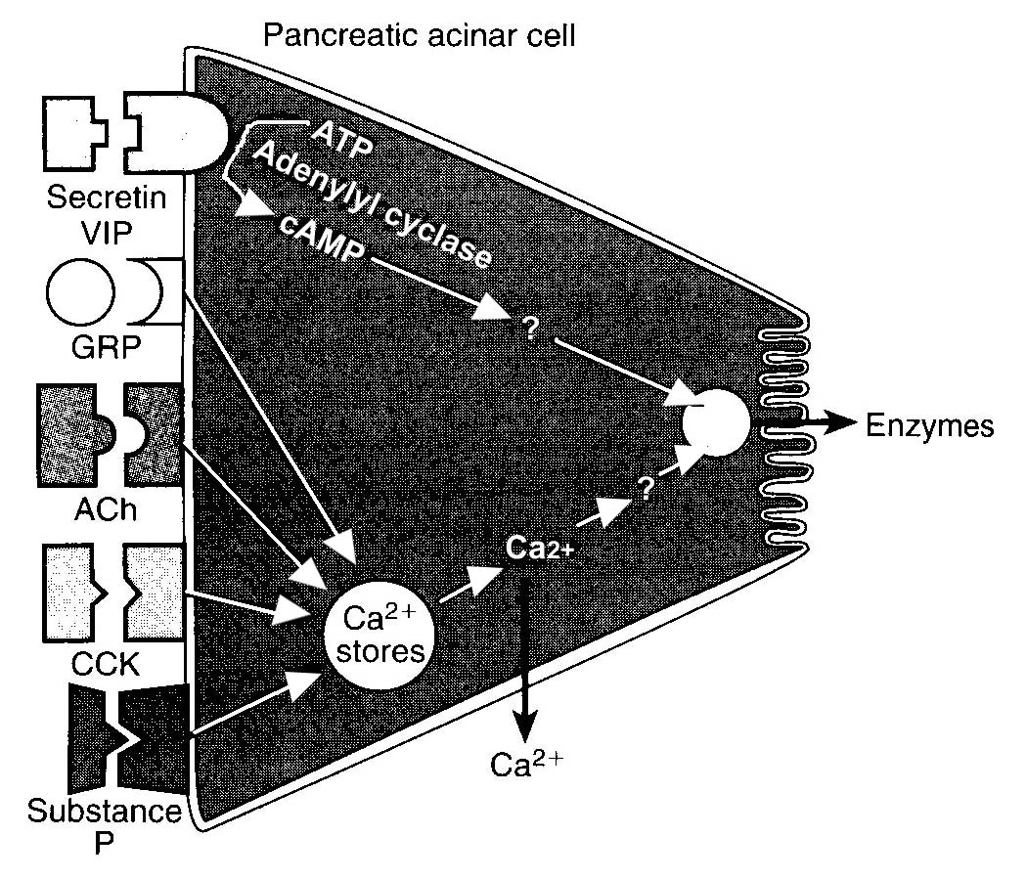

Slide 16
Pancreatic secretion is phasic
Mediators | stimulus | Phase
Release of Ach and gastrin | Smell, taste, chewing and swallowing | Cephalic phase
Vago-vagal reflex | Protein, gastric distention | Gastric phase
Secretin, CCK and vago-vagal reflex | Acid in chyme, fatty acids | Intestinal phase

Slide 17
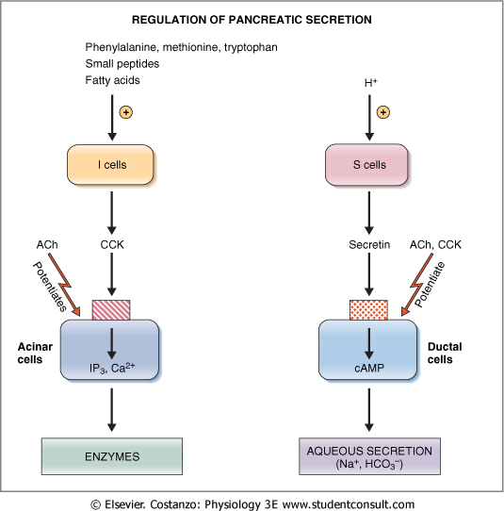
Regulation of Pancreatic Secretion

Slide 19
Secretin hormone
It is a peptide released into the blood from S cells in upper intestinal mucosa.
Stimuli for its release: Mainly acids (pH 4 or less) and to a less extent AA and FA.
Functions
1- It acts on pancreatic duct cells to stimulate secretion of HCO₃⁻ and H₂O.

Slide 20
2- It acts on biliary duct cells to stimulate hepatic bile flow and HCO₃⁻ secretion.
3- It augments the action of CCK in stimulating pancreatic enzyme secretion.
4- It inhibits gastric acid secretion and gastrin release, but it stimulates pepsin secretion.
5- It inhibits gastric motility, contracts pylorus and slows gastric emptying.
6- It relaxes LES.
7- It inhibits intestinal motility and contracts ileocecal sphincter.

Slide 21
Cholecystokinin (CCK)
It is a peptide released from I cells in the upper intestine.
Stimuli of release:- Mainly by AA and FA and to a lesser extent by HCl.
Functions
1- It acts on pancreatic acinar cells to stimulate enzyme secretion. It also augments stimulation of H₂O and HCO₃⁻ secretion by secretin.
2- It has trophic effect on pancreas.

Slide 22
3- It contracts gall bladder, relaxes sphincter of Oddi and causes discharge of bile into the intestine.
4- In small dose, it stimulates gastric acid secretion.
5- It stimulates gastric motility, contracts pylorus thus slows gastric emptying.
6- It relaxes LES.
7- It stimulates intestinal motility.
8- It may be concerned with the mechanism of satiety.

Slide 23
The End

