Slide 1
Practical Radiology Session
Liver, spleen, pancreas and biliary system.

Slide 2
Introduction
What are the radiology modalities that can be used to study solid abdominal organs?
X-ray.
US.
CT.
MRI.
Nuclear Medicine.

Slide 3
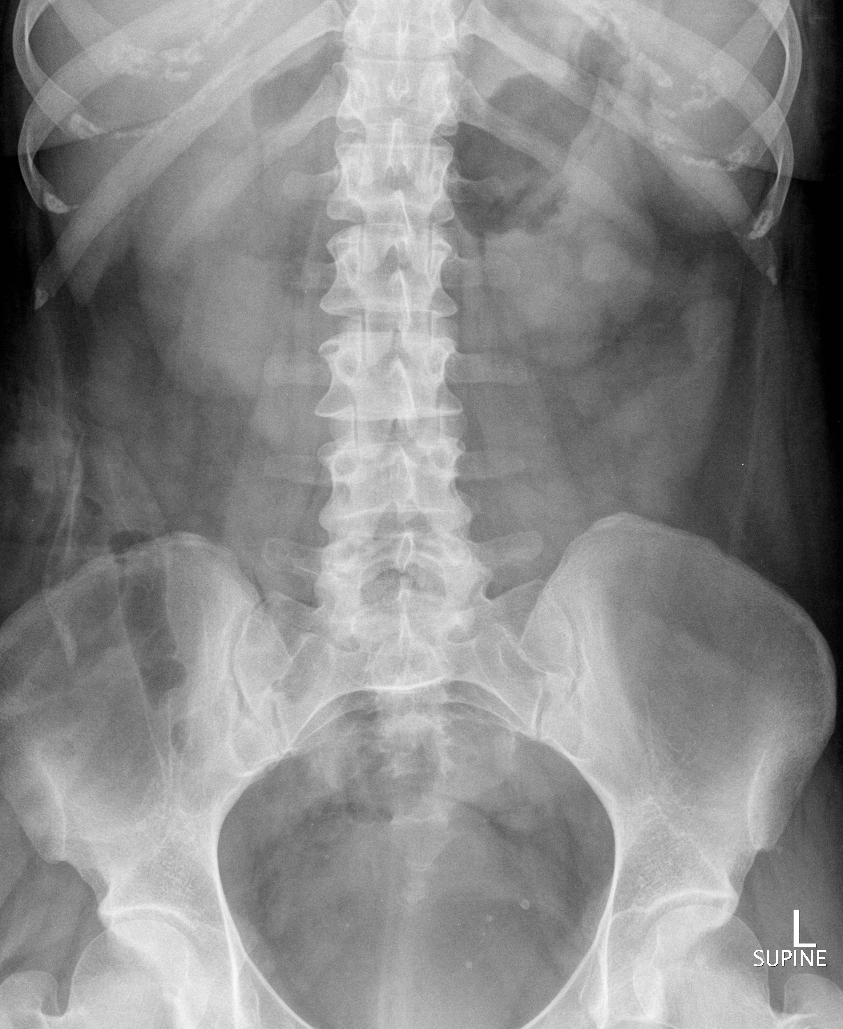
X-ray

Slide 4
X-ray
liver
spleen.
Right kidney.
Left kidney.
Right psoas muscle.
Left psoas muscle.

Slide 5
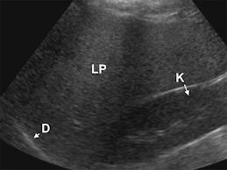
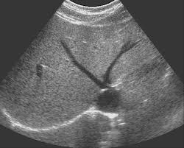
US liver
LP-liver parenchyma D-diaphragm K-right kidney

Slide 6
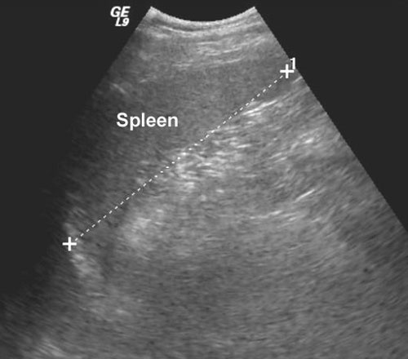
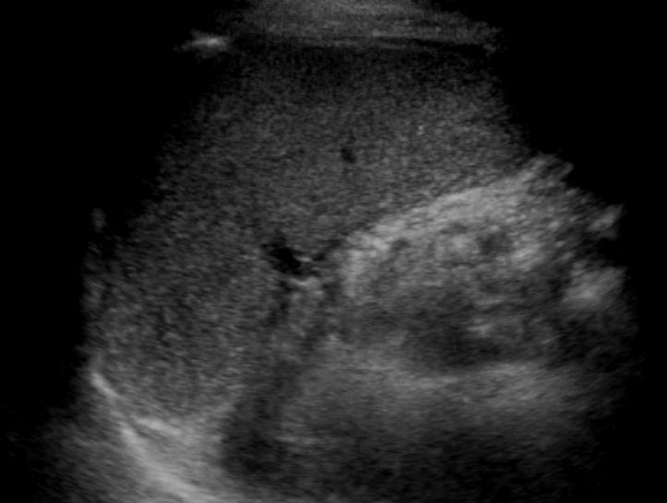
US spleen

Slide 7
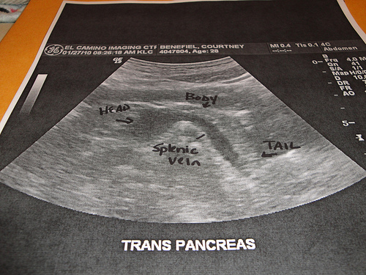
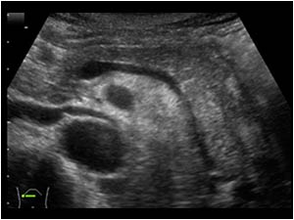
US pancreas

Slide 8
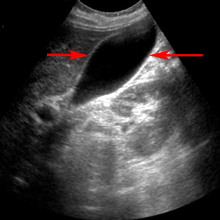
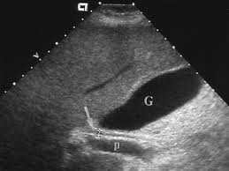
US biliary
C
G- gall bladder P- portal vein C-common bile duct

Slide 9
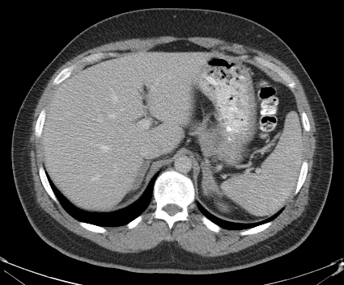
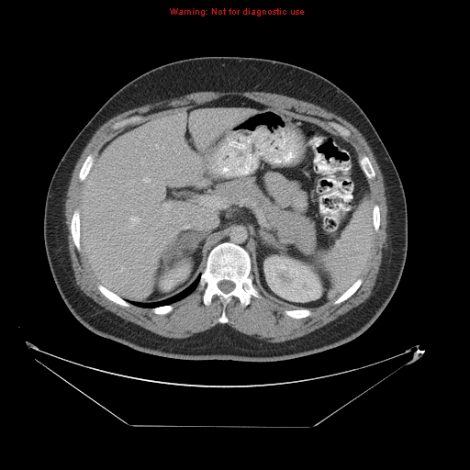
CT Abdomen
2
8
7
3
6
1
5
4
1-spleen 2-left liver lobe 3-right liver lobe 4-abdominal aorta 5-IVC.
6-pancreatic tail 7-pancreatic body 8-pancreatic head.

Slide 10
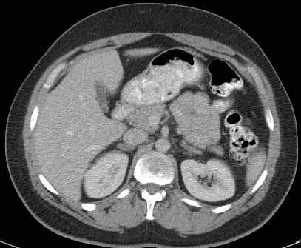
CT Abdomen
4
1
6
2
3
7
5
1-gall bladder 2-duodanum 3-pancreatic head 4-SMV 5-SMA
6-CBD 7-PV.

Slide 11
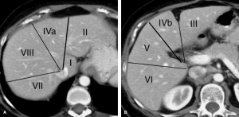
CT Liver
Different liver segments

Slide 12
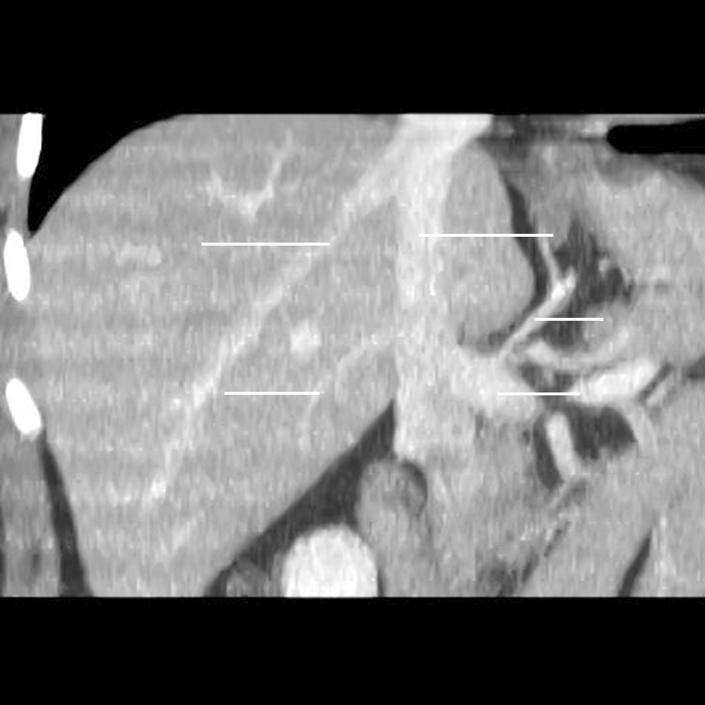
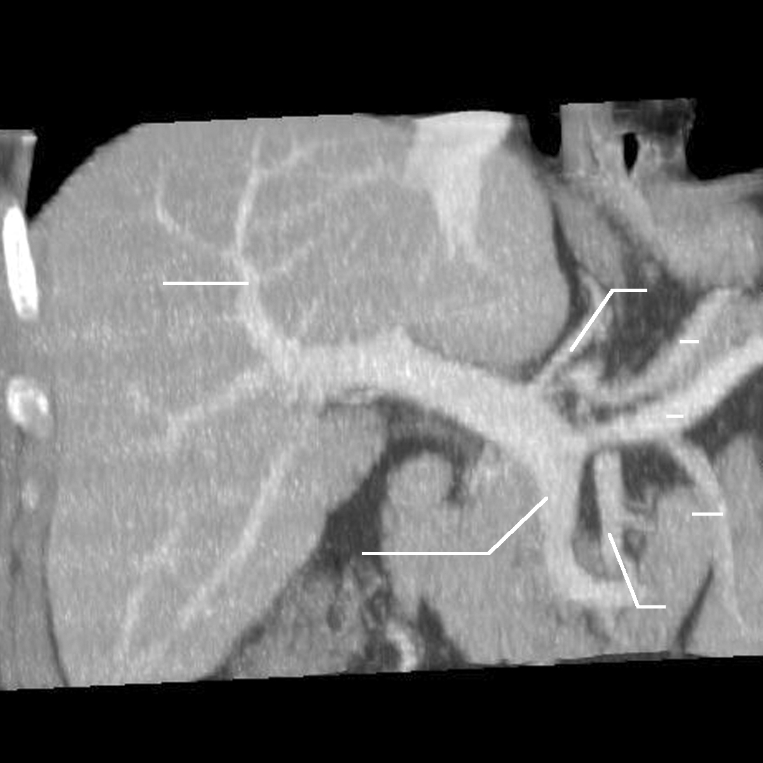
CT Liver

Slide 13
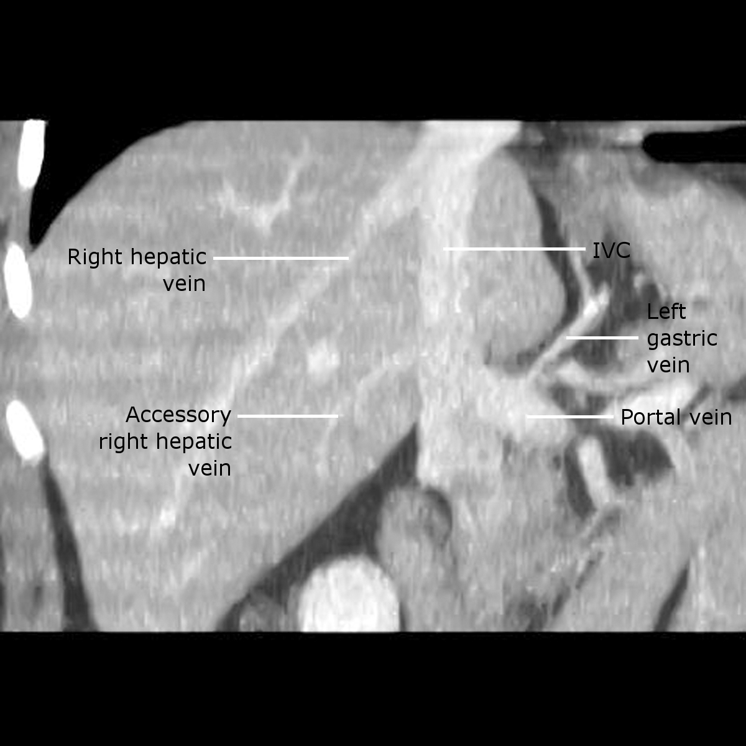
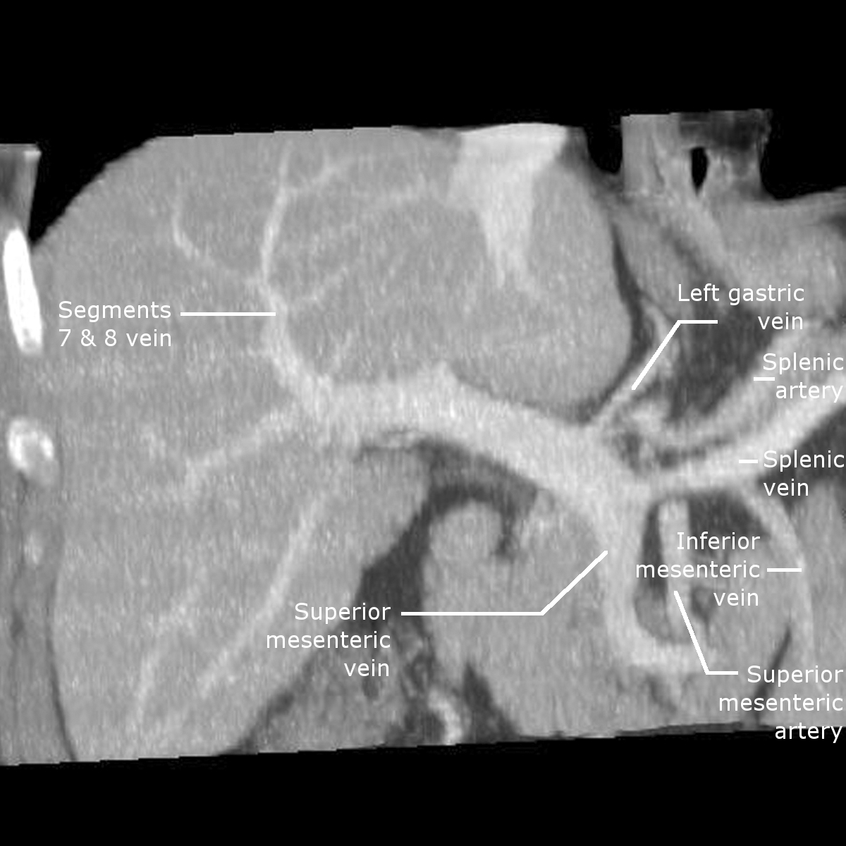
CT Liver
PV

Slide 14
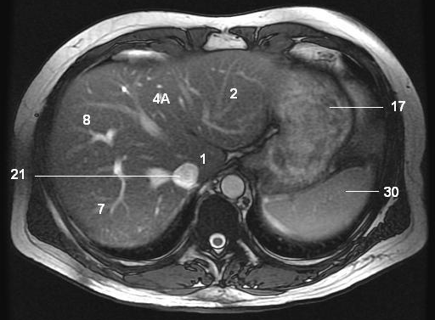
MRI Abdomen
17-stomach 21-IVC 30-spleen 1,2,4A, 7,8 liver segments

Slide 15
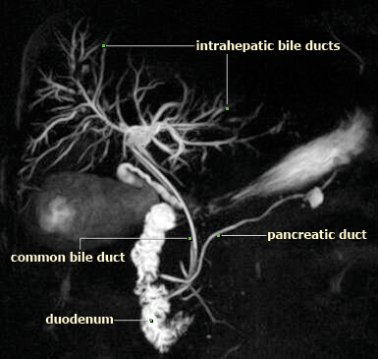
MRCP
1
5
6
4
2
3

Slide 16
MRCP
Cystic duct
Gall bladder

Slide 17
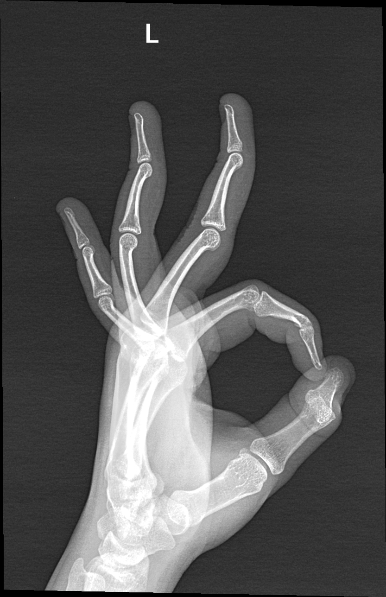
Thank you…

