Slide 1
ANAEMIA
BY
DR. ALIA ALFARAEDI
CONSULTANT HAEMATOLOGIST

Slide 5
Initially, anaemia can be so mild that it goes unnoticed. But signs and symptoms increase as the condition worsens.
Signs and symptoms:
The main symptom of most types of anemia is fatigue.
Other anemia symptoms include:
Weakness (Fatigue) Headache
Pale skin
A fast or irregular heartbeat
Palpitation
Exercise induced dyspnea
(Shortness of breath) Chest pain Dizziness
Cognitive problems
Numbness or coldness in your extremities

Slide 6
Signs of Anaemia may include:
Black and tarry stools (sticky and foul smelling)
Maroon, or visibly bloody stools
Tachycardia
Tachypnea
Pale or cold skin
Jaundice
low blood pressure
Heart murmur
Enlargement of the spleen Constipation
syncope (particularly following exercise)
bounding pulse
syncope or postural hypotension
tinnitus or vertigo irritability, restlessness
(difficulty sleeping or concentrating more frequent in severe chronic anemia)
Sweating, thirst and air hunger

Slide 7
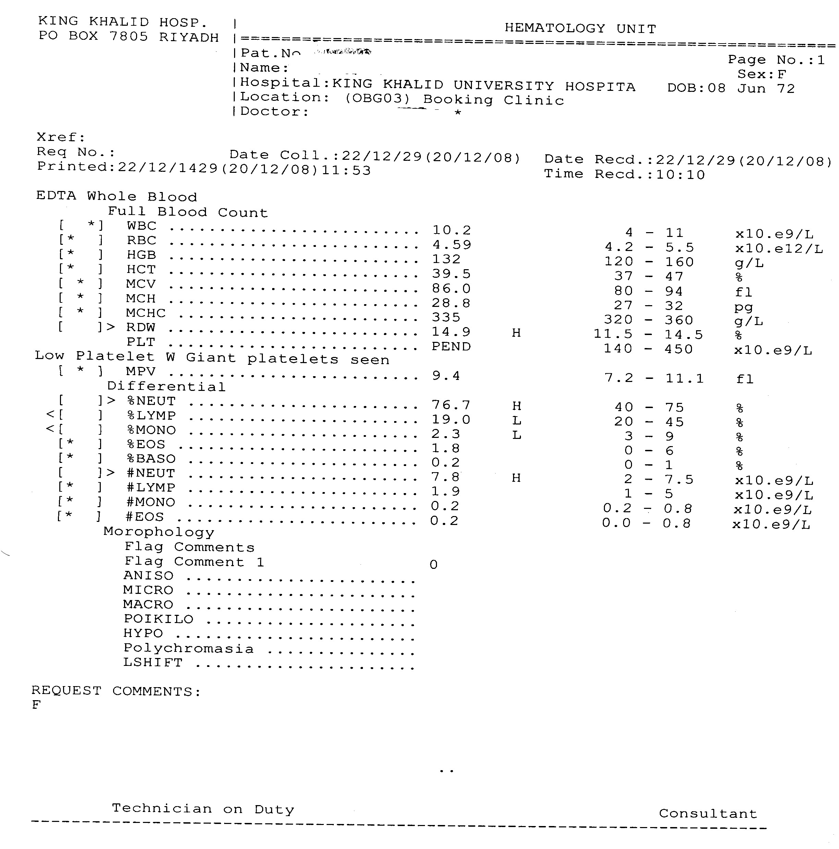

Slide 8
Hypochromic and/or Microcytic Anaemia
Serum Fe
Serum Fe Increased Hyperferraemia
Serum Fe
Reduced Hypoferraemia
Serum Fe Normal
Hemoglobin Electrophoresis, etc
Bone marrow Sideroblast Fe Increased
Bone Marrow
Macrophage Iron
Serum Ferritin
OR
Absent
Low
THLASSEMIA
IRON DEFICIENCY
SIDEROBLASTIC ANAEMIA
Normal or Increased
Increased
ANAEMIA OF CHRONIC DISORDERS
CONGENITAL
HEMOGLOBINOPATHIES (S,C,D,E)
ACQUIRED

Slide 9
MACROCYTIC ANAEMIA
BLOOD AND MARROW MORPHOLOGY
NON-MEGALOBLASTIC
MEGALOBLASTIC
Clinical data; serum vitamins
B12 DEFICIENCY
NO DEFICIENCY
FOLATE DEFICIENCY
Congenital diseases
Drugs
Schilling Test with intrinsic factor
DIET
RETICULOCYTES
corrected
Not corrected
Good
Poor
increased
Normal or decreased
Pernicious anaemia
Small bowel bacteria
Drug-induced malabsorption
Dietary Deficiency
Hemolytic Anemia
Hepatic Disease
Fish tapeworm
Myxaedema
Gastric resection
Jejunal resection
Pregnancy
Hemorrhage
Hypoplastic anemia
Ingestion of corrosives
Familial B12 malabsorption
infancy
Drug-induced malabsorption
Acq. Sideroblastic Anaemia
Tropical sprue, gluten sensitivity
Certain Blood Diseases
Inertintrinsic factor
Myelophthisic Anemia
Ileal Disease

Slide 10
NORMOCYTIC, NORMOCHROMIC ANEMIA
RETICULOCYTES
Normal or Decreased Erythrocyte Production
Increased Erythrocyte Production
History, Course, Blood Smear, Bile Pigments
Bone Marrow Aspirate and Biopsy
Hemolytic Anaemia
Post hemorr-hagic Anemia
Abnormal Marrow
Normal Marrow
Test Liver Function
Serum Iron
Hypoplastic Anaemia
Dyserythropoie-tic Anaemia
Test Renal Function
Test Endocrine Function
Infiltration
Leukemia
Anaemia of renal failure
Myxaedema
Myeloma
Anemia of liver disease
Anemia of chronic disorders
Addison’s
Myelofibrosis
eunuchoidism
Early Fe deficiency
Metastases
Panhypopituitarism

Slide 12
IRON DEFICIENCY ANAEMIA

Slide 13
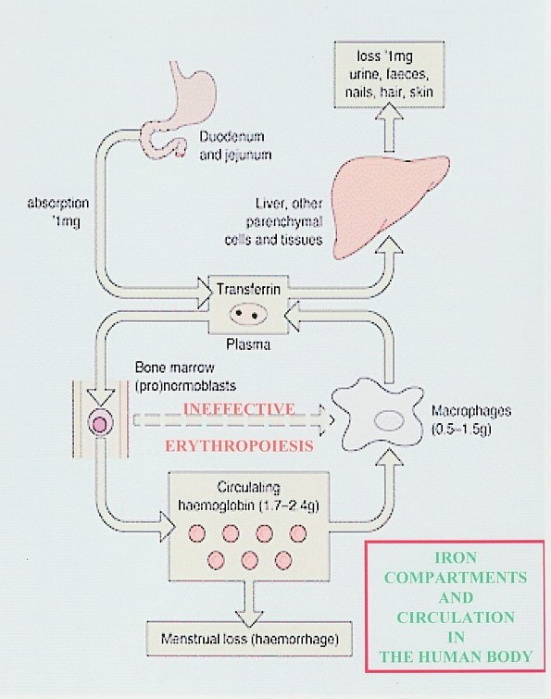

Slide 14
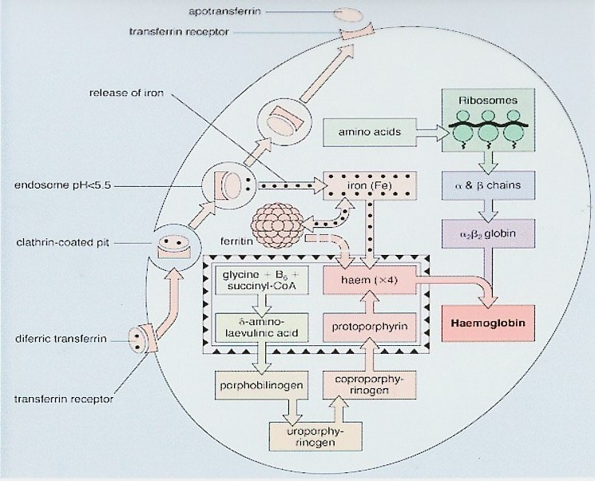

Slide 15
IRON ABSORPTION
Favored by
Dietary factors:
Increased Haem iron
Increased animal iron
Ferrous iron salts
Luminal factors:
Acid pH (e.g. gastric HCl)
Low molecular weight soluble chelates
(e.g. Vit. C, sugars, amino acids)
Ligand in meat (unidentified)
Systemic factors:
Iron deficiency
Increased erythropoiesis
Ineffective erythropoiesis
Pregnancy
Hypoxia
Reduced by
Decreased haem iron
Decreased animal iron
Ferric iron salts
Alkalis (e.g. pancreatic secretions)
Insoluble iron complexes (e.g. phytates, tannates in tea, bran)
Iron overload
Decreased erythropoiesis
Inflamatory disorders

Slide 16
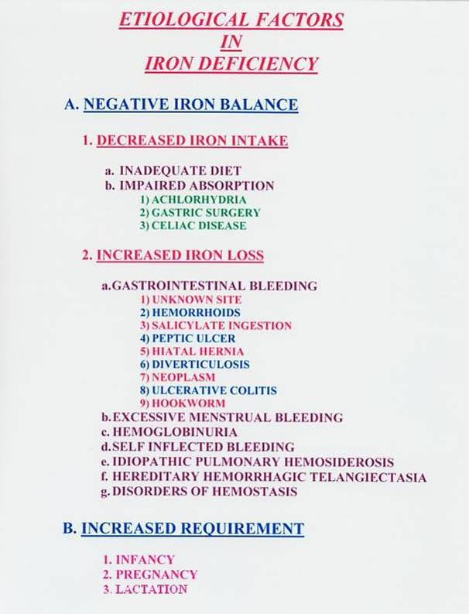

Slide 18
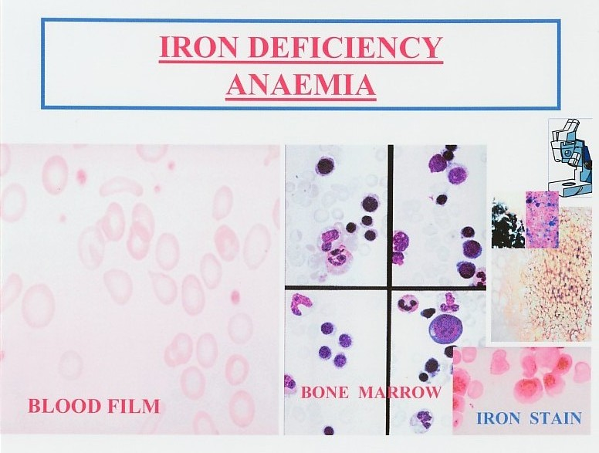

Slide 19
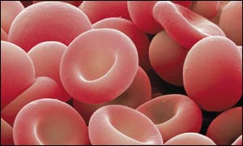
Latent Iron Deficiency
Normal Iron Deficiency Anaemia
Red cell iron
(peripheral film
And indices)
Normal normal hypochromic, microcytic
MCV↓MCH↓MCHC↓
Iron stores
(bone marrow
Macrophage iron
+++ - + 0 0
The development of iron deficiency anaemia
Reticuloendothelial (macrophage) iron stores are lost completely before anaemia develops.

Slide 20
serum iron unsaturated serum iron binding capacity
normal
iron deficiency
anaemia of chronic disorders
iron overload
0 10 20 30 40 50 60 70 80 90 100 µ mol/l
The serum iron and unsaturated serum iron binding capacity in normal subjects, iron deficiency, the anaemia of chronic disorders and iron overload. The total iron binding capacity (TIBC) is made up by the serum iron and the unsaturated iron binding capacity.

Slide 21
Normal Iron Iron Iron
Depletion Deficient Deficiency
Erythropoiesis Anaemia
Iron Stores
Erythron Iron
RE Marrow Fe (O-6) 2-3+ 0 0
Transferrin IBC (µmol/l) 60±5 70 75
Plasma Ferritin (µg/l) 100±60 10 <10
Iron Absorption Normal ↑ ↑
Plasma Iron (µmol/l) 20±9 20 <7
Transferrin Saturation (%) 35±15 30 <10
Sideroblasts (%) 40 – 60 40-60 <10
RBC Protoporphyrin 30 30 200
(µg/dl RBC)
Erythrocytes normal normal normal
The sequence of changes induced by a gradual reduction in the iron content of the body.
0-|+
65
20
↑
<10
<15
<10
100
Microcytic and hypochromic

Slide 22
IRON PROTOPORPHYRIN
(a) Iron deficiency Sideroblastic anaemia
(b) Chronic inflammation
or malignancy
HAEM + GLOBIN
Thalassaemia ( α or β )
HAEMOGLOBIN
The causes of a hypochromic microcytic anaemia include:
lack of iron (iron deficiency) or of iron release from macrophages to serum (anaemia of chronic inflammation or malignancy)
Failure of protoporphyrin synthesis (sideroblastic anaemia)
Failure of globin synthesis (α or β–thalassaemia). Lead also inhibits haem and globin synthesis.
Notes:
Management:
Management
Management:

