Slide 1
PRACTICAL ON BLOOD PARASITES

Slide 2
Common methods for parasitological diagnosis of malaria
The two methods common in use :
1: Light microscopy
2: Rapid diagnostic tests (RDTs).

Slide 3
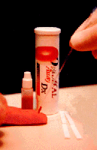
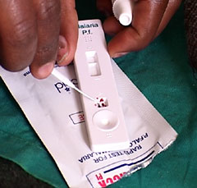
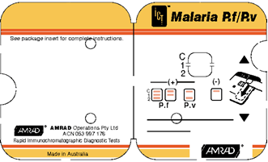
Laboratory diagnosis of malaria
Rapid diagnostic tests detect malaria antigens

Slide 4
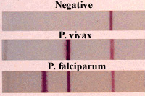
Rapid diagnostic tests detect malaria antigens

Slide 5
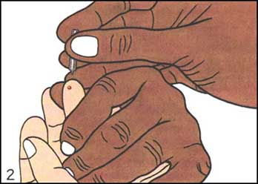
Laboratory diagnosis of malaria
Light microscopy:1: Preparing blood film

Slide 6
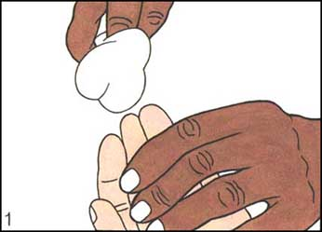
Laboratory diagnosis of malaria
Light microscopy:1: Preparing blood film

Slide 7
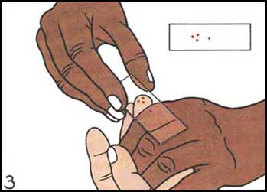
Laboratory diagnosis of malaria

Slide 8
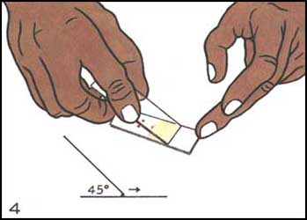
Laboratory diagnosis of malaria
Light microscopy:1: Preparing blood film

Slide 9
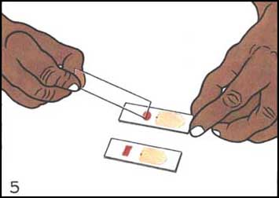
Laboratory diagnosis of malaria
Light microscopy:1: Preparing blood film

Slide 10
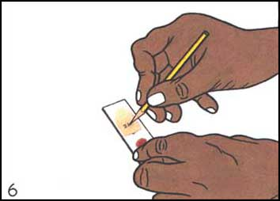
Laboratory diagnosis of malaria
Light microscopy:1: Preparing blood film

Slide 11
Laboratory diagnosis of malaria
Light microscopy: Thick and thin films

Slide 12
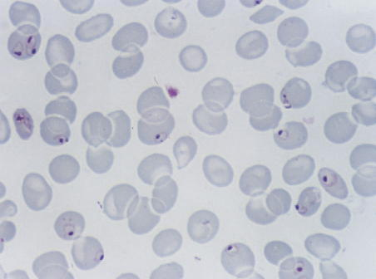
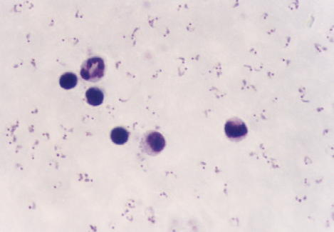
Laboratory diagnosis of malaria
Plasmodium falciparum (trophozoite stage in thin smear)
Plasmodium falciparum (trophozoite stage in thick smear)
CCMOVBD

Slide 13
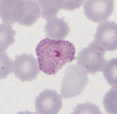
The Malaria Parasite
Trophozoites
Three developmental
stages seen in blood
films:
CCMOVBD
CCMOVBD
Trophozoite
Schizont
Gametocyte
2. Schizont
3. Gametocyte
CCMOVBD
CCMOVBD

Slide 14
Features of Plasmodium
Vacuole
Nucleus/chromatin dot
Cytoplasm
Stippling
CCMOVBD

Slide 15
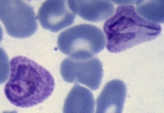
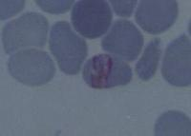
Plasmodium falciparum
Plasmodium vivax
CCMOVBD
CCMOVBD
Species of malaria is identified by its microscopic appearance:
Plasmodium malariae
Plasmodium ovale
CCMOVBD
Malaria Tutorials, Wellcome Trust

Slide 16
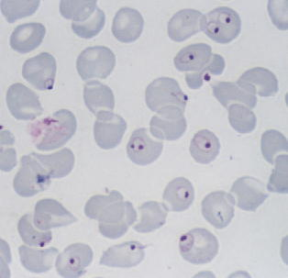
Plasmodium falciparum (trophozoite stage)
Diagnostic Points:
Small, regular, fine to fleshy cytoplasm
Infected RBCs not enlarged
Numerous, multiple infection is common
Ring, comma, marginal or accole forms are seen; often have double chromatin dots
Maurer’s dots not clearly visible
Multiple infection
Double chromatin
Marginal form
CCMOVBD

Slide 17
Plasmodium falciparum (trophozoite stage in thin smear)
CCMOVBD

Slide 18
Plasmodium falciparum (trophozoite stage in thick smear)
CCMOVBD

Slide 19
Plasmodium falciparum (schizont stage)
Diagnostic Points:
Small, rarely fill the RBC
Rare in peripheral blood
16-32 or more merozoites in compact cluster
Single dark pigment
Usually associated with many young ring forms
CCMOVBD
CCMOVBD

Slide 20
Plasmodium falciparum
(trophozoite and schizont stages in thin smear)
CCMOVBD

Slide 21
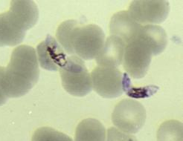
Plasmodium falciparum (gametocyte stage)
Diagnostic Points:
Banana-shaped or rounded
Macrogametocyte
small, compact, central chromatin dot
pigments closely adhere to the chromatin
Microgametocyte
broader, shorter and more sausage-shaped
loosely scattered chromatin
golden brown pigments scattered at the central half
CCMOVBD
CCMOVBD

Slide 22
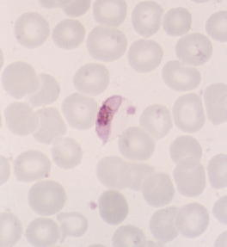
Plasmodium falciparum
(gametocyte stage in thin smear)
CCMOVBD

Slide 23
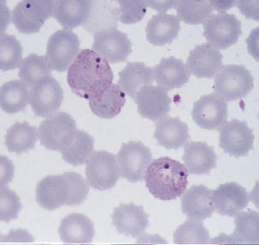
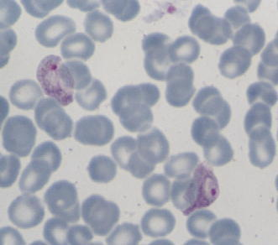
Plasmodium vivax (trophozoite stage)
Diagnostic Points:
Infected red cells usually enlarged
Irregular or fragmented cytoplasm (amoeboid)
Mature ring forms tend to be large and coarse
Schuffner’s dots (stippling) are frequently visible
CCMOVBD
CCMOVBD

Slide 24
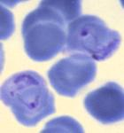
Plasmodium vivax (trophozoite stages in thin smear)
Ring form
Developing trophozoite
Mature Trophozoite
CCMOVBD
CCMOVBD
CCMOVBD

Slide 25
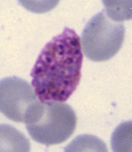
Plasmodium vivax (schizont stage)
Diagnostic Points:
Large, covering almost or the entire enlarged RBC
Few to moderate
12 – 24 merozoites in irregular cluster
Yellowish-brown loose pigments
CCMOVBD

Slide 26
In this malarial infection RBC is enlarged and oval, schuffner's dot is present. Trophozoite ring is 1/3 diameter of cell with heavy chromatin dot
Platelet
This RBC has two rings. Schüffner’s dots are present in this cell.
This RBC is not as enlarged as the others. Schüffner’s dots are not visible.

Slide 27
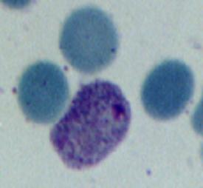
Plasmodium vivax (gametocyte stage)
Diagnostic Points:
Round; large
Usually compact nucleus the periphery
Chromatin is deep red or magenta
CCMOVBD
CCMOVBD
CCMOVBD

Slide 28
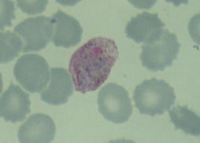
Plasmodium vivax (gametocyte stage in thin smear)
CCMOVBD

Slide 29
Plasmodium malariae (trophozoite stage)
Diagnostic Points:
Small, few
Ring to rounded, compact, vacuolated or non-vacuolated,
Band forms seen
Dark, scattered pigments
Ziemman’s stipplings not clearly visible
Infected red cell not enlarged
CCMOVBD
CCMOVBD

Slide 30
Plasmodium malariae (schizont stage)
Diagnostic Points:
Small, compact, dark
Usually few
6-12 merozoites in “rosette” formation, but more often in irregular cluster
Concentrated pigments
CCMOVBD
CCMOVBD

Slide 31
Plasmodium ovale
Diagnostic Points:
Smaller than P. vivax
Few
Ring to rounded, compact
Single, prominent chromatin
Schizonts with 4-12 merozoites
Reported in the Philippines
Malaria Tutorials, Wellcome Trust

Slide 32
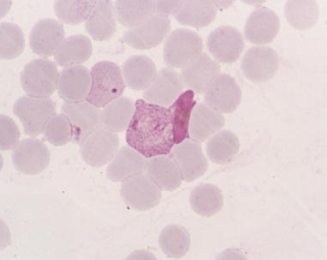
Mixed infections
Infection of an individual by more than one species of Plasmodium
Common in endemic areas in the Philippines
P. falciparum and P. vivax
Can easily be overlooked (blood films must be studied carefully to rule out mixed infections)
CCMOVBD

Slide 33
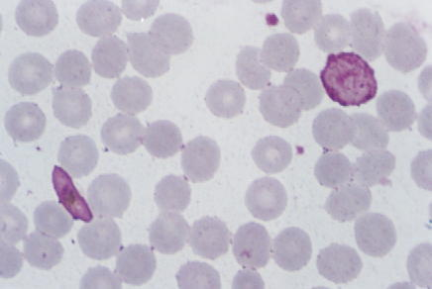
P. vivax trophozoite and
P. falciparum gametocyte
(Mixed infection, thin smear)
CCMOVBD

Slide 34
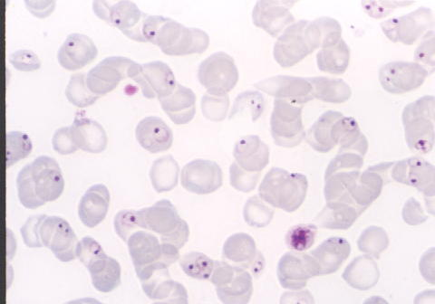
CCMOVBD
Plasmodium falciparum

Slide 35
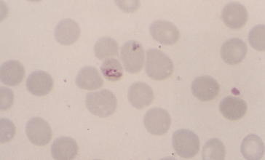
CCMOVBD
Plasmodium malariae

Slide 36
Plasmodium vivax

Slide 37
Plasmodium falciparum

Slide 38
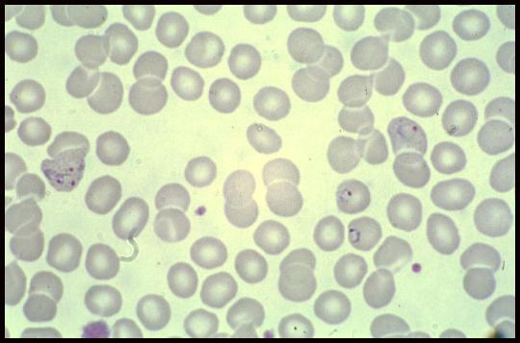
A 25 year-old male from India, who came 3 months ago was admitted in KKUH with a history of severe anaemia and intermittent high grade fever for the last two months not responding to antibiotics.
WHAT IS THE DIAGNOSIS?
Diagnosis: Plasmodium vivax

Slide 39
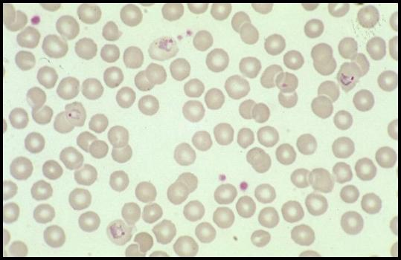
A businessman who makes frequent trips to Thailand , presents with intermittent fever .
WHAT IS THE DIAGNOSIS?
Diagnosis: Plasmodium vivax

Slide 40
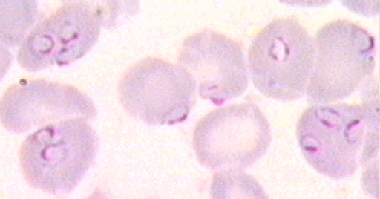
A student in KSU who returned three weeks from vacation in Africa , he developed intermittent fever last week and lost consciousness a short time ago.
WHAT IS THE DIAGNOSIS?
Diagnosis: Plasmodium falciparum

Slide 41
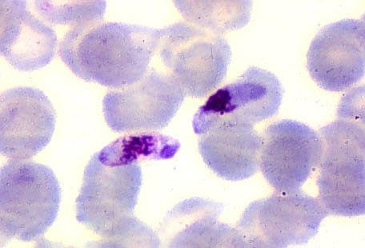
The patient was then treated with schizontocidal antimalarial drugs, a follow-up blood film is shown .
ARE THERE ANY PARASITES? WHAT STAGE ?
Plasmodium flaciparum , gametocyte stage

Slide 42
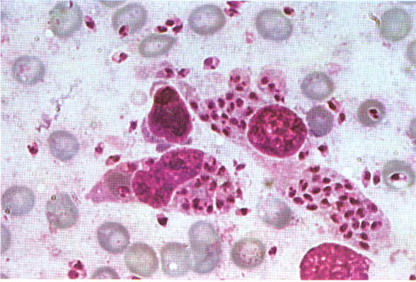
A 7 year old child presented with anemia , hepatospenomegaly and fever .Not responding to antimalarials and antibiotics . Bone marrow smear is shown
ARE THERE ANY PARASITES? WHAT STAGE ?
Leishmania , amastigote stage

