Slide 1
Adrenal (Suprarenal) Glands Anatomy & Embryology
Dr. Zeenat Zaidi & Dr. Essam Salama

Slide 2
Objectives
At the end of the lecture, the students should be able to describe the:
Location, shape and relations of the right and left adrenal glands.
Blood supply, lymphatic drainage and nerve supply of right and left adrenal glands
Parts of adrenal glands and function of each part.
Development of adrenal gland and common anomalies.

Slide 3
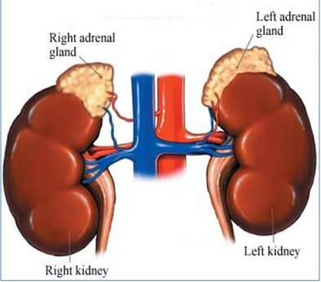
Suprarenal Glands
The two suprarenal glands are yellowish retroperitoneal organs that lie on the upper poles of the kidneys, just above the level of T12
They are surrounded by renal fascia (but are separated from the kidneys by the perirenal fat).
Each gland has an outer cortex and an inner medulla.

Slide 4
The right gland is pyramid shaped and caps the upper pole of the right kidney.
Relations:
Anterior: right lobe of the liver and inferior vena cava.
Posterior: diaphragm.
The left gland is crescent in shape and extends along the medial border of the left kidney from the upper pole to the hilus.
Relations:
Anterior: pancreas, lesser sac, and stomach
Posterior: diaphragm.

Slide 5
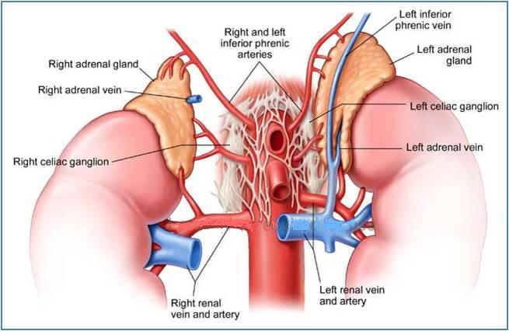
Arteries: Each gland receives branches from three main arteries:
Inferior phrenic
Aorta
Renal artery.
Veins: A single vein emerges from the hilum of each gland and drains into the Inferior vena cava on the right & Renal vein on the left.
Nerve Supply: Preganglionic sympathetic fibers derived from the splanchnic nerves. Most of the nerves end in the medulla of the gland.
Lymph Drainage: The lymph drains into the lateral aortic nodes.

Slide 6
Functions
The cortex of the suprarenal glands secretes hormones that include:
Mineral corticoids, which are concerned with the control of fluid and electrolyte balance
Glucocorticoids, which are concerned with the control of the metabolism of carbohydrates, fats, and proteins
Small amounts of sex hormones, which probably play a role in the prepubertal development of the sex organs.
The medulla of the suprarenal glands secretes the catecholamines: epinephrine and norepinephrine

Slide 7
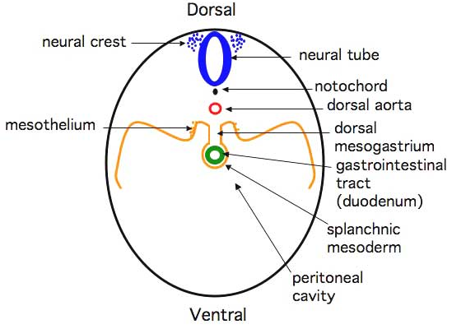
Development of the Adrenal Glands
The two parts of the adrenal gland i.e. the cortex and the medulla develop from different origins.
Cortex develops from the celomic epithelium (mesothelium) derived from mesoderm
Medulla develops from the neural crest cells

Slide 8
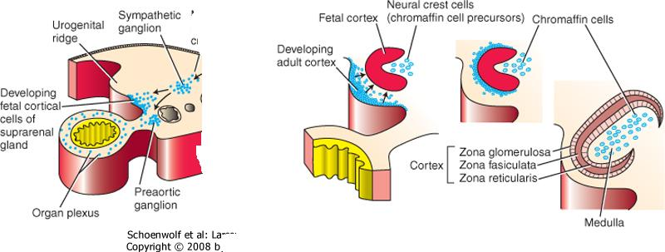
The cortex
During 6th week of development, the coelomic epithelium medial to the developing gonadal ridge proliferates.
The newly formed cells get separated from the surface epithelium enter the underlying mesoderm, and form the fetal cortex
A second wave of delaminating cells migrates and forms a thinner definitive (permenant) cortex surrounding the fetal cortex.

Slide 9
Ultrastructurally, cells of both fetal and definitive cortical layers exhibit cytologic characteristics of steroid-producing cells.
Differentiation of the characteristic suprarenal cortical zones (glomerulosa, fasciculata & reticularis) begins during the late fetal period.
At birth Zona glomerulosa & zona fasciculata are present, but the zona reticularis is not recognizable until the end of third year.

Slide 10
The medulla
Formed from the sympathochromaffin cells of the neural crest.
These cells invade the cortex on its medial side, occupy the central position and differentiate into the secretory cells.
Preganglionic sympathetic nerve fibers grow into the medulla, release Epinephrine and Norepinephrine upon sympathetic stimulation, and influence the activity of the medullary cells.

Slide 11
The suprarenal gland of the fetus is 10-20 times larger than the adult glands relative to the body weight, and are large compared with the kidneys. This is because of the extensive size of the fetal cortex. The medulla remains relatively small until after birth.
The suprarenal glands rapidly become smaller during the first 2-3 weeks after birth, due to the rapid regression of the fetal cortex. Its involution is largely completed in the first year of life.
During the process of involution, the cortex is friable and susceptible to trauma at birth leading to severe hemorrhage.

Slide 12
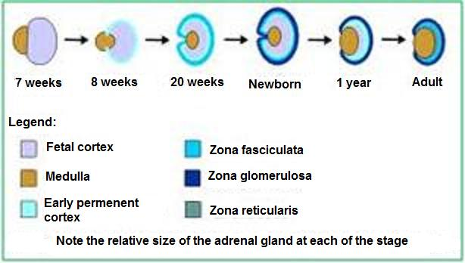
zg
zf
zr

Slide 13
Congenital adrenal hyperplasia (CAH):
An abnormal increase in the cortical cells results in excessive androgen production during the fetal period.
In females, it may lead to musculization of external genitalia and enlargement of clitorus.
In males, it may remain undetected in early infancy.
Later in childhood, in both sexes, androgen excess may lead to rapid growth and accelerated skeletal maturation.

Slide 14
Thank You & Good Luck

