Slide 1
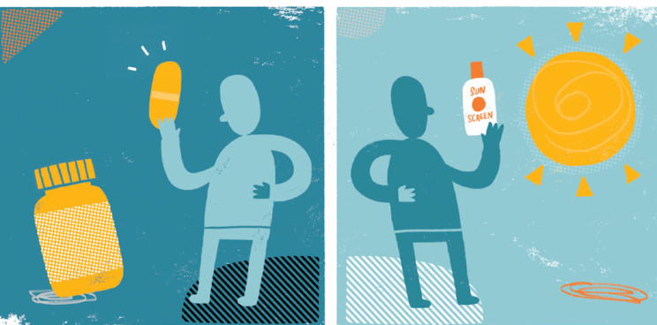
Vitamin D, Rickets and Osteoporosis
Endocrine Block | 1 Lecture |
Notes:
1

Slide 2
Overview
Vitamin D functions and metabolism
Vitamin D and calcium homeostasis
Regulation of vitamin D synthesis
Biochemistry, types and diagnosis of:
Osteomalacia and rickets
Osteoporosis
Notes:
2

Slide 3
D vitamins
A group of sterols with a hormone-like function.
Calcitriol (1, 25 diOH cholecalciferol = 1, 25 diOH D3) is the biologically active molecule.
Vitamins D2 & D3
Preformed Vitamin D in the diet: they are needed only in exposure to sunlight is limited.
They are also available as supplement
They are NOT biologically active
They are activated in vivo to the biologically active form
Recommended dietary allowance (RDA): 5 mg cholecalciferol = 200 IU of vit D3 (or more)

Slide 4
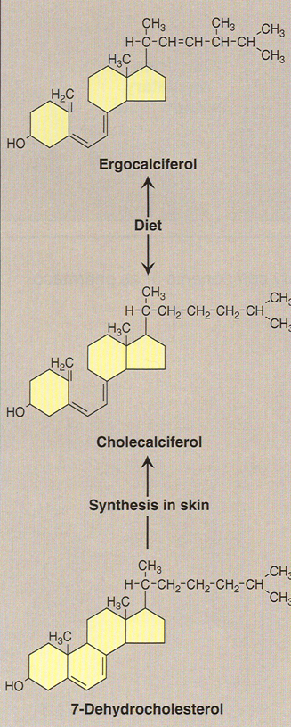
D₂,
plant source
D₃, animal source: fatty fish, liver, egg yolk
Lippincott’s Illustrated Reviews, Biochemistry, 4th Edition, Champe, Harvey and Ferrier

Slide 5
Vitamin D metabolism
Cholecalciferol is derived from 7-dehydrocholesterol in the skin by sunlight
In liver:
Cholecalciferol is converted to 25-hydroxycholecalciferol by the enzyme 25-hydroxylase
In kidneys:
The 1-α-hydroxylase enzyme converts
25-hydroxycholecalciferol to 1,25-dihydroxycholecalciferol (biologically active)
Active vitamin D is transported in blood by vitamin D-binding protein.
Notes:
5

Slide 6
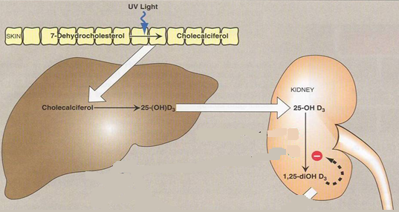
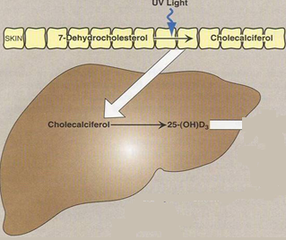
Vitamin D metabolism
Lippincott’s Illustrated Reviews, Biochemistry, 4th Edition, Champe, Harvey and Ferrier
Notes:
6

Slide 7
Notes:
7

Slide 8
Vitamin D functions
Regulates calcium and phosphorus levels in the body (calcium homeostasis)
Maintains healthy bones and teeth
Notes:
8

Slide 9
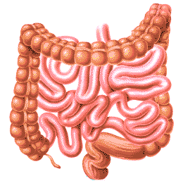
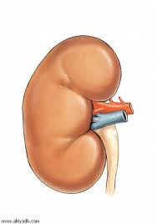
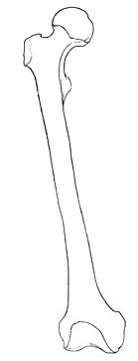
Vitamin D functions
These functions are through:
Promoting absorption of calcium and phosphorus from the intestine
Increasing reabsorption of calcium and phosphorus by renal tubules
Increasing bone mineralization
Notes:
9

Slide 10
Vitamin D regulation and calcium homeostasis
Vitamin D has essential role in calcium homeostasis
Calcium homeostasis is maintained by parathyroid hormone (PTH) and calcitonin
Regulation of active Vitamin D synthesis is strictly controlled in the kidneys by PTH
Hydroxylation of 25-hydroxycholecalciferol is PTH-dependent in kidneys
Calcium absorption in the gut:
Indirectly depends on PTH
Directly depends on vitamin D
Notes:
10

Slide 11
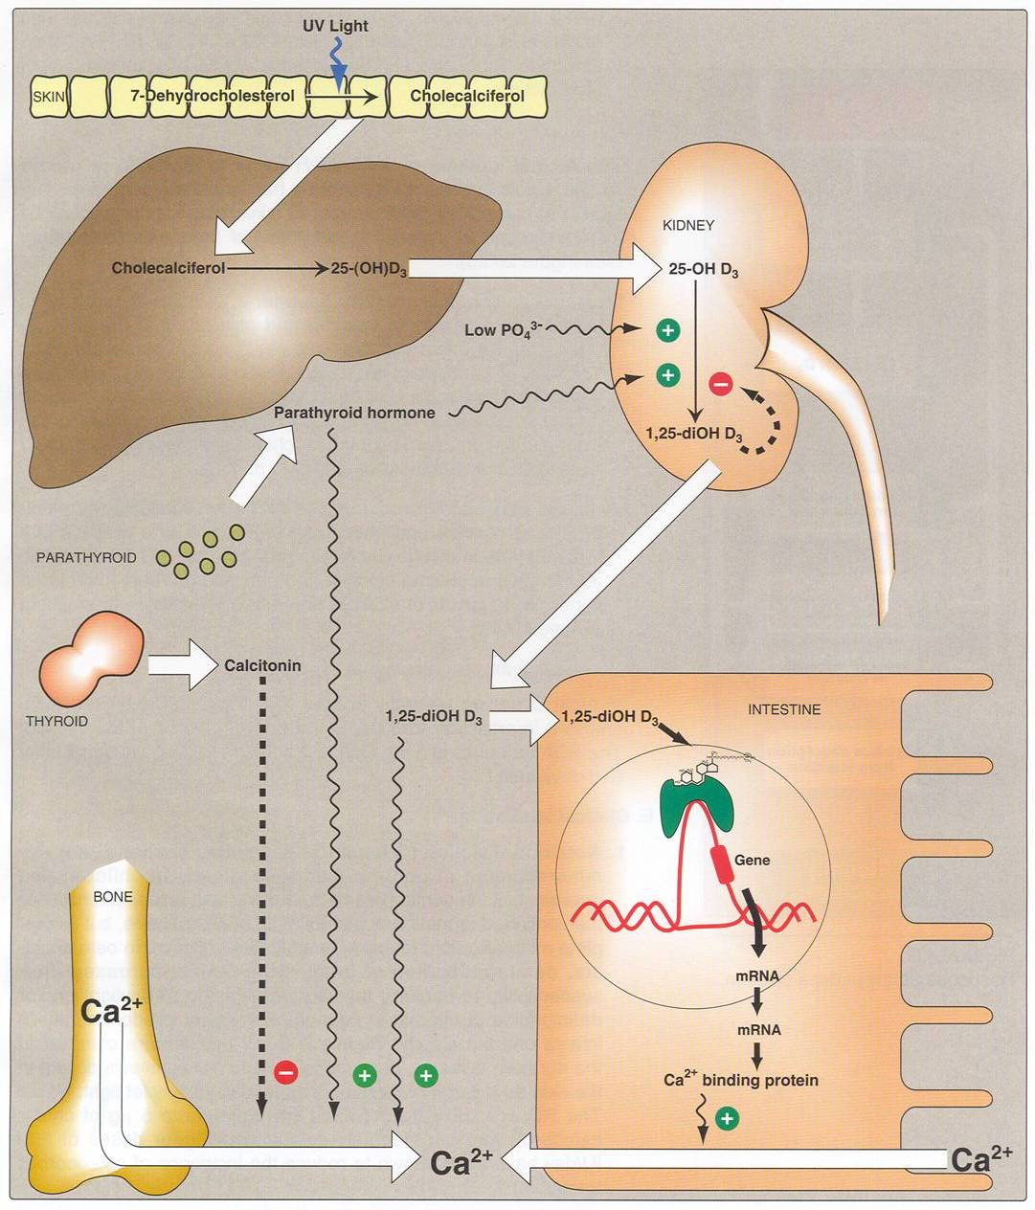
Low Ca²⁺
+
Lippincott’s Illustrated Reviews, Biochemistry, 4th Edition, Champe, Harvey and Ferrier

Slide 12
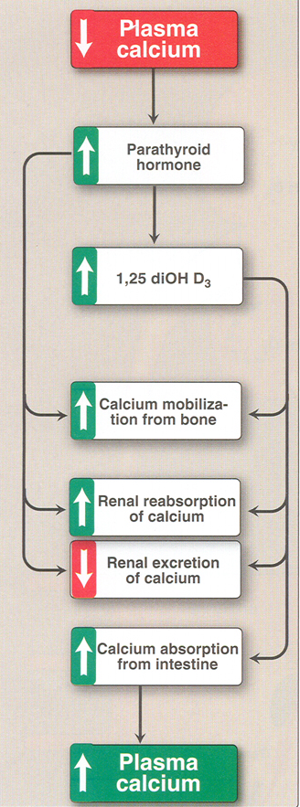
Lippincott’s Illustrated Reviews, Biochemistry, 4th Edition, Champe, Harvey and Ferrier

Slide 13
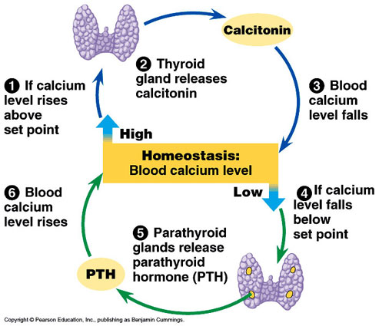
Calcium homeostasis
Notes:
13

Slide 14
Osteomalacia and Rickets
Osteomalacia:
Defective bone mineralization in adults
Rickets:
Defective bone and cartilage mineralization in children
Before introduction of vitamin D-supplemented milk, children with insufficient exposure to sunlight developed Vit D deficiency due to impaired intestinal absorption of calcium
Not common these days as foods (milk, oils) are now supplemented with vitamin D
Notes:
14

Slide 15
Osteomalacia and Rickets, continued..
These conditions are due to:
Vitamin D deficiency
Impaired vitamin D metabolism
Calcium deficiency
Imbalance in calcium homeostasis
Notes:
15

Slide 16
Osteomalacia and Rickets, continued..
Vitamin-D-dependent rickets types 1 and 2 (genetic disorders)
Rare bone diseases
Due to:
Defects in vitamin D synthesis: type 1 (can be overcome by high doses of Vit D)
Defects in vitamin D receptor: type 2 (cannot be overcome by high doses of Vit D, as the hormone is unable to act)
Notes:
16

Slide 17
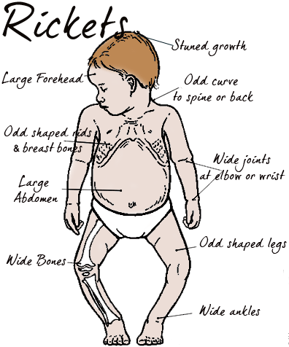
Notes:
17

Slide 18
Clinical features
Osteomalacia and Rickets, continued..
Rickets
Soft bones
Bone pain
Increased tendency of bone fractures
Skeletal deformity (bowed legs)
Muscle weakness
Dental problems
Growth disturbance
Osteomalacia
Soft bones
Bone pain
Bone fractures
Compressed vertebrae
Muscle weakness
Notes:
18

Slide 19
Osteomalacia and Rickets, continued..
Diagnosis:
Measuring serum levels of:
25-hydroxycholecalciferol
PTH
Calcium & Phosphate
Alkaline phosphatase activity
Notes:
19

Slide 20
Osteomalacia and Rickets, continued..
Serum levels of 25-hydroxycholecalciferol is low if the disease is due to Vitamin D deficiency
In severe forms:
Serum calcium falls (hypocalcemia)
PTH level increases
Alkaline phosphatase activity increases
Notes:
20

Slide 21
Osteoporosis
Reduction in bone mass per unit volume
Bone matrix composition is normal but it is reduced
Post-menopausal women lose more bone mass than men (primary osteoporosis)
The cause is unknown
Notes:
21

Slide 22
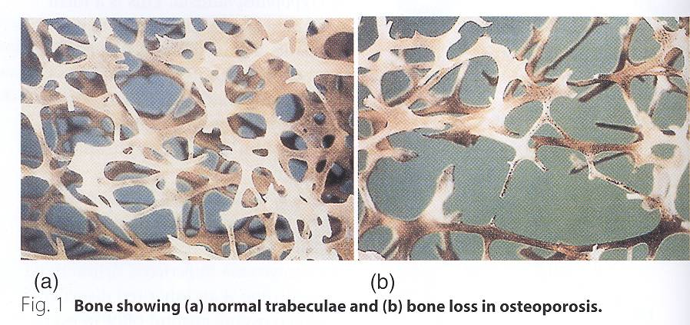
Notes:
22

Slide 23
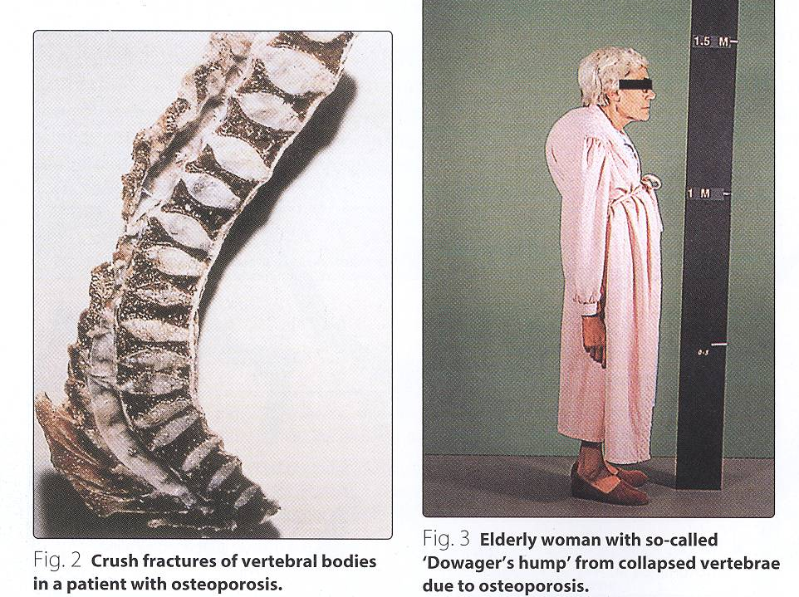
Notes:
23

Slide 24
Osteoporosis, continued..
Secondary osteoporosis may be caused by:
Drugs
Immobilization
Smoking
Alcohol
Cushing’s syndrome
Gonadal failure
Hyperthyroidism
GI disease
Notes:
24

Slide 25
Osteoporosis, continued..
Diagnosis
Serial measurement of bone density
No specific biochemical tests to diagnose or monitor primary osteoporosis
Secondary osteoporosis (due to other causes) can be diagnosed by biochemical tests
The test results overlap in healthy subjects and patients with osteoporosis
Common biochemical tests:
Urinary Hydroxyproline (bone resorption)
Osteocalcin (bone formation)
Biochemistry Diagnosis is Unremarkable in Osteoporosis
Notes:
25

Slide 26
Osteoporosis: Prevention & treatment
Prevention
Prevention from childhood is important
Good diet and exercise prevent osteoporosis later
Hormone replacement therapy in menopause prevents osteoporosis
Notes:
26

Slide 27
Osteoporosis: Prevention & treatment
Treatment
In confirmed cases of osteoporosis
Treatment options are unsatisfactory
Oral calcium, estrogens, fluoride therapy may be beneficial
Notes:
27

Slide 28
THANK YOU

