Slide 1
Biochemistry of Cushing’s Syndrome
Presented by:
Rana Hasanato MD,KSFCB
Assistant Professor and Consultant
Head, Clinical Biochemistry Department
College of Medicine
King Saud University

Slide 2
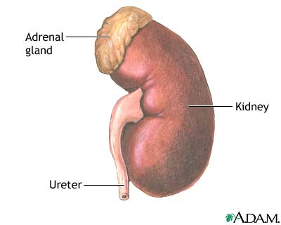
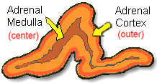
ANATOMICALLY:
The adrenal gland is situated on the anteriosuperior aspect of the kidney
﻿HISTOLOGICALLY:
The adrenal gland consists of two distinct tissues of different embryological origin, the outer cortex and inner medulla.

Slide 3
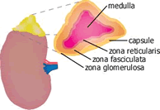
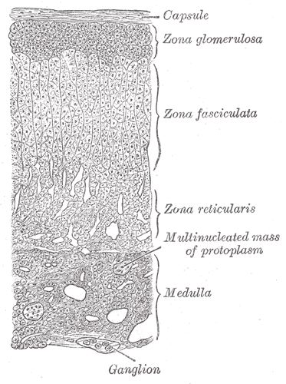
The adrenal cortex comprises three zones based on cell type and function:
Zona glomerulosa
The outermost zone → aldosterone (the principal mineralocorticoid).
The deeper layers of the cortex:
Zona fasciculata
→ glucocorticoids – mainly cortisol (95%)
Zona reticularis → Sex hormones

Slide 4
Steroid Hormone Synthesis
Cholesterol
Pregnenolone (C21)
3-β-Hydroxysteroid dehydrogenase
Progesterone (C21)
17-α-Hydroxylase
17-α-Hydroxyprogesterone (C21)
21-α-Hydroxylase
11-Deoxycorticosterone (C21)
Androstenedione (C19)
11-Deoxycortisol (C21)
11- β -Hydroxylase
Testosterone (C19)
Corticosterone
Peripheral tissues
Aldosterone (C21)
Cortisol (C21)
Estradiol (C18)

Slide 5
Hypothalamic-Pituitary-Adrenal (HPA) Axis
The hypothalamus secretes corticotrophin-releasing hormone (CRH) which stimulates the anterior pituitary gland to release ACTH.
ACTH acts on the zona fasiculata cells → release of glucocorticoids (Cortisol).

Slide 6
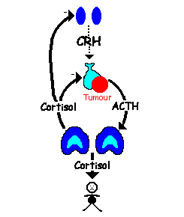
Regulation of ACTH and Cortisol Secretion:
1. Negative feedback control:
ACTH release from the anterior pituitary is stimulated by hypothalamic secretion of corticotrophin releasing hormone (CRH).
CRH → ↑ ACTH ﻿ → ↑[Cortisol]
↑[Cortisol] or synthetic steroid suppress CRH & ACTH secretion
Hypothalamus
Pituitary
Adrenal

Slide 7
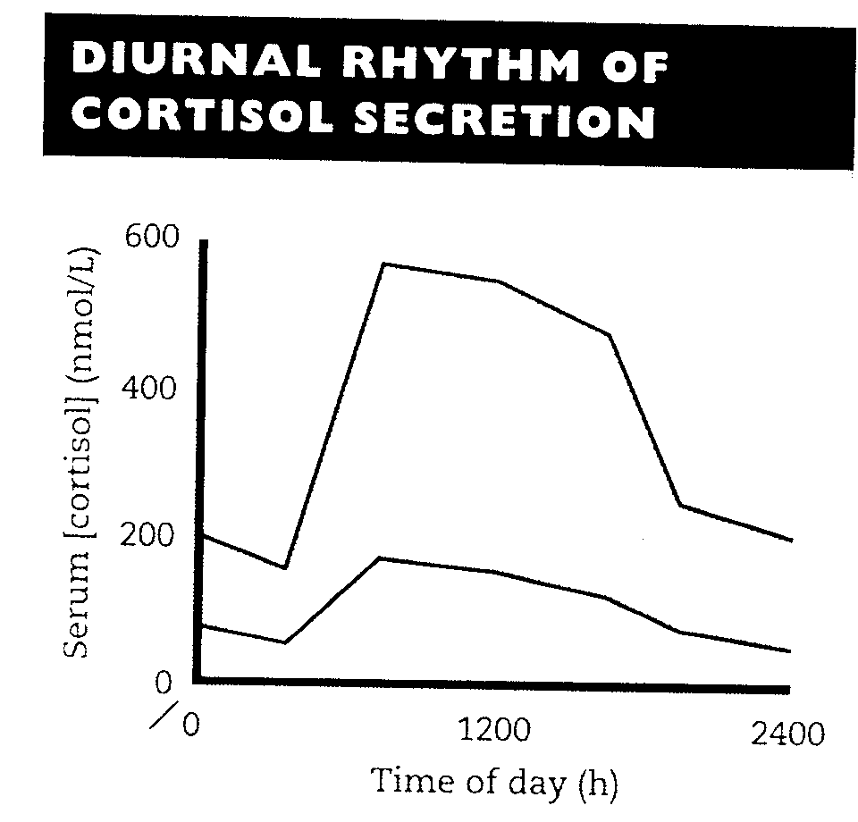
2. Stress (e.g. major surgery, emotional stress) Stress → ↑↑ CRH & ACTH → ↑↑ Cortisol
3. The diurnal rhythm of plasma cortisol:
Highest Cortisol level in the morning ( 8 - 9 AM ).
Lowest Cortisol level in the late afternoon and evening ( 8 - 9 PM ).
The diurnal rhythm of cortisol secretion; the area between the curves represents values that lie within the reference range

Slide 8
Plasma [CBG] :
In the circulation, glucocorticoids are mainly protein-bound (about 90%), chiefly to cortisol-binding globulin (CBG or transcortin).
↑↑ in pregnancy and with estrogen treatment (e.g. oral contraceptives).
↓↓ in hypoproteinemic states (e.g. nephrotic syndrome).
﻿The biologically active fraction of cortisol in plasma is the free (unbound) component.

Slide 9
Cortisol and ACTH measurements
Serum [cortisol] and plasma [ACTH]:
Serum measurement is preferred for cortisol and Plasma for ACTH.
Samples must be collected (without venous stasis) between 8 a.m. and 9 a.m. and between 10 p.m. and 12 p.m. because of the diurnal rhythm.
Temporary ↑↑ in these hormones may be observed as a response to emotional stress.

Slide 10
Urinary cortisol excretion :
Cortisol is removed from plasma by the liver → metabolically inactive compounds → excreted in urine mainly as conjugated metabolites (e.g. glucuronides).
A small amount of cortisol is excreted unchanged in the urine (UFC).
In normal individuals:
Urinary free cortisol (UFC) is < 250 nmol/24 h.
Cortisol / Creatinine ratio in an early morning specimen of urine is < 25 μmol cortisol / mol creatinine.

Slide 11
CAUSES OF ADRENOCORTICAL HYPERFUNCTION: CUSHING’S SYNDROME
ACTH - dependent :
1. ↑ Pituitary ACTH 70% (Cushing's disease).
2. Ectopic ACTH by neoplasms 10%.
3. ACTH therapy.
ACTH - independent :
1. Adrenal tumor 20% (adenoma or carcinoma)
2. Glucocorticoid therapy.

Slide 12
Causes of elevated serum cortisol concentrations:
1. Increased cortisol secretion:
• Cushing's syndrome
• Exercise
• Stress, Anxiety, Depression
• Obesity
• Alcohol abuse
• Chronic renal failure
2. Increased cortisol binding globulin (CBG):
• Congenital
• Estrogen therapy
• Pregnancy

Slide 13
Glucocorticoid functions
Glucocorticoids have widespread metabolic effects on carbohydrate, fat and protein metabolism.
Upon binding to its target, CORTISOL enhances metabolism in several ways:
In the liver, Cortisol is an insulin antagonist and has a weak mineralocorticoid action →
↑↑ Gluconeogenesis → production of glucose from newly-released amino acids and lipids
↑↑ Amino acid uptake and degradation
↑↑ Ketogenesis.

Slide 14
In the adipose tissue: Cortisol → ↑↑ Lipolysis through breakdown of fat .
In the muscles: Cortisol →↑↑ proteolysis and amino acid release.
Conserving glucose: by inhibiting uptake into muscle and fat cells.

Slide 15
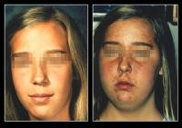
Cushing’s Syndrome
Symptoms:
Weight gain: trunk and face with sparing of the limbs (central obesity)
Buffalo’s hump.
Moon face
Excessive sweating

Slide 16
Symptoms …. (contd)
Atrophy of the skin and mucous membranes
Purple striae on the trunk and legs
Proximal muscle weakness (hips, shoulders)
Hirsuitism
The excess cortisol may also affect other endocrine systems → ↓ libido, amenorrhoea and infertility
Patients frequently suffer various psychological disturbances ranging from euphoria to frank psychosis.

Slide 17
Signs:
Loss of diurnal rhythm of cortisol and ACTH.
Hypertension (due to the aldosterone - like effects)
Hyperglycemia or diabetes due to insulin resistance.
Hypokalemic alkalosis
↑ protein metabolism.
Impaired immunity.

Slide 18
Investigations of suspected adrenocortical hyperfunction
A. Screening tests (out-patient): to assess the clinical diagnosis of adrenocortical hyperfunction.
B. Confirmatory tests (in-patient): to confirm or exclude the provisional diagnosis
C. Tests to determine the cause: to ascertain:
(a) The site of the pathological lesion
(adrenal cortex, pituitary or elsewhere?)
(b) The nature of the pathological lesion.

Slide 19
? Cushing
Screening
Low DXM/UFC
Pesudo-Cushing
True Cushing
Confirmatory
Insulin hypoglycemia
Normal response
No response
Cause
ACTH/High DXM
Alcoholism
Depression
ACTH-dependent
Adrenal
Severe illness
CRH Test
Pituitary
Ectopic
ULS/CT adrenals
MRI pituitary
CT chest

Slide 20
A. Screening tests:
The screening tests serve to: distinguish simple non-endocrine obesity from obesity due to Cushing's syndrome.
It includes:
Low-dose dexamethasone suppression test:
(Overnight suppression test)
Dexamethasone → ↓ CRH → ↓ ACTH → ↓ cortisol
24-hour urinary free cortisol

Slide 21
A. Screening tests:
Low-dose dexamethasone (DXM) suppression test: (outpatient procedure)
Procedure:
One mg DXM administered at 11-12 PM the night before attending the clinic.
serum cortisol is measured at 8-9 AM.
Result:
Cortisol < 50 nmol/L (suppression)→ exclude Cushing’s syndrome
Precautions: Drugs that induce hepatic microsomal enzymes (Phenobarbitone & phenytoin) → ↑ DXM metabolism and ↓ DXM blood level to achieve CRH suppression (false diagnosis of Cushing)

Slide 22
A. Screening tests: …. Cont’D
24- hour urinary free cortisol:
Result: Cortisol < 250 nmol/day → exclude Cushing’s syndrome.
Disadvantage: incomplete collection of urine → a false-negative result
- An alternative is to determine the urinary cortisol : creatinine ratio on an early morning specimen

Slide 23
Confirmatory Test
Confirmatory tests (in-patient basis) are required to rule out pseudo-Cushing's syndrome
Pseudo-Cushing's syndrome:
Depressed or extremely anxious patients
﻿Severe intercurrent illness
Alcoholism

Slide 24
B. Confirmatory tests: (Inpatient)
Insulin-induced hypoglycemia
Pseudo-Cushing patients show abnormal diurnal rhythm of S. cortisol, but, with Insulin-induced hypoglycemia → ↑ CRH, ACTH and cortisol blood levels
True Cushing patients:
No response to hypoglycemia

Slide 25
B. Confirmatory tests: … Cont’d
Insulin-induced hypoglycemia:
Hypoglycemia →↑ CRH →↑ ACTH →↑ cortisol
To test the integrity of the hypothalamic-pituitary-adrenal (HPA) axis.
To distinguish true Cushing's syndrome from pseudo-Cushing’s syndrome
Contraindicated in: epilepsy or heart disease.

Slide 26
Insulin hypoglycemia test …. Cont’d
Procedure:
Insulin I.V. (0.15 U/kg) to lower blood glucose to 2.2 mmol/L or less .
Samples for simultaneous measurement of serum glucose and cortisol levels are taken basally (before insulin injection) and at 30, 45, 60 and 90 min after I.V. insulin injection.
Failure to achieve a glucose level of 2.2 mmol/L invalidates the test and should be repeated with increment in step of 0.05U/kg.

Slide 27
Insulin hypoglycemia test …. Cont’d
Interpretation of the results:
Normally:
Basal serum cortisol: at least 145 nmol/L
At 60 - 90 minutes: the level > 425 nmol/L
Patients with Cushing's syndrome:
Whatever the cause, do not respond normally to insulin-induced hypoglycemia.
High basal serum cortisol than normal .
At 60 - 90 minutes: no increase in S. cortisol, despite the production of an adequate degree of hypoglycemia.

Slide 28
C. Tests used to determine the cause of Cushing's syndrome:
Plasma ACTH (Diurnal rhythm)
High-dose dexamethasone suppression test
CRH stimulation test
Radiological tests: MRI of pituitary and ultrasound or CT of adrenals

Slide 29
1. Plasma [ACTH]:
Plasma [ACTH] should be measured on blood specimens collected at 8-9 a.m. and 8-9 p.m.
Plasma ACTH
❖
❖
❖
Undetectable
↑↑ ACTH
↑ ↑↑ ↑ ACTH
Functional adrenal tumor → confirmed by an abdominal CT scan to detect an adrenal mass
Ectopic (non-endocrine) origin of ACTH
Cushing's disease (pituitary-dependent)

Slide 30
2. High-dose dexamethasone suppression test:
It is used to distinguish Cushing's disease from ectopic ACTH secretion.
2 mg dexamethasone six-hourly for 48 hours to suppress cortisol secretion.
Basal (pre-dexamethasone) serum cortisol or 24-hour urine free cortisol is compared with the results at the end of the 48-hour period.

Slide 31
2. High-dose dexamethasone suppression
Test ………. Contd
Suppression is defined as a fall to less than 50 % of basal value.
About 90 % of patients with Cushing's disease show suppression of cortisol output.
In contrast, only 10% of patients with ectopic ACTH production (or with adrenal tumors) show suppression.

Slide 32
3. CRH stimulation test:
Measures the ACTH and cortisol levels basally and 60 minutes after injection of 100 µg CRH.
Ectopic ACTH & adrenal tumors
Cushing's disease
No response
False-positive responses are unusual
↑↑ ACTH & cortisol above basal at 60 min
10% of patients fail to respond
In Cushing's disease: High-dose dexamethasone suppression test + the CRH test → 100 % specificity and sensitivity.

Slide 33
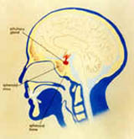
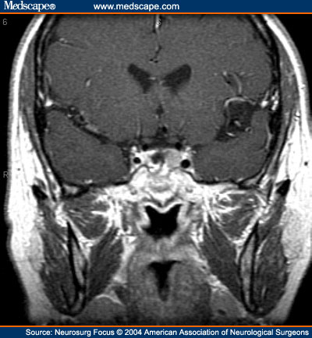
4. Radiological Investigations:
Ultrasound or CT scanning of the adrenal glands
MRI of the pituitary gland
Coronal contrast-enhanced MRI of the sella turcica in a patient with recurrent Cushing’s disease

Slide 34
Other blood tests commonly performed for patients suspected to have Cushing’s syndrome are:
Full blood count
Blood glucose
Blood electrolytes and pH
Renal function tests
Liver function tests

Slide 35
? Cushing
Screening
Low DXM/UFC
Pesudo-Cushing
True Cushing
Confirmatory
Insulin hypoglycemia
Normal response
No response
Cause
ACTH/High DXM
Alcoholism
Depression
ACTH-dependent
Adrenal
Severe illness
CRH Test
Pituitary
Ectopic
ULS/CT adrenals
MRI pituitary
CT chest

Slide 36
Adrenal Hyperfunction Summary of Biochemical Tests
Test | Cushing’s disease | Adrenal tumor | Ectopic ACTH secreting tumor
S. cortisol | ↑ | ↑ | ↑
Dexamethasone Low dose test | Not suppressed | Not suppressed | Not suppressed
Urinary cortisol | ↑ | ↑ | ↑
Diurnal rhythm | Lost | Lost | Lost
Insulin-induced hypoglycemia | No response | No response | No response
Plasma [ACTH] | Normal or ↑ | Not detectable | ↑ ↑ ↑
Dexamethasone High dose test | suppressed | Not suppressed | Not suppressed
CRH test | ↑ | No response | No response

Slide 37
Case study
58 years old man was admitted with weight loss and respiratory distress. He had increased pigmentation and BP was 140/80.
Lab tests
Urea 8.6 (2.5-7 mmol/L)
Sodium 144 (135-145 mmol/L)
Potassium 2.0 (3.5-4.5 mmol/L)
Cortisol 1650 (150-550 nmol/L)
Post overnight DMX 1530 (<50nmol/L)
Further investigation revealed the following
DMX suppression test Basal after 48 h after 48h
0.5 mg qid 2.0 mg qid
Serum cortisol 1350 1420 1100 No suppression
8 am 22.00 pm
Plasma ACTH (ng/L) 220 180 Ref. range: 7-51
CRH showed flat response for cortisol and ACTH

Slide 38
Take Home Message
Disorders of the adrenals are uncommon.
Sensitive screening tests for adrenocortical functions are important.
Additional confirmatory tests are required to establish the diagnosis and rule out pseudo-Cushing.
Other biochemical tests and radiological investigation are required to determine the cause of Cushing’s syndrome.

