Slide 1
Immune System and Endocrine Disorders
Immunology Unit
Department of Pathology
King Saud University

Slide 2
Objectives
To understand that immune system can target either single or multiple organs
To know that autoimmunity against endocrine glands can cause endocrine dysfunction
To understand various cellular and humoral auto-immune mechanisms involved in different endocrine disorders
To know about the endocrine disease associations

Slide 3
Immune response against endocrine glands
Is organ-specific autoimmunity
Both cellular and antibody mediated immune responses are involved
Manifestations are usually related to the organ involved
(Single or multiple organ involvement)

Slide 4
Autoimmune polyendocrine syndrome type
It is charaterized by multiple endocrine glands dysfunction as a result of autoimmunity and is associated with:
Hypoparathyroidism (Hypocaclaemia)
Addison’s disease (Hypoglycemia, hypotension)
Hypothyroidism
Hypogonadism and infertility
Vitiligo (depigmentation of the skin)
Alopecia (baldness)
Malabsorption
Pernicious anemia
Chronic active (autoimmune) hepatitis
Diabetes (Type 1)

Slide 5
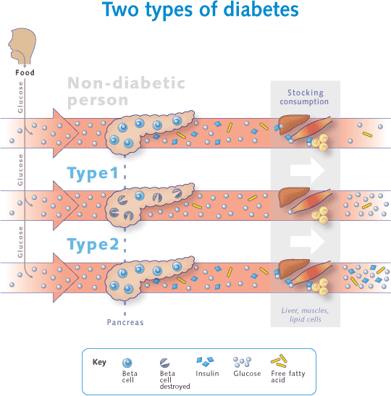
PANCREASE

Slide 6
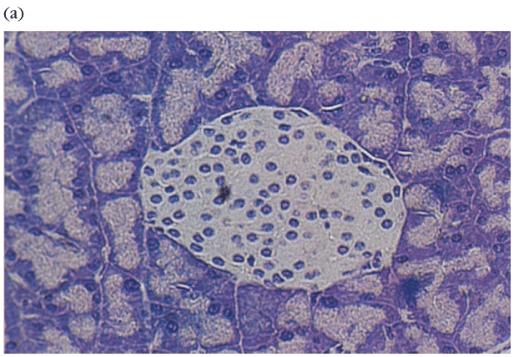
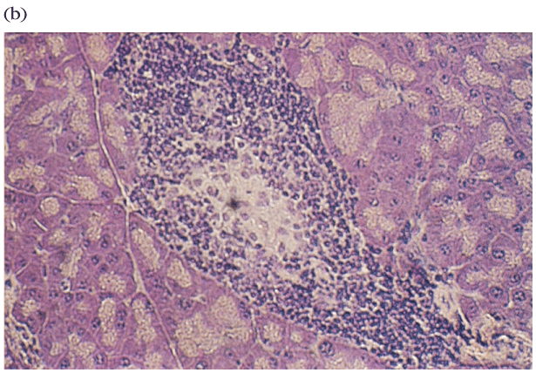
Type I Diabetes: Pancreatic β cells express abnormally high levels of MHC I and MHC II (?)
Normal Pancreas Pancreas with Insulitis

Slide 7
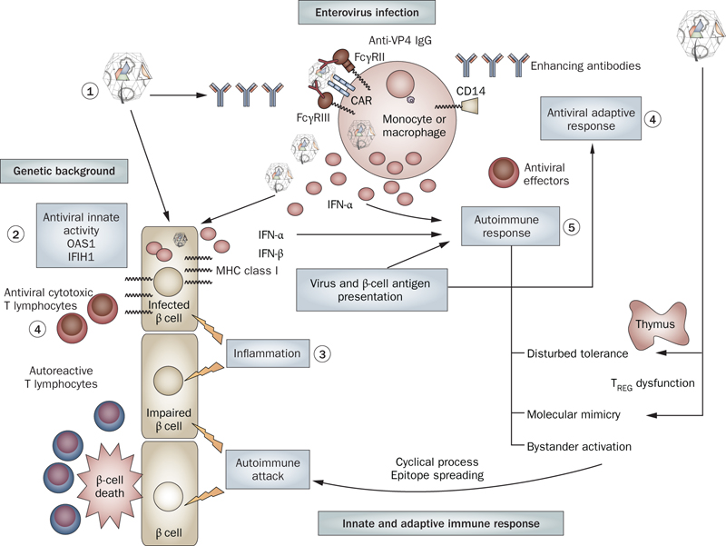
Innate antiviral activity

Slide 8
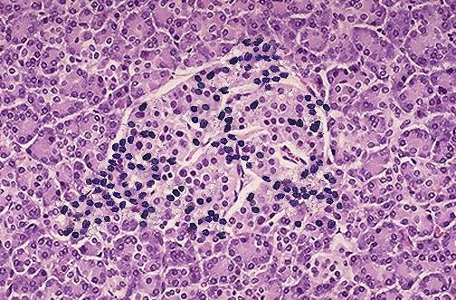
Type 1 diabetes is T cell mediated
Infiltrating CD4+, CD8+ T cells
Anti-T cell therapies are effective
Islet cell autoantibodies ≠ disease
CD4
T-cell
CD8
T-cell
CD4
Treg
TCR
Epitope
HLA II
HLA I
APC
Type 1 Diabetes: Cellular, Molecular & Clinical Immunology Edited by George S. Eisenbarth Online Edition Version 3.0
Islet
autoantigen

Slide 9
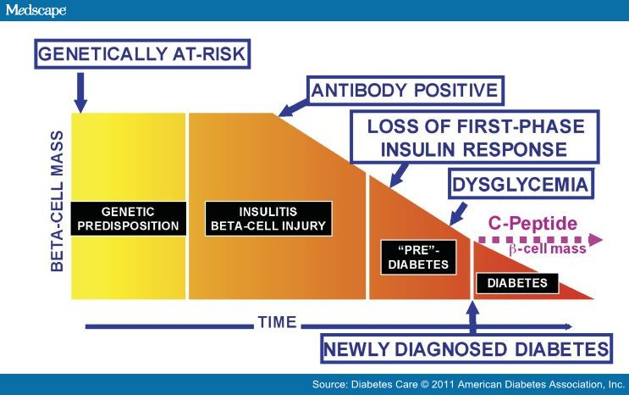
Development of Type I diabetes mellitus

Slide 10
Type 1 Diabetes mellitus (T1DM)
Predisposition
Genetic (HLA DRB, DQA, DQB)
Viral infections
Stress
Environmental exposure - exposure to certain chemicals or drugs
10% chance of inheriting if first degree relative has diabetes
Most likely to be inherited from father

Slide 11
Type I Diabetes
Four auto-antibodies are markers of beta cell autoimmunity in type 1 diabetes:
Islet Cell Antibodies (ICA), against cytoplasmic proteins in the beta cell found in 75-90% patients
Antibodies to Glutamic Acid Decarboxylase 65 (GAD65) in 80% of patients
Insulin Auto-antibodies (IAA) is the first marker found in 70% of children at the time of diagnosis
IA-2A, (Insulinoma associated 2 auto-antibodies) to protein tyrosine phosphatase found in 54-75% of patients

Slide 12
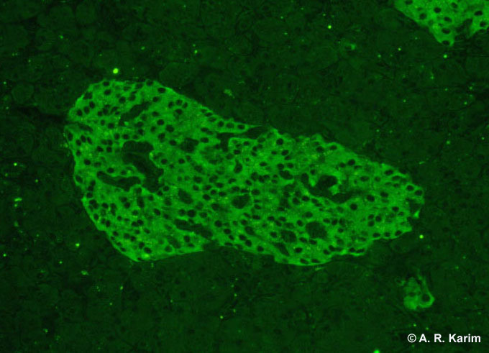
Islet cell antibody (Immunofluorescence)

Slide 13
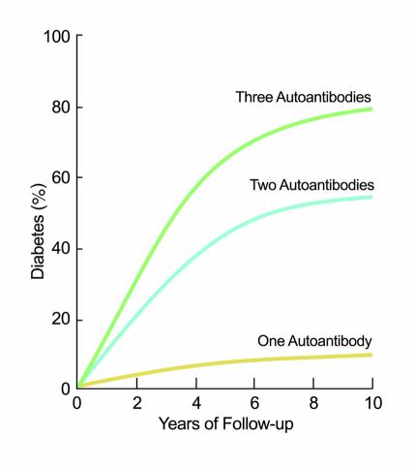
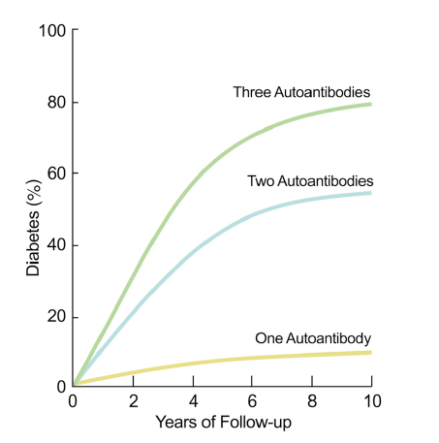
Prediction of
TIDM

Slide 14
Limitations
Auto-antibodies may disappear months or years later without the development of diabetes
Since insulin-treated patients develop insulin antibodies, analysis of IAA is not useful in insulin-treated patients
Antibodies may be transferred trans-placentally to infants of type 1 diabetic mothers so caution must be used for interpretation

Slide 15
Anti-insulin antibodies
Anti-insulin antibodies either of IgG and/or IgM class against insulin are elevated and this may make insulin less effective or neutralize it IgG: is the most common type of anti-insulin antibody IgM: may cause insulin resistance IgE: may be responsible for allergic reactions

Slide 16
Disease associations
About 10% patients with Type 1 diabetes are prone to other autoimmune disorders such as:
Addison’s disease
Pernicious anemia
Graves’ disease
Hashimoto’s thyroiditis

Slide 17
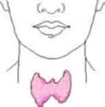
Thyroid autoimmunity
Hypothyroidism
Hashimoto’s disease
Atrophic thyroiditis
Hyperthyroidism
Graves’ disease

Slide 18
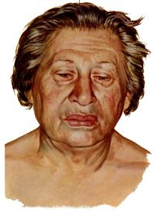
Chronic Lymphocytic Thyroiditis (Hashimoto’s Thyroiditis)
Male: Female ratio is 1:3
Associated with HLA-B8
Symptoms of hypothyroidism
Fatigue
Increased sensitivity to cold
Unexplained weight gain
Dry skin
Hoarseness
Puffy face
Thinning hair

Slide 19
Hashimoto’s Thyroiditis
Frequently affects middle-aged women
Individuals produce auto-antibodies and sensitized TH₁ cells specific for thyroid antigens.
It is a delayed type of hypersensitivity response and is characterized by:
An intense infiltration of the thyroid gland by lymphocytes, macrophages, and plasma cells, which form lymphocytic follicles and germinal centers

Slide 20
Hashimoto’s-Pathogenesis
Sensitization of autoreactive CD4+ T-helper cells to thyroid antigens appears to be the initiating event.
The thyrocytes may be destroyed by:
CD8+ cytotoxic T cell-mediated cell death: CD8+ cytotoxic T cells may cause thyrocyte destruction by either:
Perforin/granzyme granules
Engagement of death receptors (Fas) on the target cell
Cytokine-mediated cell death: CD4+ T cells produce inflammatory cytokines such as IFN-γ followed by recruitment and activation of macrophages and damage to follicles.
Binding of antithyroid antibodies: followed by antibody-dependent cell-mediated cytotoxicity (ADCC)

Slide 22
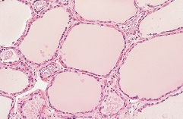
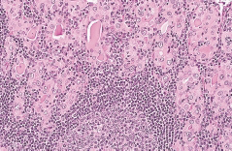
Hashimoto’s Thyroiditis
Lymphocytic infiltrate in the thyroid gland, with lymphoid follicle formation and fibrosis
Normal thyroid histology
Hashimoto’s throiditis with intense cellular infiltrates

Slide 23
Hashimotos’ thyroiditis
The inflammatory response causes:
A goiter, or visible enlargement of the thyroid gland
Antibodies are formed to a number of thyroid proteins, including:
- Thyroglobulin
- Thyroid peroxidase
(both are involved in production of thyroid hormone)

Slide 24
Graves’ disease
Clinical Features:
Agitation
Sleep disturbance
Sweating
Palpitations
Muscle weakness
Weight loss despite increased appetite
Goiter
Tremor
Ophthalmopathy (Exopthalmos)

Slide 25
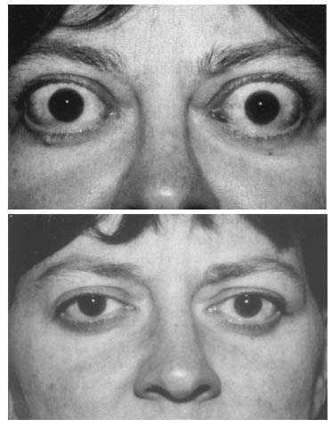
Graves’ Disease
Less common than
Hashimoto’s disease
Male: Female ratio 1:7
Associated with HLA-B8
Characterized by production of stimulating antibodies against TSH receptors

Slide 26
Graves' Disease
The production of antibodies in Graves' Disease is thought to arise by activation of CD4+ T-cells
Followed by B-cell recruitment into the thyroid
These B-cells produce antibodies specific to the thyroid antigens

Slide 27
Graves’ Disease
The thyrotropin receptor (Thyroid Stimulating Hormone (TSH) receptor) is the antigen for TSH receptor antibodies (TRAbs)
There are three types of TSH receptor antibodies:
Activating antibodies (associated with hyperthyroidism)
Blocking antibodies (associated with thyroiditis)
Neutral antibodies (no effect on receptor

Slide 28
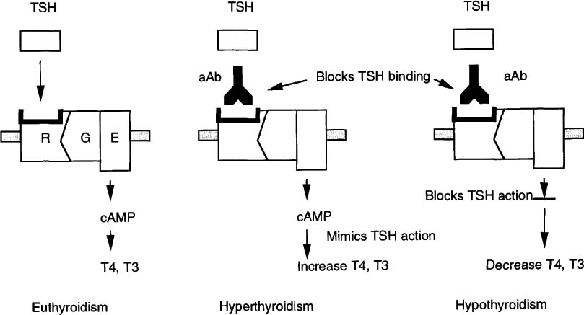

Slide 29
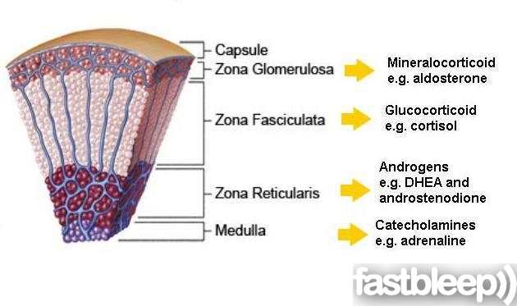
Adrenal Gland

Slide 30
Addison’s Disease
Female: Male ratio : 4:1
Susceptibility genes:
HLA-DR3 and/or DR4

Slide 31
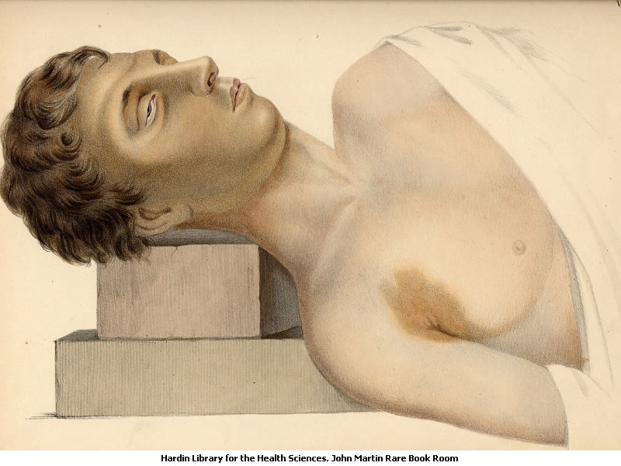
Primary adrenal insufficiency: Symptoms & Physical findings
Weakness
Weight loss
Poor appetite
-Confusion
Hyper-pigmentation
Hypotension
Weak pulse
Shock

Slide 32
Autoimmune Adrenocortical Failure, or Addison's disease
It develops as a consequence of autoimmune destruction of steroid-producing cells in the adrenal gland
The major auto-antigen is 21-hydroxylase
An enzyme involved in the biosynthesis of cortisol and aldosterone in the adrenal cortex

Slide 33
Autoimmune Adrenalitis
Humoral Immunity:
Autoimmune adrenalitis is characterized by the presence of serum antibodies against
21-hydroxylase
17-alpha-hydroxylase
The serum concentration of auto-antibodies, specifically against 21-hydroxylase correlates strongly with the degree of adrenal dysfunction
Adrenal insufficiency becomes clinically evident only after at least 90 percent of the cortex has been destroyed

Slide 34
Autoimmune Adrenalitis
Cellular Immunity:
The presence of lymphocytic infiltration in the adrenal glands
A Th1 response characterized by the production of Interferon-gamma
An antigen-specific T helper cell-driven process with cytotoxic T lymphocytes and activated macrophages mediate the destruction of the adrenal cortex

Slide 35
Gonads
Autoimmune oophoritis
(Inflammation of the ovaries)
Autoimmune orchitis:
Testicular pain involving swelling, inflammation and infection
Pituitary gland
Lymphocytic hypophysitis: Inflammation of the gland (autoimmune) resulting in decreased production of one or more hormones by the pituitary gland

Slide 36
Take home message
Either single or more than one endocrine glands may be targeted by immune system in a particular patient
Immunological damage to endocrine glands is mediated by autoimmune reactions
Endocrine dysfunction associated with immunological injury in majority of cases is due to end organ failure except in Graves’s disease.
Patients suffering from a particular immune mediated endocrine disorder frequently harbor antibodies against other endocrine glands.

