Slide 1
Anterior Pituitary insufficiency
Anwar Ali Jammah
Asst. Professor & Consultant
Medicine and Endocrinology

Slide 2
Objectives
Basic Embryology, Anatomy and physiology
Non-functional pituitary tumours mass-effect
Prolactin secreting cell disorder: prolactinoma
Growth hormone secreting cell disorder: acromegaly
ACTH secreting cell disorders: cushing’s
TSH secreting cell tumor: TSHoma
Gonadotropin secreting cell disorder

Slide 3
Pituitary Development
Anterior pituitary is recognizable by 4- 5th wk of gestation
Full maturation by 20th wk
Notes:
Diaphragma sella is formed by a reflection of dura matter preventing CSF from entering the sella turcica by this diaphragm

Slide 4
Pituitary Development
Anterior Pituitary developed from Rathke’s pouch, Ectodermal evagination of oropharynx & Migrate to join neurohypophysis
Posterior pituitary from neural cells as an outpouching from the floor of 3rd ventricle
Pituitary stalk in midline joins the pituitary gland with hypothalamus that is below 3rd ventricle

Slide 5
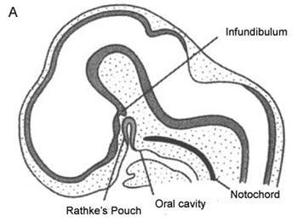
Figure 1A. 6-week embryo shows the dual origin of the gland from Rathke's pouch and from diencephalic floor (infundibulum) (used with permission).
Sadler, T., Susceptible periods during embryogenesis of the heart and endocrine glands. Environ Health Perspect, 2000; 108: 555

Slide 6
Figure 1B. Pituitary at 11 weeks of life. The gland is formed and a cleft persists between pars intermedia and pars anterior. The craniopharyngeal canal closes and occasionally the adenohypophysis remains in the nasopharynx (used with permission).
Sadler, T., Susceptible periods during embryogenesis of the heart and endocrine glands. Environ Health Perspect, 2000; 108: 555

Slide 7
Pituitary Anatomy
Lies at the base of the skull as sella turcica
Roof is formed by diaphragma sellae
Floor by the roof of sphenoid sinus
Notes:
Diaphragma sella is formed by a reflection of dura matter preventing CSF from entering the sella turcica by this diaphragm

Slide 8
Pituitary Development

Slide 9
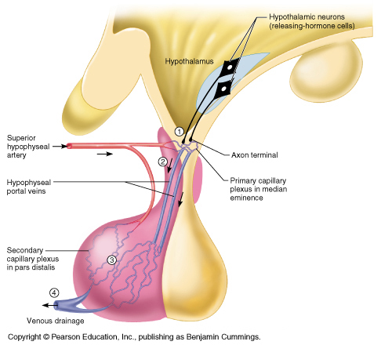

Slide 10
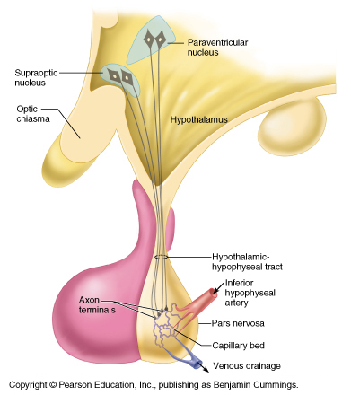

Slide 11
Pituitary Anatomy
Pituitary stalk and its blood vessels pass through the diaphragm
Lateral wall by cavernous sinus containing III, IV, VI, V1, V2 cranial nerves and internal carotid artery with sympathetic fibers. Both adjacent to temporal lobes
Pituitary gland measures 15 X 10 X 6 mm, weighs 500 mg but about 1 g in women
Notes:
Height is 5-7 mm and 10 mm lateral dimension, height is 10. superior, middle supply ant. Pituitary. Inferior supply stalk and post pituitary artery

Slide 12
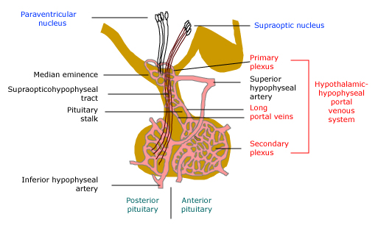
Vascular and neural connections between the hypothalamus and pituitary
Blood supply : Superior, middle, inferior hypophysial arteries ( internal carotid artery) running in median eminence from hypothalamus. Venous drainage:
To superior and inferior petrosal sinsuses to jugular vein

Slide 13
Pituitary Anatomy
Optic chiasm lies 10 mm above the gland and anterior to the stalk

Slide 14
Pituitary hormones
Posterior lobe
Anterior lobe

Slide 15
Hypothalamic stimulatory hormones
Corticotropin-releasing hormone - 41 amino acids; released from paraventricular neurons as well as supraoptic and arcuate nuclei and limbic system | Adrenocorticotropic hormone - basophilic corticotrophs represent 20 percent of cells in anterior pituitary; ACTH is product of proopiomelanocortin (POMC) gene
 | Melanocyte-stim hormonee POMC product
 | Endorphins - also products of POMC gene
Growth hormone-releasing hormone - two forms, 40 and 44AA | Growth hormone - acidophilic somatotrophs represent 50% of cells in anterior pituitary
Gonadotropin-releasing hormone - 10 amino acids; mostly released from preoptic neurons | Luteinizing hormone and follicle-stimulating hormone - gonadotrophs represent about 15 % of anterior pituitary cells
Thyrotropin-releasing hormone - three amino acids; released from anterior hypothalamic area | Thyroid-stimulating hormone - thyrotropes represent about 5 percent of anterior pituitary cells
Prolactin-releasing factors (serotonin acetylcholine, opiates, &estrogens) | Prolactin - lactotrophs represent 10 to 30 percent of anterior pituitary cells

Slide 16
Hypothalamic inhibitory hormones
Somatostatin - 14 amino acids | Inhibits the release of growth hormone
Prolactin-inhibiting factors - includes dopamine | Major prolactin control is inhibitory

Slide 17
Sellar masses Causes:
Benign tumors | Metastatic
Pituitary adenoma (most common sellar mass) | Lung
Craniopharyngioma | Breast
Meningiomas | Cysts
Pituitary hyperplasia | Rathke's cleft
Lactotroph hyperplasia (during pregnancy) | Arachnoid
Thyrotroph and gonadotroph hyperplasia | Dermoid
Somatotroph hyperplasia due to ectopic GHRH | Pituitary abscess
Malignant tumors | Lymphocytic hypophysitis
Primary | Carotid arteriovenous fistula
Germ cell tumor (ectopic pinealoma)
Sarcoma
Chordoma
Pituitary carcinoma (rare)

Slide 18
Sellar masses Causes:
Neurologic symptoms (most common)
Visual impairment
Headache
Other (including diplopia, seizures, and CSF rhinorrhea)
Incidental finding
When an imaging procedure is performed because of an unrelated symptom
Hypopituitarism
Biochemical evidence (most common)
Clinical symptoms (less common, but include oligomenorrhea or amenorrhea in women, decreased libido and/or erectile dysfunction in men)

Slide 19
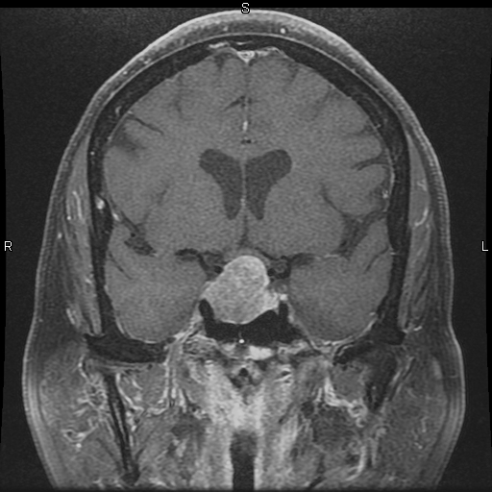

Slide 20
Notes:
Left side microadenoma post contract

Slide 21
Evaluation of Pituitary mass
Pituitary incidentaloma: 1.5 -31% in autopsy ( prevalence)
10 % by MRI most of them < 1 cm
Notes:
Guanine nucleatide stimulatory protein gene found in 40 % of somatotroph adenoma/ inactivation mutation in tumor supressing gene in men 1.

Slide 22
assessment of pituitary function
Baseline: TSH, FT4, FT3, LH, FSH, Prolactin, GH, IGF-I,Testosterone, Estradiol
MRI brain
Neuropthalmic evaluation of visual field

Slide 23
Evaluation of Pituitary lesion
Functional adenoma ( hormonal-secreting)
Non-Functional adenoma

Slide 24
Evaluation of Pituitary lesion

Slide 25
Evaluation of Pituitary lesion
Non-Functional pituitary lesion:
No signs and symptoms of hormonal hypersecretion
25 % of pituitary tumour
Needs evaluation either micro or macroadenoma
Average age 50 – 55 yrs old, more in male

Slide 26
Non- functional pituitary adenoma
Presentation of NFPA:
As incidentaloma by imaging
Symptoms of mass effects ( mechanical pressure)
Hypopituitarism ( mechanism)
Notes:
Mass effect tumour expansion lateral compressing cavernous sinus causing cranial nerve palsy like double vision, stretching meninges causing headache, or pushing temporal lobe causing seizure, pushing optic chiasm or headache from apoplexy. Hypopituitarism from suprasellar mass pushing stalk and cutting portal blood supply and hypothalamus signal to pituitary

Slide 27
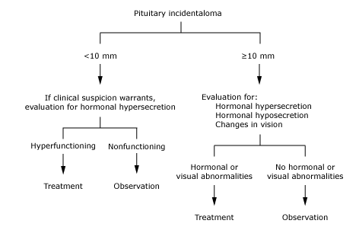
Approach to the patient with an incidental abnormality on MRI of the pituitary gland

Slide 28
Treatment of Non- functional pituitary adenoma
Surgery
Recurrence rate 17 % if gross removal, 40 % with residual tumour
Predictors of recurrence: young male, cavernous sinus invasion, extent of suprasellar extention of residual tumor, duration of follow up, marker; Ki-67
Observation
Adjunctive therapy:
Radiation therapy
Dopamine agonist
Somatostatin analogue
Notes:
Tumour greater than 2 cm, visual field defect, optic chiasm compression or touching by tumor with no visual field defect, headach, suprasellar/parasellar tumor extension

Slide 29
Effect of pituitary tumor
Notes:
Detailed history and physical examination

Slide 30
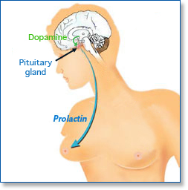
Prolactinoma

Slide 31
Prolactinoma
Premenopausal women
Menstrual dysfunction (oligomenorrhea or amenorrhea10 to 20 % )
Infertility (luteal phase abnormalities or anovulation).
Galactorrhea.
Postmenopausal women (already hypogonadal)
It must be large enough to cause headaches or impair vision,
Incidental sellar mass by MRI.
Men
Decreased libido and infertility.
Erectile dysfunction
Gynecomastia and rarly galactorrhea

Slide 32
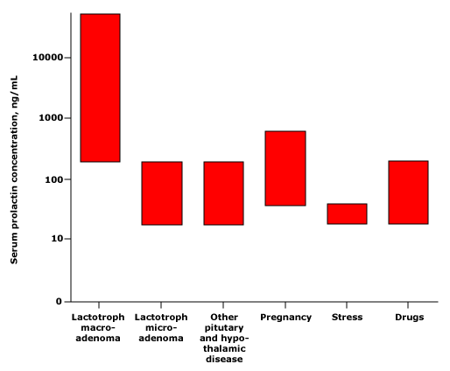
Am J Obstet Gynecol 1972; 113:14; N Engl J Med 1977; 296:589; Clin Ther 2000; 22:1085; Clin Endocrinol 1976;

Slide 33
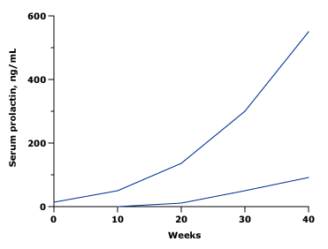
Serum prolactin concentrations increase during pregnancy
Tysonet al, Am J Obstet Gynecol 1972

Slide 34
Partial list of drugs known to cause hyperprolactinemia and/or galactorrhea
Typical antipsychotics | Gastrointestinal drugs
Chlorpromazine, Clomipramine fluphenazine], prochlorperazine, thioridazine | Cimetidine (Tagamet)
Haloperidol (Haldol) | Metoclopramide (Reglan)
Pimozide (Orap) | Antihypertensive agents
Atypical antipsychotics | Methyldopa (Aldomet)
Risperidone (Risperdal) | Reserpine (Hydromox, Serpasil, others)
Molindone (Moban) | Verapamil (Calan, Isoptin)
Olanzapine (Zyprexa) | Opiates
Antidepressant agents* | Codeine
Clomipramine (Anafranil) | Morphine
Desipramine (Norpramin)

Slide 35
Growth hormone
Hyperfunctioning mass →→ Acromegaly
Pituitary tumor as mass effect →→ Growth hormone deficiency (Short stature)

Slide 36
Growth hormone disorder

Slide 37
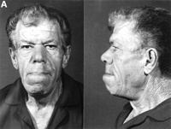
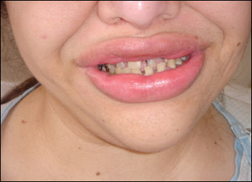
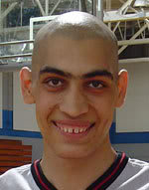
Nose is widened and thickened
Cheekbones are obvious
Forehead bulges
Lips are thick
Facial lines are marked
Overlying skin is thickened
Mandibular overgrowth
Prognathism
Maxillary widening
Teeth separation

Slide 38
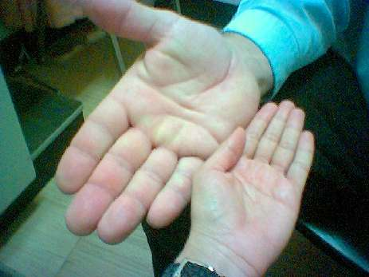
Swelling of the hands in a patient with acromegaly, which resulted in an increase in glove size and the need to remove rings.

Slide 40
Acromegaly Diagnosis
GH level ( not-reliable, pulsatile)
IGF-I is the best screening test
75 g OGTT tolerance test for GH suppression is the gold standered
Other :
Fasting and random blood sugar, HbA1c
Lipid profile

Slide 41
Acromegaly complications
Cardiac disease is a major cause of morbidity and mortality
50 % died before age of 50
HTN in 40%
LVH in 50%
Diastolic dysfunction as an early sign of cardiomyopathy

Slide 42
Acromegaly Treatment
Medical
Somatostatin analogue
Pegvisomant
Surgical resection of the tumour

Slide 43
ACTH-disorders

Slide 44
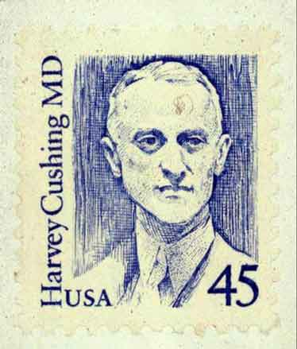
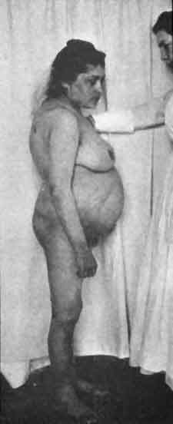

Slide 45
ACTH-disorders

Slide 46
CRH
(+)
(-)
ACTH (+)
(-) Cortisol

Slide 47
CRH
ACTH-dependent Cushing’s disease
(+)
Autonomous ACTH secreting tumour
ACTH (+)
(-) Cortisol

Slide 49
Diagnosis | Percent of patients
ACTH-dependent Cushing's syndrome
Cushing's disease | 68
Ectopic ACTH syndrome | 12
Ectopic CRH syndrome | <<1
ACTH-independent Cushing's syndrome
Adrenal adenoma | 10
Adrenal carcinoma | 8
Micronodular hyperplasia | 1
Macronodular hyperplasia | <<1
Pseudo-Cushing's syndrome
Major depressive disorder | 1
Alcoholism | <<1

Slide 50
HPA-axis ( excessive cortisol)
80 % HTN
Heart Failure
OSA: 33% mild, 18% severe.
Glucose intolerance in 60%, control of hyperglycemia
Osteoporosis with vertebral fracture→→ positioning of patient in OR ( 50 %), 20 % with fracture
thin skin

Slide 51
TSH-Producing adenoma
Very rare < 2.8 %
Signs of hyperthyroidism
High TSH, FT4, FT3
Treatment preop with anti-thyroid meds pre-op

